Slide 1
E-commerce Group 07: Presentation 2
Algorithm & Implementation Choices

Slide 2
Baseline Algorithm
Job Migration

Slide 3
Cascading failures
If the target of the job migration fails, then the next best target is chosen and the task is relayed to it.
B
A
C

Slide 4
Minimising Latency
Using the Manhattan distance, the algorithm can calculate the closest edge with respect to the user, then migrate the data over to it if needed.
Image of Manhattan distance

Slide 5
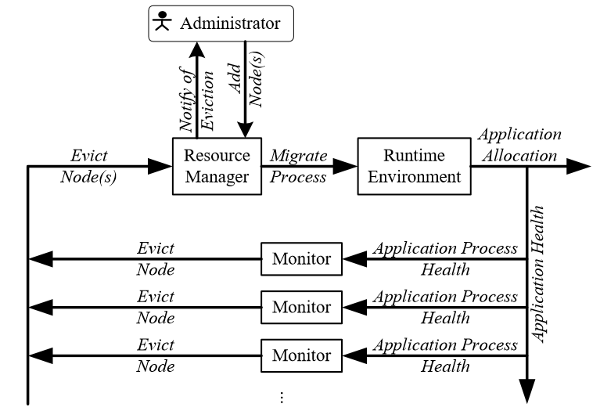
Improved algorithm
Preemptive migration:
Looks for fault flags in the system w/ feedback loop
Moves tasks to new location before a failure occurs

Slide 6
Assumed Results
The results will be better as the baseline algorithm relies solely on a responsive mechanism when dealing with failures. With the improved algorithm, the proactive migration of a task before a failure occurs will result in less time wasted waiting for a PM/VM to restart.
Also, because the job will in most cases be migrated to an Edge close(er) to the user, this will minimise latency and energy consumption.

Slide 7
Testing methodology & Sampling time
Testing methodology will be running similar work loads on both the baseline and improved algorithms, comparing the results and using them to possibly further improve our work on it.
Sampling time will be 10min.
Example test table

Slide 8
Controller

Slide 9
Infrastructure

Slide 10
Implementation choices

Slide 11
SLAs

