Slide 1
E-commerce Group 07: Presentation 2
Algorithm & Implementation Choices

Slide 2
Baseline Algorithm
Job Migration
Migrates a failed job to a new VM / PM and tries to re-execute it.
More efficient than task resubmission with a higher chance of success on the first attempt.
A
B

Slide 3
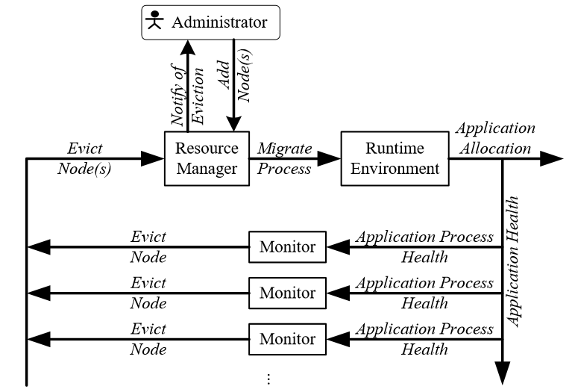
Improved algorithm
Pre-emptive migration:
Looks for fault flags in the system w/ feedback loop
Moves tasks to new location before a failure occurs

Slide 4
Cascading failures
If the target of the job migration fails, then the next best target is chosen and the task is relayed to it.
B
A
C

Slide 5
Minimising Latency
Using the Manhattan distance, the algorithm can calculate the closest edge with respect to the user, then migrate the data over to it if needed.
4(Distance)x30ms(Latency)
2(Distance)x30ms(Latency)
 | E |  |  | E
 |  |  |  |  | E
 |  | U
 | E

Slide 6
Assumed Results
The results will be better as the baseline algorithm relies solely on a responsive mechanism when dealing with failures. With the improved algorithm, the proactive migration of a task before a failure occurs will result in less time wasted waiting for a PM/VM to restart.
Also, because the job will in most cases be migrated to an Edge close(er) to the user, this will minimise latency and energy consumption.

Slide 7
Testing methodology & Sampling time
Testing methodology will be running similar work loads on both the baseline and improved algorithms, comparing the results and using them to possibly further improve our work on it.
Sampling time will be 10min.

Slide 8
Controller

Slide 9
Infrastructure

Slide 10
Implementation choices
Java as it is a language that lets us represent each entity as a class and we can instantiate as many of each type as we need to run the testing.

Slide 11
SLAs

