Slide 1
E-commerce Group 07: Presentation 2
Algorithm & Implementation Choices

Slide 2
Baseline Algorithm

Slide 3
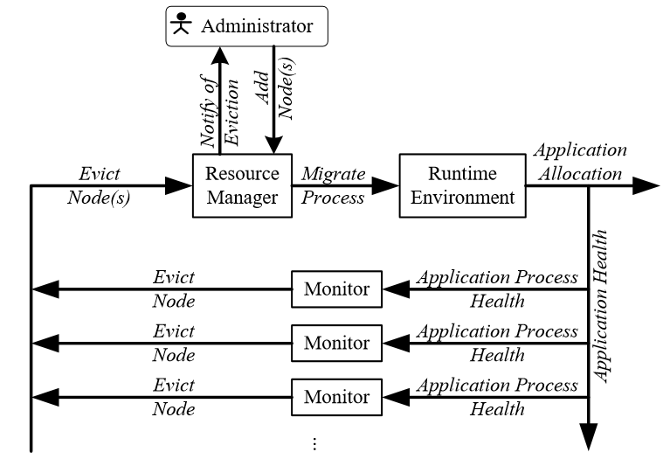
Improved algorithm
Preemptive migration:
Looks for fault flags in the system w/ feedback loop
Moves tasks to new location before a failure occurs

Slide 4
Assumed Results

Slide 5
Testing methodology & Sampling time

Slide 6
Controller

Slide 7
Infrastructure

Slide 8
Implementation choices

Slide 9
SLAs

