Slide 1

IoT Basics
With the ESP-(WROOM-)32
© 2023 Severin Mairinger

Slide 2
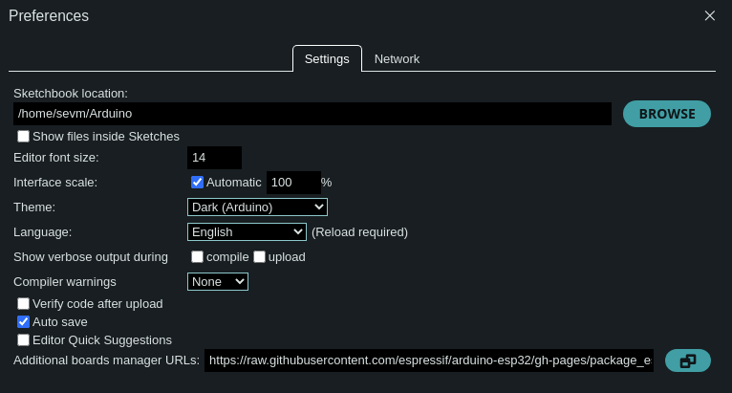
Development Environment
Resources: https://github.com/sevsev9/iot-workshop-0123
Arduino IDE
Esp32 Board Scripts
  Paste the URLs under File > Preferences

Slide 3
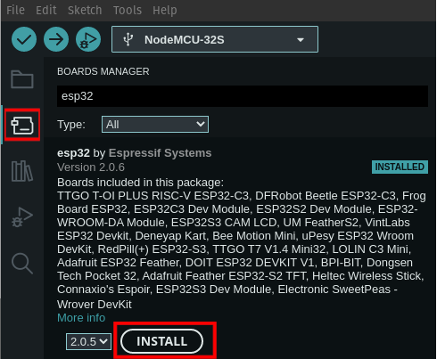
Development Environment
Download the “esp32” Board Scripts

Slide 4
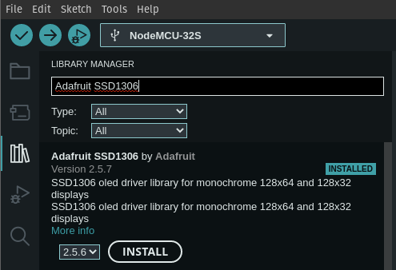
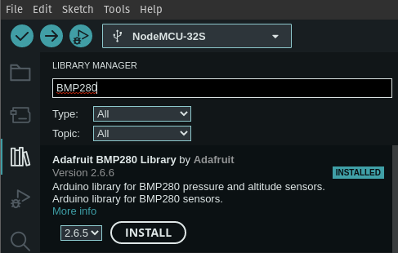
SSD1306 & BMP280

Slide 5
In the Meantime - ESP32 Specs
2 x Xtensa 32bit LX6 Cores (80MHz – 240MHz)
448KB ROM, 520KB SRAM (Up to 11MB external)
Realtime Clock with Low-Power Co-Processor
  Pins with Power-On Interrupts
  8KB FAST & SLOW Memory
WiFi & Bluetooth LE
I2C, I2S, SPI, PWM, RMT, PCTN, UART, Ethernet MAC
SDIO Host/Slave, TWAI (CAN) Controller
12x 12bit ADC, Touch, 2x 8bit DAC, Hall Sensor, 34x GPIO (all PWM)

Slide 6
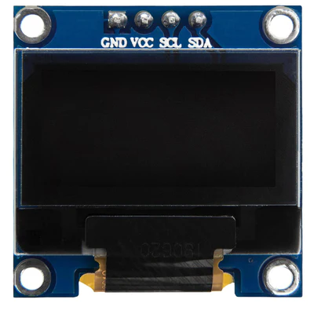
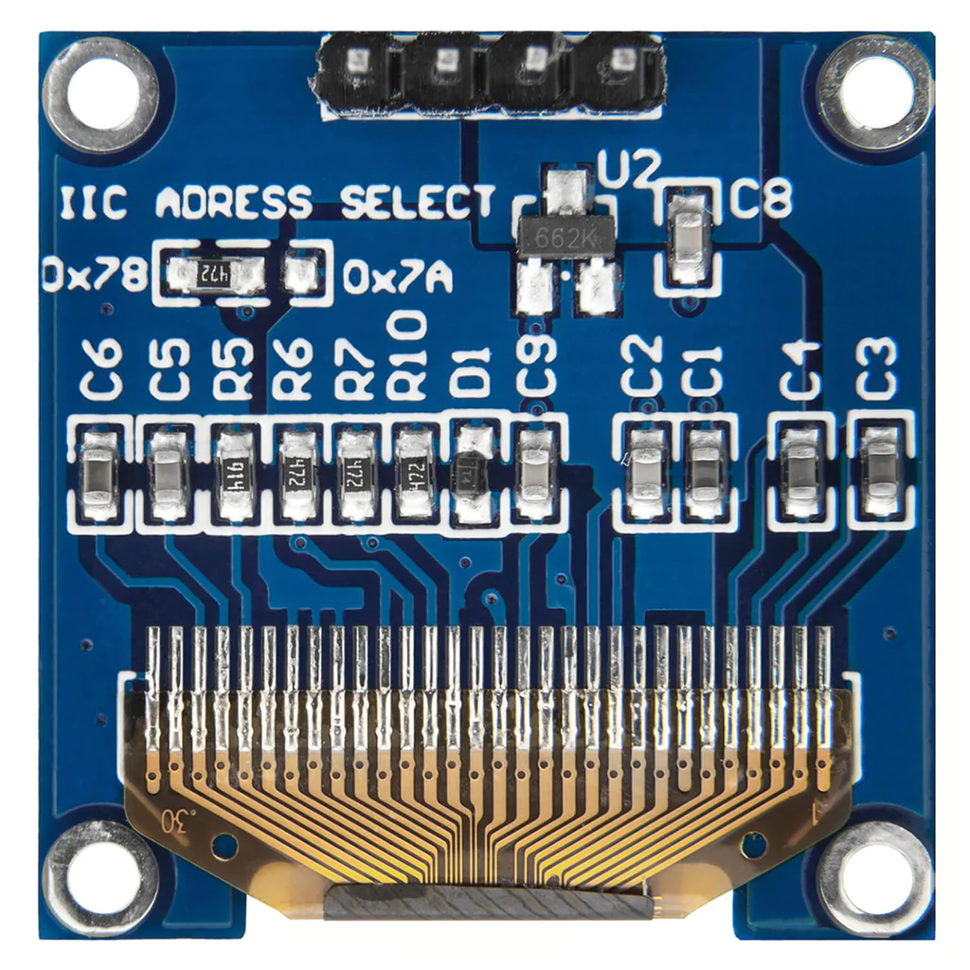
SSD1306 – 0.96” OLED Display
Resolution: WHOPPING 128x64
Two Color Display (lines 0, 1 yellow, the rest blue)

Slide 7
BMP280 – Temperature and Pressure
Operation Range:
  Pressure: 300 … 1100hPa
  Temperature: -40°C … 85°C
Accuracy:
  Pressure (Abs.): +- 1hPa @ 0.01 hPa
  Temperature: +- 0.5°C @ 0.01 °C
Power Consumption @ 1Hz: 3.4µA @ 1.2 – 3.6V input
I²C and SPI Capable

Slide 8
I²C Protocol
2 Pins
  SCL: Serial Clock
  SDA: Serial Data
Synchronous Protocol
Speeds:
  Standard Mode = 100 kbps
  Fast Mode = 400 kbps
  High Speed mode = 3.4 Mbps
  Ultra Fast Mode = 5 Mbps
# of Devices per Channel = 1008

Slide 9
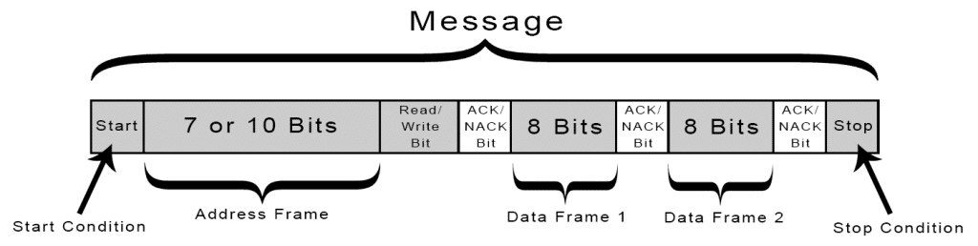
I²C Protocol
Start Condition: (SDA | H → L) → (SCL | H → L)
Stop Condition: (SCL | L → H) → (SDA | L → H)
8 bit Data Frame
Every Slave Receives every package
Slave only reacts, if the address matches its own

Slide 10
Any Questions so far?

Slide 11
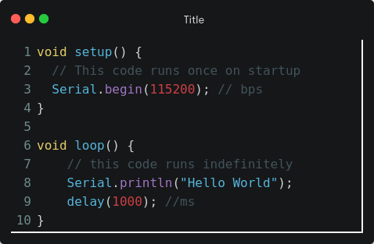
Serial Communication

Slide 12
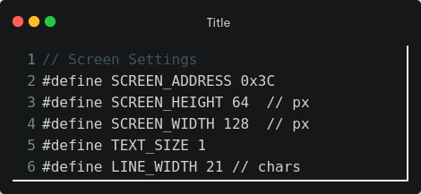
Let’s Print Something on the Display
The Screen Settings

Slide 13
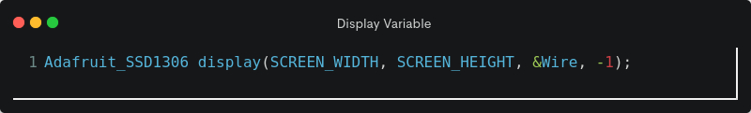
I²C Display
Define the display globally

Slide 14
I²C Display

