Slide 1

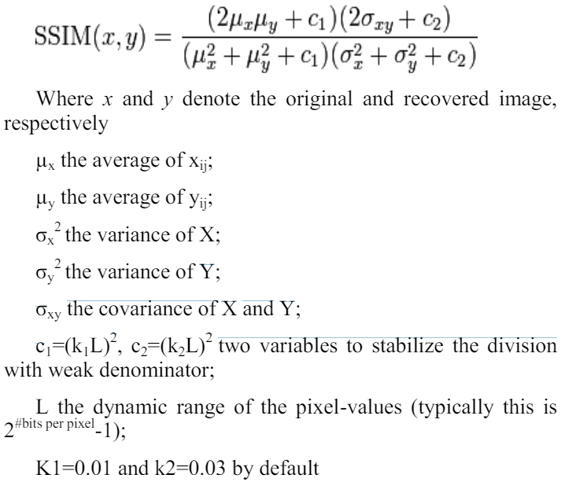
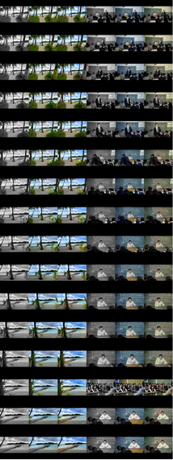

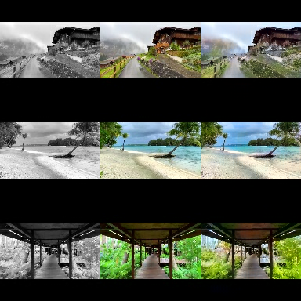
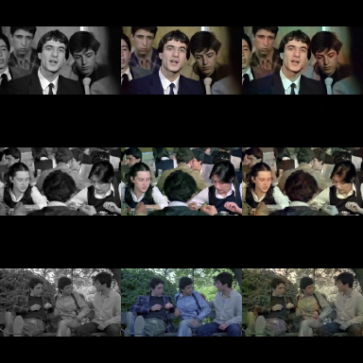
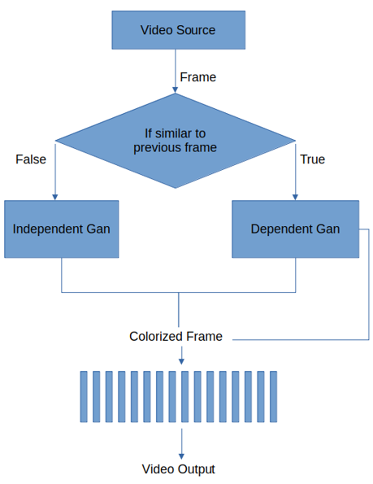
COLORIZING GRAY LEVEL IMAGES WITH GENERATIVE ARTIFICIAL INTELLIGENCE
YILDIZ TECHNICAL UNIVERSITY
FACULTY OF ELECTRICAL AND ELECTRONICS
DEPARTMENT OF COMPUTER ENGINEERING
Mehmet Alperen Ölçer, Şevval Bulburu, Prof. Dr. Mine Elif Karslıgil
alperen.olcer@std.yildiz.edu.tr, sevval.bulburu@std.yildiz.edu.tr, elif@yildiz.edu.tr
Özet
Renksiz fotoğraf ve videoları renklendirmek, geçmişi daha erişilebilir ve anlaşılır kılar, estetik ve sanatsal ifadeyi zenginleştirir. Yapay zekada gri seviyesindeki fotoğrafları renklendirmek zor bir problemdir ve Pix2Pix yaklaşımı kullanılır. GAN mimarisi temel alınarak farklı derin öğrenme yöntemleri geliştirilmiştir. Bu çalışmada, düşük çözünürlüklü veri setlerinde farklı modeller optimize edilip yüksek çözünürlüklü fotoğraflara uyarlanmıştır. Fotoğraf renklendirmede başarı sağlandığında, video kareleri arası bilgi aktarımı ve sahne değişim kontrolü ile video renklendirme gerçekleştirilmiştir.
III. Experimental/Application Results ~ Deneysel/Uygulamalı Sonuçlar
Metrics used to measure the performance are the two most popular image reconstruction metrics: PSNR and SSIM. PSNR measures the similarity and noise level of the original signal versus a copy of that signal. When used in GAN, the original signal corresponds to ground truth images, whereas the referred to as copy signal refers to images colored by the generator. PSNR is defined as the dB difference between signal and noise. A high PSNR value indicates higher quality, whereas a low PSNR value indicates increased information loss and lower quality. PSNR metric can be calculated using MSE [1].
The structural similarity (SSIM) index is designed to improve on traditional metrics like PSNR and MSE, which have proved to be inconsistent with human eye perception. It is basically a method for measuring the similarity between two images. The SSIM index is a full reference metric, in other words, the measuring of image quality based on an initial uncompressed or distortion-free image. SSIM compares local patterns of pixel intensities that have been normalized for luminance and contrast [2].
Abstract
Colorizing black-and-white photos and videos helps preserve historical and cultural heritage, making the past more accessible and enhancing aesthetic expression. In AI, colorizing grayscale photos is a challenging problem, addressed using the Pix2Pix approach. Various deep learning methods, primarily based on GAN architecture, have been developed for this purpose. This study took cumulative steps towards video colorization, optimizing different generative and discriminative models on low-resolution datasets before adapting them to high-resolution photos. Successful photo colorization enabled information transfer between video frames and scene change control, leading to effective video colorization.
Figure/Şekil 2. PNSR Calculation Formula
I. Introduction / Giriş
Image colorization bridges the past and present, enhancing our understanding of history. Recently, Generative Adversarial Networks (GANs) have emerged as a promising method for this task. This project investigates the application of GANs for colorizing images and videos. By reviewing existing methods and conducting preliminary studies, we developed and optimized various GAN models to find the best performance. The study also explores innovative approaches for video colorization, addressing scene changes with both dependent and independent GAN models.
Figure/Şekil 3. SSIM Calculation Formula
II. System Design / Sistem Tasarımı
The developments consists 3 steps which are low resolution image coloring, high resolution image coloring, high resolution video coloring. And different datasets used for each steps.
Name | SSIM a | SSIM b | SSIM c | PNSR a | PNSR b | PNSR c
Hababam | 0.607 | 0.986 | 0.964 | 19.759 | 35.423 | 27.302
Documentary | 0.759 | 0.986 | 0.953 | 15.203 | 33.235 | 25.356
A. Datasets Design
The fırst developments made with 32x32 pixel 60.000 images CIFAR-10 dataset. It was imported from ’tensorflow.keras.datasets’. After successfull results new dataset needed for further development. A dataset creation pipeline was created to gather image dataset by frame extracting from YouTube videos. Two 128x128 pixel datasets generated with this method; 25.000 images of ’Hababam Sınıfı’ movies and 150.000 images of ’Documentary’ videos.
Table/Tablo 2. Metrics for Hababam and Documentary Datasets, a:min, b:max, c:mean, X-Y-Z in name stands for Generator X, Discriminator Y, Batch Size Z
B. Low Resolution Image Coloring And Grid Search
A GAN architecture was created by developing and testing two different generator models and two different discriminator models. These models were evaluated using grid search to select the optimal combination and hyperparameters.
Name | SSIM a | SSIM b | SSIM c | PNSR a | PNSR b | PNSR c
1-1-128 | 0.80 | 0.99 | 0.91 | 14.80 | 34.37 | 22.90
1-1-256 | 0.81 | 0.99 | 0.92 | 16.00 | 36.40 | 23.65
1-2-128 | 0.81 | 0.99 | 0.92 | 14.68 | 34.72 | 22.91
1-2-256 | 0.80 | 0.99 | 0.92 | 15.25 | 33.20 | 23.55
2-1-128 | 0.82 | 0.97 | 0.92 | 16.61 | 29.37 | 22.95
2-1-256 | 0.82 | 0.97 | 0.92 | 14.86 | 27.80 | 22.62
2-2-128 | 0.81 | 0.99 | 0.92 | 15.34 | 35.15 | 23.30
2-2-256 | 0.81 | 0.99 | 0.93 | 15.04 | 35.02 | 24.07
Figure/Şekil 4. CIFAR-10 IO
Figure/Şekil 4. Documentary IO
Table/Tablo 1. Metrics for each Combination, a:min, b:max, c:mean, X-Y-Z in name stands for Generator X, Discriminator Y, Batch Size Z
C. High Resolution Image Coloring
The grid search results we made are examined and it is seen that discriminator 2 and
generator 2 are more successful. These two models are optimized and modified to run
at higher resolutions.
D. High Resolution Video Coloring
The scene change detection algorithm determines which model will receive the next frames. If there is no scene change between the previous frame and the current frame, the dependent GAN model takes the color channels of the previous frame and the gray level channel of the current frame and performs a colorization process depending on the previous frame. The block diagram of the generated design is shown in Figure 1.
Figure/Şekil 4. Video Colorization
Figure/Şekil 4. Hababam IO
Conclusion / Sonuç
This study confirms the effectiveness of GAN models in colorizing images and videos. Optimized GAN structures produced successful results, as measured by SSIM and PSNR scores. The adversarial approach of GANs proves highly capable of achieving realistic colorization. Additionally, a novel design for video colorization based on scene change detection showcases the potential for future advancements. As GAN models improve, more precise solutions for colorization are expected, further enriching our connection to historical and cultural heritage.
Figure/Şekil 1. Video Colorization Block Diagram
References / Kaynakça
[1] B. Lv, Y. Liu, S. Zhang, H. Zeng, and G. Zhu, “Super resolution with generative adversarial networks,” Association for the Advancement of Artificial, 2018.
[2] T. Bhattacharjee, J. P. Singh, and A. Nag, “A lossless secret image sharing scheme based on pixel partitioning,” International Journal of Electronics Communication and Computer Technology, vol. 2, no. 1, 2012. 41

