Slide 1
Tur2Spell
Turing Machine Implementation
for Spelling Turkish Words
Taalai ALMASOVA
Şevval MEHDER

Slide 2
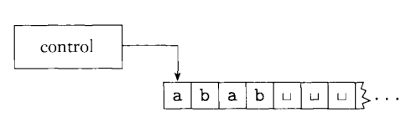
What ıs turıng machıne?
A Turing machine is a mathematical model of computation that defines an abstract machine which manipulates symbols on a strip of tape according to a table of rules. [1]
Figure 1.1 Schematic of a Turing machine[2]

Slide 3
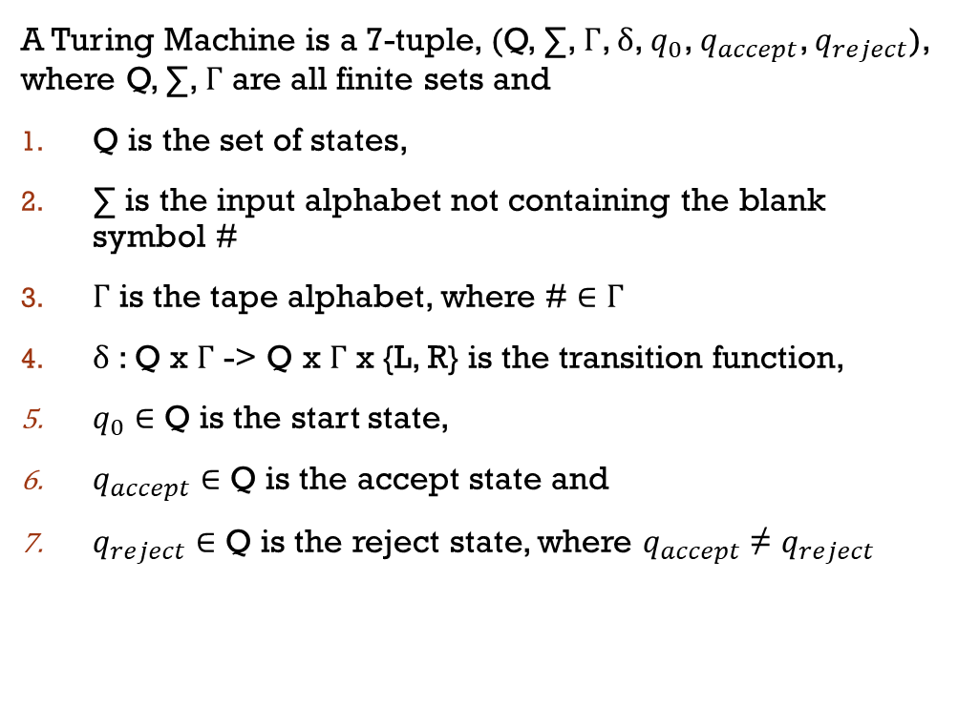
Formal defınıtıon of turıng machıne
A Turing Machine is a 7-tuple, (Q, ∑, Γ, δ, $q_{0}$, $q_{accept}$, $q_{reject}$), where Q, ∑, Γ are all finite sets and
Q is the set of states,
∑ is the input alphabet not containing the blank symbol #
Γ is the tape alphabet, where # ∈ Γ
δ : Q x Γ -> Q x Γ x {L, R} is the transition function,
$q_{0}$ ∈ Q is the start state,
$q_{accept}$ ∈ Q is the accept state and
$q_{reject}$ ∈ Q is the reject state, where $q_{accept}$ ≠ $q_{reject}$

Slide 4
How to spell turkısh words?
There are 3 rules according to TDK[3] :
If there is consonant between two vowels in word, this consonant has a syllable with the next vowel. For example: araba –> a-ra-ba
If there are two repeated consonant in word, the first one has a syllable with the previous vowel and the second one has a syllable with the next vowel. For example: sevmek -> sev-mek
If there are three repeated consonant in word, the last one has a syllable with the next vowel. For example: korkmak -> kork-mak

Slide 5
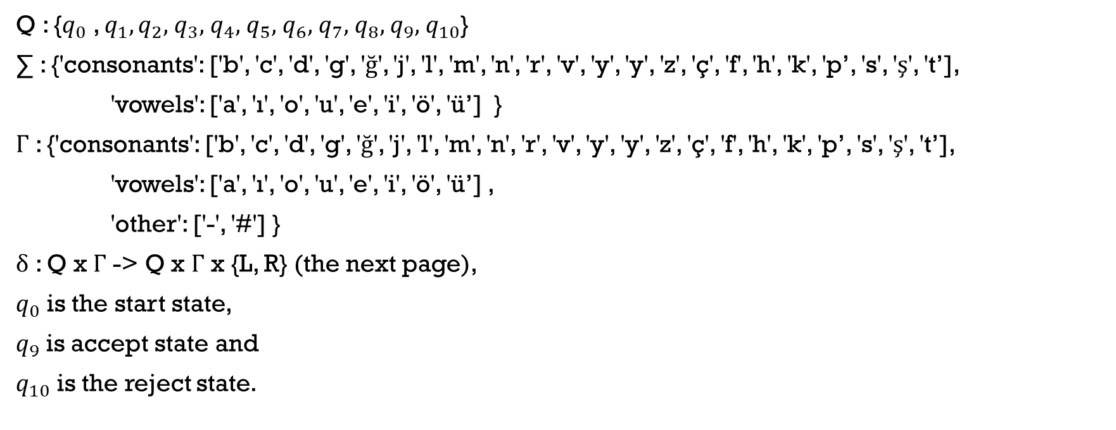
What are the tuples of tur2spell
Q : {$q_{0}$ , $q_{1},q_{2},$ $q_{3},$ $q_{4},$ $q_{5},$ $q_{6},$ $q_{7},$ $q_{8},$ $q_{9},$ $q_{10}$}
∑ : {'consonants': ['b', 'c', 'd', 'g', 'ğ', 'j', 'l', 'm', 'n', 'r', 'v', 'y', 'y', 'z', 'ç', 'f', 'h', 'k', 'p’, 's', 'ş', 't’],
'vowels': ['a', 'ı', 'o', 'u', 'e', 'i', 'ö', 'ü’] }
Γ : {'consonants': ['b', 'c', 'd', 'g', 'ğ', 'j', 'l', 'm', 'n', 'r', 'v', 'y', 'y', 'z', 'ç', 'f', 'h', 'k', 'p’, 's', 'ş', 't’],
'vowels': ['a', 'ı', 'o', 'u', 'e', 'i', 'ö', 'ü’] ,
'other': ['-', '#'] }
δ : Q x Γ -> Q x Γ x {L, R} (the next page),
$q_{0}$ is the start state,
$q_{9}$ is accept state and
$q_{10}$ is the reject state.

Slide 6

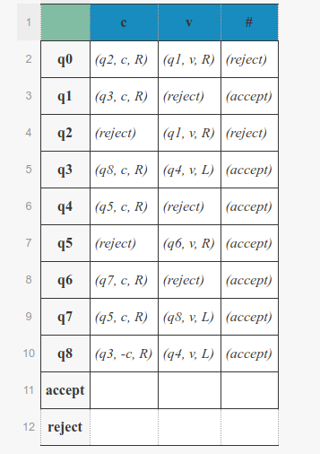

The transıtıon functıon

Slide 7
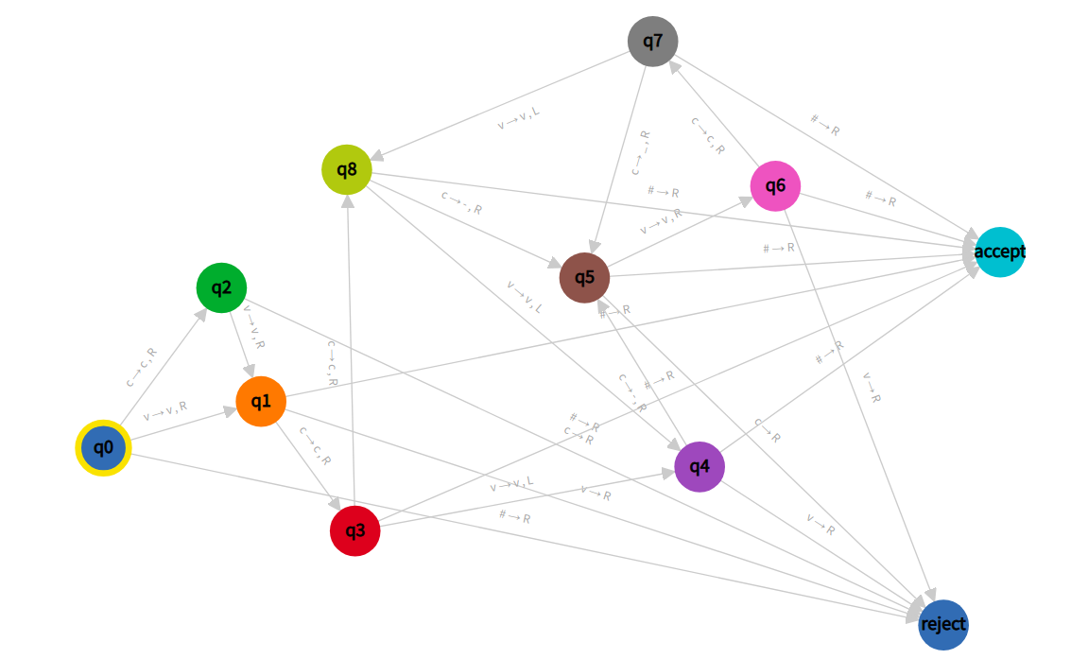
The machıne

Slide 8
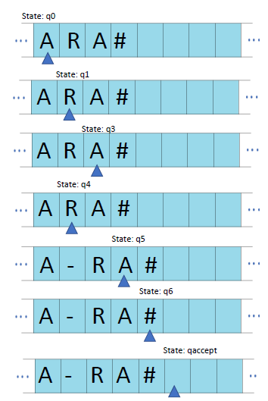
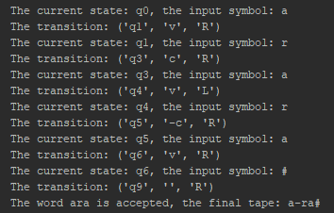

Examples

Slide 9
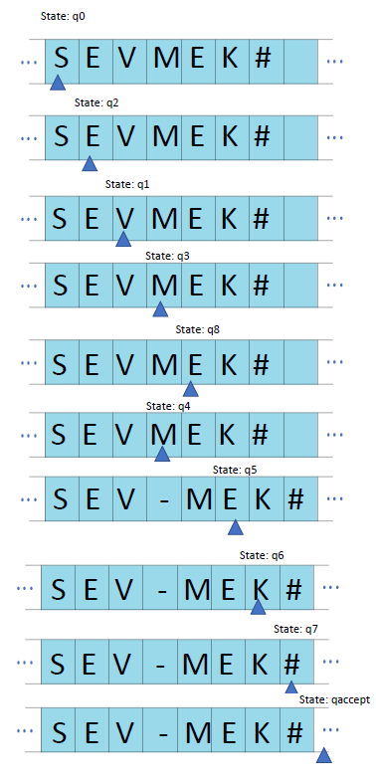
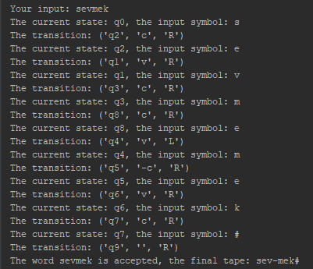
Examples

Slide 10
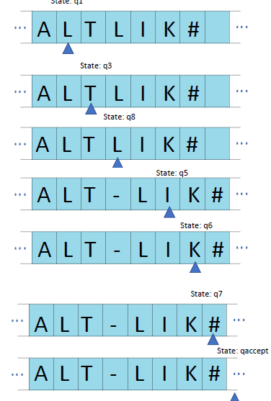
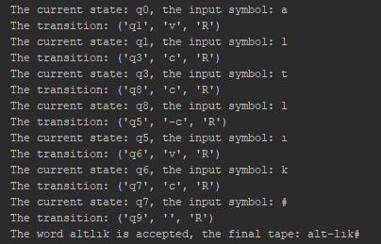
Examples

Slide 11


demo[4]

Slide 12
references
[1] https://en.wikipedia.org/wiki/Turing_machine
[2] Introduction to the Theory of Computation, Second Edition. by Michael Sipser.
[3] http://www.tdk.gov.tr/index.php?id=208:Hece..&option=com_content
[4] https://github.com/sevvalmehder/Tur2Spell

