Slide 1
Book2
File created on: 4/28/2023 9:29:27 AM

Slide 2
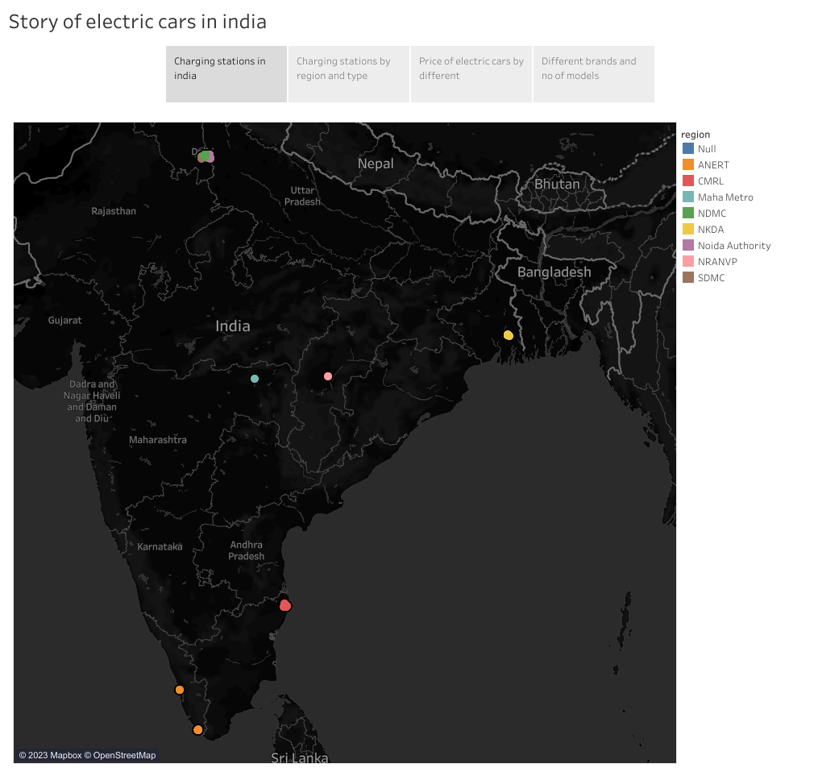

Slide 3
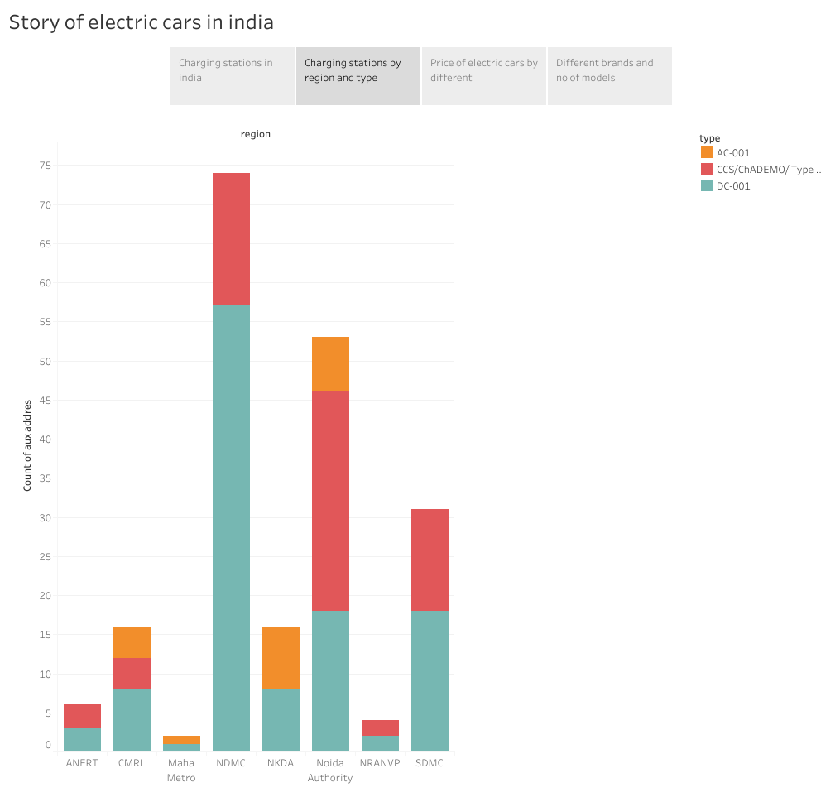

Slide 4
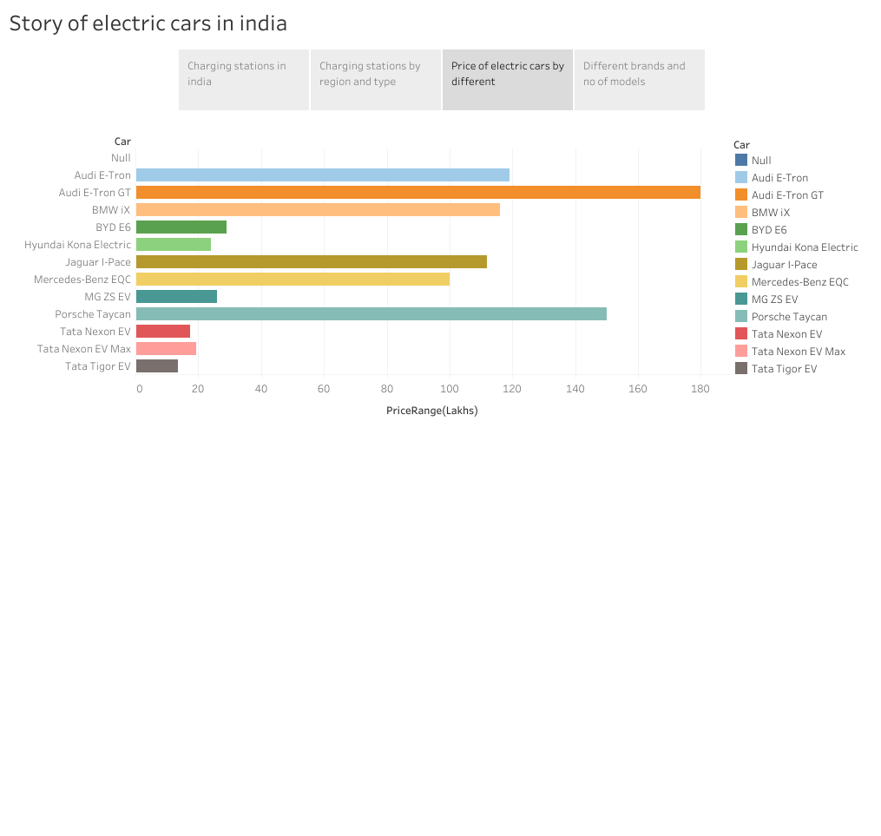

Slide 5
