Slide 1
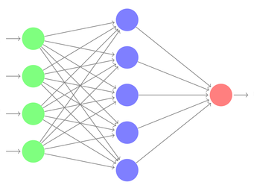
GCAAGAGATCAAAGAGAT
GCGCGAGCCAGCAGTACC
GCGAGACACCGCATACAG
GCGAGATCCACGAATTAC
GCAAGAGATNAAAGAGAT
GCGCGAGCCAGCAGNACC
GCGAGANACCGCATACAG
GCGAGATCCACGNATTAC
Germline assignment
Feature extraction
Error prediction by
deep neural network
DNA sequences from immune
repertoire sequencing
Predicted errors eliminated

Slide 2

GAGATCAAAGAGAT
GAGCCAGCAGTACC
GACACCGCATACAG
GATCCACGAATTAC
GAGATNAAAGAGAT
GAGCCAGCAGNACC
GANACCGCATACAG
GATCCACGNATTAC
Next-generation sequencing of immune repertoires
Raw DNA sequences
Error correction by
deep neural network
Error-corrected sequences

Slide 3
Immune repertoire
sequencing
Raw DNA sequences
GAGATCAAAGAGAT
GAGCCAGCAGTACC
GACACCGCATACAG
GATCCACGAATTAC
GAGATNAAAGAGAT
GAGCCAGCAGNACC
GANACCGCATACAG
GATCCACGNATTAC
Error correction by
deep neural network
Error-corrected sequences

Slide 4
Immune repertoire
sequencing
Raw DNA sequences
GAGATCAAAGAGAT
GAGCCAGCAGTACC
GACACCGCATACAG
GATCCACGAATTAC
GAGATNAAAGAGAT
GAGCCAGCAGNACC
GANACCGCATACAG
GATCCACGNATTAC
Error correction by
deep neural network
Error-corrected sequences

Slide 5
GAGATCAAAGAGAT
GAGCCAGCAGTACC
GACACCGCATACAG
GATCCACGAATTAC
GAGATNAAAGAGAT
GAGCCAGCAGNACC
GANACCGCATACAG
GATCCACGNATTAC
Next-generation sequencing of immune repertoires
Raw DNA sequences
Error correction by
deep neural network
Error-corrected sequences

Slide 6
ErrorX eliminates false clonal lineages in antibody repertoire
SEQ170844
ErrorX collapses false clones into one consensus sequence
8 “clones” in lineage

Slide 7
False clonal variants from same template
SEQ93940
ErrorX collapses into true sequence
SEQ17575
SEQ979990
SEQ170844
SEQ170844
SEQ525409
SEQ101101
SEQ920175
SEQ234967

Slide 8
SEQ93940
SEQ17575
SEQ979990
False clonal variants from same template
SEQ170844
SEQ525409
SEQ101101
SEQ920175
SEQ234967
ErrorX collapses into true sequence
SEQ170844

Slide 9
ErrorX eliminates false clonal lineages in antibody repertoire
Before correction
After correction
__ Sequencing error
N=predicted as error by ErrorX

Slide 10
Before correction
After correction
__ Sequencing error
N=predicted as error by ErrorX

Slide 11
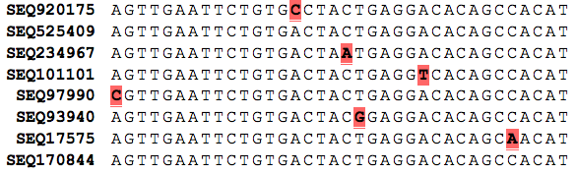
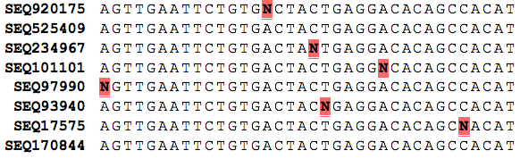
Before correction
After correction
__ Sequencing error
N=predicted as error by ErrorX

Slide 12


