Slide 1
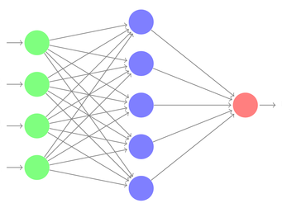
GCAAGAGATCAAAGAGAT
GCGCGAGCCAGCAGTACC
GCGAGACACCGCATACAG
GCGAGATCCACGAATTAC
GCAAGAGATNAAAGAGAT
GCGCGAGCCAGCAGNACC
GCGAGANACCGCATACAG
GCGAGATCCACGNATTAC
Germline assignment
Feature extraction
Error prediction by
deep neural network
DNA sequences from immune
repertoire sequencing
Predicted errors eliminated

Slide 2

GAGATCAAAGAGAT
GAGCCAGCAGTACC
GACACCGCATACAG
GATCCACGAATTAC
GAGATNAAAGAGAT
GAGCCAGCAGNACC
GANACCGCATACAG
GATCCACGNATTAC
Next-generation sequencing of immune repertoires
Raw DNA sequences
Error correction by
deep neural network
Error-corrected sequences

Slide 3
Immune repertoire
sequencing
Raw DNA sequences
GAGATCAAAGAGAT
GAGCCAGCAGTACC
GACACCGCATACAG
GATCCACGAATTAC
GAGATNAAAGAGAT
GAGCCAGCAGNACC
GANACCGCATACAG
GATCCACGNATTAC
Error correction by
deep neural network
Error-corrected sequences

Slide 4
Immune repertoire
sequencing
Raw DNA sequences
GAGATCAAAGAGAT
GAGCCAGCAGTACC
GACACCGCATACAG
GATCCACGAATTAC
GAGATNAAAGAGAT
GAGCCAGCAGNACC
GANACCGCATACAG
GATCCACGNATTAC
Error correction by
deep neural network
Error-corrected sequences

Slide 5
GAGATCAAAGAGAT
GAGCCAGCAGTACC
GACACCGCATACAG
GATCCACGAATTAC
GAGATNAAAGAGAT
GAGCCAGCAGNACC
GANACCGCATACAG
GATCCACGNATTAC
Next-generation sequencing of immune repertoires
Raw DNA sequences
Error correction by
deep neural network
Error-corrected sequences

Slide 6
ErrorX eliminates false clonal lineages in antibody repertoire
SEQ170844
ErrorX collapses false clones into one consensus sequence
8 “clones” in lineage

Slide 7
A
False clonal variants from same template
SEQ93940
ErrorX collapses into true sequence
SEQ17575
SEQ979990
SEQ170844
SEQ170844
SEQ525409
SEQ101101
SEQ920175
SEQ234967

Slide 8
SEQ93940
SEQ17575
SEQ979990
False clonal variants from same template
SEQ170844
SEQ525409
SEQ101101
SEQ920175
SEQ234967
ErrorX collapses into true sequence
SEQ170844

Slide 9
ErrorX eliminates false clonal lineages in antibody repertoire
Before correction
After correction
__ Sequencing error
N=predicted as error by ErrorX

Slide 10
Before correction
After correction
__ Sequencing error
N=predicted as error by ErrorX

Slide 11
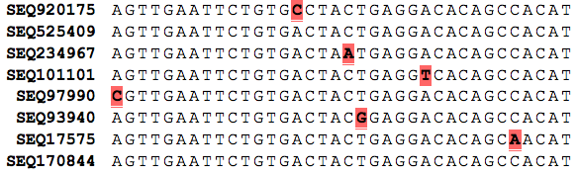
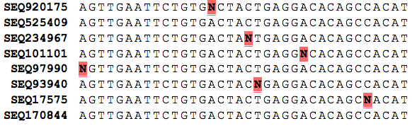
B
Before correction
After correction
__ Sequencing error
N=predicted as error by ErrorX

Slide 12
False clonal variants from same template
Before correction
SEQ93940
SEQ17575
SEQ979990
SEQ170844
SEQ101101
After correction
SEQ525409
SEQ920175
SEQ234967
SEQ170844
ErrorX collapses into true sequence
__ Sequencing error
N=predicted as error by ErrorX

Slide 13


