Slide 1

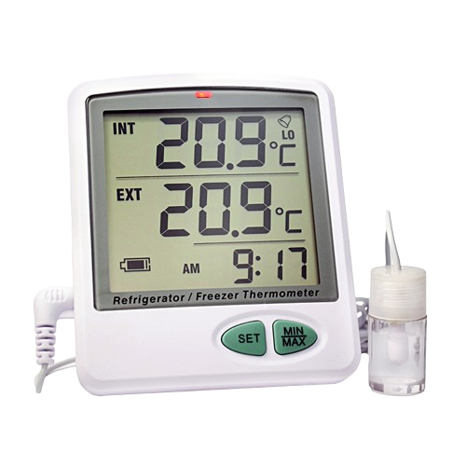
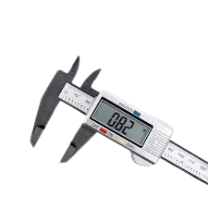
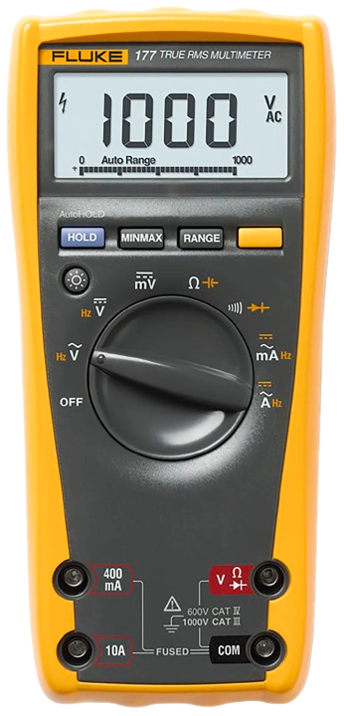
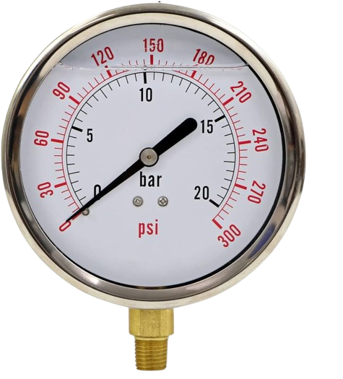
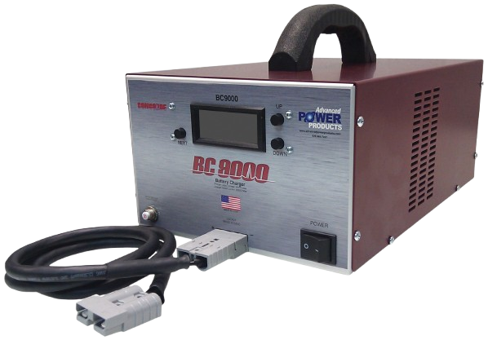
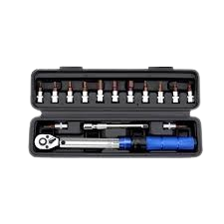
AVIATION TOOLING SOLUTIONS
TORQUE WRENCH
DATA LOGGERS
PRESSURE GAUGES
FLUKE MULTIMETER
BATTERY CHARGERS
CALLIPERS

