Slide 1

ClearEdge
SOLUTIONS
Specialty Chemical Supply, Technical Support & Practical Manufacturing Solutions
We help coatings, adhesives, sealants, plastics, inks, construction, and composites manufacturers source, offset, blend, and commercialize specialty raw materials with fewer supply-chain headaches.
Customer-first technical sales
Supplier network
Local stocking & blending
Reverse engineering
Company overview deck
Notes:
Slide 1: Use this slide to explain ClearEdge Solutions' customer-first role in specialty chemical supply, technical offsets, sourcing, stocking, and blending. Keep examples tied to the customer's market and application.

Slide 2

Who We Are
A specialty chemical partner built for customers who need responsive support, practical alternatives, and reliable raw material access.
CLEAREDGE IN ONE SENTENCE
We connect technical chemistry, sourcing, inventory, and manufacturing support so customers can solve problems faster than they can through large, slow-moving channels.
Specialty raw material distributor and manufacturer
Technical product offsets for premium additive and resin lines
Customer-driven stocking, blending, tolling, and formulation support
Focused on speed, flexibility, and practical problem solving
ClearEdge Solutions
02
Notes:
Slide 2: Use this slide to explain ClearEdge Solutions' customer-first role in specialty chemical supply, technical offsets, sourcing, stocking, and blending. Keep examples tied to the customer's market and application.

Slide 3

ClearEdge
SOLUTIONS
The Problems We Help Customers Reduce
Long lead times and unpredictable import timing
ClearEdge position
A nimble technical supplier that can stock, blend, source, and develop alternatives around the customer’s actual production needs.
One-source dependence on large chemical suppliers
Expensive branded additives with limited flexibility
Small-volume technical problems that large suppliers ignore
Need for faster offsets, samples, and practical formulation help
ClearEdge Solutions
03
Notes:
Slide 3: Use this slide to explain ClearEdge Solutions' customer-first role in specialty chemical supply, technical offsets, sourcing, stocking, and blending. Keep examples tied to the customer's market and application.

Slide 4
How We Work
Our approach is simple: understand the application, identify the right chemistry, and support the customer through commercialization.
Listen
Match
Test
Supply
Scale
application, pain point, specs
supplier lines, offsets, options
samples, lab checks, customer trials
stock, imports, logistics
blending, private label, tolling
This gives customers a practical path from problem to product - without forcing them to wait months for answers or carry inventory risk alone.
Fit-for-use discussions before quoting
Competitive alternatives where they make sense
Commercial support after the first sample ships
ClearEdge Solutions
04
Notes:
Slide 4: Use this slide to explain ClearEdge Solutions' customer-first role in specialty chemical supply, technical offsets, sourcing, stocking, and blending. Keep examples tied to the customer's market and application.

Slide 5
Product Families We Support
ClearEdge works across multiple raw material categories commonly used in coatings, adhesives, sealants, plastics, inks, composites, and construction products.
Additives
Resins & Reactives
Functional Materials
Defoamers & deaerators
Epoxy resins and curing agents
Wax additives and dispersions
Wetting agents & dispersants
Reactive diluents
Flame retardants and synergists
Slip, flow, leveling, surface control
UV acrylates, monomers, oligomers
Silicas and matting agents
Silanes & water repellents
Polyaspartic and coating resin support
Pigments and pigment dispersions
ClearEdge Solutions
05
Notes:
Slide 5: Use this slide to explain ClearEdge Solutions' customer-first role in specialty chemical supply, technical offsets, sourcing, stocking, and blending. Keep examples tied to the customer's market and application.

Slide 6
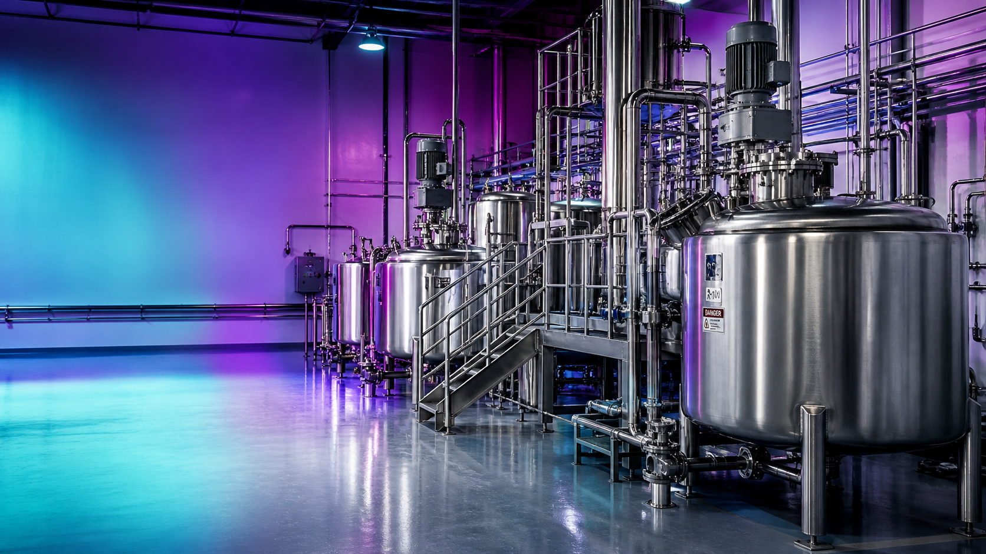
Supplier Lines & Strategic Coverage
We combine represented product lines with qualified sourcing and technical development to give customers options.
Representative areas
Atul / Lapox epoxy systems
SynthEdge UV monomers, oligomers, photoinitiators, and additives
Rudolf / Access Rudolf coating additives and silanes
DEUREX wax technologies
SilaZen sourcing network for broader chemical supply
We position these lines as practical alternatives and complementary solutions - not just catalog items.
ClearEdge Solutions
06
Notes:
Slide 6: Use this slide to explain ClearEdge Solutions' customer-first role in specialty chemical supply, technical offsets, sourcing, stocking, and blending. Keep examples tied to the customer's market and application.

Slide 7
Technical Offsets & Reverse Engineering
ClearEdge helps customers evaluate alternatives to premium additives and resins when supply, cost, or support becomes a problem.
1
2
3
4
Identify target
Screen chemistry
Lab / customer trial
Commercialize
Current product, function, dosage, constraints
Comparable composition, functionality, and handling
Performance checks, sample support, adjustment
Stocking, packaging, private label, documentation
Common offset targets: BYK, Evonik, TEGO, Surfynol / Dynol style products, Solsperse dispersants, selected epoxy curing agents, and specialty UV additives.
ClearEdge Solutions
07
Notes:
Slide 7: Use this slide to explain ClearEdge Solutions' customer-first role in specialty chemical supply, technical offsets, sourcing, stocking, and blending. Keep examples tied to the customer's market and application.

Slide 8
Manufacturing, Blending & Inventory Support
ClearEdge can support customers beyond simple distribution.
CAPABILITIES
Local stocking to reduce customer lead-time pressure
Drum, tote, and bulk-packaging support where practical
Blending support for epoxy systems, additives, waxes, silanes, and specialty raw materials
Private-label opportunities for customers who need a repeatable finished system
Growing production footprint in Newberry, South Carolina
ClearEdge Solutions
08
Notes:
Slide 8: Use this slide to explain ClearEdge Solutions' customer-first role in specialty chemical supply, technical offsets, sourcing, stocking, and blending. Keep examples tied to the customer's market and application.

Slide 9
Quality, Documentation & Compliance Mindset
Chemical supply is not just about moving drums. It is about moving the right material with the right paperwork and the right expectations.
Documentation
HazMat awareness
SDS, TDS, COA, labels, regulatory support
UN, DOT, GHS, storage and handling review
QC discipline
Practical transparency
Sample tracking, retains, customer feedback loops
Clear timing, pricing, and replacement-cost discussions
Our goal is to help customers avoid surprises: performance surprises, delivery surprises, and documentation surprises.
ClearEdge Solutions
09
Notes:
Slide 9: Use this slide to explain ClearEdge Solutions' customer-first role in specialty chemical supply, technical offsets, sourcing, stocking, and blending. Keep examples tied to the customer's market and application.

Slide 10
Markets We Serve
We are built around customers that need specialty materials, technical flexibility, and responsive commercial support.
Adhesives & Sealants
Coatings
Construction Products
ClearEdge
Solutions
Inks & UV Cure
Composites
Plastics & Masterbatch
We support both commodity-adjacent supply needs and higher-value technical projects where chemistry matters.
ClearEdge Solutions
10
Notes:
Slide 10: Use this slide to explain ClearEdge Solutions' customer-first role in specialty chemical supply, technical offsets, sourcing, stocking, and blending. Keep examples tied to the customer's market and application.

Slide 11
ClearEdge
SOLUTIONS
Why Customers Choose ClearEdge
Speed
Fast answers, samples, and options
Flexibility
Not locked into one chemistry or one route
Technical translation
We bridge formulation needs with commercial supply
Accountability
Direct communication and practical follow-through
The difference is not just what we sell. It is how quickly we help customers get to a workable answer.
ClearEdge Solutions
11
Notes:
Slide 11: Use this slide to explain ClearEdge Solutions' customer-first role in specialty chemical supply, technical offsets, sourcing, stocking, and blending. Keep examples tied to the customer's market and application.

Slide 12
Working With ClearEdge
A simple path for customers who want to evaluate a product, source an alternative, or develop a new supply solution.
Send product target, SDS/TDS, or performance requirement
ClearEdge Solutions
Define must-haves: chemistry, VOC, silicone-free, APEO-free, viscosity, cost, lead time
Specialty chemical supply
Technical offsets
Blending & manufacturing support
Customer-driven stocking
ClearEdge proposes options, samples, and commercial path
Customer trial, pricing, stocking plan, and scale-up support
Newberry, South Carolina
Bring us the product you need, the problem you are trying to solve, or the supplier you need to offset.
ClearEdge Solutions
12
Notes:
Slide 12: Use this slide to explain ClearEdge Solutions' customer-first role in specialty chemical supply, technical offsets, sourcing, stocking, and blending. Keep examples tied to the customer's market and application.

