Slide 1
Software prototype
Paper prototype
Medium Prototype
The ICT co-design iterative prototyping process

Slide 2
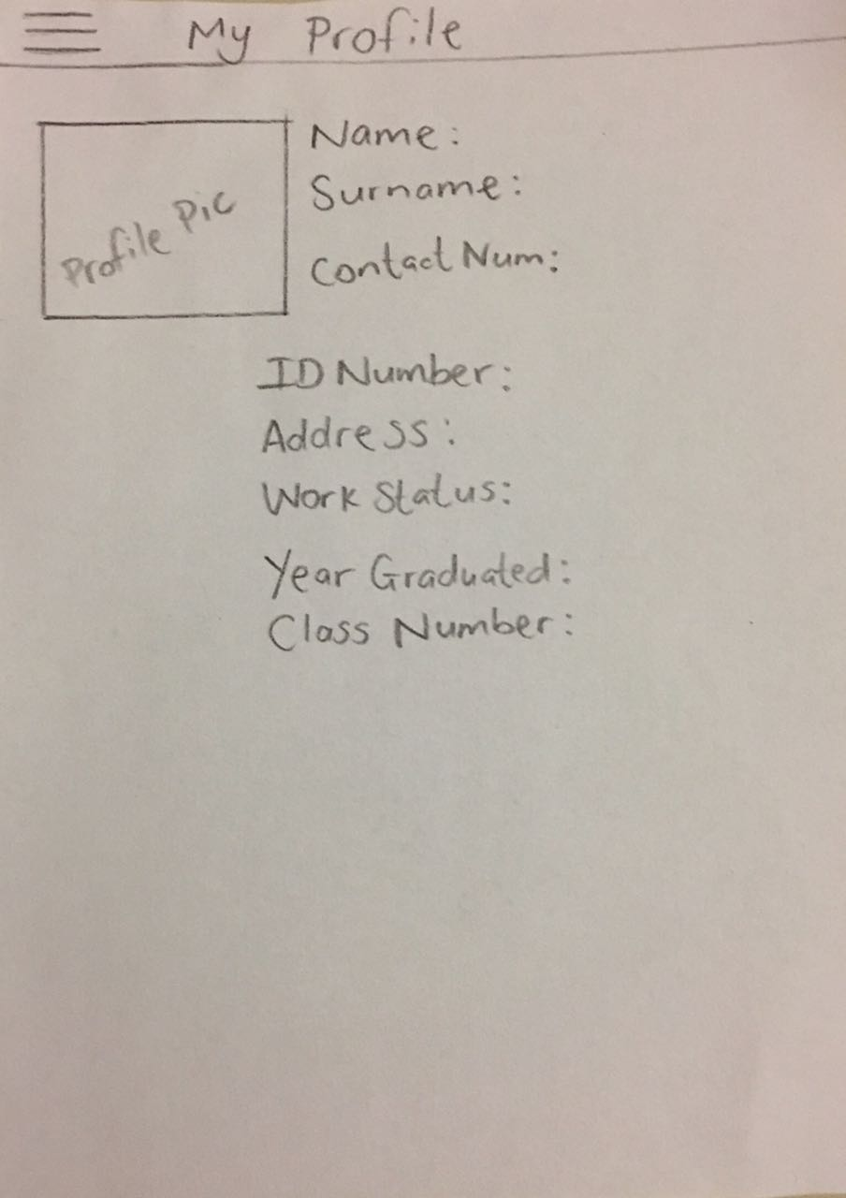
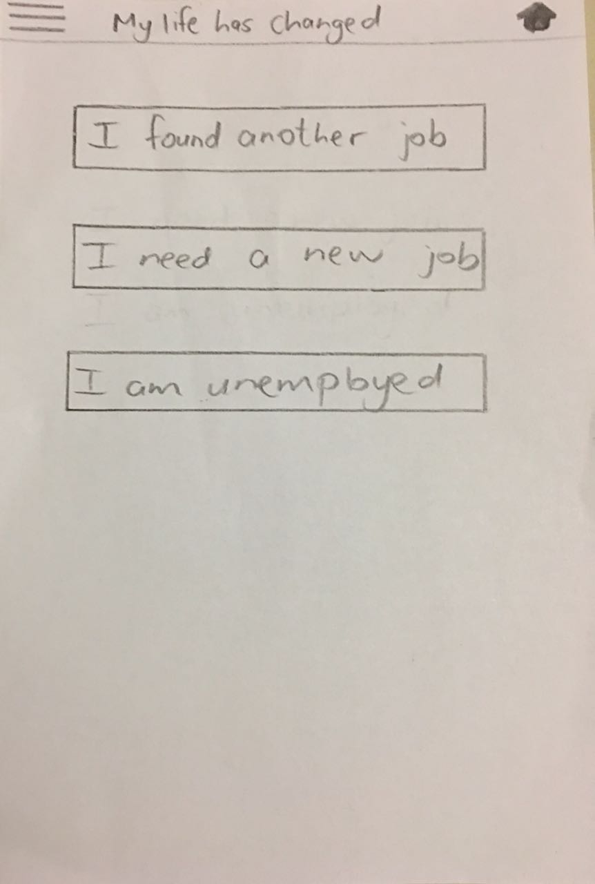
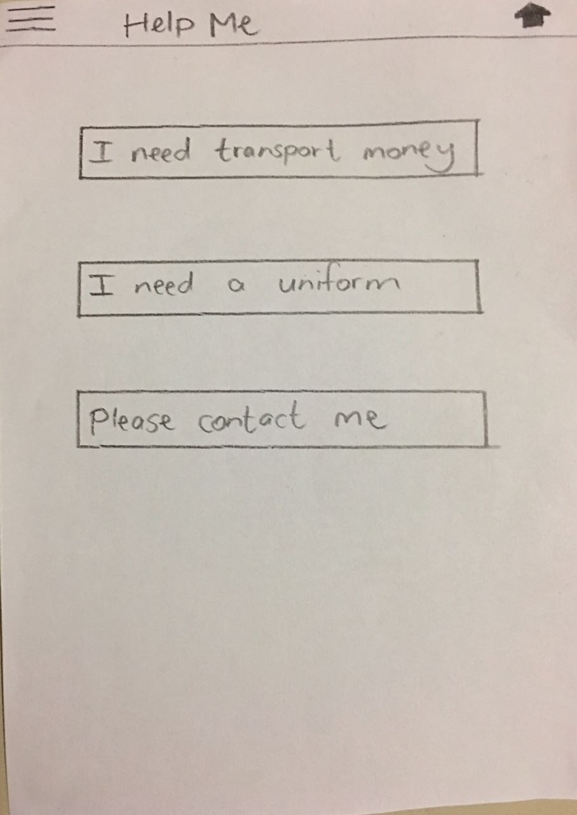
Figure 3 - From left (a) View Profile, (b) My life has changed, (c) Help me

Slide 4
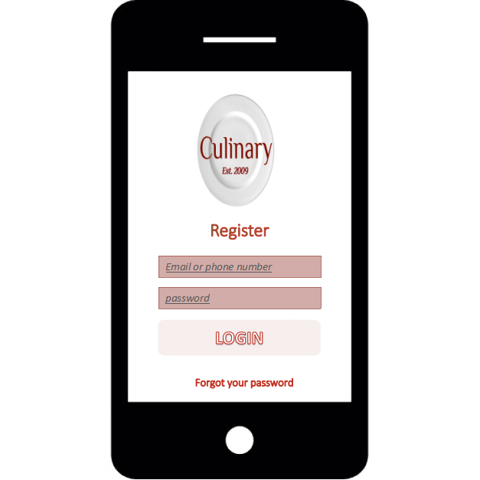
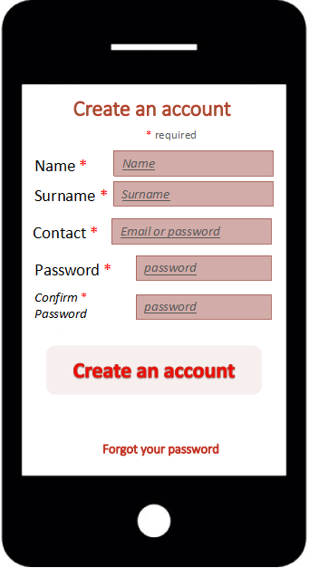
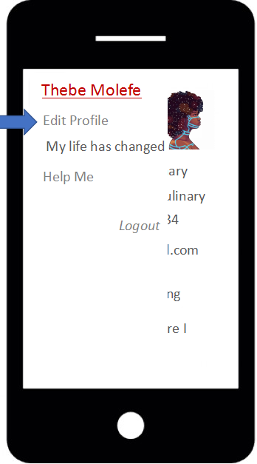
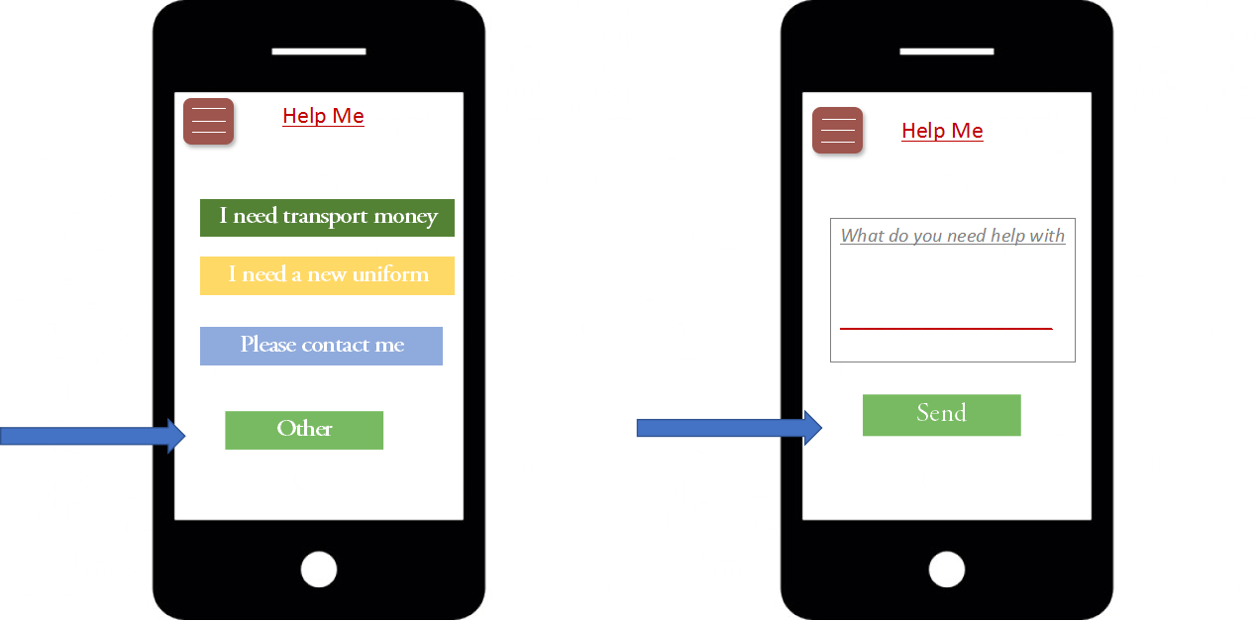
Figure 4 - From left (a) Login, (b) Create an account, (c) Navigation drawer ,(d) help me, and (e) help me: other

Slide 5
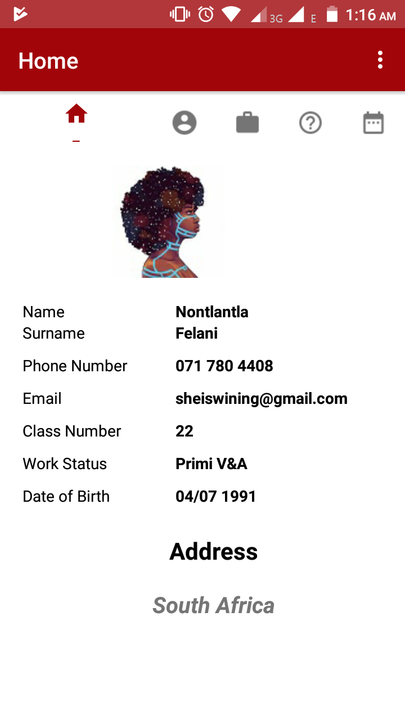
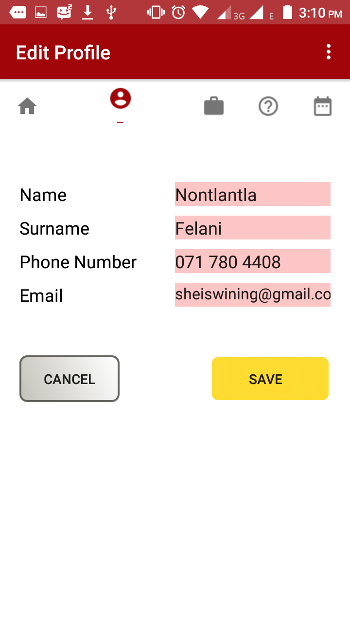
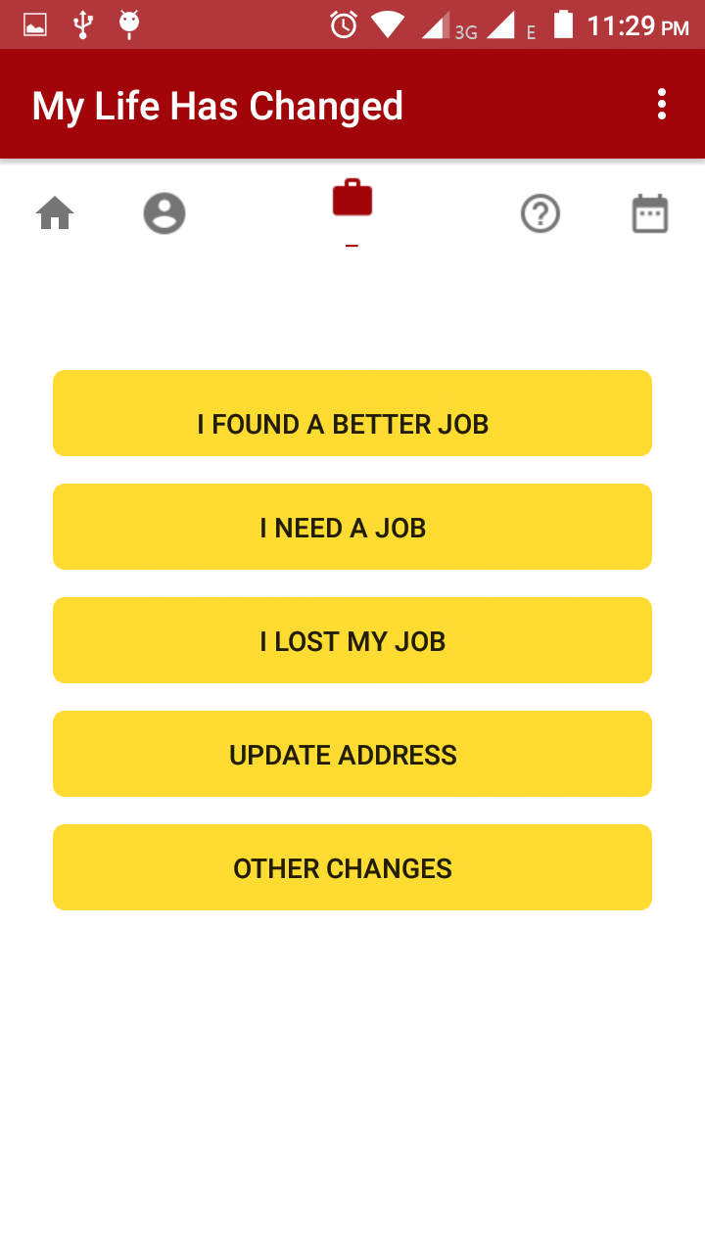
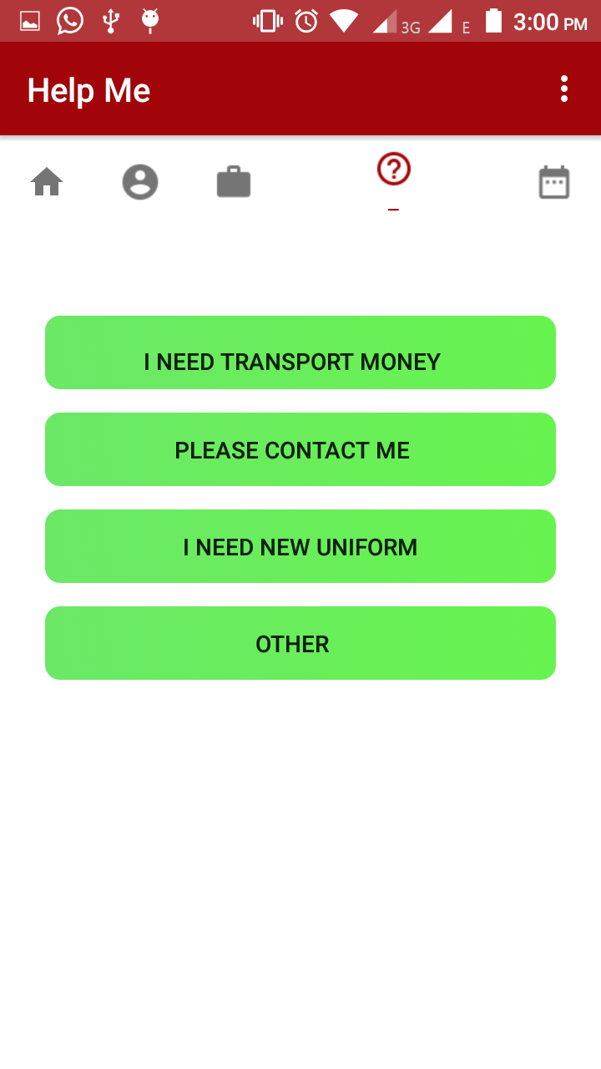
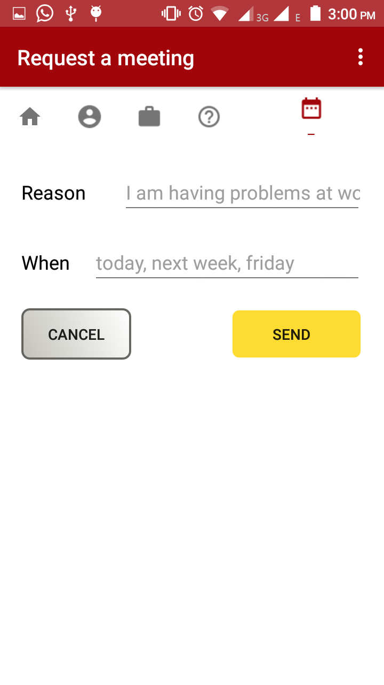
Figure 5 - From left (a) home, (b) edit Profile, (c) my life has changed, (d) help me, and (e) request a meeting

Slide 6
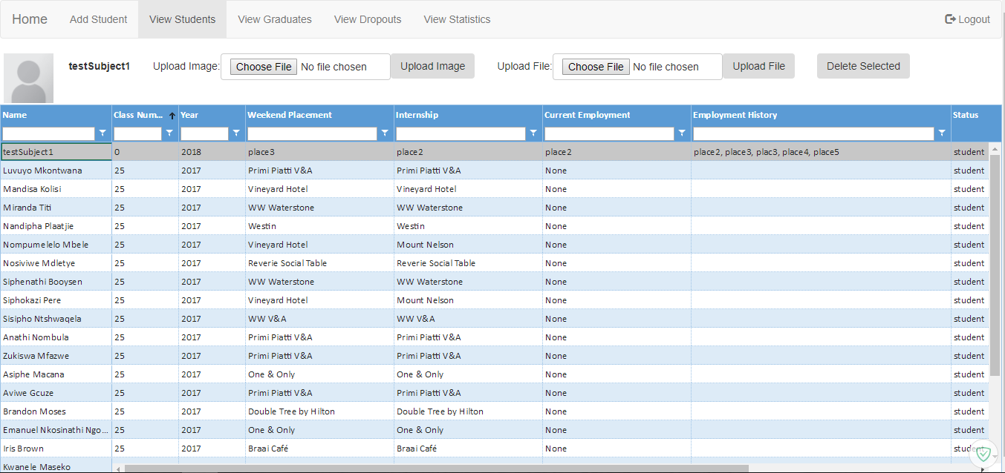

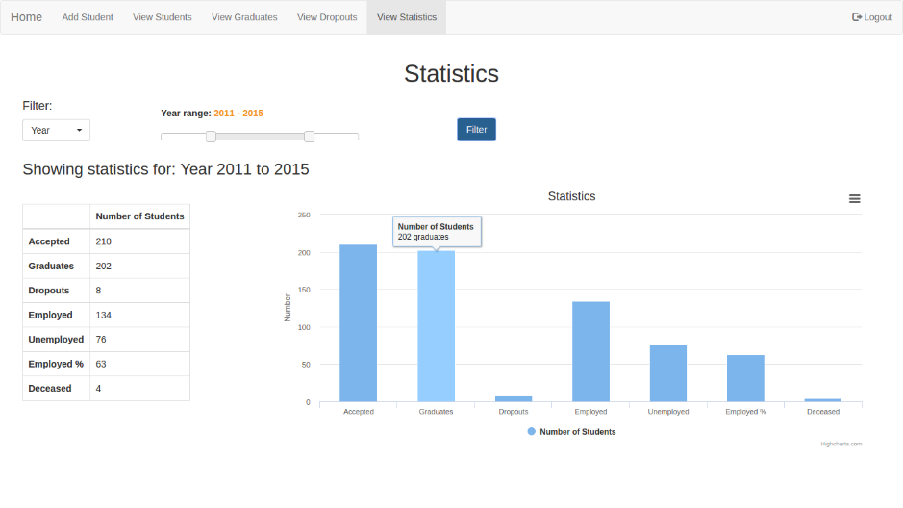
ICT Database
Data Management Tool
Mobile Application
Statistics Tool

