Slide 1
Docker command
20200451
박세원
System Software Lab.

Slide 2
Energy infographics
1
2
3
Solar Energy
Wind power
Hydropower
Mars is a red planet
We all live on Earth
Jupiter is a big planet
4
5
6
Biomass
Geothermal
Tidal energy
Saturn is a gas giant
Neptune is an ice giant
Mercury is very small
This template has been created by Slidesgo

Slide 3
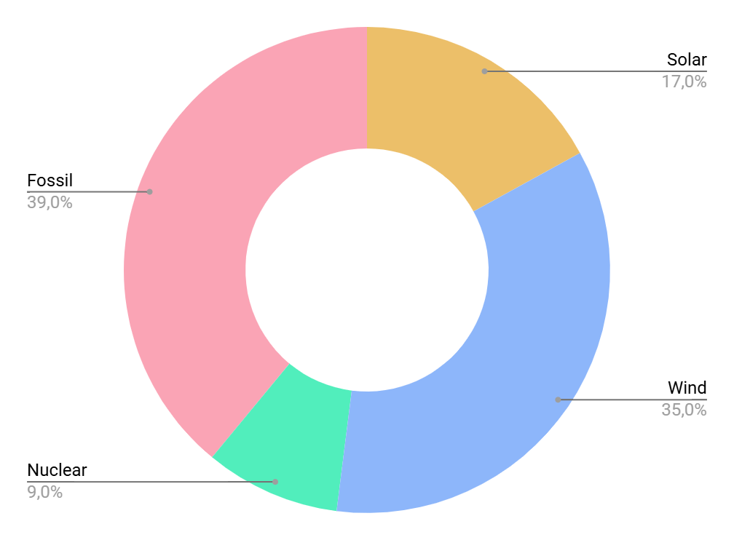
Energy infographics
Most used types of energies
Nuclear
Venus is a hot planet
Wind power
Saturn is the ringed planet
Solar energy
Jupiter is a gas giant
Fossil fuels
Mars is a cold planet
Follow the link in the graph to modify its data and then paste the new one here. For more info, click here
This template has been created by Slidesgo

Slide 4
Energy infographics
Energy milestones
Solar expansion
Battery innovation
Energy storage
AI optimization
We all live on Earth
Mars is very cold
Saturn has rings
Saturn has rings
20XX
20XX
20XX
20XX
Future energy
Branding
Smart grids with predictive control
Clean tech
This template has been created by Slidesgo

Slide 5
Energy infographics
Zero emissions fuel
Hydrogen
Emerging
Supply and demand
Storage
Medium
Energy transition overview
Low emissions and scalable
Wind
Medium- High
Abundant and renewable
Solar
High
This template has been created by Slidesgo

Slide 6
Energy infographics
Jupiter is the biggest planet of them all
Jupiter is big
Earth is the third planet from the Sun
Earth has life
Energy
storage
1
2
Hydrogen economy
Smart
grids
Nuclear
fusion
3
4
Despite being red, Mars is very cold
Mars is very cold
Saturn was named after a Roman god
Saturn has rings
This template has been created by Slidesgo

Slide 7
Energy infographics
How energy travels
Energy
source
Generation plant
Distribution substations
Urban
grid
Jupiter is the biggest planet of them all
Neptune is the eighth planet from the Sun
Saturn has a high number of moons, like Jupiter
Mercury is the smallest planet of them all
1
2
3
4
This template has been created by Slidesgo

Slide 8
Energy infographics
Renewable energy
Pros | Cons
Jupiter is the biggest planet of them all Venus is the second planet from the Sun Neptune is far away from Earth | Mercury is a small planet Venus is a hot planet Earth is the planet with life Jupiter is big
Conventional energy
Pros | Cons
Mars is actually a very cold place Jupiter was named after a Roman god Saturn has beautiful rings | Jupiter is a big planet Saturn was named after a Roman god Neptune is far away from us
This template has been created by Slidesgo

Slide 9
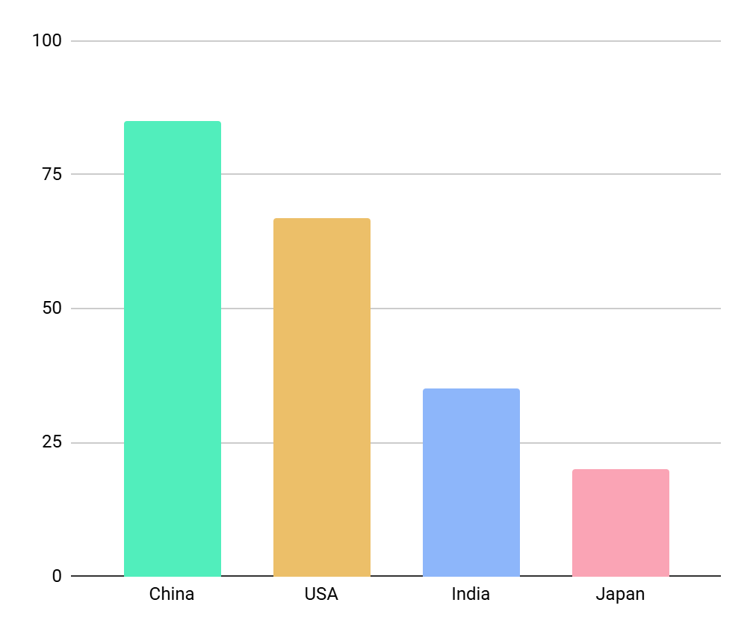
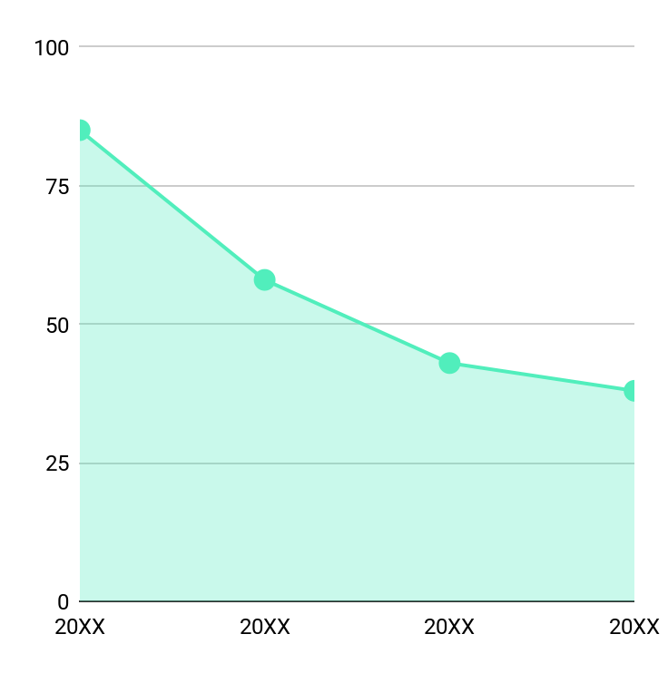
Energy infographics
Top 5 countries by renewable
power generation
Energy
cost trend
20XX
$0.85
20XX
$0.58
20XX
$0.43
20XX
$0.38
Follow the link in the graph to modify its data and then paste the new one here. For more info, click here
This template has been created by Slidesgo

Slide 10
Energy infographics
Sustainable energy network
1
Base
infrastructure
Saturn is the second-largest planet in the Solar System
2
Clean
generation
Jupiter is a gas giant and has around eighty moons
3
Smart
distribution
Despite being red, Mars is actually a cold place
4
Efficient consumption
Earth is the third planet from the Sun and has life
This template has been created by Slidesgo

Slide 11
Energy infographics
Residential vs industrial
energy efficiency
Most efficient
household appliances
Residential
55%
1
LED Bulb
85%
2
Pump
70%
Industrial
30%
3
Fridge
60%
Public entity
15%
4
Electric stove
40%
This template has been created by Slidesgo

Slide 12
Instructions for use
If you have a free account, in order to use this template, you must credit Slidesgo in your final presentation.
As a Free user, you are allowed to:
Modify this template
Use it for both personal and commercial projects
You are not allowed to:
Sublicense, sell or rent any of Slidesgo Content
Distribute Slidesgo Content unless it has been expressly authorized by Slidesgo
Include Slidesgo Content in an online or offline database or file
Offer Slidesgo templates (or modified versions of Slidesgo templates) for download
Acquire the copyright of
Slidesgo Content
For more information about editing slides, please read our FAQs or visit our blog

Slide 13
Instructions for use (premium users)
As a Premium user, you can use this template without attributing Slidesgo
You are allowed to:
Modify this template
Use it for both personal and commercial projects
Share this template in an
editable format
Hide or delete the “Thanks” slide and the mention to Slidesgo in the credits
You are not allowed to:
Sublicense, sell or rent any of Slidesgo Content
Distribute Slidesgo Content unless it has been expressly authorized by Slidesgo
Use any of the elements that are part in a separated way
Register any of the elements as a trademark or logo in an intellectual property registry
For more information about editing slides, please read our FAQs or visit our blog

Slide 14
Infographics
You can add and edit some infographics to your presentation to present your data in a visual way.
Choose your favourite infographic and insert it in your presentation using Ctrl C + Ctrl V or Cmd C + Cmd V in Mac
Remember to choose the “Keep source formatting” option so that it keeps the design. For more info, please visit our blog
01
07
Select one of the parts and ungroup it by right-clicking and choosing “Ungroup”
Repeat the steps above with the other parts and when you’re done editing, copy the end result and paste it into your presentation
02
06
03
Change the color by clicking
on the paint bucket
05
Group the elements again by selecting them, right-clicking and choosing “Group”
Then resize the element by clicking and dragging one of the square-shaped points of its bounding box (the cursor should look like a double-headed arrow). Remember to hold Shift while dragging to keep the proportions
04

