Slide 1

CLOUD
COMPUTING
Version 1.1 - 2022-02-07
by Mark Kelly
vcedata.com
mark@vcedata.com

Slide 2
What is ‘cloud computing?’
Doing ICT without applications (e.g. word processor, spreadsheet, slideshows, database) installed on the local computer.
Software is on the internet and accessed through a web browser
Apps are run on internet-based servers
Documents are saved on the internet rather than locally

Slide 3
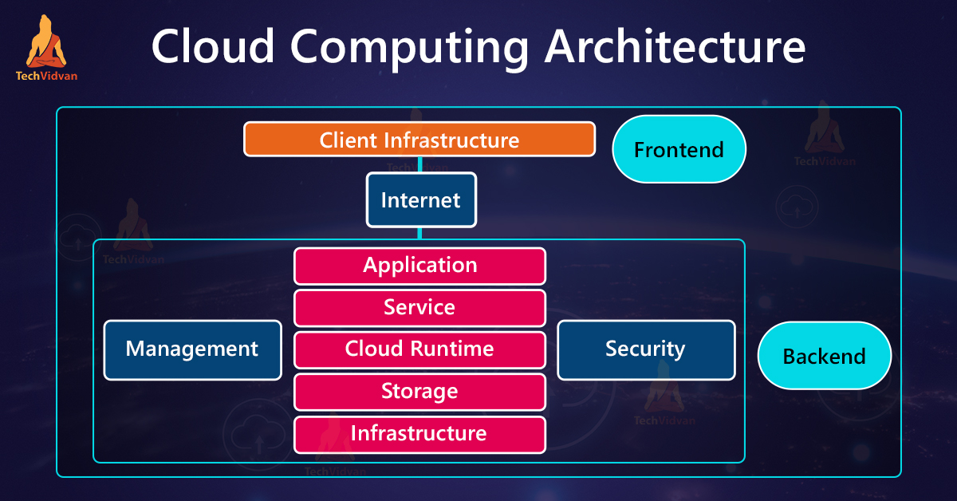
What is ‘cloud computing?’

Slide 4
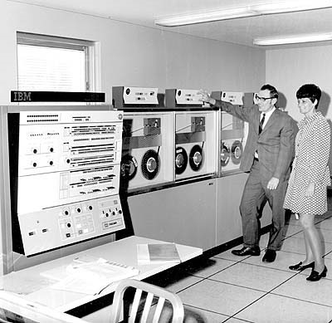
A change of paradigm
Original computers: mainframes ran programs for dumb terminals.
Workstations: run locally-installed software independent of other computers.
Cloud computing: use a web browser to watch software being run on servers on the internet.

Slide 5
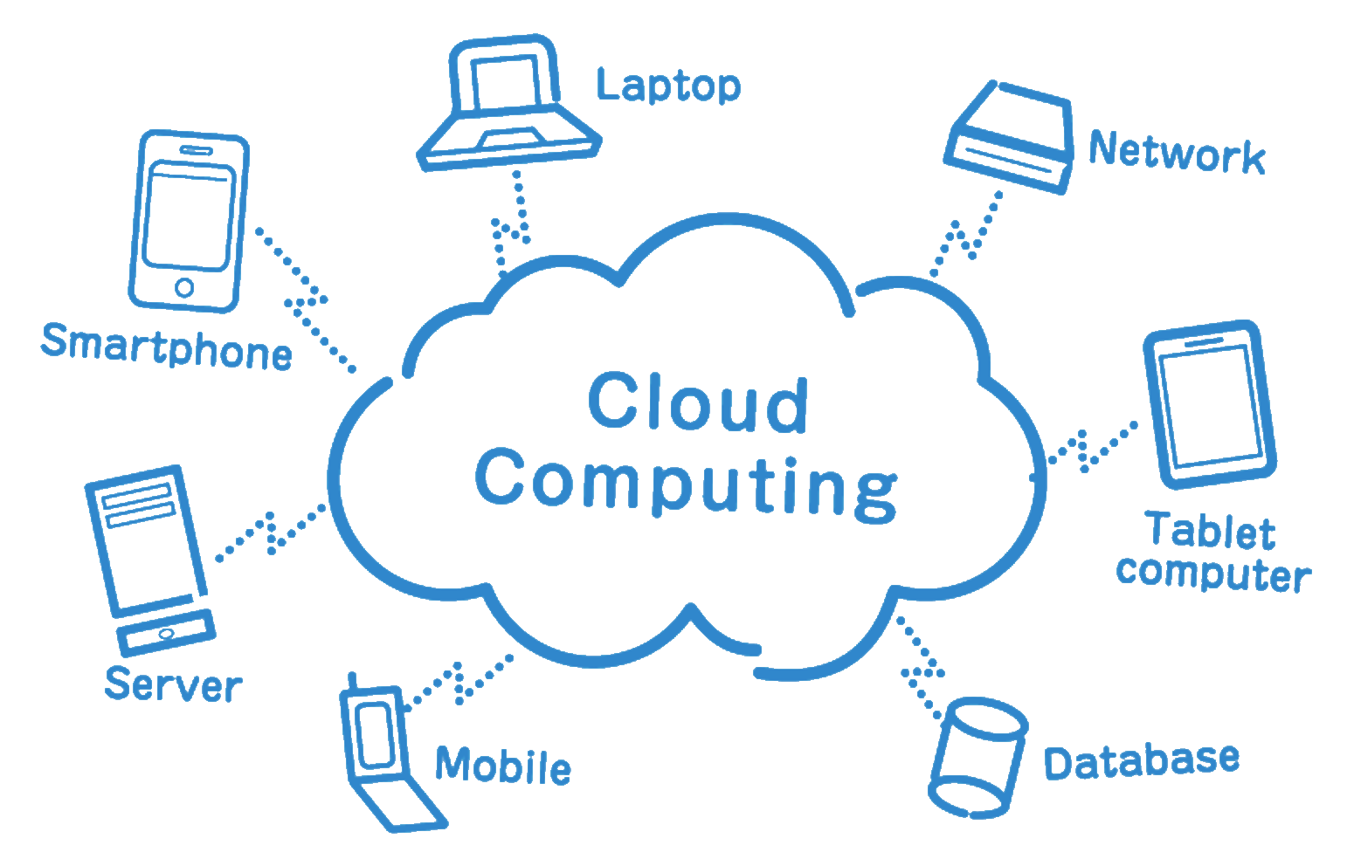
A change of paradigm Accessibility Everywhere, Everywhen

Slide 6

Providers of cloud computing
Google (free Google Apps, Google Docs, gMail)
Microsoft Azure (subscribe or pay as you go)
Adobe Creative Cloud
IBM Cloud
HP
Amazon Web Services
Alibaba Cloud (in China)
Dell, HP, Cisco etc etc

Slide 7
Benefits to Organisations
Less ICT infrastructure (servers etc) for organisations to buy and maintain since all the processing is farmed out to the cloud.
Fewer technicians needed
Less equipment maintenance
Less chance of equipment / service failure

Slide 8
Benefits to Organisations
Better collaboration through document sharing
Platform-independence: use exactly the same apps on Windows, Mac, Linux, Android, iPhone, tablets

Slide 9
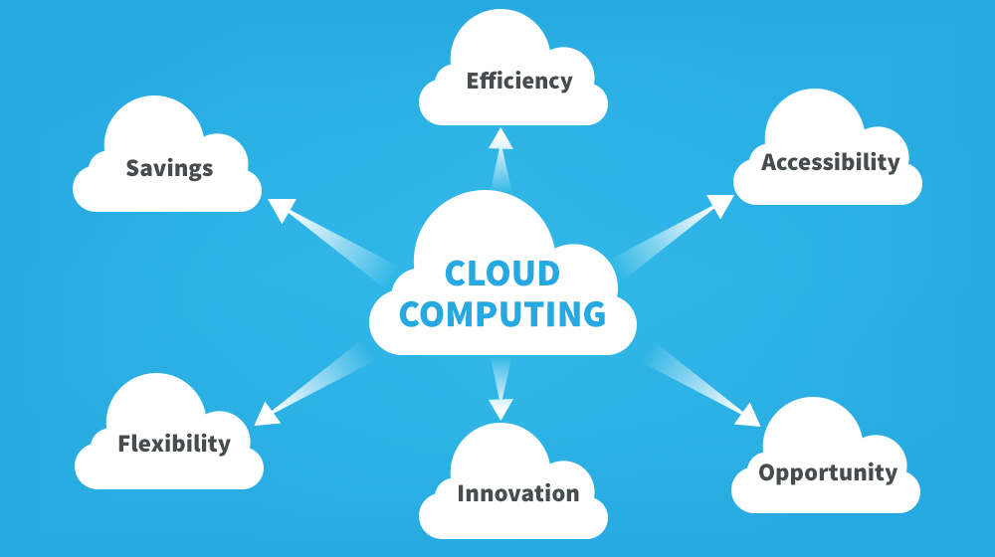
Benefits to Organisations

Slide 10
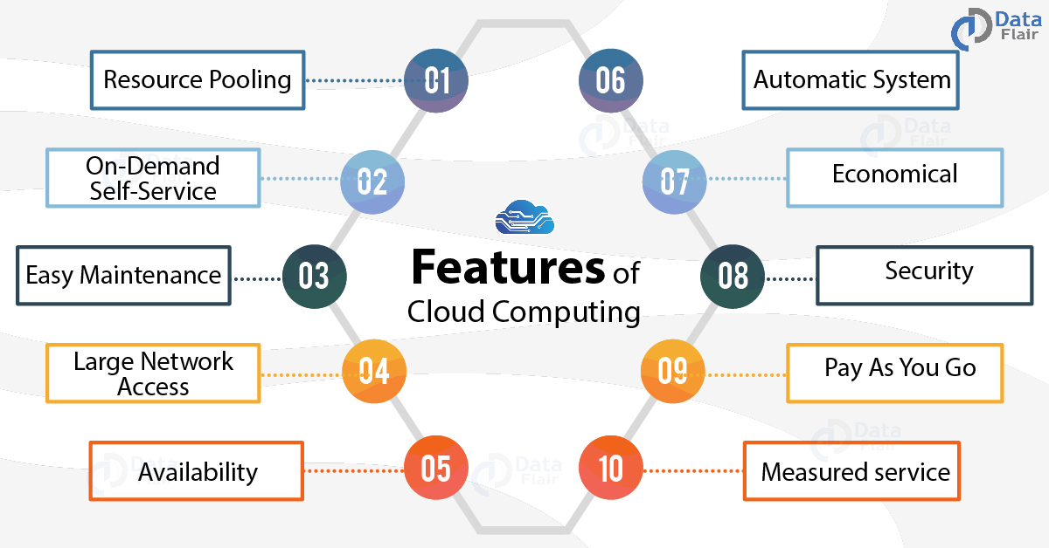
Features

Slide 11
Google Drive
Email, Live chat, VoIP
Word processor
Spreadsheet
Slideshow presentations
Forms (for data acquisition)
Drawing
etc

Slide 12
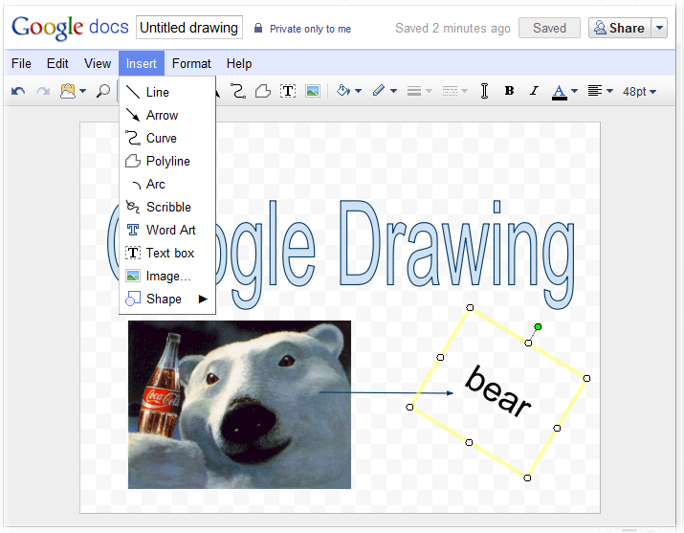
Google Drawing

Slide 13
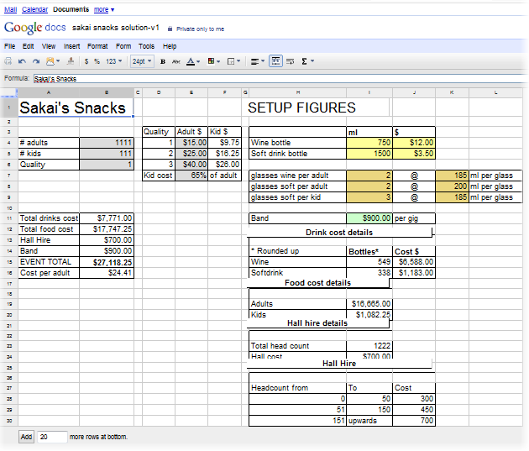
Google Spreadsheets
This spreadsheet was imported directly from Excel 2007 into a Google spreadsheet.
All Excel formatting and formulas (including VLOOKUP) worked normally.

Slide 14
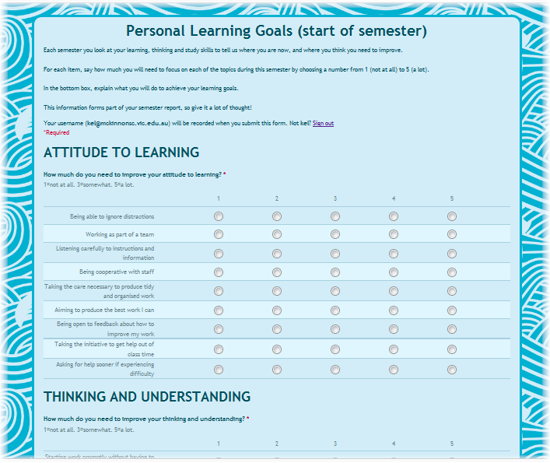
Google Forms
Using Google Forms for students to fill in their personal learning goals online.
They used to fill in paper forms by hand, which were slowly typed up by hired help.
Data can be saved to an online spreadsheet and imported directly into a reporting database.

Slide 15
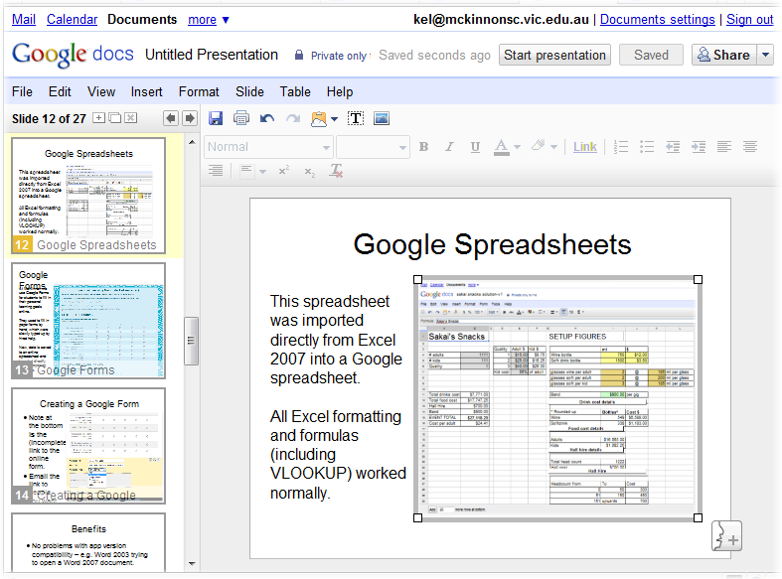
Google Presentations
This is the slideshow you’re currently watching after being imported from Powerpoint 2007 into Google Presentations.
Google does currently lack advanced features like transitions and fancy text formatting.

Slide 16
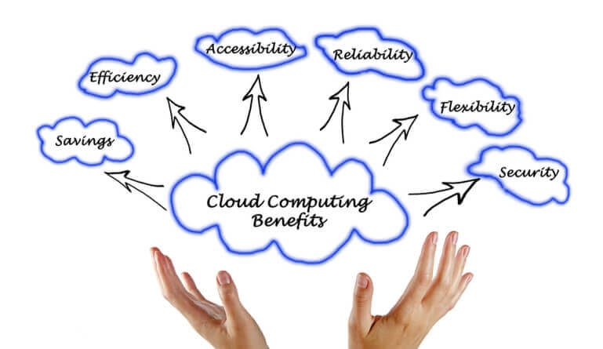
Benefits
No problems with app version compatibility – e.g. Word 2003 trying to open a Word 2007 document.
Saves storage space on local PC - no local software or documents

Slide 17
Benefits to Users
Only need a cheap, low-powered computer since all processing is done remotely.
Don’t need lots of RAM.
Only need a small SSD since storage is online.
Better computer performance since fewer apps need to run locally at the same time: they’re being run in the cloud.

Slide 18

Benefits to Users
Even if you’re paying to ‘rent’ cloud software, it’s probably cheaper than buying office suites since you pay for the apps you need.
You don’t have to buy an entire suite only to use 2 apps in it.

Slide 19
Benefits to Users
Can be free to use (Google) – no software to buy.
No software to update or patch etc.
Can choose ‘Pay As You Go’ plans for cents per hour
Software updates are automatic.
Excellent for teams for collaboration and knowledge sharing.

Slide 20
Benefits to users
Can access documents anywhere there is an internet connection. No more “Oops. I forgot to copy that document to my laptop before I left...”
Backups are done for you. Google apps even saves your work every few seconds so it can’t be lost.

Slide 21
Benefits
Integrated tools in Google, e.g. Contacts/mail/chat/calendar/VoIP work together
You are no longer tethered to a single computer: you can move to any device that has an internet connection and continue work from where you left off.

Slide 22
More Benefits to Users
Makes real-time document sharing possible and easy: no more emailing versions of documents back and forth.
Several people can edit the same document at the same time
Unwanted edits can be rolled back.
Google forms allows easy data acquisition via easily-built email or web forms

Slide 23

Drawbacks for Users
Can’t access documents or do work without an internet connection

Slide 24
Drawbacks for Users
A slow internet connection can make cloud computing painfully slow
Who knows what is being done with your documents and data?
Do you own your intellectual property?
Will your content be mined to create user-directed advertising or personalised spam?

Slide 25
Disadvantages
Software quality or functionality may not be as good as traditional installed software (e.g. Compare Powerpoint with Google Presentations’ basic features)
But online tools are maturing rapidly

Slide 26

Drawbacks for Users
Are confidential documents safe? You cannot control the security of them.
Who is reading / copying them?
Do hackers have access?
Does the cloud supplier offer decent (or any) encryption?

Slide 27

Drawbacks for Users
If you delete a document, is it really deleted forever? Or is it archived somewhere...?
You must trust in the honesty, competence and effectiveness of the cloud host.
Would you trust your diary with this man?

Slide 28
Drawbacks for Users
If you create a document in a proprietary cloud software tool, can the document be read by other software packages?
Can you import/export data between the cloud software and other software?
May have limited online storage space

Slide 29
Drawbacks for Users
What happens to your data if your cloud supplier goes broke or sells out to a different company?
What do you do if your cloud host goes offline for hours or days due to DDOS/ransomware attacks, malware, cable outages etc?

Slide 30

Drawbacks for Users
What happens if your cloud supplier suddenly decides you’ve violated their terms of acceptable usage and cancels your account without warning?

Slide 31
APPLIED COMPUTING SLIDESHOWS
by Mark Kelly
vcedata.com
mark@vcedata.com
These slideshows may be freely used, modified or distributed by teachers and students anywhere on the planet (but not elsewhere).
They may NOT be sold.
They must NOT be redistributed if you modify them.

