Slide 1

Applied Computing Slideshows by Mark Kelly vcedata.com mark@vcedata.com
Practices that cause conflict

Slide 2
Contents
Practices that cause conflict between stakeholders who use, or are affected by, solutions that operate within networked environments

Slide 3

‘Stakeholders’?
People who stand to gain or lose from something
People who have some sort of investment (e.g. time, money) in something
People who are affected by something, for better or worse.

Slide 4
Causes of network conflict
Using more than one’s fair share of resources (e.g. hogging the printer or bandwidth)
Interfering with someone else’s work or workplace
Spamming
Failure to follow local conventions (e.g. filenaming)

Slide 5
Causes of network conflict
Carelessly damaging equipment
Carelessly deleting vital data
Violation of Acceptable Use Policies
Misuse of network privileges (e.g. Youtube during working hours)

Slide 6
Causes of network conflict
Inappropriate downloads
Sexual harassment using the network
Using other people’s passwords
Introducing security risks (e.g. opening Trojans, bringing viruses in on Flash drives, responding to phishing)
Theft of equipment or software

Slide 7
Causes of network conflict
Copyright violation
Violation of the Privacy Act, Human Rights act, etc.
Sending silly, unwanted jokes in emails
Sending emails to the wrong people or groups

Slide 8
Causes of network conflict
Revealing valuable corporate information to competitors
Using unauthorised software
Using unauthorised hardware (e.g. connecting an insecure WAP to a workstation, taking work home on a Flash drive or USB HDD)

Slide 9
Causes of network conflict
Inequality of network resources given to different people
Lack of response to urgent calls for help or repairs
Unrealistic expectations of a system
Poor quality hardware or software

Slide 10
Causes of network conflict
Interference by management in areas they know little about
Monitoring of workers by management
Lack of support by management
Clueless management

Slide 11

Causes of network conflict
Lack of training opportunities offered by management
Trolls who deliberately provoke people to anger
Racism, sexism, religious intolerance

Slide 12
Causes of network conflict
Failure to attend to your section of a collaborative task
Making careless work errors that coworkers have to fix
Leaving jammed printers for someone else to clear

Slide 13
Causes of network conflict
Not replying promptly to urgent communications

Slide 14
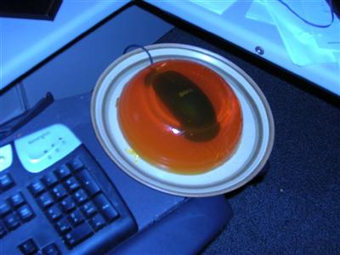
Causes of network conflict
Embedding workmates’ mice in jelly and other office pranks

Slide 15
Causes of network conflict
… And other annoying pranks

Slide 16
Resolving conflict
(Not key knowledge, but useful to know)
Accommodation – giving someone what they want at your own expense.
Avoidance - ignoring or postponing the conflict.
Collaboration - working together to achieve more for each party than either would have gained in a win/lose outcome.
Competition – beat the opponent so you get what you want.
Compromise – each side agrees to accept less than they originally wanted so each enjoys some benefit.

Slide 17
Applied Computing Slideshows
by Mark Kelly
vcedata.com
mark@vcedata.com
These slideshows may be freely used, modified or distributed by teachers and students anywhere on the planet (but not elsewhere).
They may NOT be sold.
They must NOT be redistributed if you modify them.

