Slide 1
Applied Computing Slideshows by Mark Kelly vcedata.com mark@vcedata.com
1
a
Data
Types

Slide 2
Mandated data types
In the 2016-2019 study design, there are no mandated data types. The Glossary only says…
Data types are the particular forms that an item of data can take including numeric, character and Boolean, and are characterised by the kind of operations that can be performed on it...
these fundamental types can be divided into more specific types, for example integer and floating point are numeric types.
More sophisticated types can be derived from them, for example a string of characters or a date type.
Their names may vary, such as text versus string.

Slide 3
The VCAA Glossary Definition
(2020-2024 Study Design)
Data types
The forms that an item of data can take,
including
binary (as represented in images and sound),
Boolean,
character
numeric
characterised by the kind of operations that can be performed on it.
Depending on the software being used, these data types can be divided into more specific data types, for example integer and floating point, which are numeric types.
More sophisticated types can be derived from them, for example
a string of characters or a data type,
and their names may vary, such as
text data type versus string data type.

Slide 4
Binary
May only have values zero or one
Base 2 counting system
Compared with decimal – base 10 – which has ten digits: 0,1,2,3,4,5,8,9
To get bigger binary numbers, add more columns

Slide 5
Counting in Decimal
So, for example, to get the number 65,536 in decimal you use
6 | 5 | 5 | 3 | 6
10⁴ | 10³ | 10² | 10¹ | 10⁰
10,000 | 1,000 | 100 | 10 | 1

Slide 6
Counting in Binary
Each column in binary can only go up to 1
Add columns to get larger numbers
1 | 0 | 0 | 1 | 0 | 0 | 1 | 1
2⁷ | 2⁶ | 2⁵ | 2⁴ | 2³ | 2² | 2¹ | 2⁰
128 | 64 | 32 | 16 | 8 | 4 | 2 | 1
So, in 8 bits (binary digits) you have 128+16+2+1 = 147 (in decimal)
Binary uses more columns than decimal, but can reach the same big numbers

Slide 7
Why use binary?
Actually, humans don’t.
Digital computers do – because they only understand electricity. 1 = there is electrical power, 0 there is no electrical power.
Human programmers compromise with computers and use octal (base 8) or hexadecimal (base 16)

Slide 8
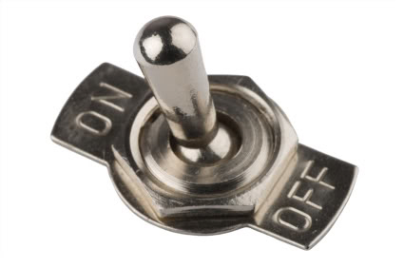
Boolean (logic)
Boolean - stores only a True or False value.
Very efficient storage. Little memory required.
Ideal for flags which store a yes/no true/false state.
Usually stored as a zero (false), or non-zero (true)
Note – just because a field or variable can take 1 of only 2 possible values does not make it Boolean.
Boolean must be a true/false answer, not (for example) a “Large or small?” option.

Slide 9
Integer
A specific numeric data type
Cannot hold fractional parts (decimal places)
Little storage needed compared with floating point numbers
Quicker to do calculations with integers
Some variants supported by different apps…
Short Integer - stores values from negative 32768 to +32767
Long Integer - stores values from negative 2,147,483,648 to 2,147,483,647
Byte - stores values between 0 and 255 in one byte. Efficient storage for small numbers.

Slide 10
Floating point numbers a.k.a. Decimal, Real
Store numbers with a fractional (decimal) part (e.g. 3.14159)
Variants…
Single Precision - stores values from -3.402823e38 to -1.401298e-45 for negative values and from 1.401298e-45 to 3.402823e38 for positive values…

Slide 11
Floating Point Numbers
Double Precision - for storing values from -1.79769313486232e308 to -4.94065645841247e-324 for negative values and from 4.94065645841247e-324 to 1.79769313486232e308 for positive values.
The 'e' means 'times 10 to the power of'. In other words 4.94065645841247e-324 is roughly 4.9 followed by 324 zeroes. It allows extreme precision...

Slide 12
Double precision!
49,000,000,000,000,000,000,000,000,000,000,000,000,000,000,000,000,000,000,000,000,000,000,000,000,000,000,000,000,000,000,000,000,000,000,000,000,000,000,000,000,000,000,000,000,000,000,000,000,000,000,000,000,000,000,000,000,000,000,000,000,000,000,000,000,000,000,000,000,000,000,000,000,000,000,000,000,000,000,000,000,000,000,000,000,000,000,000,000,000,000,000,000,000,000,000,000,000,000,000,000,000,000,000,000,000,000,000,000

Slide 13

Currency data type
A special type of floating point used for finances.
Has a high-precision fractional part to prevent bad rounding of cents.

Slide 14

String (text)
String - stores text composed of any ASCII* characters (alphabetic letters, numerals, punctuation and control codes like carriage return, backspace, bell).
Character - can hold a single ASCII character, e.g. “A”, “3”, “&”, tab character.

Slide 15
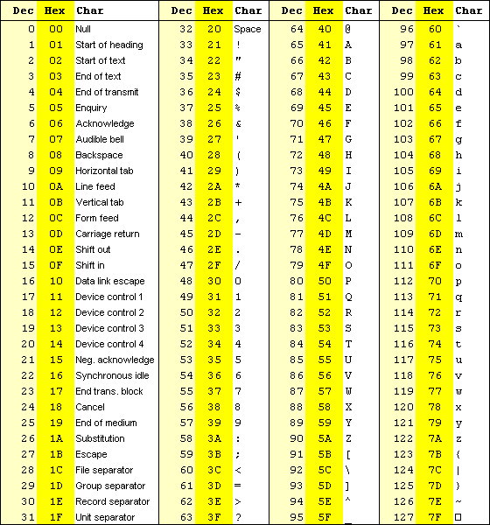
A
S
C
I
I

Slide 16
String (text)
While strings can store numerals, they cannot interpret the value of numbers and instead treats them as plain text.
So if you add "1" and "2" you'll get "12" instead of 3
Beware of this when adding numbers in text boxes!

Slide 17
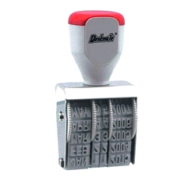
Special data
Date - holds a complete date value (including day, month and year). Stored as a number.
Time – stores a time of day as a number of seconds since midnight
Timestamp - holds a complete date (DDMMYYYY) and time of day (hours, minutes and seconds) in a single value. Stored as a number.

Slide 18
Special types
The programming language C has a special data type designed to hold a pointer to a memory location.
Filemaker Pro databases have a container data type which can hold any binary data like video, photo, audio, word processor documents etc
Different software may support other data types (e.g. nybble – half a byte)

Slide 19
Why bother with data types?
Use the right data type to get maximum manipulation power
E.g. When a date is stored as “Date” data type instead of text, the software can perform data calculations
Age ←(DateToday – DateBirth)/365

Slide 20
Why bother with data types?
Use the right size data type to avoid wasted memory (e.g. using double when byte would do, or using float when number will always be integer)
Programs run faster when using smaller, simpler variables.
Calculations using decimal places takes extra processing.

Slide 21
Using GUI storage structures
Textboxes can store numbers, but to do calculations, the text must be converted to number format first. (Slow, painful)
List boxes/combo boxes are good for displaying data, but not efficient for large storage and manipulation tasks compared with arrays.

Slide 22
Also see
Naming conventions for variables etc

Slide 23
Applied Computing Slideshows by Mark Kelly vcedata.com mark@vcedata.com
These slideshows may be freely used, modified or distributed by teachers and students anywhere on the planet (but not elsewhere).
They may NOT be sold.
They must NOT be redistributed if you modify them.

