Slide 1
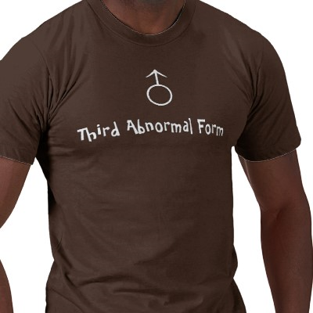
Applied Computing Slideshows
by Mark Kelly
vcedata.com
mark@vcedata.com
Database
Normalisation

Slide 2
Contents
What is normalisation?
Why normalise?
Normal forms 1,2,3

Slide 3
What is normalisation?
Organising a relational database so…
Data repetition is minimised
Data access is maximised

Slide 4
Why normalise?
Removing data repetition saves lots of storage space and speeds up data access.
Changes need only be made in one place rather than in many places.
More powerful data access is possible

Slide 5
The normal forms
Are called 1NF (first normal form) to 5NF, but only 1-3 matter here.
Are guidelines (not laws) for structuring database tables and fields.
Note: they are often applied instinctively as part of skilled database design, and are not an extra step to do after databases are created.

Slide 6
1NF
First Normal Form - sets the most basic rules for an organised database
The 1NF guidelines are common sense.
1. Eliminate duplicate columns from the same table.
(But how thick would you have to be to allow duplicate columns in a table?)

Slide 7
1NF – First normal form
2. Create separate tables for each group of related data and identify each row with a unique column or set of columns (the primary key).

Slide 8
Things NF1 wants*
Rows and columns do not have to be sorted in a particular way for the table to work.
E.g. Excel VLOOKUP and HLOOKUP requires a lookup table to be sorted alphabetically or numerically for a range lookup to work. This would violate NF1.
* According to Chris Date in “What First Normal Form Really Means”

Slide 9
Things NF1 wants
No duplicate rows (records). Each row must be unique in some way.
Each field entry can only contain one piece of data.
E.g. A name field containing “Fred Smith” has surname and first name, violating 1NF.

Slide 10
Things NF1 wants
Each field entry can only contain one piece of data.
E.g. A phone number field with more than one phone number entered for a person

Slide 11
Things NF1 wants
Each field entry can only contain one piece of data.
Why?
You cannot easily access the data embedded in the single field (e.g. grab a postcode)
You can’t use embedded data for sorting
You can’t use data like “2kg” as a number for calculations, sorting, summaries etc.

Slide 12
Your turn… repair this!
Customer ID | Name
111 | Fred Smith
222 | Mary Jones
333 | Tim Blogs

Slide 13
Repaired!
Customer ID | FirstName | Surname
111 | Fred | Smith
222 | Mary | Jones
333 | Tim | Blogs
Now, customers can be sorted and searched by first name and/or surname separately.
Also, the names can be used individually, like “Dear Fred” instead of “Dear Fred Smith”

Slide 14
Repair This!
Product ID | Colour | Weight
A345 | Red | 4kg
A568 | Blue | 300g
B695 | White | 1.5kg

Slide 15
Repaired!
Product ID | Colour | Weight (g)
A345 | Red | 4000
A568 | Blue | 300
B695 | White | 1500

Slide 16
Repair This!
Album | Track | Length
Monster | 1 | 3:23
Monster | 2 | 4:12
Collapse into Now | 1 | 4:01

Slide 17
Repaired
Album | Track | Length (sec)
Monster | 1 | 203
Monster | 2 | 252
Collapse into Now | 1 | 241
Time notation like “3:23” represents two pieces of data – minutes and seconds – that mean nothing to a database
Cannot be understood a database without serious text parsing
Single “seconds” value can be sorted, searched, compared

Slide 18
Repair This!
Customer ID | Address
111 | 66 Lake Rd, Mentone, 3198
222 | 2/45 Richmond Lane, Richmond, 3121
333 | 135 Spring St, Melbourne, 3000
An address like “3 Fred St, Sale, 3586” has 3 pieces of data: street address, town, postcode.

Slide 19
Repaired!
Customer ID | Street | Suburb | Postcode
111 | 66 Lake Rd | Mentone | 3198
222 | 2/45 Richmond Lane | Richmond | 3121
333 | 135 Spring St | Melbourne | 3000
Now each field can be searched & sorted and used individually (e.g. addressing envelopes)

Slide 20
Repair this… it’s tricky!
CUSTOMER
Customer ID | Name | Phone
111 | Fred Smith | 4566 3456
222 | Mary Jones | 4567 8900 (BH) 3456 2314 (AH)
333 | Tim Blogs | 3254 5676 0402 697 495

Slide 21
First attempt…
Customer ID | Name | Phone1 | Phone2
111 | Fred Smith | 4566 3456
222 | Mary Jones | 4567 8900 | 3456 2314
333 | Tim Blogs | 3254 5676 | 0402 697 495
Problems:
Trouble querying the table: “Which customer has phone # 3456 2314?” Have to search more than 1 field… messy. Ugly.
Can’t enforce validation rules to prevent duplicate phone #s
Can’t enter three or more phone numbers
Waste of space for all people with only 1 number

Slide 22
Second attempt…
CUSTOMER NAME TABLE
Customer ID | Name
111 | Fred Smith
222 | Mary Jones
333 | Tim Blogs
CUSTOMER PHONE TABLE
Customer ID | Phone
111 | 4566 3456
222 | 4567 8900
222 | 3456 2314
333 | 3254 5676
333 | 0402 697 495
Benefits:
Unlimited phone numbers for everyone!
No need to search multiple Phone fields
No need to tear apart text from one field to extract a particular number
All we need is a 1:many relationship between customer name table and customer phone table using the ID as the key field.

Slide 23
Tip
Don’t use a database’s TIME data type to store durations of time
The TIME data type stores a time of day (e.g. 9:17 A.M.)
Elapsed time is stored as a number of seconds, minutes, hours, days etc – integer!

Slide 24
2NF
2NF

Slide 25
2NF – Second Normal Form
Achieving 2NF means 1NF has already been achieved
Each normal form builds on the previous forms
2NF removes more duplicate data.
2NF deals with design problems that could threaten data integrity.

Slide 26
2NF – Second Normal Form
Removes subsets of data that apply to multiple rows of a table and places them in separate tables.
Creates relationships between these new tables and their predecessors using foreign keys.

Slide 27
2NF example
CustomerID | Gname | Sname | Phone
111 | Fred | Smith | 1293 5934
222 | Mary | Jones | 4839 2712
222 | Mary | Jones | 2849 5967
333 | Ike | Turner | 2393 4955
If Mary Jones got married and changed her name, changes would need to be made in more than one record. If one change were missed, the integrity of the data would be damaged.
Making multiple changes like this is also time-consuming and repetitious, thereby eating up storage space.
Solution: Store names only once in a separate table, as in the phone number example before. Name changes now only need to be made once.

Slide 28
Solution
CUSTOMER NAME TABLE
Customer ID | Name
111 | Fred Smith
222 | Mary Jones
333 | Tim Blogs
CUSTOMER PHONE TABLE
Customer ID | Phone
111 | 4566 3456
222 | 4567 8900
222 | 3456 2314
333 | 3254 5676
333 | 0402 697 495
Ignore the fact that the name is stored in one field above. I’m lazy.

Slide 29
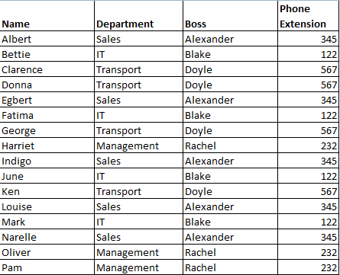
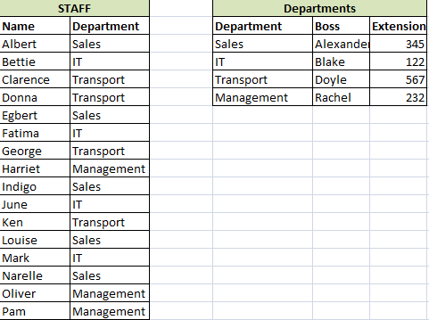
Without NF2: flat file
With NF2: relational
Department data is only stored once. So:
Less storage space required
Department changes now only made once, not once for each worker in that dept!

Slide 30
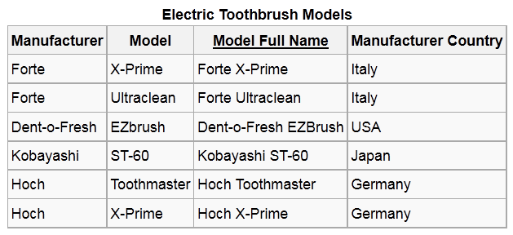
2NF
The table above is a problem.
Let’s say {Model Full Name} is the primary key.
The {Manufacturer Country} field is based on the {Manufacturer} field, and will need to be constantly updated if manufacturers change their location.
To be properly 2NF, you’d need to do this…

Slide 31
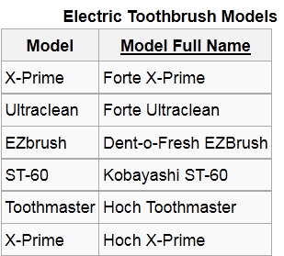
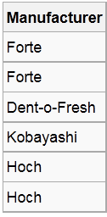
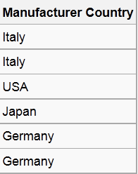
2NF

Slide 32
2NF
Break the data into two tables

Slide 33
2NF
Make the same key fields in each table

Slide 34
2NF
Set up the relationship between the key fields in each table

Slide 35
3NF
3NF

Slide 36
3NF
Third normal form (3NF) goes one large step further
Remove columns that are not dependent upon the primary key.

Slide 37
Remember…
Every non-prime attribute of relationship R is non-transitively dependent on every candidate key of R.
Glad we cleared that up…

Slide 38
To revise
E.F. Codd first described normalisation in 1971.
1NF ensures that every attribute (like a field) must give a fact about the key field.
2NF ensures attributes give a fact about the entire key, not just part of it. E.g. if a table key was surname and postcode, a field might give information about just the postcode.
3NF ensures that attributes give information on nothing but the key field.

Slide 39

In other words
Non-key attributes must give information about the key, the whole key, and nothing but the key, so help me Codd.
(Bill Kent)

Slide 40
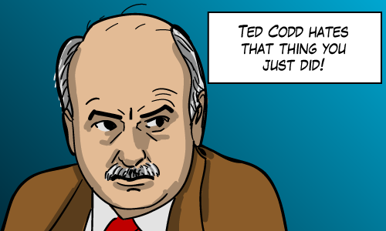

Slide 41
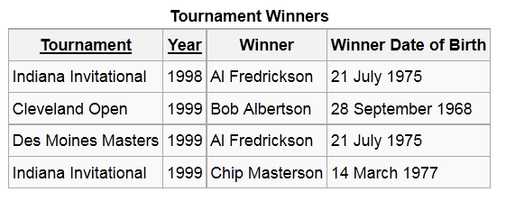
3NF FAIL
Field name underlining indicates key fields.
You may have a gut feeling that this table is not good. But why?

Slide 42
3NF FAIL
Each attribute (‘field’) should be giving information about the key field (a particular tournament + year).

Slide 43
3NF FAIL
But the DOB field is not describing the tournament – it’s describing the tournament’s winner.

Slide 44
3NF FAIL
But the DOB field is not describing the tournament – it’s describing the tournament’s winner.

Slide 45
3NF FAIL
This is bad because the DOB does not describe the key field (tournament). It describes a looked-up value (the tournament’s winner).

Slide 46
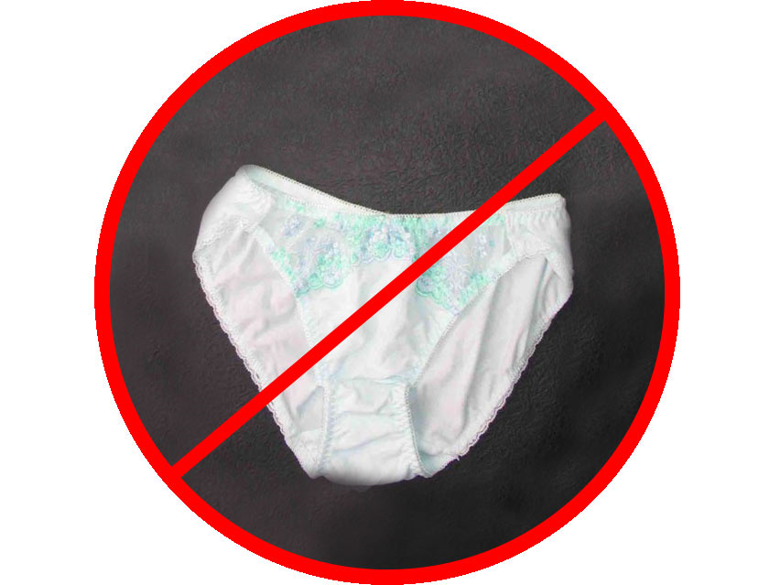
3NF FAIL
It’s like your mum keeping her knickers in your sock drawer because you’re related to her.
They don’t belong there!

Slide 48
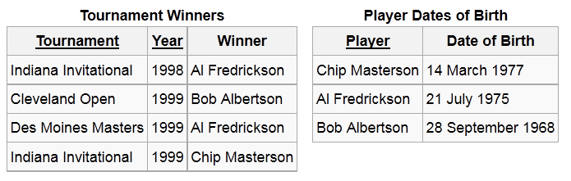
3NF FTW!
Now the two tables are 3NF, and update anomalies cannot occur (e.g. updating a DOB in one record but missing it in another record).

Slide 49
In other words
Let X → A be a nontrivial FD (i.e. one where X does not contain A) and let A be a non-key attribute. Also let Y be a key of R. Then Y → X. Therefore A is not transitively dependent on Y if and only if X → Y, that is, if and only if X is a superkey.
’kay?

Slide 50

Because you’ve been so good…

Slide 51
Applied Computing Slideshows
by Mark Kelly
vcedata.com
mark@vcedata.com
These slideshows may be freely used, modified or distributed by teachers and students anywhere on the planet (but not elsewhere).
They may NOT be sold.
They must NOT be redistributed if you modify them.

