Slide 1

Applied Computing Slideshows by Mark Kelly vcedata.com mark@vcedata.com
Design
Elements

Slide 2

Factors that contribute to the appearance and functionality of an information product:
proportion (visual hierarchy),
orientation (direction/aspect),
clarity and consistency,
colour and contrast,
usability and accessibility,
appropriateness
relevance.

Slide 3
Proportion (visual hierarchy)
To visually show the relative importance of different parts of an information product, make some things bigger than others.
Headings are big, bold, coloured or in a different typeface.
Subheadings are less big.
Body text is least big.

Slide 4

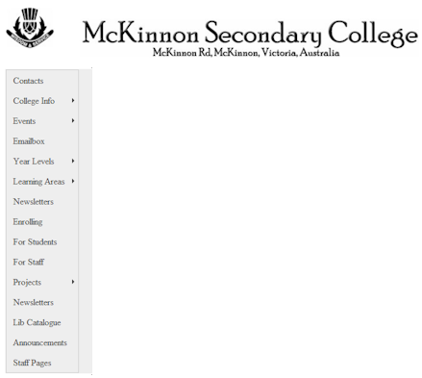
Orientation (direction/aspect)
Objects can be laid out vertically, horizontally, diagonally.
Columns have a vertical orientation.
H o r i z o n t a l

Slide 5
Clarity
Clarity = being clear
This text has clarity
This text has less clarity
This text has hardly any clarity
Use a simple serif typeface for body text
Maybe a simple sans serif typeface for headings
Make text size easy enough to read

Slide 6
What’s a serif?
Times New Roman
(a serif typeface)
Arial
(a sans serif typeface)
E
E
Serifs make letters more easily distinguishable when reading quickly
‘Sans’ is French for ‘without. ‘Sans serif’ = ‘without serif’

Slide 7
A Quick Clarity Test
What is this word?
Ill

Slide 8
A Quick Clarity Test
Easier to read with a serif typeface?
Ill

Slide 9
Consistency
Consistent = not changing frequently
Consistent use of icons, colours, typefaces
Consistent positioning of navbars, menus etc
Being consistent is not ‘unimaginative’
Inconsistency makes life hard for readers
Showing off a hundred typefaces/icons won’t impress anybody!

Slide 10

Consistency
Imagine what would happen if road signs or traffic lights were different in every state of Australia.
What if car makers put brake, clutch and accelerator pedals in any old order?

Slide 11
Consistency
What if every computer program had different menu positions, or didn’t stick to conventions like Ctrl+C to copy?

Slide 12
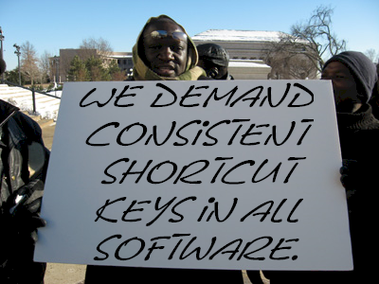
Imagine
All of those things used to happen until everyone demanded consistency and standards!

Slide 13
Colour and contrast
The difference between a background colour and a foreground (text) colour
Poor contrast
Reasonable contrast
Good contrast
Maximum contrast

Slide 14

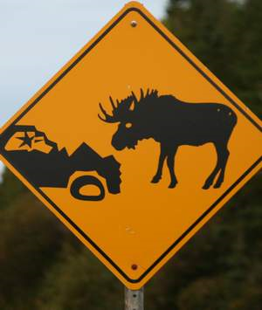

Which may help explain this familiar universal colour scheme

Slide 15

Be careful with background images
Be careful with background images
Be careful with background images
Be careful with background images
They’re bound to obscure some text

Slide 16
Be careful with background images
A Tip – duplicate the text, change its colour and set it behind as a shadow
Be careful with background images
Either the text or the shadow will be visible at any position
Either the text or the shadow will be visible at any position

Slide 17
Usability
Usability = Is the software product easy to use?
Are the most commonly-used features more easy to get to than rarely-used features?
E.g. not buried deeply in menus
E.g. shortcut keys are available
Is it easy to see what controls will do?
Are labels unambiguous?
Is help available e.g. F1, tooltips, online help

Slide 18

Usability
Do links work as expected?
Do multimedia (pictures, sounds, video) appear properly?
Do buttons, menus etc all work?
Are dangerous actions made hard to do accidentally?

Slide 19
Benefits of good usability
Saves money and time for users
Fewer people calling help hotline
Less training and documentation needed
Satisfied customers will come back and recommend services
A pleasant experience encourages people to use the product fully
Good reputation
Fewer complaints

Slide 20
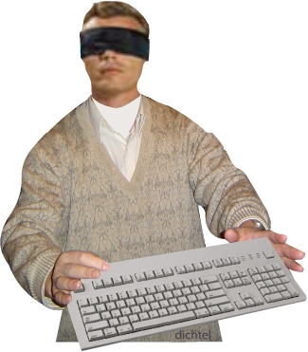
Accessibility
Accessibility = ease of use by people with special needs or disabilities.
Vision impaired = use good text size
Colour blind = avoid red/green mix
Poor muscle control = no tiny controls, provide keyboard equivalent

Slide 21
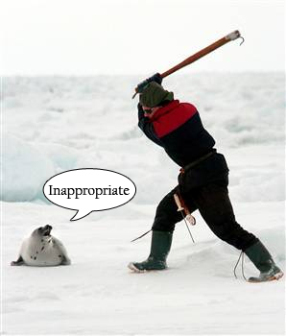
Appropriateness
Contents of websites, slideshows, animations, spreadsheets, databases etc must be suitable for the intended audience.
Avoid politics, sex, religion – guaranteed to offend someone.
No rude words – even ones you consider to be minor.
Content should be age-appropriate. E.g. no gory pictures for a toddlers’ road safety page.

Slide 22
Relevance
Only discuss matters that people should be reasonably expecting to be discussed in a presentation.
Don’t stray off-topic – e.g. a discussion of the causes of World War 2 ends up discussing your great-grandmother.
Even some relevant details may need to be left out if time or space is limited. Stick to the most relevant and important information.

Slide 23
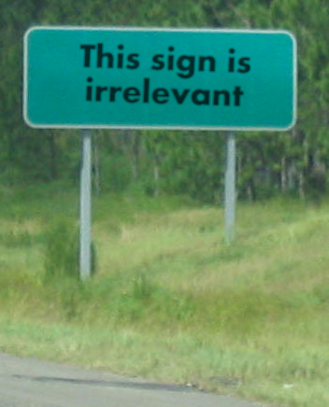
This slide is irrelevant

Slide 24
Applied Computing Slideshows
by Mark Kelly
vcedata.com
mark@vcedata.com
These slideshows may be freely used, modified or distributed by teachers and students anywhere on the planet (but not elsewhere).
They may NOT be sold.
They must NOT be redistributed if you modify them.

