Slide 1
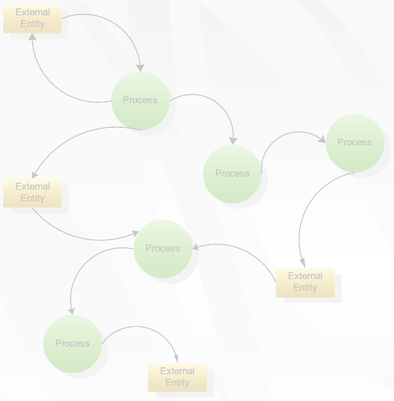
Applied Computing Slideshows
by Mark Kelly
vcedata.com
mark@vcedata.com
Data Flow Diagrams
&
Context diagrams
IT Applications Theory Slideshows
Data Flow Diagrams (DFD)
& Context diagrams
By Mark Kelly
McKinnon Secondary College
Vceit.com

Slide 2
Context Diagram
A high-level Data Flow Diagram (DFD).
Shows a system in relation to other external systems
Does not show details within the system
The simplest form of a DFD.

Slide 3
Context Diagram
Contains:
One Process – the whole system as a single shape
No Data Store
One or more External Entities – other systems with a data flow to the system being described.
Two or more Data Flows
Later will zoom in and expand a context diagram into sub-processes, creating more detailed DFDs.

Slide 4
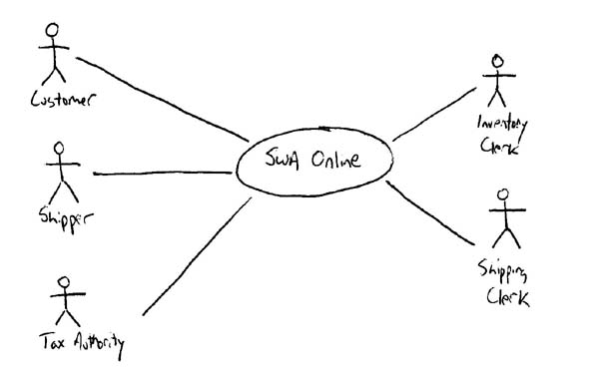
Context Diagram
External entity
Data flow
The entire system

Slide 5
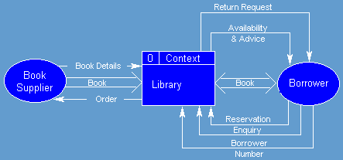

Slide 6
DFD/Context diagram shapes
External Entity: sources or destinations of data
Data Flow: movement of data.
Data Store: where data is stored (e.g. database)
Entity
name
data name
data store name
…OR…
data store name
…OR…
data store name

Slide 7
DFD/Context diagram shapes
Process: an activity that transforms or manipulates the data (combines, reorders, converts, etc.).
Process
name

Slide 8
EXTERNAL ENTITIES

Slide 9
External Entities:
Can be duplicated on the diagram one or more times, to avoid line crossing.
Are not part of the system being studied.
May be part of the same organisation, but are beyond the influence of the system being described.

Slide 10
External Entities:
Can represent another system or subsystem within the same organisation.
Must receive data from or send data to the system being described.
Are placed on the edges of the DFD

Slide 11
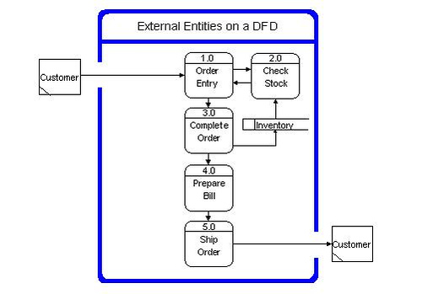
External entities
The system

Slide 12
External Entities
Rule 1: In a DFD do not show direct data flow from one external entity to another.
They are irrelevant to the system being described because they are external.
Like how a conversation between two people you don’t know is irrelevant to you.

Slide 13
DATA FLOWS

Slide 14
Data Flows:
Rule 2: Only represent data, not material goods like books, goods.
Shown as arrows with labels.
Must be named.
Rule 3: Only include one type of data per arrow. E.g. “Orders”, “Customer Data”
Do not use arrows with heads on each end. Identify each flow separately.

Slide 15
Data Flows:
A fork in a data flow means that the same data goes to two destinations.
The same data coming from several locations can also be joined.
Valid order
New order
Validate
order
Invalid order

Slide 16
DATA STORES

Slide 17
Data Stores:
Where data is stored
They look the same whether stored electronically (e.g. Database) or manually (e.g. paper files)
Must be named
Orders
Valid order
New order
Validate
order
Invalid order

Slide 18
Data Stores:
Name is usually the plural form of the data being flowed into it.
E.g. An ‘order’ is stored in a datastore called ‘orders’
Makes sense!
Orders
Valid order
New order
Validate
order
Invalid order

Slide 19
Data Stores:
Can be duplicated one or more times to avoid line crossing.
Can be shared by two or more systems.
Contents of datastore are detailed elsewhere in a data dictionary.
Sometimes show as
Data store
Data Store
Data store

Slide 20
Data store
Can also appear like this if it’s a duplicate
Data Store
Duplicates are used to avoid having data flow arrows crossing each other.
The extra vertical line reminds you that this data store already appears in the chart and is not a new store.

Slide 21
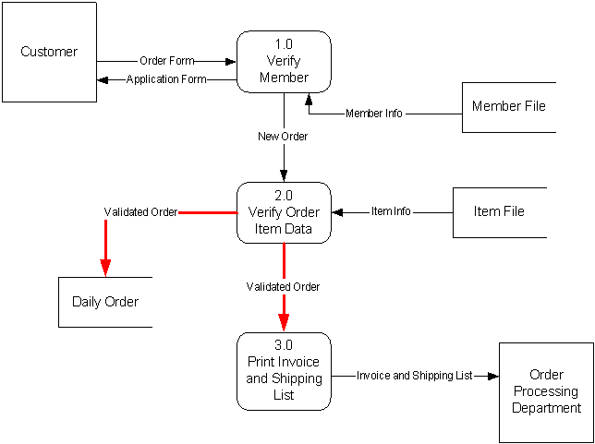
Sample DFD with 3 data stores

Slide 22
PROCESSES

Slide 23
Processes
Rule 7: Processes must have at least one data flow in and one data flow out.
Show data transformation or change
Data coming into a process must be "worked on“ in some way and then output.
Otherwise it can’t transform data!

Slide 24
Processes
Are named with a verb and an object of the verb (the thing being processed)
E.g. “Calculate (verb) wages (object)”.

Slide 25
Processes
Each process should represent only one function or action.
An "and" in the name probably betrays the presence of more than one process.

Slide 26
Processes
Rule 5: Processes have no order of operation stated or implied.
E.g. Just because one process to above or to the left of another process does not mean that process must take place before the other one.

Slide 27
IT’S A BAD DFD
Do not use direct data flows from one data store to another. There must be a process between the store.s
Do not use direct data flows from an external entity to a data store flows. Again, a process is needed between them.
Do not show direct data flows between external entities.

Slide 28
Bad! Flow between external entities
Fire brigade
Weather forecast
Weather bureau
Weather forecast
Call for help
Assess fire risk

Slide 29
Bad! Flow direct to data store
Fire brigade
Weather bureau
Weather forecast
Call for help
Forecast history
Assess fire risk
Weather forecast

Slide 30
Bad! Flow direct between data stores
Customer
Order
Process
order
Invoice
Inventory
Order
Stock check
Stock numbers
Orders

Slide 31
Creating a DFD
list the external entities that provide data or receive data from system being described;
list the data being sent to and from the entities;
create a context diagram with the system in the middle of the external entities sending and receiving data flows;

Slide 32
Creating a DFD
List the processing functions carried out in the system;
Identify the data connections between these processing functions;
Explode each process and repeat above steps as needed.

Slide 33
DFD Tipz
Label your processes carefully. A process just labelled "Produce Report" and has the output of "Report" says little – what is the report about?
If you have trouble labelling anything on the diagram, it may be because you don’t fully understand what it does!
Stick with it until a clear label is found.

Slide 34
DFD Tipz
Rule 4: Do not label processes as people (e.g. “Secretary”).
DFDs are not concerned with who does a process, but what the process is.
Besides, the secretary might have several functions – tea maker, mail runner, receptionist. Identify the process, not the body.

Slide 35
DFD Tipz
Rule 5 again: Time and place are not important.
It does not matter whether one data flow occurs before or after another data flow, or in which office it happens.
Don’t worry about how or when a process happens. It just happens!

Slide 36
DFD Tipz
Data flows are pathways for data. Think about what data is needed to perform a process or update a data store.
Rule 6: A DFD is not a flowchart and should not have loops or transfer of control.
Rule 7: Keep your DFD clear and easy to read – avoid crowding or crossed data flow lines.

Slide 37
DFD Tipz
Do not try to put everything you know on the DFD.
The DFD should serve as an index and outline.
Details are fleshed out in other places such as the data dictionary, data structure diagrams, flowcharts etc.

Slide 38
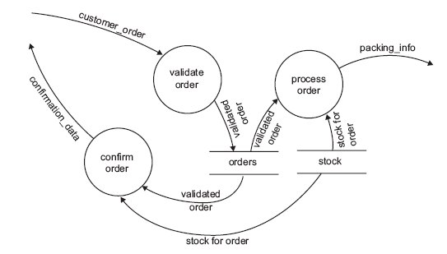
EXAM DFD – SD 2006
A company, No Blots, supplies ink cartridges for printers which are sold only through the internet.
When customers place an order, the order is checked, a confirmation is sent back to the customer and the details of the order are sent to the warehouse.
The diagram below shows the data flow diagram (DFD) for the No Blots online purchasing system. The diagram does not show the data sources and destinations.
In a DFD a circle represents a process. Briefly explain what is meant by a process. (1)
b. In the DFD, what do the symbols labelled stock and orders represent? (1)

Slide 39
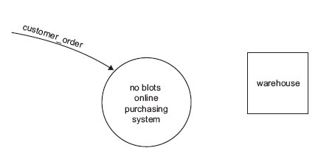
c. Complete the context diagram below for the No Blots system. (3)
(The previous DFD is here again so you can refer to it)
Proceed only when you have worked out your solution…

Slide 40
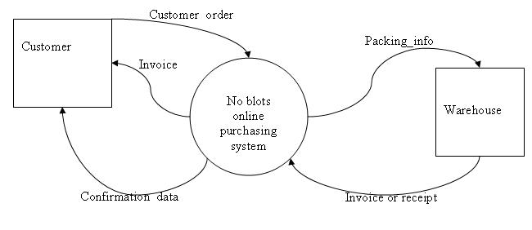
A solution

Slide 41
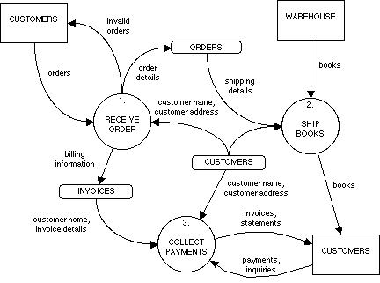
DFD Analysis
In this DFD, which “non-standard shape represents a data store?
It has “books” appearing. Does this obey DFD rules?

Slide 42
Applied Computing Slideshows by Mark Kelly vcedata.com mark@vcedata.com
These slideshows may be freely used, modified or distributed by teachers and students anywhere on the planet (but not elsewhere).
They may NOT be sold.
They must NOT be redistributed if you modify them.

