Slide 1
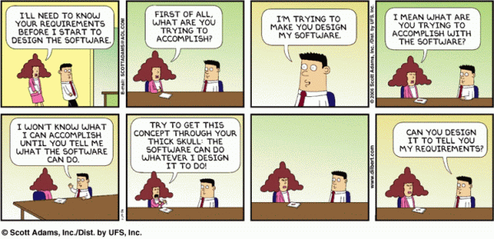
Applied Computing Slideshows by Mark Kelly vcedata.com mark@vcedata.com
Software Requirements specifications (SRS)

Slide 2

In general
An SRS is the art and science of developing an accurate and complete definition of the behaviour of software that can serve as the basis for software development.

Slide 3

Housekeeping note:
Please ignore the file name of this slideshow : “DesignTools-SRS”
The SRS is an tool to document the analysis stage of a project, before design begins.
It was only named like that for me to keep it grouped with logically-similar slideshows.
OK?
Good.
Let’s move on.

Slide 4
In general
An SRS is produced during the analysis phase of the PSM and guides the rest of the software’s life cycle

Slide 5

In general
Many projects are delayed or fail completely because development begins before anyone on the project team really understands how the software should behave.

Slide 6

The SRS document
Gathers about the software’s aims before the software is designed and produced.
Look before you leap.

Slide 7
Study Design 2020 Definition
The intended purpose and environment of a software solution. It documents the key activities associated with the analysis stage of the problem-solving methodology. Features of an SRS should include
a description of the functional and non-functional requirements,
system and technical requirements,
constraints,
scope and
assumptions.

Slide 8

Definition
The SRS fully describes
the conditions affecting the solution (constraints)
the parameters of the solution (scope).
the functional requirements (what it is required to do) and
non-functional requirements of the solution (solution attributes)...

Slide 9
Definition
Nonfunctional requirements are qualities such as
user-friendliness, performance levels,
response rates, quality standards
robustness,
portability,
reliability and
maintainability

Slide 10
Definition
SRS breaks down the problem into component parts
SRS provides input to the PSM design stage
SRS is referred to during later stages of the PSM.
It acts as a blueprint for completing the project with as few re-designs and retrofitting features as possible.

Slide 11
Wikipedia adds
An SRS uses use cases to describe all the interactions the users will have with the software
The SRS does NOT aim to work out how the software will work. (That’s design.)
An SRS just describes is what people want the software to do.

Slide 12

So what’s an SRS for?
It’s a written understanding of what a client requires of a system.
Is an insurance policy: the software developer knows exactly:

Slide 13
What the SRS defines
what the product should be able to do (functional requirements)
what features the product should have (non-functional requirements) e.g. Portability, ease of use.
what limitations (constraints) there are on the way by which the product must abide (e.g. Must be finished next month, must be suitable for vision-impaired users)
how far the product needs to be developed (its scope)

Slide 14
FRs and NFRs
Functional requirements – what jobs should the software be able to DO.
If you can say, “The software needs to be able to…” and then add a verb (e.g. “calculate”), it’s a FR.
Non-function requirements – what qualities or features should distinguish the software.
If you can say, “The software needs to be…” and then add an adjective (e.g. “easy to use”), it’s a NFR.

Slide 15
Some Typical NFRs
Reliability
Performance
Security
Usability
NFRs often also form constraints.

Slide 16
NFR - Reliability
Can it be trusted to do its job properly?
like a reliable car
Is it available when needed?
Does it have a high failure rate?

Slide 17
NFR - Performance
Speed of operation
Responsiveness
Throughput requirements – e.g. “The system should be able to to be able to process 1000 orders per hour.”

Slide 18
NFR - Security
Preventing unauthorised access
Able to protect data from accidental or deliberate loss or damage
E.g. Data should only be able to be edited by users with level 3 passwords.

Slide 19
NFR - Usability
Able to be used easily
Easy to learn
Hard to make mistakes
Forgiving
Intuitive
Easy to navigate
Anticipates the user’s needs
Compensates for (or auto-fixes) common errors

Slide 20
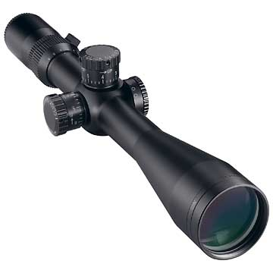
Scope
A description of the software in terms of
major inputs,
processing functionality and
outputs
The scope defines where a solution’s responsibilities end (e.g. A toaster should not be expected to make a cup of tea)

Slide 21

Pwned by SRS
All later work is based on the SRS such as:
project management,
design specifications,
software architecture specifications,
testing plans and
user documentation plans
Get the SRS wrong, and the whole project goes wrong

Slide 22
What the SRS does not have
An SRS describes what a solution should be able to achieve.
It does not contain:
Design suggestions
Ways of solving technology problems
Future software or hardware assumptions
These happen later in the design phase
SRS is developed during analysis.

Slide 23

A good SRS...
assures the customer that the software developer understands
what the customer wants the software to be able to do, and
what features it should have

Slide 24
A good SRS...
Is written in unambiguous, natural language that cannot be misinterpreted.
Even defines what words like “shall”, “must”, “will” and “should” mean to avoid later arguments.
Uses charts, tables, DFDs, decision tables etc to keep issues really clear

Slide 25
A good SRS...
Breaks down the problem into small, organised, manageable component parts

Slide 26
A good SRS...
Feeds the design phase of the PSM.
Tells the design and development workers what needs to be achieved and what is not.

Slide 27
A good SRS...
Acts as the final judge during testing and evaluation.
The SRS defines
what needs to work,
what conditions need to be met while it works,
how to tell if the product is a success or not.

Slide 28
How are requirements discovered?
onsite visits
questionnaires, surveys, interviews
perhaps a return-on-investment (ROI) analysis
a needs analysis of the client's business environment
observation of the current system
data gathering on the current system

Slide 29

What’s in an SRS?
International standards (like the IEEE) identify what must be in an SRS
Interfaces
Functional Capabilities
Performance Levels
Data Structures/Elements
Safety
Reliability
Security/Privacy
Quality
Constraints and Limitations

Slide 30
Templates
Software developers often use an SRS template that gives a new SRS its content requirements and structure.
For each SRS, fill in the gaps in the template.

Slide 31

Sample Template
1. Introduction
2. Overall Description
3. External Interface Requirements
4. System Features
5. Other Nonfunctional Requirements
6. Other Requirements

Slide 32
1. Introduction
1.1 Purpose
1.2 Document conventions
1.3 Intended audience
1.4 Additional information
1.5 Contact information/SRS team members
1.6 References

Slide 33
2. Overall Description
2.1 Product perspective
2.2 Product functions
2.3 User classes and characteristics
2.4 Operating environment
2.5 User environment
2.6 Design/implementation constraints
2.7 Assumptions and dependencies

Slide 34
3. External Interface Requirements
3.1 User interfaces
3.2 Hardware interfaces
3.3 Software interfaces
3.4 Communication protocols and interfaces

Slide 35
4. System Features
4.1 System feature ‘A’
4.1.1 Description and priority
4.1.2 Action/result
4.1.3 Functional requirements
4.2 System feature ‘B’
4.2.1 Description and priority
4.2.2 Action/result
4.2.3 Functional requirements
etc

Slide 36
5. Other Nonfunctional Requirements
5.1 Performance requirements
5.2 Safety requirements
5.3 Security requirements
5.4 Software quality attributes
5.5 Project documentation
5.6 User documentation

Slide 37
6. Other Requirements
Appendix A:
Terminology/Glossary/Definitions
Abbreviations used in the SRS
Appendix B:
To be determined

Slide 38
An example SRS
Smart Internet Cafe
SOFTWARE REQUIREMENTS SPECIFICATION
Prepared for: November 2nd 2005.
Prepared by: Anoop.K.S, M.A.Harikrishnan, N.S.Jeyendran, R.Pattabiraman, M.Naveen.
(TEAM CODE: RHS051195)
Contents:

Slide 39
1.Introduction.
1.1.Purpose of Requirements Document
1.2. Document conventions
1.3. Intended audience and reading suggestions
1.4. Scope of development project
1.5. Definitions, Acronyms, and Abbreviations
1.6. References
1.7.Document overview
2.Overall Descriptions.
2.1.Product Perspective
2.2.Product Function
2.3.User classes and Characteristics
2.4.Operating environment
2.5. Design and Implementation constraints
2.6. User documentation
2.7. Assumptions and dependencies
2.8. Overview of data requirements
2.9.General constraints, assumptions, dependencies, guidelines
2.10. User view of product use

Slide 40
3. External interface requirements
3.1. User interface
3.2. Hardware interfaces
3.3. Software interfaces
3.4. Communication interfaces
4. System features
4.1. System features 1
4.1.1. Description and Priority
4.1.2. Stimulus/response sequences
4.1.3.Functional requirements

Slide 41
5. Other non-functional requirements
5.1. Performance requirements
5.2. Safety requirements
5.3. Security requirements
5.4. Software quality attributes
5.5. Business rules
5.6. Special user requirements
5.6.1.Backup and recovery
5.6.2.Data migration
5.6.3.Data retention
5.6.4. User training
5.6.5. Installation
6. Other Requirements

Slide 42
1.Introduction.
1.1. Purpose of Requirements Document
This Software Requirements Specification (SRS) specifies the requirements of the SMART INTERNET CAFÉ (SIC), which will be used in College Internet Laboratories or Internet cafes. This document will be useful for the clients to ensure all specifications and requirements are conducive as mentioned by the software engineer to design the system.

Slide 43
1.2. Document conventions
Main Section Titles
Font: Times New Roman , Face: Bold , Size: 14
Sub Section Titles
Font: Times New Roman , Face: Bold , Size: 12
Other Text Explanations
Font: Times New Roman, Face: Normal, Size: 12

Slide 44
1.3. Intended audience and reading suggestions
Clients: The users of the system will get a clear idea of the software and hardware requirements to be engaged.
Lab Technicians: They will be in a position to attain the various features that are enabled in the software there by inducing a new definition for security.
Developers: Project developers have an advantage of quickly understanding the methodology enabled and personalizing the product.
Students: The project shows an infinite path in the field of security in Internet labs. There is always a perspective of development.
The authors would suggest clients to go through the requirement section thoroughly before installing the software. The lab technicians are expected to have certain knowledge in the terms used and hence can go for the security issues directly. Students and Developers can utilize the documentation as a resource in developing the project to a new product.

Slide 45
1.4.Scope of development project
The modern colleges have Internet facilities that are not secure and are based on costly Softwares for maintaining users. Security system is not that efficient also. Many firewalls and tracking Softwares are used for security purposes that reduce the total efficiency of the Internet system.
SIC software will deliver an open source operating system with inbuilt features for accessing secure Internet. The software also has an accounting and monitoring module to trace and keep track of various Internet activities. The targeted users are Internet labs in colleges and Internet Cafes.

Slide 46
1.5. Definitions, Acronyms, and Abbreviations
1) SRS: Software Requirement Specification
2) SIC: SMART INTERNET CAFE
3) Client/User: Internet user at the Internet access point
4) Server: A system that runs in Linux always monitoring the actions.
5) RAM: Random Access Memory
6) SQL: Structured Query Language
7) HTTP: Hyper Text Transfer Protocol
8) UserID: Unique username issued to each user on login
9) Password: Unique word given to each user as a secret code.

Slide 47
1.6.References
Books:
HACKING LINUX EXPOSED By Brian Hatch
LINUX BIBLE By Cristopher Negus.
Websites:
http://www.linuxlinks.com
http://www.tldp.org
http://www.reallylinux.com
http://www.linuxquestions.org

Slide 48
1.7. Document overview
The first section of SRS builds a brief idea what the proposed System of SIC is and what is the need behind having it. Along with this background information it also provides the reference information for further study, design and implementation.
The second section shows the way to overall description of application, functions, perspective, operating environment, design and implementation constraints, data inputs required.
The third section explores the various descriptions of external interfaces such as user interface, hardware interface, communication interface and software interface.
The fourth section is written with a goal to show the various system features in detail. The subsections give an elaborate description of individual features.
The fifth section focuses on details of non-functional requirements such as security requirements, safety requirements etc.

Slide 49
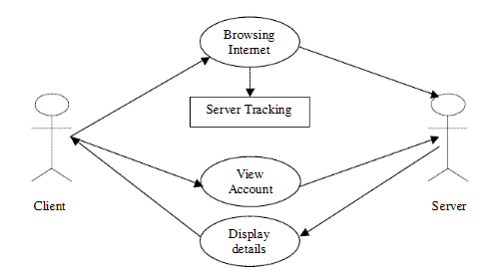
2.Overall Descriptions.
2.1. Product Perspective
The client will be given Internet access only by the knowledge of the server. When a client is accessing Internet the server will be tracking the user name and the account details of the user logged in. There is also an option for the user to view the account details of the user.

Slide 50
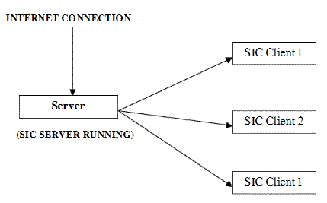
2.2. Product Function
The SIC client should be running on the client system so as to track the account details of the user. The server will only respond to those systems where the client is running.

Slide 51
2.3. User classes and Characteristics
General Users: They will be in a position to permit access to the users in the Internet and acknowledge their account status.
Administrators: They are the core users and are able to add new users to the system and permit them to access the Internet resources. They can also view in real time what a user is performing right now. They can also get the overall report of the user sessions.
Client Users: They login at the client level and this is to get access to the Internet at the client level. They can also view their account status in the client system.

Slide 52
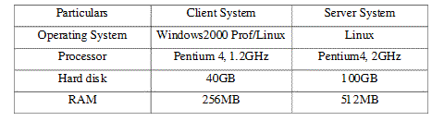
2.4. Operating environment

Slide 53
2.5. Design and Implementation constraints
Each user must keep their password as confidential. More over the user must have individual ID for creating a login in the SIC system.
Only Administrator can control user addition and deletion in the SIC system. Also this group could only create reports
2.6. User documentation
The product is under development stage and requires a complete implemented prototype to explain the user documentation. Once the prototype is designed and implemented online manuals, user manuals can be provided.

Slide 54
2.7. Assumptions and dependencies
Initially only two locations are connected to the SIC
Each location is always connected, whether an operator is logged on at the remote location or not
Each User must have a UserID and password
There is only one Administrator.
Server must always run under Linux system
Internet connection is a must.
Proper browsers should be installed
Text readers should be installed to view the help files.

Slide 55
2.8. Overview of data requirements
Inputs:
User must give his ID and password to access the Internet.
Request from the user to view his account details
Output:
User account details from the server.
Details of various logins
2.9.General constraints, assumptions, dependencies, guidelines
--- NOT APPLICABLE ---

Slide 56
2.10. User view of product use
The user screens that the user would finally be seeing could only be displayed at the end of the whole project. Once the project is implemented the samples of data used and the dramatic sceneries can be depicted.

Slide 57
3.External interface requirements
3.1. User interface
Login Screen: This is for the Administrator to get into the software. It requires a user name and password.
Account Details: This shows the account status of various users with their login times.
New Registrations: This utility is to create new users or clients in the SIC.
Reports: This utility is used to generate reports of the login and account details of the users.
User Login (Client Side): The user has to give a username and password by which he or she can access the Internet.
User Account: This enables the user to view the account status of their account.

Slide 58
3.2.Hardware interfaces
The server is directly connected to the client systems. Also the client has the access to the database for accessing the account details and storing the login time.
The client access to the database in the server is only read only.
3.3. Software interfaces
SIC is a multi-user, multi-tasking environment. It enables the user to interact with the server and attain access to the Internet and also leaves a record in the inbuilt database. It uses java servlets as the front end programming tool and SQL as the backend application tool.

Slide 59
3.4. Communication interfaces
The SIC uses java servlets and hence require HTTP for transmission of data. More over this allows easy interact5ion between the various clients and the server.
4.System features
4.1. Authentication
4.1.1. Description and Priority
The system offers access to Internet at client level and access to server resources at server level only by validating the user with the unique username and password.

Slide 60
4.1.2.Stimulus/response sequences
The response/stimulus for the different classes of users are:
1) Users: - Login.
2) Administrator: Adding new accounts, giving account status, getting & sending reports.
4.1.3. Functional requirements
All system should have the client for program running. The server should identify individual systems by their name.
Input: User name and password, Account number
Output: Access to Internet, Available balance, Account Details.

Slide 61
4.2. Monitoring
4.2.1.Description and Priority
This utility is used to monitor the user status of the various users using the system. More over it provides real time reporting.
4.2.2.Stimulus/response sequences
The response/stimulus for the different classes of users are:
1) Administrator: Login, View Accounts, View real time users.

Slide 62
4.2.3. Functional requirements
All system should have the client for program running. The server should identify individual systems by their name.
Input: User name and password, Account number
Output: Available balance, Account Details, Real time users.
4.3. Accountability
4.3.1. Description and Priority
This module is designed to support the user accounts in the SIC software. Only the administrators could access this.

Slide 63
4.3.2. Stimulus/response sequences
The response/stimulus for the different classes of users are:
1) Administrator: Login, View and calculate Accounts, Create real time reports.
4.3.3. Functional requirements
All system should have the client for program running. The server should identify individual systems by their name.
Input: User name and password, Account number
Output: Available balance, Account Details, Report.

Slide 64
5.Other non-functional requirements
5.1.Performance requirements
The important aspects of SIC software is time constrain. SIC software system is real time and hence should be performed in minimum requirements. The accountability is a vital feature and this could only be assured if the system is working in full capability. So uninterrupted power supply is needed.
5.2. Safety requirements
The data handled in the SIC system is very vital. The server should always be confirmed to run properly and the data are saved to the database at consecutive intervals. Power is a significant feature and the power supply should be always taken care of. An Uninterrupted Power Supply is always recommended.
5.3.Security requirements
The security system features from having a login for all the users to access the software. The login details will be used in the system also. So the chances of the software getting intruded are very less.

Slide 65
5.4.Software quality attributes
The source code of the product is going to be open as this is going to be open source software. It will be free for further modifications and improvements.
5.5. Business rules
Illegal duplication of the reports should be strictly dealt with. The administrator should have full details of the user while a user is getting registered to the system.

Slide 66
5.6.Special user requirements
5.6.1.Backup and recovery
a. Keep backups of all data files in a separate directory/drive.
b. Frequently auto-save information, in the case of a lost network connection, the browser or the system crashing, etc.
5.6.2. Data migration
The concept of data migration is important to ensure that the data that is being entered and stored today could be accessed after even several years.

Slide 67
5.6.3. Data retention
Maintaining a log file for each user logging in and also maintaining the account details of the users who have finished the accounts could be obtained from SIC reports.
5.6.4. User training
Clients must be trained to operate the SIC software in creating new accounts and performing report operations.
5.6.5. Installation
A conducive environment for the efficient running of the SIC is always recommended. The server should be handled with great care and all unauthorised access should be restricted.
6.Other Requirements
--- NOT APPLICABLE ---

Slide 68
References
VCE Study Design glossary
http://www.techwr-l.com/techwhirl/magazine/writing/softwarerequirementspecs.html
Wikipedia
Organizational Requirements Engineering by Prof. Dr. Armin B. Cremers & Sascha Alda.

Slide 69
Applied Computing Slideshows
by Mark Kelly
vcedata.com
mark@vcedata.com
These slideshows may be freely used, modified or distributed by teachers and students anywhere on the planet (but not elsewhere).
They may NOT be sold.
They must NOT be redistributed if you modify them.

