Slide 1

Applied Computing Slideshows by Mark Kelly vcedata.com mark@vcedata.com
WEBSITE
DESIGN
TOOLS

Slide 2
Design Tools for Websites
Storyboards
Annotated diagrams (mock-ups)
Layout diagrams
Site maps

Slide 3
Site Maps
Graphic representation of how each page (of a website) or screen (slideshow, animation, database) link together.
It’s like an atlas of the entire site

Slide 4
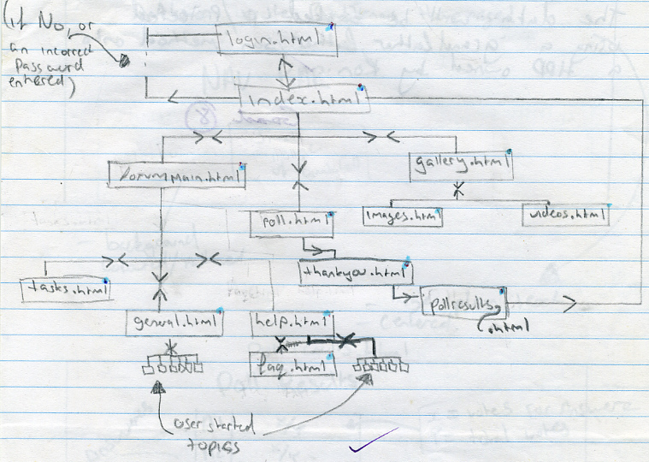
A sample sitemap by a student

Slide 5
Storyboard
Explains the mechanics of a site – how it’s built.
Designs how components on individual pages or screens link to other pages.
Should identify the purpose, contents and design elements of each page.
Areas used for input, output and navigation should be clearly identified and labelled.
Leave detailed formatting information for the page mock-up.

Slide 6
Storyboard
May also include:
Page title, filename
Page number
Background images/colours
Screen dimensions
List of image filenames
List of links required

Slide 7
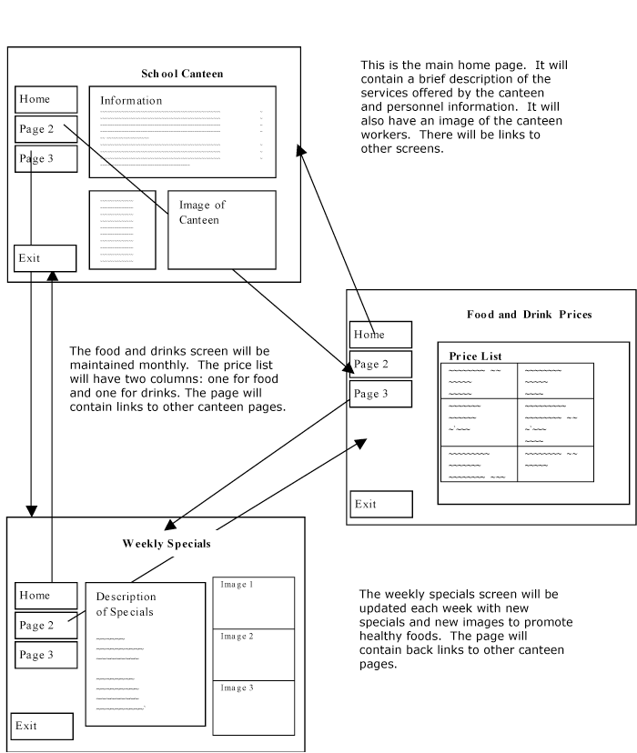

Slide 8
Mock-ups (annotated diagrams)
A sort of “photographic” representation of what a printed page or a screen will look like
A bit like a prototype or demonstration model
Can be produced with software for extra realism
May have faked text

Slide 9
Mock-ups – another interpretation
Another view of mock-ups is a hand-drawn representation of a page or screen with detailed formatting information.

Slide 10
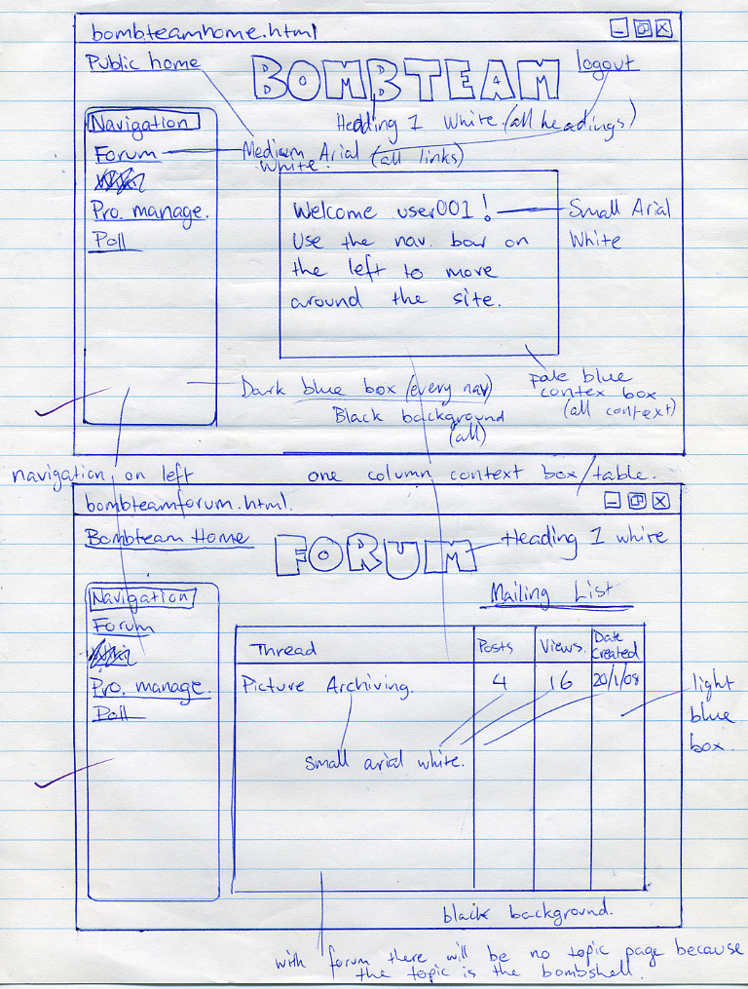
This mock-up plans out content, layout and formatting.

Slide 11
Mock-ups
Give enough detail so that the design could be given to someone else to accurately produce the page or screen.
E.g. “Arial, 14pt, bold, dark blue”
Don’t repeat yourself endlessly: summarise. E.g. “All body text 12pt Arial. All links are blue. All tables have invisible borders except for the pets table” etc

Slide 12
Mock-ups
Does not need to be 100% specific. E.g. can specify a “fancy font, big, blue” or “picture of a cat”.
Include content information (what a text block is talking about; what a picture should show)

Slide 13
Mock-ups
Exact wording of text not needed. Include headings to identify contents of the text (e.g. Why dogs are good pets”)
Do not produce a uselessly vague mock-up…
heading
text
picture
This sort of design is a waste of time.
No-one could work out what needs to go on this page.
text

Slide 14
Layout diagrams
Opinions differ as to what they look like
Done by hand
Like a mock-up, but not as “photorealistic”
Concentrates on the locations and formatting of screen or page elements (e.g. headings, fields, tables)

Slide 15
Layout Diagrams
Include detailed formatting info e.g. positions of objects, relative sizes, colours, borders, typefaces, text styles (e.g. bold) etc
Logo – 200 pixels wide
Pets for Sale
Fancy font, 20 pt, black, centred
logo
Pet’s picture
Pet’s name, age, sex
Cost $
All body text is 12pt TNR, black.
Left justified.
Cost text is red if pet is on sale.
White page background
Table 60% of screen, 3 cols, 3 point cell padding, black border 1 pt.
Max of 6 rows per page
As above
Page last modified
Date code

Slide 16
Common sense says
If using more than one tool, don’t repeat information given in one tool in another tool (e.g. don’t put the same formatting info in mock-up and layout diagram)
Main idea is to thoroughly plan the content and appearance of the output.

Slide 17
Then Again
There are variations on these themes
When in doubt, follow your teacher’s definitions!

Slide 18
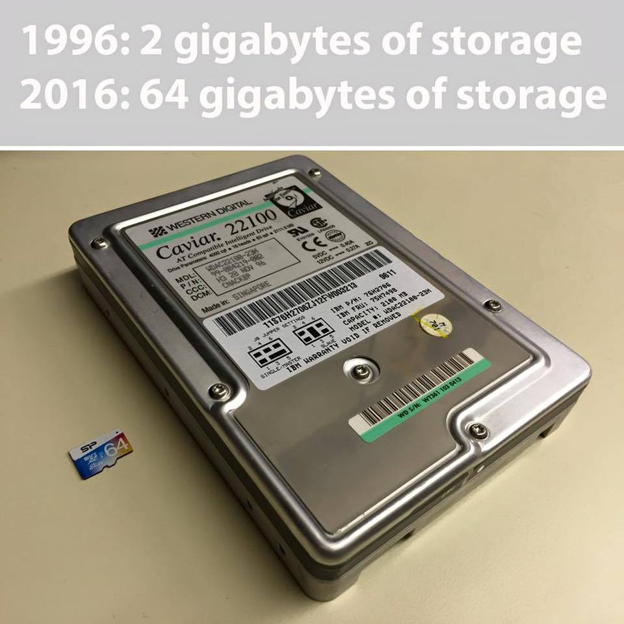
Because you’ve been good

Slide 19
Applied Computing Slideshows by Mark Kelly vcedata.com mark@vcedata.com
These slideshows may be freely used, modified or distributed by teachers and students anywhere on the planet (but not elsewhere).
They may NOT be sold.
They must NOT be redistributed if you modify them.

