Slide 1
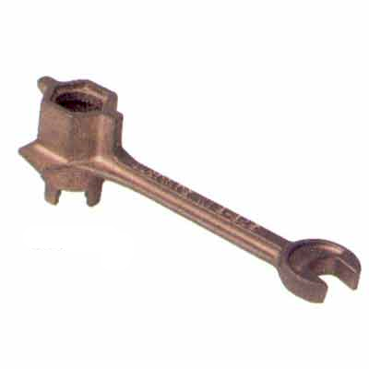
Applied Computing Slideshows by Mark Kelly vcedata.com mark@vcedata.com Last changed 2024-09-07 – now features EXCITING WOW INCENTIVES!
Design tools (not including tools for Database or Website Design or DFD)
They have their own slideshows

Slide 2

Contents
Designing functionality and appearance
Context Diagrams
Hierarchy Charts / Organisational charts
Decision Trees
Flow Charts, Nassi-Shneiderman (NS) charts
Pseudocode

Slide 3

Also see my other exciting slideshows
Database design tools
Input-Process-Output (IPO) charts
Data structure tables, data dictionaries
Structure Charts
Website design tools
Annotated diagrams / mockups
Layout diagrams
Storyboards
Sitemaps
DFD/context diagram, ERD

Slide 4

Two main categories of design tools
1. Logical
2. Physical

Slide 5

Logical Design Tools
They don’t design how to actually build any part of the system
They specify a plan for a system’s overall structure and what it should be able to achieve
Could well be used during the PSM’s analysis phase (which develops a logical design rather than a physical design)

Slide 6

Logical Design Tools
Examples
Context Diagrams
Data Dictionaries
Hierarchy Charts / Organisational charts
Decision Trees
Use Case diagrams

Slide 7

Physical Design Tools
These actually plan how to build a system
They give instructions on what to do
Data Flow Diagrams
Storyboards
Flow Charts, Nassi-Shneiderman charts
Structure Charts
IPO charts
Layout diagrams / mockups
Pseudocode

Slide 8
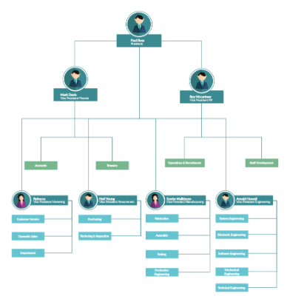
Hierarchy Charts Organisational charts
Show the organisation of a complex system or organisation, from highest levels to lowest levels

Slide 9
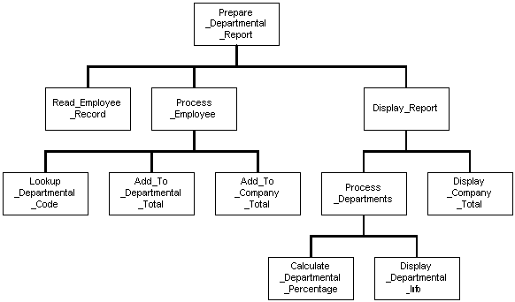
Hierarchy – an organisation based on rank, or levels
Highest level
Sublevel
Subsublevel
Subsubsublevel

Slide 10
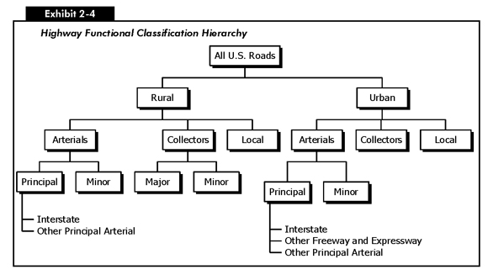
A ‘parent’ level can be logically divided into sublevels

Slide 11
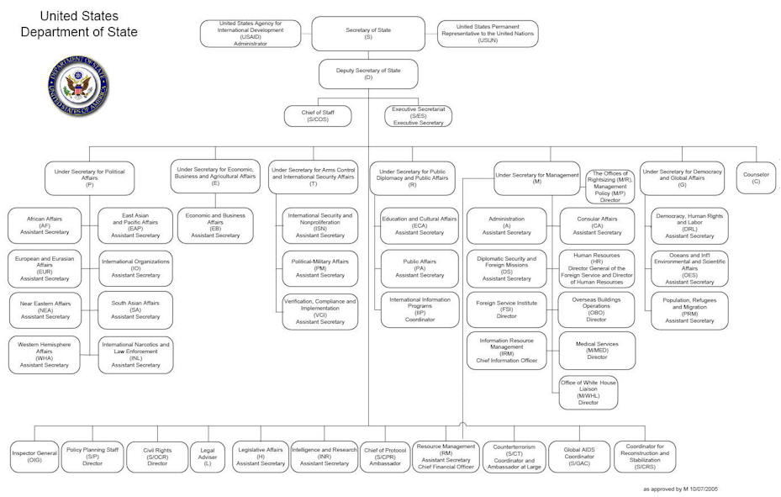
When a hierarchy chart is used to show levels of authority in an organisation, it’s called an organisational chart (org chart)

Slide 12
Decision Trees
A chart showing decisions (usually yes/no) and consequent actions.
Very clear and unambiguous decisions and instructions
Often done with flowchart shapes
Good for emergency plans

Slide 13
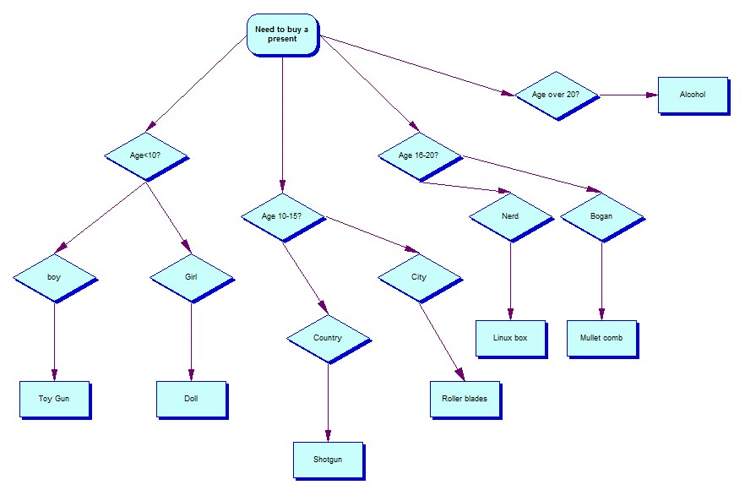
Decision Tree

Slide 14
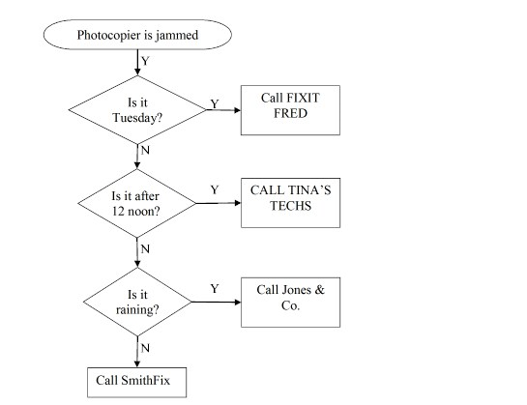
Decision Tree

Slide 15
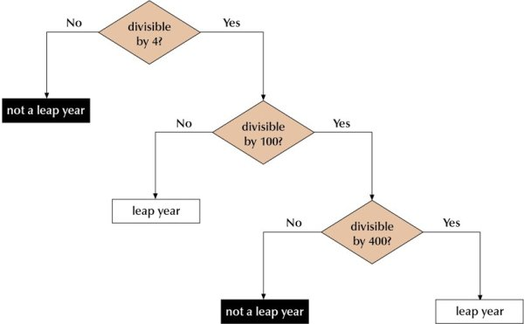
Decision Tree

Slide 16
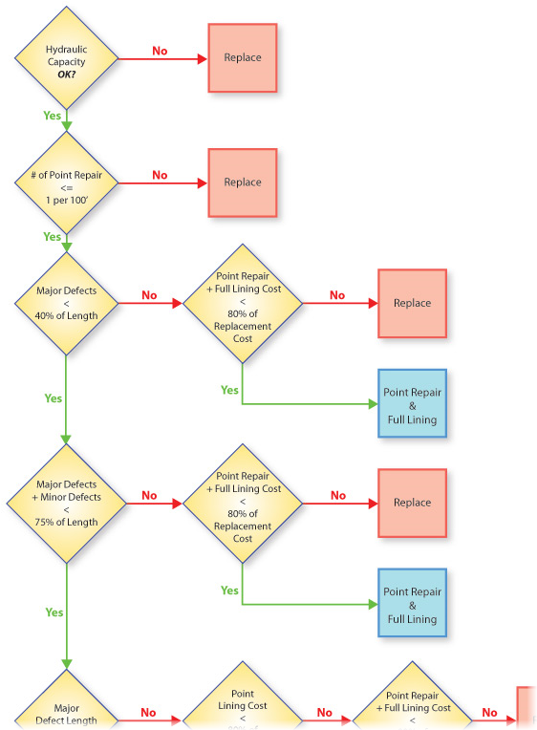
Decision Trees underlie Expert Systems

Slide 17
Flow Charts Nassi-Shneiderman charts (not part of new SD course)
Step-by-step decisions and actions
Used to design processes and procedures
Commonly used in programming

Slide 18
Flow Charts
Few shapes – easy to remember
Bulky – takes a lot of paper to print!
No special purpose shapes to show common programming constructs such as loops, multi-branch decisions etc
These constructs have to be created out of basic shapes like decision and action.

Slide 19
Basic Flow Chart Shapes
Decision
Start / End
Process
Connector
Data input/output

Slide 20
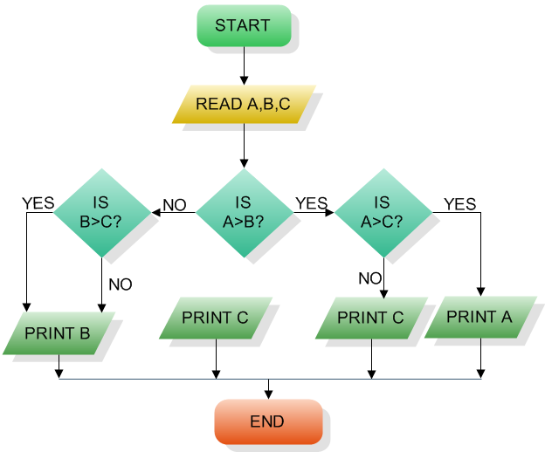
Flowchart

Slide 21
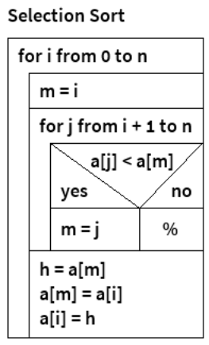
Nassi-Shneiderman
A more compact form of flowchart
Note the spelling of the names
Has space-saving special-purpose shapes such as WHILE loops etc.
More dense than flowchart – not as easy to decode

Slide 22
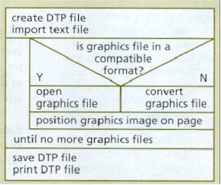
Flowchart v N-S
Begin
Create DTP file
Import text file
N
Any more graphics files?
Y
Is graphics file in a compatible format?
Y
Open graphics file
Image from IT@Work by Andersen, Christophersen and Timmer-Arends,VCTA / MacMillan.
N
Convert graphics file
Position graphics image on page
Save DTP file
PrintDTP file
End

Slide 23
Pseudocode
Note the spelling!
Halfway between normal language and programming language
Allows very rapid planning of ideas and methods without getting bogged down in 100% accurate program coding
Once the logic is worked out, pseudocode is translated into proper programming code.

Slide 24
Pseudocode
e.g. an algorithm to sort a virtual deck of cards in Structured English (or pseudocode).
create an array of 52 integers - cards(52)
loop through the array, filling each array item - card(i) - with the index (1 to 52)
loop through the array
for each card
generate a random number between 1 and 52 (rnd)
swap the current index with that of array(rnd) - swap card(i),card(rnd)
end loop

Slide 25
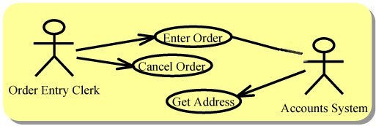
Use Case Diagram (UCD) – for SD
Logical design tool
Map out roles and communications
See the separate UCD slideshow

Slide 26

Applied Computing Slideshows
by Mark Kelly
vcedata.com
mark@vcedata.com
These slideshows may be freely used, modified or distributed by teachers and students anywhere on the planet (but not elsewhere).
They may NOT be sold.
They must NOT be redistributed if you modify them.

