Slide 1
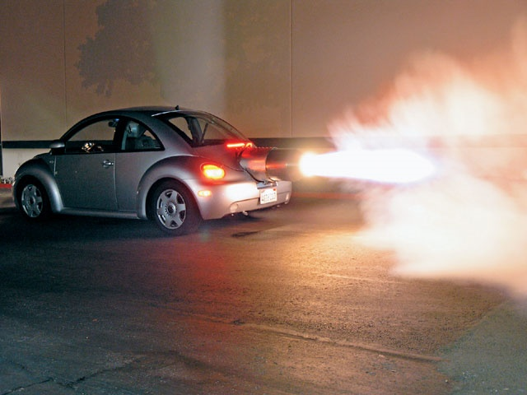

Applied Computing Slideshows by Mark Kelly vcedata.com mark@vcedata.com
Characteristics of
efficient and effective
solutions
v2 - 2024-09-10

Slide 2
Contents
characteristics of efficient and effective solutions

Slide 3
Efficient
Not wasting
time,
money (not just purchase price – see the separate COST slideshow)
labour (man-hours)

Slide 4
Effective
Doing the job well
Achieving its goals, e.g.
Accurate
Enjoyable
Fun
Easy to use
Note – what is ‘effective’ in one solution may not be effective in another. e.g. an effective spreadsheet is not meant to be entertaining.

Slide 5
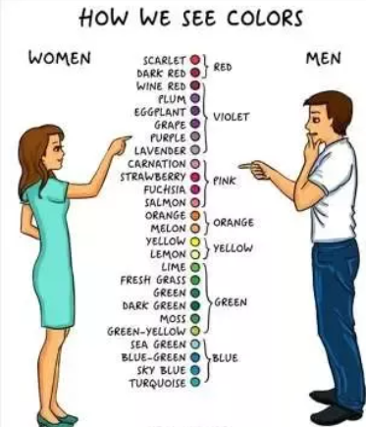
Note the difference!
Exams often have specific questions that see if you know the subtle differences between them

Slide 6
From the 2020 study design*
EFFECTIVENESS = A measure of how well something functions… and the extent to which it achieves its intended results.
Measures of an effective information system include reliability and maintainability.
Measures of an effective information product include completeness, readability, attractiveness, clarity, accuracy, accessibility, timeliness, communication of message, relevance and usability.
Measures of an effective file management strategy include integrity of data, security, ease of retrieval and currency of files.
Measures of effective networks include reliability and maintainability.
*Ignore the old study design that decided to put “Ease of use” as an efficiency criterion. It was wrong, and embarrassing.

Slide 7
From the study design
EFFICIENCY
A measure of how little time, cost and/or effort is applied or wasted in order to achieve intended results.
Measures of an efficient solution include the speed of processing, the functionality of the solution, the ease of use of the solution and the cost of information file manipulation.
Measures of an efficient network or information system include its productivity, processing time, operational costs and level of automation.
Measures of an efficient information product include the speed of processing, functionality, and the cost of information processing.

Slide 8
Exam Questions
2002 – “List a software tool you've used this year and describe how a function of the software, other than copy and paste, allowed you to produce information efficiently.”

Slide 9
2003
11d. Prepare 2 questions for inclusion in the survey. The first question must focus on identifying any improvements in the efficiency of the network. The second question must focus on the effectiveness of the new network.

Slide 10
2004
11d. Discuss three ways that the new system will improve the efficiency of running the business.

Slide 11
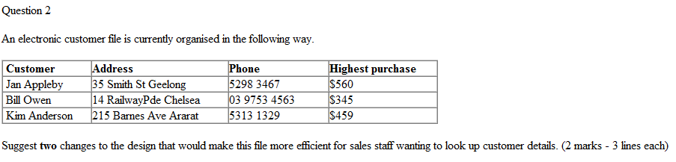
2005
Question A2
The best measure for evaluating the effectiveness of a website would be
A. ease of navigation.
B. speed of download.
C. cost of ongoing maintenance.
D. communication of the message.

Slide 12
2006
Question 16
Peripheral devices are most efficient when connected to a computer through
A. a series connection.
B. a USB 2.0 connection.
C. a wireless connection.
D. a dial-up modem connection.
Question 17
Using an LCD flat screen is more efficient than using a CRT screen because the LCD flat screen
A. allows you to adjust the brightness.
B. produces less radiation.
C. uses less power.
D. can be easily read from an angle.

Slide 13
2006
Question 18
The most efficient strategy to evaluate the security of an existing large network is to
A. interview the network manager and monitor log in errors.
B. interview all the users and survey the network managers.
C. monitor the login errors and interview all the network users.
D. survey the company manager and monitor all network users.

Slide 14
2006
Star Movies is an independent chain of cinemas located in Victoria. An employee works at the ticket counter for 4 hours each day and at other times tickets are sold at the candy bar. The manager has seen a new touch-screen ticketing machine that will allow movie goers to use cash or a credit card to pay for their ticket after selecting the movie, session and type of ticket on the touch screen. The ticket still needs to be handed to an attendant to enter the cinema.
a. Identify and explain one cost efficiency the manager could gain by implementing this system. 2 marks

Slide 15
2008
The efficiency of onscreen help provided for users of a spreadsheet package could best be evaluated by
A. counting the number of incomplete customer records.
B. observing the time it takes users to retrieve the help they need.
C. asking users in an online survey if they are happy with the onscreen help.
D. checking the Help Desk log for the number of data errors in the onscreen help.

Slide 16
And so on
Every exam has efficiency/effectiveness questions

Slide 17
So, an efficient solution would
Calculate quickly
Not slow down the operator’s workflow (e.g. with a poor interface or confusing operations)
Cost little to buy, run, maintain, upgrade and repair
Take few man-hours to operate
Process lots of data in a short time

Slide 18
So, a totally effective solution would
Be reliable, easy to maintain, complete, readable, attractive, clear, accurate, accessible to those with disabilities, timely (available when it’s needed), relevant, and it would get its message across.
It would protect its data from damage or loss, prevent unauthorised access, be easy to retrieve data from, and it would be up to date.
And it would be fun to use.
But not all of these criteria are important to every solution.

Slide 19

Applied Computing Slideshows
by Mark Kelly
vcedata.com
mark@vcedata.com
These slideshows may be freely used, modified or distributed by teachers and students anywhere on the planet (but not elsewhere).
They may NOT be sold.
They must NOT be redistributed if you modify them.
Thank you for your attention.
Now – go snooze on a puppy.

