Slide 1
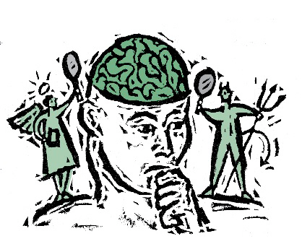
Applied Computing Slideshows by Mark Kelly vcedata.com mark@vcedata.com
Managing ethical dilemmas
With bonus real exam questions!
Last changed 2024-09-05

Slide 2
Contents
suitability of
setting codes of ethics
imposing sanctions
education programs and
the use of decision-support frameworks
as strategies for managing ethical dilemmas.

Slide 3
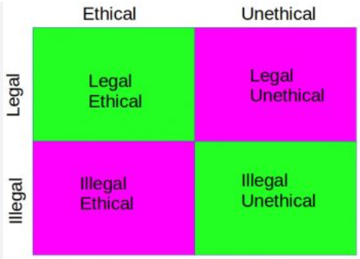
‘Ethical’?
Being morally correct or proper according to accepted standards of social or professional behaviour.
Actions may be legal but not ethical
Examples?

Slide 4

‘Dilemma’?
A state of doubt where you have to make a decision between equally bad options.
A situation where obeying one moral belief would disobey another.
A problem with no easy ‘right’ answer

Slide 5
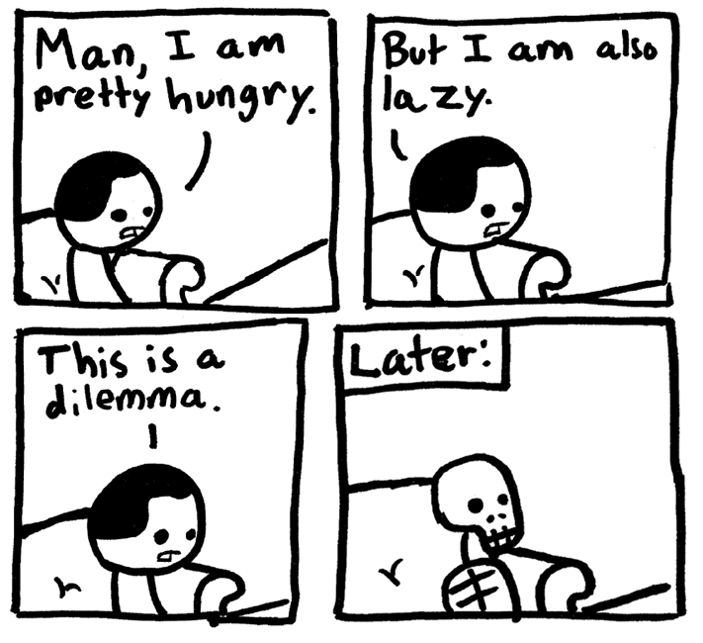

Slide 6
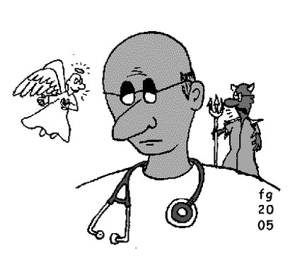
Sample Dilemma
A pregnant woman is brought unconscious to a hospital’s emergency room. She has no identification so her family cannot be contacted.
Doctors find that if she continues with the pregnancy, she will surely die. If she does not continue, the baby will die.
What does the doctor do?

Slide 7
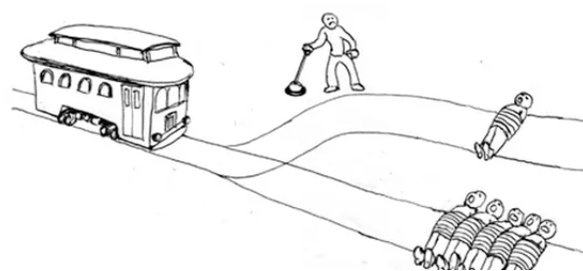
Sample Dilemma
An employer suspects his wife who works with him is being unfaithful. The employer asks an IT technician to install a secret keylogger on his wife’s computer to get evidence of her infidelity.
The technician disagrees with this action, but fears being fired if he refuses.
What does he do?

Slide 8

Ethical dilemma
During World War 2, Nazi doctors performed horrific medical experiments on prisoners to find how hypothermia killed people. Most of the test subjects died in agony, but the tests uncovered useful medical information.
Should this unethical research be used to treat people suffering hypothermia today?

Slide 9
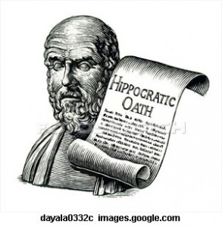
Codes of ethics
Common in professions
Medicine (Hippocratic oath), nursing
Law
Teaching
Journalism
IT workers
An AUP (Acceptable Use Policy is similar to a code of ethics

Slide 10

Why have a code of ethics?
to define acceptable professional behaviours and responsibilities
to promote high standards of practice
to provide a benchmark for members to use for self evaluation
a vehicle for occupational identity
to weed out undesirable members

Slide 11
Why have a code of ethics?
To enhance the sense of community among members
To form a group with common values and a common mission
To reassure the public that the group is trustworthy and reliable
To gain and maintain a good reputation for the profession

Slide 12

Why have a code of ethics?
Just developing a code forces a group to define what is important about their profession
Also identifies known ways the profession can go ‘bad’ and acts against those ways
To inspire members of the group to be good

Slide 13
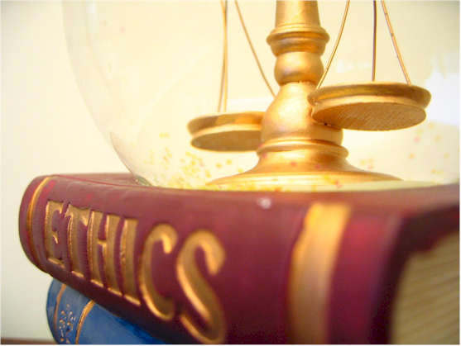
Why have a code of ethics?
To set down aspirations that outline what ideals the organisation aspires to
To list some rules or principles, which members of the organisation will be expected to adhere to.
To get agreement amongst members on how they should behave.

Slide 14
Aust Computer Society’s Code
As an ACS member you must uphold and advance the honour, dignity and effectiveness of being a professional.
1. The Primacy of the Public Interest You will place the interests of the public above those of personal, business or sectional interests.

Slide 15
Aust Computer Society’s Code
2. The Enhancement of Quality of Life You will strive to enhance the quality of life of those affected by your work.
3. Honesty You will be honest in your representation of skills, knowledge, services and products.
4. Competence You will work competently and diligently for your stakeholders.

Slide 16

Aust Computer Society’s Code
5. Professional Development You will enhance your own professional development, and that of your colleagues and staff.
6. Professionalism You will enhance the integrity of the Society and the respect of its members for each other.
Yes, this is boring, but it could well be on the exam

Slide 17
e.g. Competence
Accept only such work as you believe you are competent to perform and do not hesitate to obtain additional expertise from appropriately qualified individuals where advisable.
You should always be aware of your own limitations and not knowingly imply that you have competence you do not possess.
i.e. don’t pretend you know how to do a job you have NO IDEA about, wasting the client’s time and money and destroying their data.

Slide 18

Imposing sanctions
Sanction = Punishment
Oddly, sanction also means “to give permission or approval”

Slide 19

Imposing sanctions
Sanctions deter group members from acting unethically.
Public sanctions remind other group members of the rules and the consequences of breaking the rules
Establishes that the group takes its code of ethics seriously

Slide 20
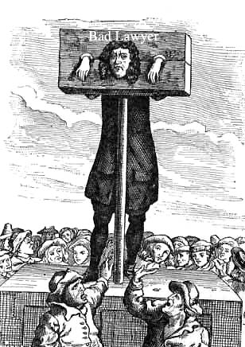
Imposing sanctions
Types of sanctions:
Official warning
Admonition
Supervised practice
Enforced public apology (e.g. in newspapers)
Expulsion from the group (e.g. deregistration of doctors, defrocking of priests)
Suspension of privileges or right to practice
Others?

Slide 21

Education programs
“Ignorance of the law is no excuse”
Group members need to be educated about what rules they must follow
It’s better to educate people and prevent misbehaviour than it is to punish people who are ignorant of the rules

Slide 22
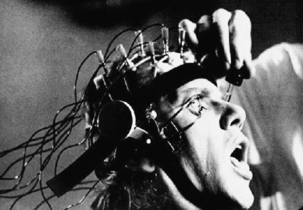
Education programs
Some groups formally test newcomers on their knowledge of the society’s ethics
Codes of ethics are usually publicly posted
Rule-breakers may be sentenced to a re-education program

Slide 23
Decision-support frameworks
Decision-support frameworks guide people who have to make difficult decisions
Difficult decisions can be made easier by having an agreed system to handle them
e.g. If this situation arises, you should…
Reduces the chance of individuals making inappropriate or inconsistent decisions

Slide 24
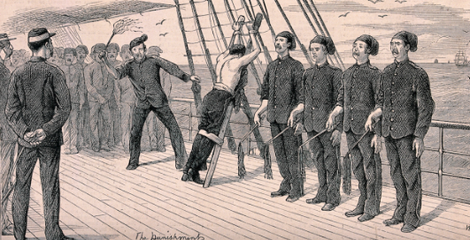
Decision-support frameworks
E.g. If you break this rule, the punishment is…
E.g. For a second offence the consequence is…
E.g. Under these circumstances the penalty should be increased/decreased…

Slide 25
Decision-support frameworks
A formulated framework reduces favouritism and unfairness in dealing with issues
All people are treated equally, based on established procedures.
It gives the decision-maker more confidence since the decision is not just his or her opinion.

Slide 26
Some Sample Dilemmas for you to Manage or prevent

Slide 27
For the following dilemmas
What is the dilemma?
What options are there to choose from?
Why is each option bad?
How could the dilemma have been either prevented or dealt with once it did happen?

Slide 28
How to handle these dilemmas?
An IT technician was undertaking a major upgrade to all the laptops within her company. While working on the laptop of the Finance Director, she noticed that this laptop contained thousands of pornographic pictures.
What is the dilemma?
What options are there to choose from?
Why is each option bad?
How could the dilemma have been prevented or dealt with?

Slide 29
How to handle these dilemmas?
A trainee at a design company is learning to use an expensive CAD program. Each day she borrows the program’s CD-ROM and practises using the software.
Notices in company say that copying software is forbidden.
One day, she copies the CD so she can work on her training at home and become a more-skilled worker.
What is the dilemma?
What options are there to choose from?
Why is each option bad?
How could the dilemma have been prevented or dealt with?

Slide 30
How to handle these dilemmas?
A project manager suspects a team member of using his company email account to send offensive messages to other employees of the company.
She asks the company's network manager to give her copies of the team member's emails.
What is the dilemma?
What options are there to choose from?
Why is each option bad?
How could the dilemma have been prevented or dealt with?

Slide 31
How to handle these dilemmas?
An IT manager is choosing a supplier of a large fleet of computers.
One supplier’s product is slightly inferior to the other, but the supplier offers the manager a free computer for home use if the manager chooses the supplier.
What is the dilemma?
What options are there to choose from?
Why is each option bad?
How could the dilemma have been prevented or dealt with?

Slide 32
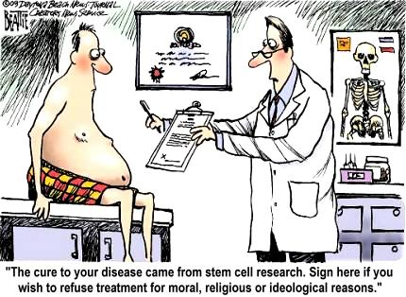

Slide 33
Sample Ethical Dilemma Past Exam Questions

Slide 34
2007 ITA exam Question 10
Karen is the manager of a Melbourne medical clinic with 500 patients. She has checked the appointments for the past 12 months and decided to archive the electronic record files of 100 patients.
Karen has been asked to send the archived patient records to a medical research project.
c. Discuss one legal obligation and one ethical conflict for Karen. (4 marks State average=1.75)

Slide 35
Examiner’s answer
Legal obligation: Karen has to work within the provisions of the Health Records Act 2001. For example, she must be sure that patients have consented to the disclosure of information given in confidence.

Slide 36
Examiner’s Answer
Ethical conflict: Although the medical research may be beneficial to society and, in some circumstances, it may be legal for Karen to send the records to a research project, it may not be ethical.
Karen may be worried about breaking the trust between patients and doctors if she reveals information given in confidence.

Slide 37
Examiner’s comment The emphasis is mine
Many students described one of the other 11 principles in the Health Records Act 2001 to correctly answer the first part of this question. Although many students could identify a legal reason why the medical clinic should monitor or control the storage, communication or disposal of information, they were not able to explain an ethical dilemma.
Many students seemed to have a vague understanding that Karen would be uncomfortable about sending the information given in confidence, but they could not frame an answer in terms of Karen ‘weighing up’ or choosing between two equally difficult or equally beneficial options.

Slide 38
2008 ITA Exam
d. Doctors have been asked to send complete patient records of all 18 year olds to the Australian Government Health Commission. A patient's parents want to understand what ethical dilemmas may arise if the records are sent.
For each of the following, write a question the parents could ask to identify these ethical dilemmas. (3 marks, 3 x 2 lines)
i. Doctor
ii. Patient
iii. Health Commissioner
State average was 0.35 / 3 (11%) - A shocking result!

Slide 39
Examiner’s answer
…many students responded by providing a question that would help the patient’s parents understand a legal position rather than an ethical dilemma.
A dilemma is a choice between two equally undesirable choices. In most instances the responses that received full marks made it clear that the parents were weighing up their child’s right to privacy against the benefits to society.
The following examples are from successful responses.

Slide 40
Sample answers
4di.- Parents to doctor: Do you benefit from sending my child’s medical records?
4dii. - Parents to patient: We want to make sure your rights are protected but are you comfortable for us to see your records?
4diii. - Parents to the Australian Health Commission: We want our child’s privacy protected but will their medical records help research or save the lives of other people?

Slide 41



2008 SD Exam – Section C, Q8
Part of (programmer) Pattie's agreement with [her customer] is to keep development costs to a minimum. When the programmers are discussing how best to store the client quotes on the mobile device, one programmer, Schroeder, argues that they must include encryption. Another programmer, Sally, disagrees as encryption will increase the overall development cost.
Discuss the ethical considerations from each point of view.
4 marks – state average was 2.2

Slide 42
Examiner’s Comment
Generally this question was not answered as well as expected.
Students were asked to discuss the ethical considerations from both points of view. It was expected that students would contrast the two views and add further relevant information showing their understanding.
However, many failed to do this and either simply restated the question and/or only discussed one point of view.
Students need to understand that when an ethical dilemma exists usually there is not a clear-cut right or wrong viewpoint; rather it is a matter of weighing up these viewpoints, and determining which stakeholder has the strongest argument.

Slide 43
An acceptable answer
Ethically programmers are expected to create programs which do not maliciously seek to cause harm to other companies (e.g. virus) and are expected to maintain the integrity of the data which has been given to them, so as it does not breach the Privacy Act 1988 or the Information Privacy Act 2000.
While Sally contends that implementing encryption software is expensive and will increase the overall development costs, and it might be ethically wrong, she is bound by law to abide with the agreement with Pattie.
While Schroeder is correct that ethically they should include the encryption software as it is part of their job as programmers to protect the information given to them, legally he cannot do anything about it as he would be breaking the contractual agreement which Pattie agreed to.

Slide 44
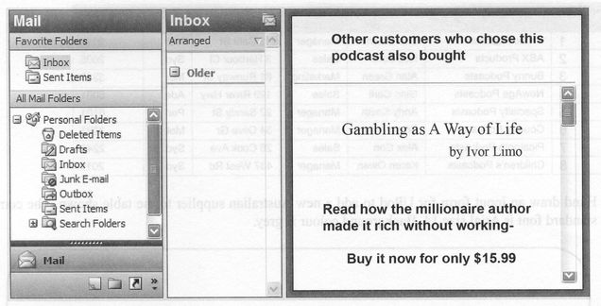
2009 ITA Exam, Q11e
When Sam's fifteen-year-old brother Gino ordered a podcast from UPod, UGambling sent him the following email.
e. Identify an ethical dilemma for the management of UPod and UGambling raised by this email.
iii. Write a question you would ask the management of UGambling about sending this email to a teenager. (VCAA provided no answers for this question)

Slide 45
My answer
i. UPod management
Should we profit by providing contact information to Ugambling if we don’t know the age of our customers?
ii. UGambling management
We could get new customers, but we could be sending promotional gambling material to children or gambling addicts who might be badly affected or influenced by the material.
iii. question for UGambling.
Do you know that the recipient was a child below the legal age to gamble and what effects this email might have had on him?
1 + 1 + 1=3 marks
State average for this question was 55%

Slide 46
Applied Computing Slideshows by Mark Kelly vcedata.com mark@vcedata.com
These slideshows may be freely used, modified or distributed by teachers and students anywhere on the planet (but not elsewhere).
They may NOT be sold.
They must NOT be redistributed if you modify them.

