Slide 1

File Management
Applied Computing Slideshows
by Mark Kelly
vcedata.com
mark@vcedata.com

Slide 2
Managing & Transmitting files
Encryption
Access hierarchy
Backups
Virus scanners
Classifying and naming files
Directory/folder/site structures
Version control

Slide 3
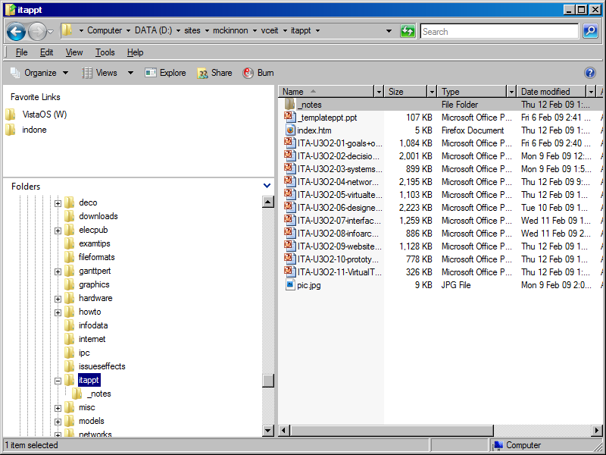
Managing Files
Use a file manager like Windows Explorer.
File:
Opening
Copying
Moving
Renaming
Deleting
Categorising
Viewing
Archiving
etc
Preferably a better file manager.

Slide 4
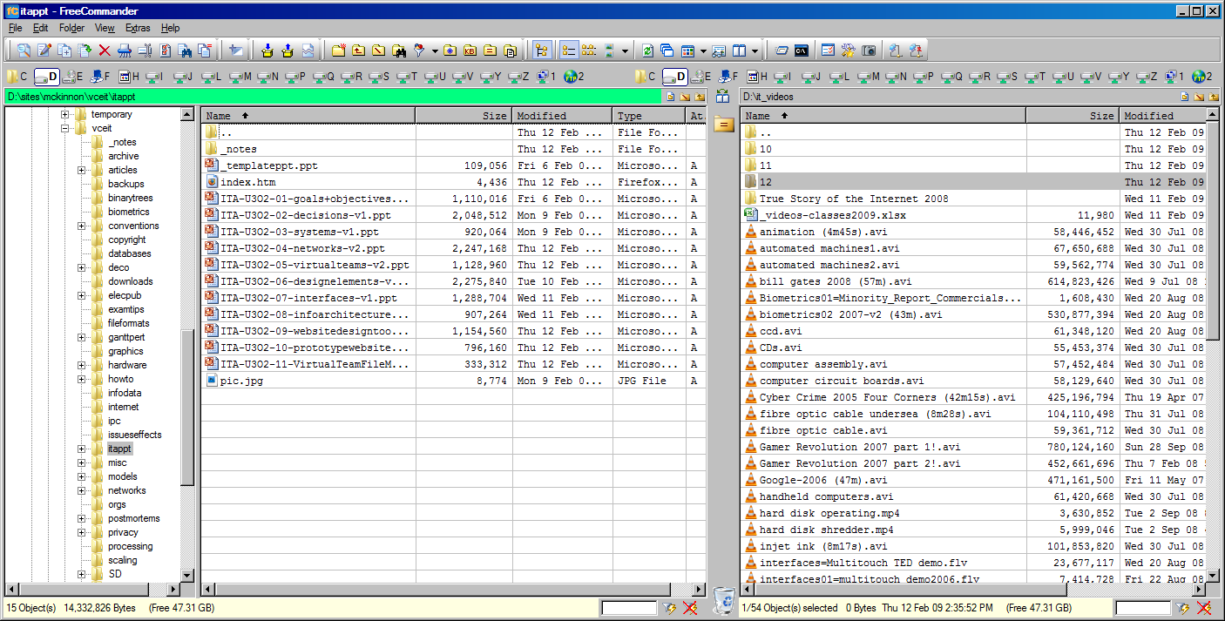
A better file manager – File Commander

Slide 5
And other tools
There are many utilities which help manage particular types of files, or carry out specialised actions…

Slide 6
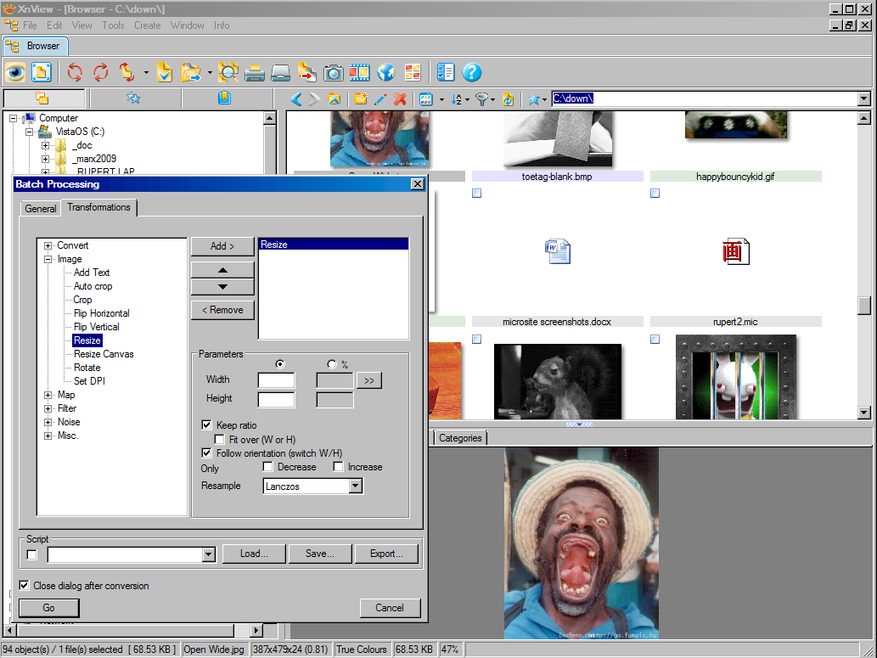
Managing Picture Files
Picture:
Previews
Resizing
Reformat
Sort
Create webpage
Contact sheet
File Info

Slide 7
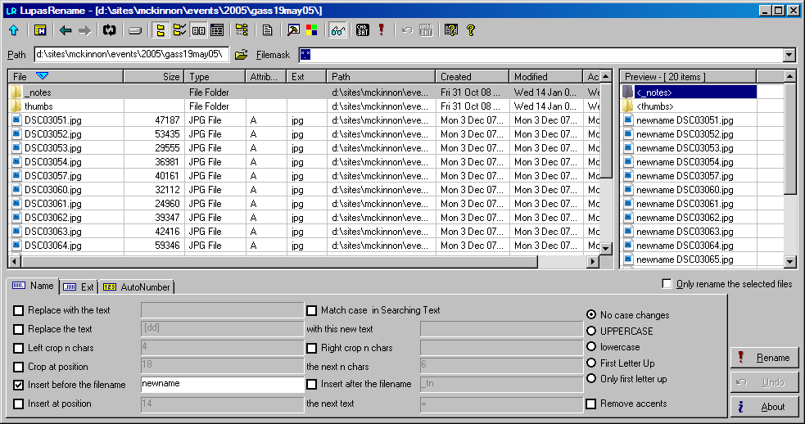
Mass File Renaming
Instantly renames thousands of files with great flexibility. Saves HOURS of labour when working with large numbers of files.

Slide 8
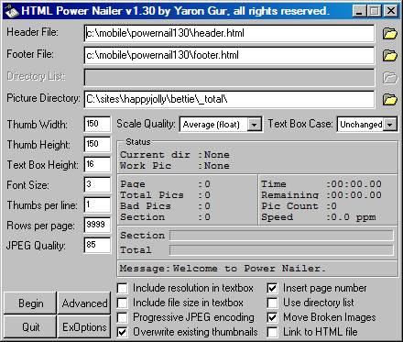
Thumbnailed web photo galleries
Converts any number of photos into pages full of small thumbnailed images linked to the large pictures.

Slide 9
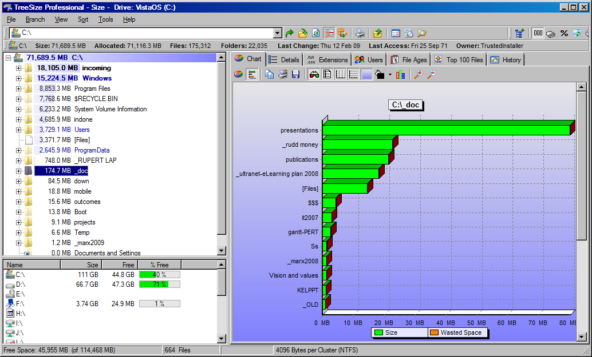
Find where disk space is used/wasted

Slide 10
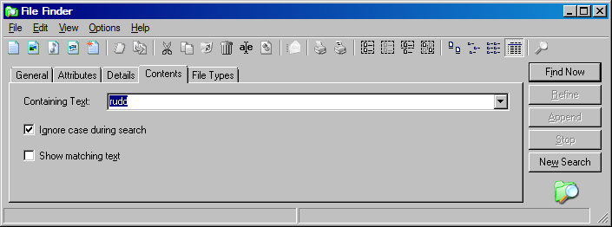
Searching for files
Find files matching given criteria (e.g. name, file type, contents) anywhere on a computer or network.

Slide 11
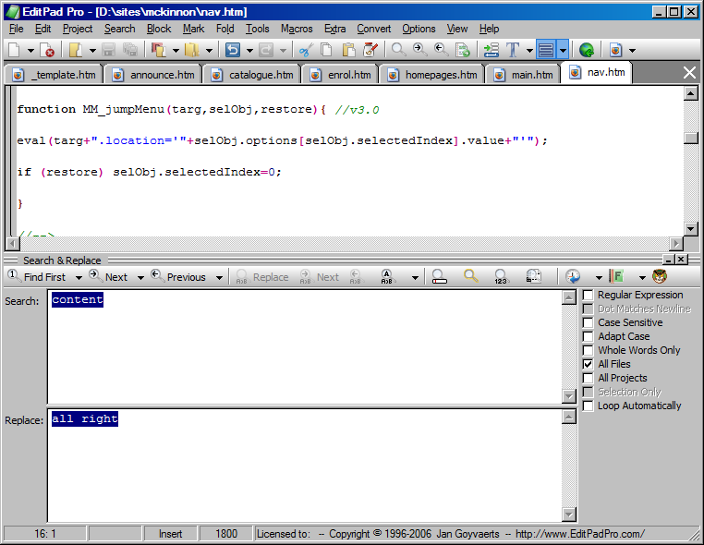
Search & Replace over many files
Some text editors let you carry out a search and replace over many files at once.
Far easier than making the same edit on 1200 files individually!

Slide 12
Transmitting Files
Files can be sent using the normal web HTTP protocol but it’s not the best way.
File Transfer Protocol (FTP) is the standard way of transferring files over the internet – especially big files and large numbers of files.
FTP client is like a 2-pane file manager with your local files in one pane and the remote files on the webserver in the other pane.

Slide 13
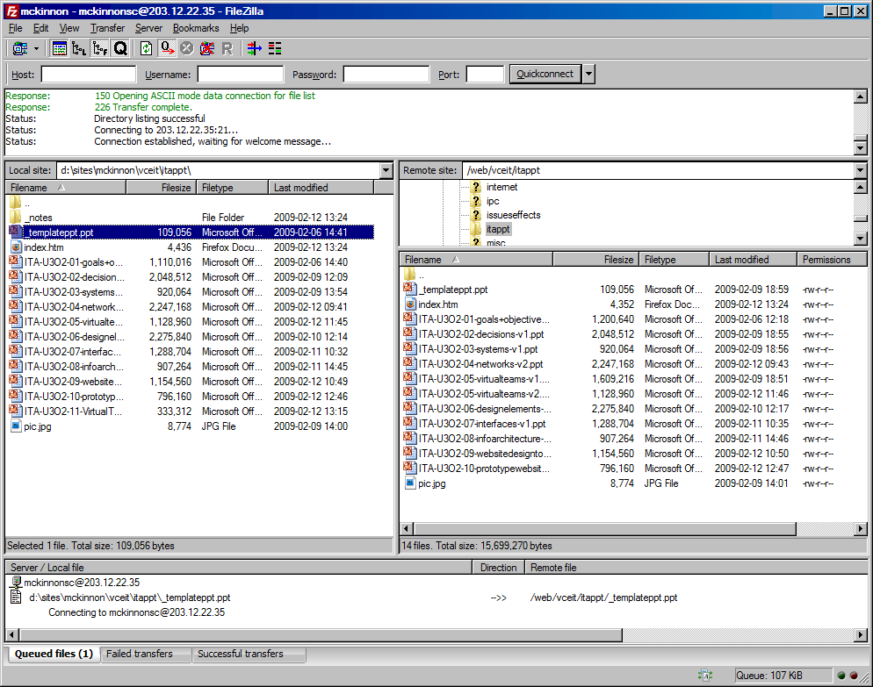
Filezilla – an open source FTP client

Slide 14
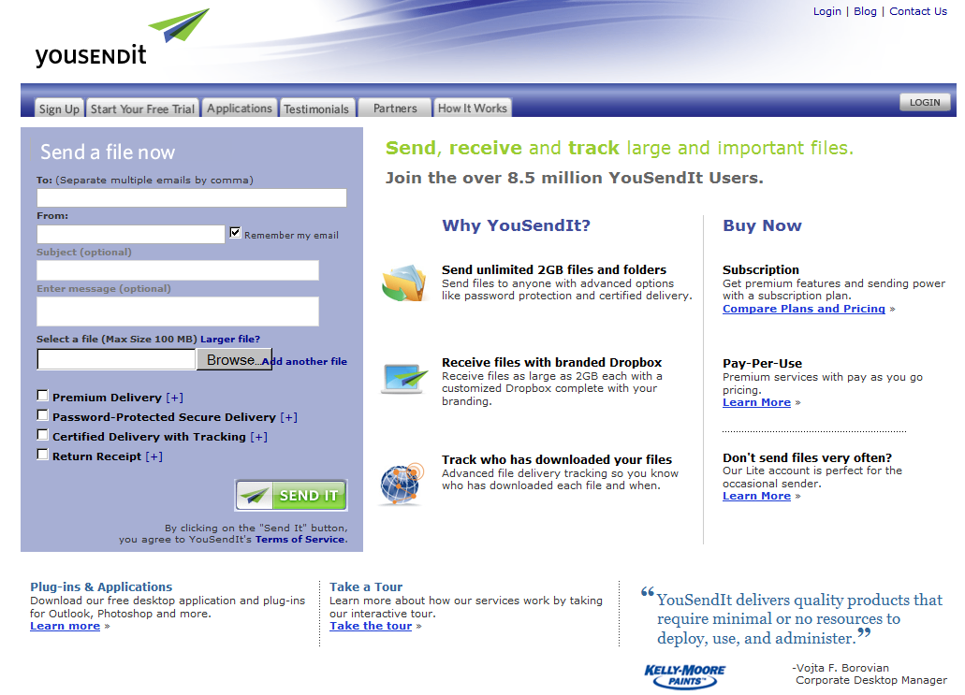
Commercial file-sharing services

Slide 15
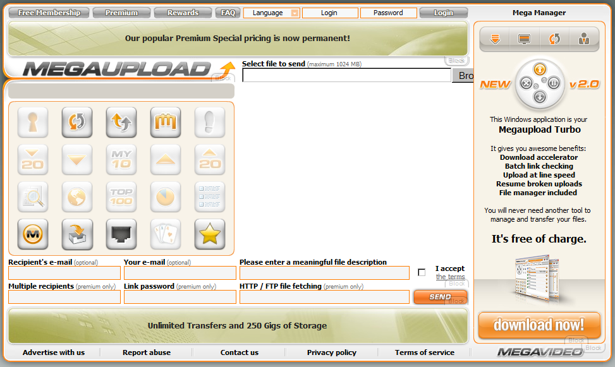
Commercial file-sharing services

Slide 16
Email attachments
Easy to send
Limited by size of recipient’s mailbox or ISP restrictions

Slide 17
Don’t recommend
Snail mail
Couriers
We need ICT solutions!

Slide 18
PLEASE NOTE
A firewall (hardware or software) will not stop viruses!
A firewall will not stop viruses!
A firewall will not stop viruses!
A firewall will not stop viruses!
A firewall will NOT stop viruses!
I’m glad we got that clear

Slide 19
Classifying and naming files
Random file naming leads to confusion, time wasting and difficulty finding information
Store all documents in one location, not sprinkled around the computer and network!
Other team members might need to access your documents, so they need to be able to find them simply by filename.
With thousands of files, a ramshackle pile of careless filenames will become unmanageable.

Slide 20


Slide 21
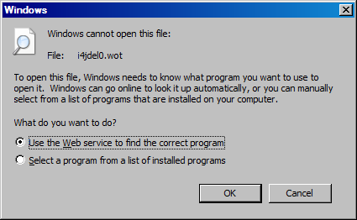
File naming
All team members must use the same sort of software – preferably the same version (e.g. MS Word 2007)

Slide 22
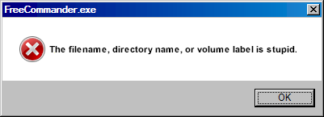
Filenaming
Use a regular pattern in your filenames
E.g. all invoices begin with INV- with customer surname+initials-date-your initials
INV-smithjs-20081228-KEL.xls
Note the date code above: year (2008) month (12) day (28) so they sort nicely
All team members must agree to and cooperate with the file naming scheme

Slide 23
Directory/folder/site structures
Logical directory structure and naming is vital on networks and web/FTP servers
Should be hierarchical. E.g. website for team on the corporate site…
corporate.com (organisation’s site)
Corporate.com/vt (virtual team’s directory)
Corporate.com/vt/calendars (all calendars stored here)
Corporate.com/vt/calendars/fred.cal (fred’s calendar)

Slide 24
Directory/folder/site structures
Where would the team store minutes of their meetings?
Corporate.com/vt/minutes
Corporate.com/vt/minutes/2009
Corporate.com/vt/minutes/2009/hardware_team
Corporate.com/vt/minutes/2009/hardware_team/minutes_20091231.htm

Slide 25
Valid alternative…
Corporate.com/vt/minutes
Corporate.com/vt/minutes/hardware_team
Corporate.com/vt/minutes/hardware_team/2009
Corporate.com/vt/minutes/hardware_team/2009/minutes_20091231.htm
Both are organised and hierarchical
Different organisation of team/year importance.
Decision may depend on whether they will need to search more by team or date.
Naming schemes should complement the way the team will work.
TIP: Avoid the temptation to abbreviate too much: e.g. a path like
Corporate.com/vt/min/hw/09/m091231.htm
could easily become unintelligible.

Slide 26
Version control
Keeps tracks of documents as they are being developed
Avoids confusion about which is the latest version
Simple to achieve…

Slide 27
Version Control
Never re-save a document with the same name
Can never recover the overwritten version
First save as document-v1.doc
Edit it, save as document-v2.doc
Re-edit. Save as document-v3.doc

Slide 28
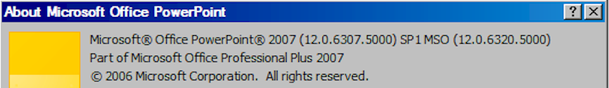
Software Versioning
E.g FredSoft 7.1.2
Major version: 7
Minor version: 1
Subversion: 2

Slide 29
Version Control
Easy to keep track of which is newest
Especially if you have copies on your PC, network, home PC, website and smartphone!
Also, can revert to a previous version if you discover you’ve ruined the document.
All team members must comply with the versioning scheme.
Can delete old versions when all is finished.

Slide 30
Version Control System
Automates version numbering of team documents
Keeps track of when documents are copied, edited, saved etc
Major software often has inbuilt versioning features (e.g. Word, wiki software)

Slide 31
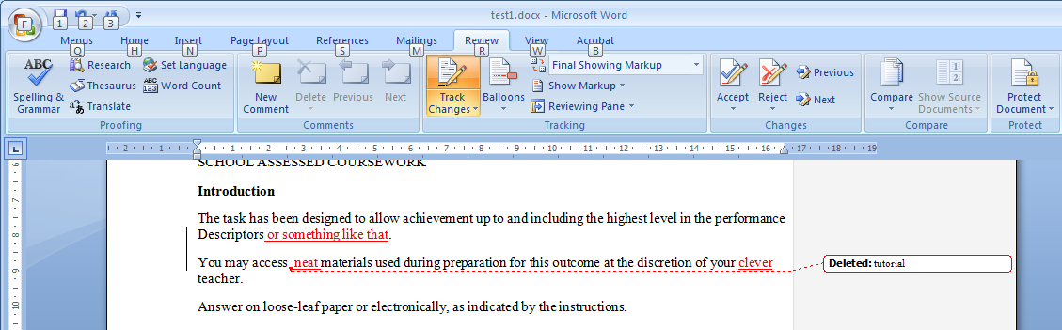
Version control
See TRACK CHANGES in MS Word.
Tracks all changes made to a document.
Can undo changes made by someone else.

Slide 32
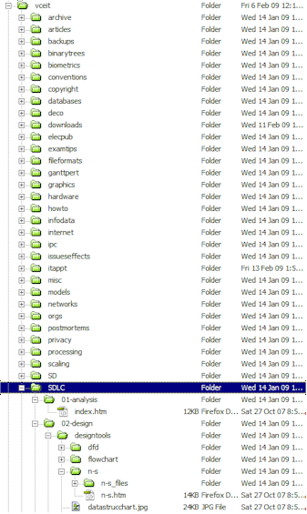
Applied Computing Slideshows by Mark Kelly vcedata.com mark@vcedata.com
These slideshows may be freely used, modified or distributed by teachers and students anywhere on the planet (but not elsewhere).
They may NOT be sold.
They must NOT be redistributed if you modify them.

Slide 33
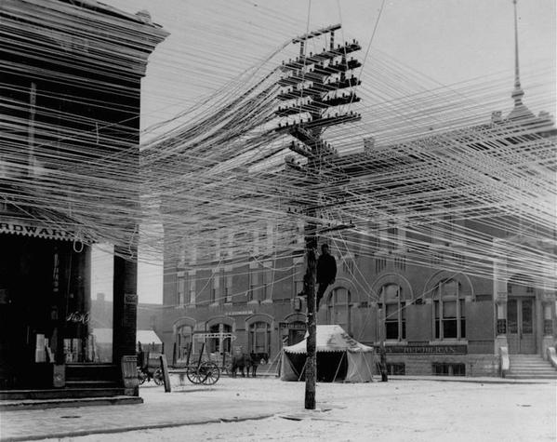
Because you’ve been good…

