Slide 1
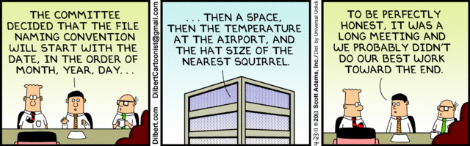
Applied Computing Slideshows by Mark Kelly vcedata.com mark@vcedata.com Last changed 2024-03-20
File Naming
© Scott Adams

Slide 2
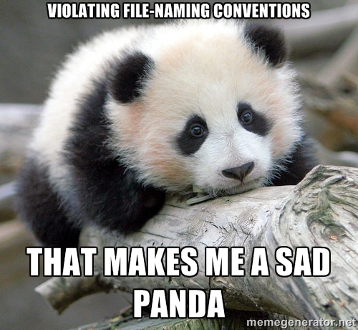
Contents
Why have file naming conventions?
What are some file naming conventions?

Slide 3

Two names to know
Camelcase
Hungarian notation
That is all

Slide 4
CamelCase
Capitalise the first letters of words
MonthlyReportForKaren.doc
It’s easier to read than monthlyreportforkaren.doc
This is commonly used in file names when programming .

Slide 5
Hungarian Notation
Put the most important identifying information FIRST, for example
REPORT-2024-03-20
INVOICE-2024-03-20
CLAIM-2024-03-20
They will be easily sorted and found later.
Tip: Hungarian Notation is usually mandatory in professional programming, e.g. intShoeSize specifies the data type of a variable.

Slide 6
Why have file naming conventions?
Makes it quicker and easier to locate a specific file
Means teams can share files more efficiently
Reduces the risk of accessing or working on the wrong file
Prevents system errors caused by ‘illegal’ names (e.g. characters like \ * : > ?)

Slide 7
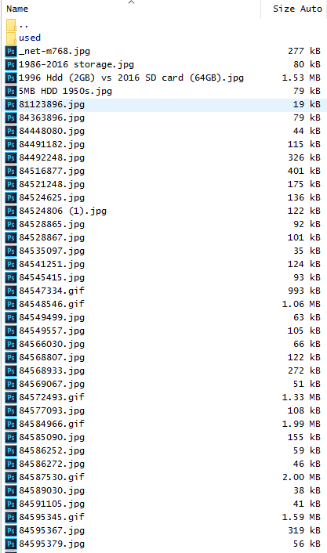
Good File Names Should…
not be arbitrary or random
Having to open dozens of files with meaningless names to find the one you need is a waste of time and effort.
"Doc1.docx" will mean nothing even just five minutes later

Slide 8
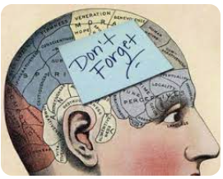
Good File Names Should…
not be so short that they soon mean nothing to you, let along a colleague
“IFST.doc” meaning “Invoice for Fred Smith – Tuesday” will only be memorable for 4 minutes.

Slide 9

Good File Names Should…
not be be so long that they cause problems
Long names are painful to type in, and invite typing errors
llanfairpwllgwyngyllgogerychwyrndrobwllllantysiliogogogoch.xls

Slide 10
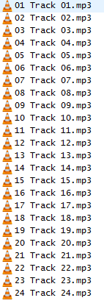
Good File Names Should…
be meaningful and self-descriptive
“CurriculumCommitteeMinutes-2016-04-19.docx” tells its own story better than “CCM6.docx”

Slide 11
Good File Names Should…
put the most relevant information first
If the most important distinguishing information comes first, file identification is easier.
Move leading articles (the,a,an) to the end of names
History of the First World war, The
Dates – use YYYY-MM-DD format
Put family name before given name… Smith, Elena

Slide 12
Good File Names Should…
Leave out trivial fillers such as “a”, “an”, “the” and leave out unnecessary information
A really exciting story about a group of rabbits called Watership Down by Richard Adams.doc
versus
Adams, Richard-Watership Down.doc

Slide 13
Good File Names Should…
not contain spaces
The internet hates file names with spaces.
A name could work well for you, but fail in a different OS which interprets a space as the end of a filename (e.g. Linux)
Use dashes or CamelCase instead.
Don't use underscores that become invisible when link text is underlined in a browser. The file name "This_Is_A_File_Name.txt" when used as a link becomes "This_Is_A_File_Name.txt" and the underscoring becomes invisible and unreadable.

Slide 14
Good File Names Should…
use capitalisation cautiously.
Some operating systems are case-insensitive, but others might not
e.g. MyFile.doc ≠ myfile.doc

Slide 15
Good File Names Should…
Contain foreign characters (e.g. Chinese, German, French)
Begin with a dot

Slide 16
Good File Names Should…
Respect file extensions (the bit after the last dot)
Operating systems use the file extension (e.g. mp3, docx, pdf, html) to determine which software to use to open the document

Slide 17
Good File Names Should…
be consistent so names are sorted in a logical order and files can be easily found
Dates: YYYY-MM-DD format (year-month-day with leading zeroes) e.g. 2016-12-03 = 3 December 2016
Leading zeroes to force proper sequential sorting:
File1.doc File10.doc File100.doc File2.doc File21.doc File3.doc | File001.doc File002.doc File003.doc File010.doc File021.doc File100.doc

Slide 18
Good File Names Should…
be consistent so names are sorted in a logical order and files can be easily found
Consistent positioning of name elements.
e.g. don’t name one file
“Invoice-Fred Smith-2016-05” and the next one
“Fred Smith-June 2016 Invoice”

Slide 19
Good File Names Should…
preferably contain some version information
different generations of a document can easily be distinguished, e.g.
"AnnualReport2016-v1.xlsx" for the first saved version,
"AnnualReport2016-v2.xlsx" for the next time it is changed and saved.
Such versioning* prevents collaborators or single users working on different or outdated versions of a document.
*Yes. “Versioning” is a horrible word.

Slide 20
Good File Names Should…
Also, giving different versions of files different names means the previous versions will not be overwritten and lost.
e.g.
Diary.com will be lost if it is changed and saved with the same name.
Diary-2024-03-20 will not overwrite its earlier version, and can be recovered if necessary.

Slide 21
Tips
You can force a file or folder to appear at the top of a sorted list by prefixing its name with an underscore or dash so it’s easier to find.
Use an automated renaming utility (e.g. Bulk Rename Utility) to rename thousands of files automatically.
Plan your folder naming scheme as well as your file naming scheme.

Slide 22
Tips
Don’t rely on the operating system to record a file’s creation date because many programs will update the file’s date whenever it’s opened. Put the creation date in the file’s name.
Media files (photos, music etc) support saving metadata within files, so not all file info has to go into the filename.

Slide 23
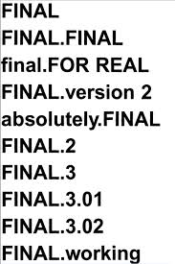
Tips
Don’t use the word FINAL in a file name.
You can never tell which version will actually be the last one, so you end up with a meaningless mess…

Slide 24
Applied Computing Slideshows by Mark Kelly vcedata.com mark@vcedata.com
These slideshows may be freely used, modified or distributed by teachers and students anywhere
but
they may NOT be sold.
they must NOT be redistributed if you modify them.
This is not a VCAA publication and does not speak for VCAA.
Portions (e.g. exam questions, study design extracts, glossary terms) may be copyright Victorian Curriculum and Assessment Authority and are used with permission for educational purposes. Thanks, guys!

Slide 25
THANKS!
Because you’ve been so good, here’s a picture you can look at
while your teacher works out what to do next.
Good file naming schemes prevents situations like this:

