Slide 1

Applied Computing Slideshows by Mark Kelly vcedata.com mark@vcedata.com
Website
Formats and Conventions

Slide 2
Formats
Ways of presenting information, such as:
Graphs
Web pages
Slide shows
Printed books
Comics
Leaflets
Posters
Road signs

Slide 3
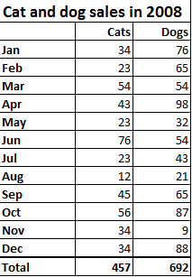
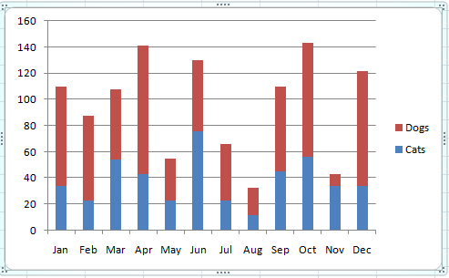
Often there is a choice which format to use for showing some information:

Slide 4
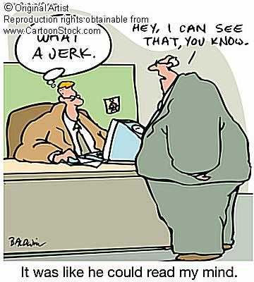
Comic Conventions
Conventional use of speech balloons and thought balloons in the comic book format.
Reverse them and you’ll confuse people.

Slide 5
But whichever format you choose
Each format has its own conventions, or commonly-accepted ways of using that format.
Some tabular format’s conventions:
Main table heading
Column headings at the top
Bold headings
Total at the bottom
Thicker dividing line above total
Right-justified numbers

Slide 6
If you’d chosen the graph format…
Some graph conventions:
Coloured portions of each bar
Legend identifying the colour scheme
Labelled axes, with 0 at the bottom
Horizontal lines to make reading bar heights more convenient
Different chart types have their own conventions

Slide 7
Why use conventions?
Because everyone wants and expects you to.
Makes it far quicker and easier to absorb information
Audiences don’t have to learn a completely different method of representing information.

Slide 8
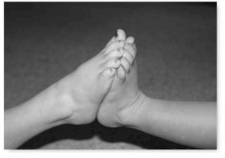
Examples of conventions
Shaking hands, not feet
Driving in the left lane in Australia
All pilots describe altitude in feet, and communicate in English. (Why?)
Using page numbers in books
Underlining web page hyperlinks

Slide 9
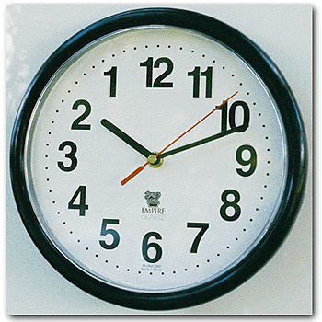
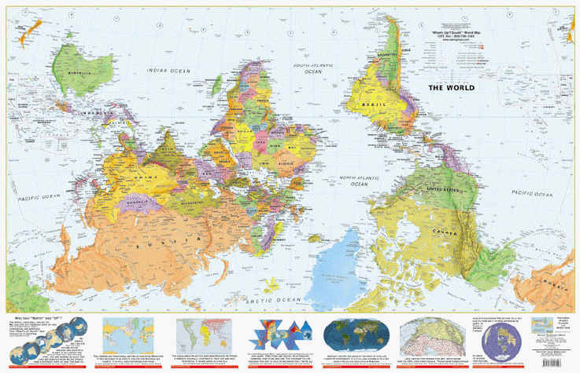
Convention Blindness
You become so used to seeing conventions that you only notice when they’re misused.
Ask yourself: why is Australia always at the bottom of the globe? Purely convention. There is no “up” and “down” in space.

Slide 10
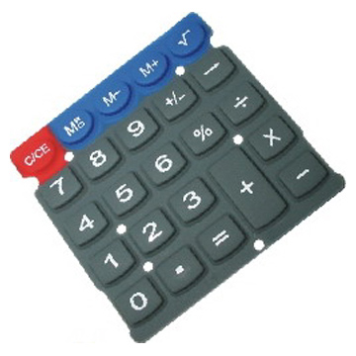

Arbitrary Conventions
Some standards are no better or worse than alternatives – but everyone agrees to use them. That’s what makes a convention.
Ever noticed that calculator keypads and phone keypads are reversed?
Why? Who knows…
But you’d be feeling odd if they were reversed only occasionally.

Slide 11
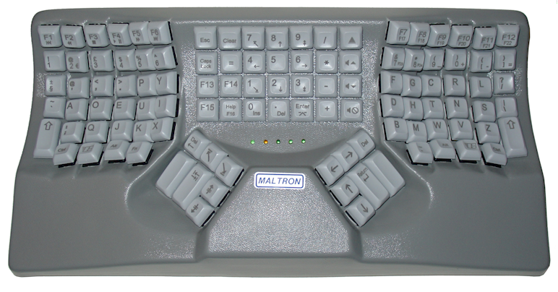
Sometimes, the abuse of conventions can lead to fear, loathing and confusion…
An ergonomic Dvorak keyboard – very unconventional in 2 ways...

Slide 12
Strengths of conventions
Conventions vary in how important it is to follow them.
Mandatory conventions
Preferred conventions
Optional conventions

Slide 13

Mandatory conventions
Their use is dictated by law or rule.
Broken only at your own risk.
Penalties apply for abusing them.
Set by:
Government
Employers
Parents
Other figures of authority

Slide 14
Mandatory conventions
Drive on left hand side of the road in Australia.
Put the words “Tax Invoice” on a receipt.
Don’t go to work naked.
Put the company logo on all outgoing correspondence.
Take off your shoes when you come into the house.
Don’t laugh at the priest during mass.

Slide 15

Preferred Conventions
Penalties won’t apply, but there is a strong preference that you do things a particular way.
E.g. you won’t be arrested for failing to put page numbers in a printed textbook, but don’t expect anyone to be happy about it.

Slide 16

Preferred Conventions
Australia Post issues their “Post Office Preferred” envelopes, and they have a preferred means of addressing envelopes.
They won’t refuse to deliver non-compliant letters, but they may be delivered less efficiently.

Slide 17
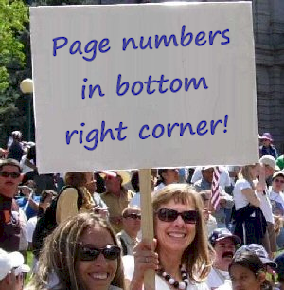
Optional Conventions
There is more than one way of presenting the information and no-one is too fussed about which style you choose.
E.g. while using page numbers in a textbook is preferred, exactly where they are put on a page is up to you.
E.g. whether you choose to use a bar chart or a line graph is sometimes unimportant.

Slide 18
Specific Web conventions
Opening page of site = index.htm(l)
Underlined links
No other underlining allowed
Thumbnailed images
Menu bar
Search facilities
Contact Us page
Privacy Policy Page

Slide 19
Specific Web conventions
One idea per page
Email link / web form
Links from bottoms of pages to top
Every page links to index
Only GIF, JPG, PNG images
Reasonably sized media
Good contrast between text/background
No <blink> tag!

Slide 20
Specific Web conventions
Cross-browser compatibility
‘Date last modified’ code
Others?

Slide 21
Web Suggestions
Text
·only centre short units of text (usually left justify)
· sans-serif font for main text to ensure readability
· consistent fonts, type sizes (usually 9-12 pt)
· no longer than 60-character line length (10-11 words)
· limit paragraph size (4-8 lines)
· use wide margins
· avoid using all capitals
· no underscore (underlining)
· consistent headings
· use bold and italics sparingly.

Slide 22
Suggestions
Sound · clarity of sound · length - not too long · indicate length of sound track, file type and size such as WAVE (type), 645K (size), 1 minute (length) · for hearing-impaired people, also include a transcript of speeches, etc.

Slide 23
Suggestions
Still / Moving Images
· keep videos short/images small to reduce transfer time
· give a description of the video and file size and type, for example AVI (.avi), MPEG (.mpg; mpe), QUICKTIME (.qt; .mov)
· make images less than 480 pixels
· small coloured graphics can be used as organisation and navigation buttons.

Slide 24
Suggestions
Colours
· avoid red text on blue background
· most text is in black
· most backgrounds are white or grey
· avoid red and green together (difficult to distinguish for colour-blind people)
· be colour consistent
· use white space
· use links as the source of colour
· limit the number of colours used in text and figures to four.

Slide 25
Web pages 1
· each page should contain a different concept or idea
· display the most important information first
· each segment should fill a single screen - if not enough text, combine with another
· if page is longer than five screens, break into smaller segments
· at the end of each page include name, email address, and date of last modification

Slide 26
Web pages 2
home page should not take more than 15 seconds to load
· provide common element/theme/look such as logo
· 3 hops/clicks is maximum number to get to important information
· 4-5 hops should take users to 80 per cent of the documents they may want to view
· placement of navigation bar depends on length of page - at top usually, unless page warrants a couple of scrolls
· create one main frame.

Slide 27
Applied Computing Slideshows by Mark Kelly vcedata.com mark@vcedata.com
These slideshows may be freely used, modified or distributed by teachers and students anywhere on the planet (but not elsewhere).
They may NOT be sold.
They must NOT be redistributed if you modify them.

