Slide 1
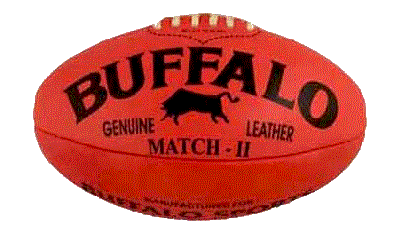
Organisational System
Goals
Objectives
Applied Computing Slideshows
by Mark Kelly
vcedata.com
mark@vcedata.com

Slide 2

Goals
Goals, in IT, are big, vague, long-term things that someone wants to achieve.

Slide 3
Freg Zample
Typical goals are:
“Provide good customer service”
“Make good decisions”
“Provide a safe working environment”
“Work efficiently”
“Produce quality products”
But it is hard or impossible to say exactly IF or WHEN such fuzzy goals have been achieved.

Slide 4
Vague but useful
A manager can’t say, “Yes! We achieved efficient work practices at 3:57pm last Friday”
But goals are useful to guide people in a particular direction, even if it’s hard to say when or if you actually reach the destination.

Slide 5
Goals
Goals can shape everything an organisation does from day to day. E.g. aiming for “good customer service” means people need to do specific things to head for the overall goal.

Slide 6
Objectives
Objectives are smaller targets and are aimed at helping to achieve a larger goal.
Objectives are specific, measurable, achieveable.
You can objectively say, “Yes – we definitely achieved that objective” (or not)
Objective (adjective) = fact-based
Subjective (adjective) = opinion-based)

Slide 7
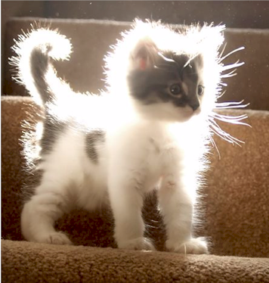
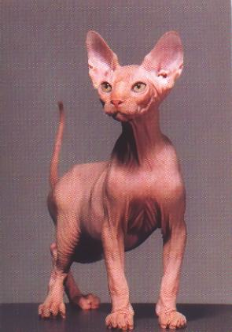
A fuzzy goal
A non-fuzzy objective

Slide 8

TIP
Can often identify objectives because they contain numbers.
E.g. We aim to increase our market share by 10% in the next 12 months.
Wrong!
Objectives are specific. Goals are vague!

Slide 9
Objectives -> Goals
To achieve a goal, several specific objectives are created.
GENERAL GOAL: To provide good customer service.
SPECIFIC OBJECTIVES:
To answer all customer emails within 24 hours.
To reduce customer complaints by 10% this year.
To get at least 90% satisfaction on the next customer survey.

Slide 10
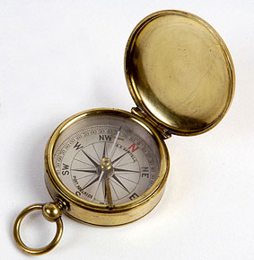
So…
If you achieve the objectives, you know you are heading in the right direction toward achieving the larger goal.

Slide 11
Organisational…
Organisational goals and objectives relate to the whole organisation.
They are the things the whole organisation wants to achieve.
They will affect the daily business of all the people in the organisation.
They will guide the overall direction and efforts of the organisation over time.

Slide 12
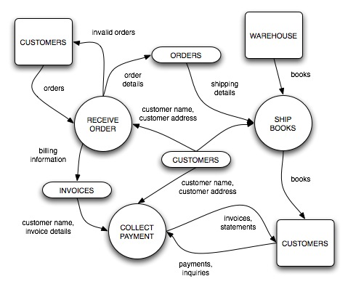
Systems
Systems exist within an organisation.
A system is a combination of
People
Equipment
Data
Procedures
Components in a system work together to get a particular type of job done.

Slide 13
Types of systems
An org could well have systems like:
Communications system (phone, email, web, radio, mail etc)
Accounting system (to pay staff, process payments from customers etc)
Transport and distribution system
Staff management system
Office automation system (e.g. word processing, databases)

Slide 14
System goals and objectives
Each system within an organisation would have its own goals and objectives.
E.g. the accounting system’s goals may include accuracy of calculations, speed of producing output, security of data.
Objectives may include: “No more than 1% error rate when producing staff wages” and “Produce an invoice within 48 hours of receiving an order from a customer.”

Slide 15
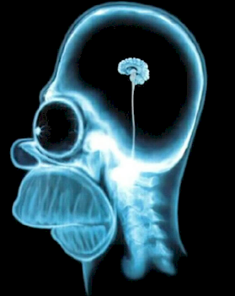
A brain-helping review
Organisational goals and objectives are what the whole organisation is aiming for in the long and short term.
System goals and objectives are what the systems within an organisation are aiming for in the long and short term.

Slide 16
Finding them in a case study
Look for references to:
What the organisation or system is proud of.
What they are worried about.
What they’re hoping for.
These all indicate things that the org or system is aiming to achieve (or avoid). In either case, they are important to the org or system.

Slide 17
Examples
“Bill Masters is keen to become the biggest manure distributor in Bendigo.”
“Cheryl is concerned that the data in her finance system is not well protected.” (therefore, her goal is to have secure data)
“XQZ Corp is proud of its good public image” (and therefore a goal is to maintain or improve their public image)

Slide 18
Types of organisations
Commercial
E.g. Microsoft, McDonalds, the local fish & chip shop
Number One goal is profit
Must show a profit to be considered successful
No matter how well they do on any other matter, if they don’t make money they have failed.

Slide 19
Types of organisations
Service (“not-for-profit”)
E.g. public schools and hospitals, police, churches, charities, public transport
Number One goal is providing a service
Need not show a profit to be considered successful
Must provide good service to be considered successful
Don’t want to waste money, but are not mainly concerned with profit

Slide 20
E.g. Victorian public transport has never made a profit.
E.g. the police force or army are not criticised because they’re not showing a profit at the end of the financial year!

Slide 21
So you can safely assume…
In a case study, when asked to identify the organisation’s goals
If the org is commercial, the number 1 goal will always be profit
If the org is not-for-profit, its number 1 goal will be to provide its service.

Slide 22
So you can safely assume…
Any organisation – commercial or not-for-profit – would have common goals:
Being efficient (not wasting time, money or labour)
Making good decisions
Avoiding a bad reputation
Having good communications with staff and customers
etc

Slide 23
But always remember
If given a case study and asked to find the organisational/system goals/objectives, look in the case study and find the ones specific to the organisation in the case study.
Then, if you like, you can trot out the goals you can safely assume (e.g. profit, efficiency)
Your answers must always directly relate the case study if one is given to you.

Slide 24
Goals Question Time
Which of these is an organisational goal?
Increase sales by 10% this year.
Improve our reputation with the public.
Reduce payroll running costs.
Improve the security of our website.

Slide 25
Goals Question Time
Which of these is an organisational goal?
Increase sales by 10% this year.
Improve our reputation with the public.
Reduce payroll running costs.
Improve the security of our website.

Slide 26
2. Identify the organisational and system goals and objectives in this case study.
Fred’s law firm has 2 computers. He wants his firm to be more successful, so he is updating his information system. He wants his PCs to run 20% faster to help him produce more accurate communications with customers and to increase income by 10% this year. With increased income, he can spend money on extra secretarial support because he wants his firm to get a reputation for professional excellence.

Slide 27
2. Identify the organisational and system goals and objectives in this case study.
Fred’s law firm has 2 computers. He wants his firm to be more successful, so he is updating his information system. He wants his PCs to run 20% faster to help him produce more accurate communications with customers and to increase income by 10% this year. With increased income, he can spend money on extra secretarial support because he wants his firm to get a reputation for professional excellence.

Slide 28
2. Identify the organisational and system goals and objectives in this case study.
Fred’s law firm has 2 computers. He wants his firm to be more successful, so he is updating his information system. He wants his PCs to run 20% faster to help him produce more accurate communications with customers and to increase income by 10% this year. With increased income, he can spend money on extra secretarial support because he wants his firm to get a reputation for professional excellence.

Slide 29
2. Identify the organisational and system goals and objectives in this case study.
Fred’s law firm has 2 computers. He wants his firm to be more successful, so he is updating his information system. He wants his PCs to run 20% faster to help him produce more accurate communications with customers and to increase income by 10% this year. With increased income, he can spend money on extra secretarial support because he wants his firm to get a reputation for professional excellence.

Slide 30
2. Identify the organisational and system goals and objectives in this case study.
Fred’s law firm has 2 computers. He wants his firm to be more successful, so he is updating his information system. He wants his PCs to run 20% faster to help him produce more accurate communications with customers and to increase income by 10% this year. With increased income, he can spend money on extra secretarial support because he wants his firm to get a reputation for professional excellence.

Slide 31
The End!
Applied Computing Slideshows
by Mark Kelly
vcedata.com
mark@vcedata.com

