Slide 1
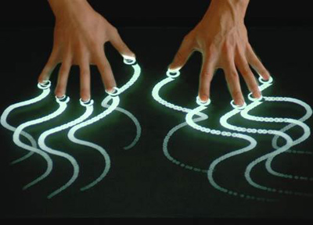
Applied Computing Slideshows
Interfaces
Interfaces
by Mark Kelly
vcedata.com
mark@vcedata.com

Slide 2
Interface = Where humans interact with and control software.
GUI = Graphical User Interface
‘Desktop’ metaphor - mimics human behaviour e.g. drop into trash, ‘folders’
3D effects e.g. buttons push in
Easy to learn compared with text-based CLI (command line interface)

Slide 3
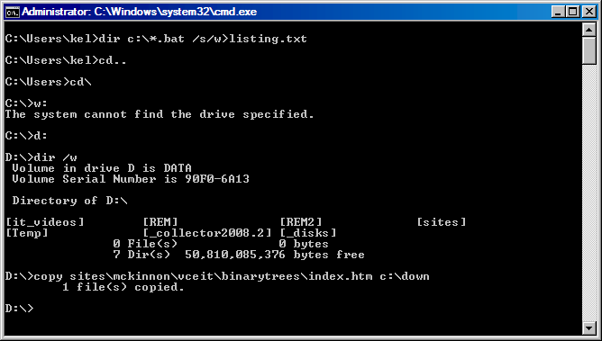
Command Line Interface
Text-based, lots of typing
Hard to learn
Powerful, efficient
Very low technology requirements

Slide 4
Good interfaces need to be…
Designed carefully
Considerate of users’ needs
Tested
And…

Slide 5
Be accurate
links should work
buttons do what they claim to
accurate spelling and punctuation
Silly errors looks amateurish
Users lose confidence in the product and its producer

Slide 6
Be easy to use (useability)
Little training required
Easy-to-find and easy –to-understand help
Most commonly-used tasks should be easiest to find, not hidden deep-down in menus
Give users alternative ways of doing things (e.g. Ctrl+C shortcut, a “Copy” in the toolbar, “Copy” menu item, a “Copy” action in the right-click context menu.
Intuitive design – it should be obvious how to do something even for a beginner.

Slide 7
Easy to read (legibility)
simple language
Small words
Avoid jargon
Simple sentences
Avoid words where possible and use icons
good colour contrast
Avoid similar text colour + background colours
Black on white is excellent
Avoid background images

Slide 8
Be consistent, predictable (consistency)
What an icon means must not change from page to page
Page numbering should follow the same pattern throughout
The same theme (colours, typefaces, text formatting) should be used throughout a document
Don’t change things for the sake of change

Slide 9
Be accessible
Usable by people with disabilities or special needs, e.g.
Poor vision (use large text, good contrast)
Poor muscular control (make controls a reasonable size, don’t crowd buttons together)
Weak English skills (use simple language)
Colour blindness (don’t combine red/green)

Slide 10
Use affordance
Interface features should be intuitive and clearly suggest what should be done to operate them
E.g. 3D buttons that look clickable
Scroll bars that are naturally draggable
Red text for emergency information

Slide 11
Use tolerance
User should be able to easily recover from errors
E.g. provide cancel/back buttons to escape unwise decisions
“Are you sure?” confirmations for expensive/dangerous operations
Allowing recovery of deleted data

Slide 12
Follow standard conventions
Conventions are used to reduce the amount of learning users need to invest in a product. They expect each product to follow standard behaviour
e.g. The leftmost menu is ‘File’ and the rightmost is ‘Help’
The software version is always found under Help > About

Slide 13
Follow standard conventions
Ctrl+C = copy
A menu item followed by … leads to a dialogue box for more settings rather than an action occurring immediately.
Underlined text on a webpage is a hyperlink, not emphasis!
Right-clicking on an object brings up relevant commands in a pop-up context menu

Slide 14
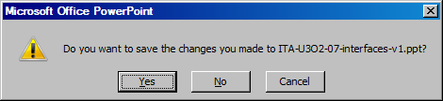
Follow standard conventions
Clicking once selects an item. Double-clicking opens it.
Don’t think your software or webpage or database or spreadsheet is SO special that it does not have to follow conventions.
YOU’RE JUST NOT THAT IMPORTANT!
The least dangerous button is always the default.
The safer option is the default button (dark border, dotted outline). If the user just hits ENTER, the safer option (saving before exiting) is chosen.

Slide 15
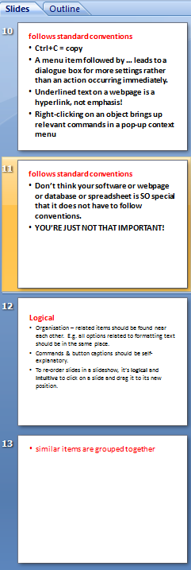
Be logical, intuitive
Organisation – related items should be found near each other. E.g. all options related to formatting text should be in the same place.
Commands & button captions should be self-explanatory.
To re-order slides in a slideshow, it’s logical and intuitive to click on a slide and drag it to its new position.
Users should not re-learn basic skills just for your software!

Slide 16
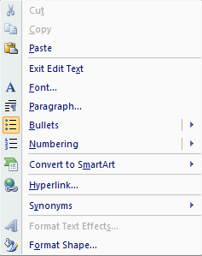
Prevent disaster
Anticipate actions that could cause data loss and guard against them.
Warn users if their document is unsaved before they’re allowed to exit.
Any sort of ‘delete all’ command should give users a chance to cancel, and some sort of Undo facility.
Hide dangerous operations from novice users.
Disable inappropriate function buttons or menu items
Notice how the Cut and Copy commands are ghosted because no text was selected and those actions make no sense.

Slide 17
Be Helpful
Context-sensitive: pressing F1 brings up help topics related to what the user is currently doing.
Pop-up tool tips inconspicuously remind users of what controls are for.
For big help files, search facilities are important to find help on the desired topic.
Preferably layered, with help on common problems first, but has links to more details on obscure, technical or uncommon issues for advanced users.

Slide 18
Offer Shortcuts
Keyboard shortcuts replace or supplement buttons/mouse/menu actions (e.g. Ctrl+S to save)
Power users hate having to use menus for operations they use hundreds of times a day. Forcing them to use a mouse is frustrating.
Make shortcut keys configurable rather than hard-coded into the software.

Slide 19
Wizards help with complex or rarely-used operations
Handy step-by-step helpers to assist beginners, those with poor memory, or those confused by complex operations.
Automate the selection of options.
Tend to only offer simple, basic results for average users. Advanced options are often not offered, and human expertise is needed to produce really customised results.
Good software offers wizards but gives users manual control as well.

Slide 20

Attractive
to look at
Modest decoration
Generous margins
Whitespace
Subtle colours
Align controls horizontally & vertically
Space between items. Don’t overcrowd
Consistent formatting of headings & body text

Slide 21
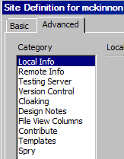
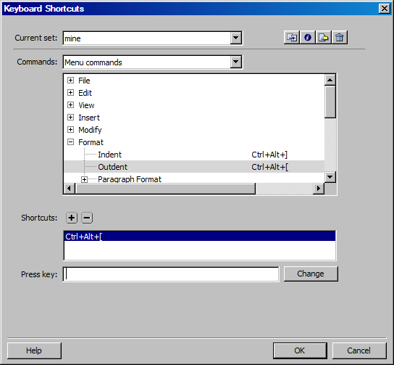
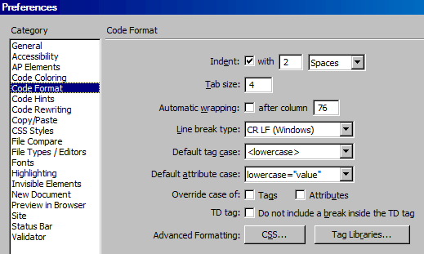
Configurable to suit users' preferences
Specifying your skill level lets the software show/hide scary options or show more/less help.
Adapt shortcut keys to suit user.
Let user customise options e.g. confirm file deletion)

Slide 22
Provide an escape hatch or safety net
Let users undo actions
Don’t trap users in a dangerous operation with no way out.
Where possible, provide a ‘Back’ button to return to the previous step.
Always offer a ‘Cancel’ option.
Give clear warnings of the consequences of an action.

Slide 23
Applied Computing Slideshows by Mark Kelly vcedata.com mark@vcedata.com
These slideshows may be freely used, modified or distributed by teachers and students anywhere on the planet (but not elsewhere).
They may NOT be sold.
They must NOT be redistributed if you modify them.

