Slide 1
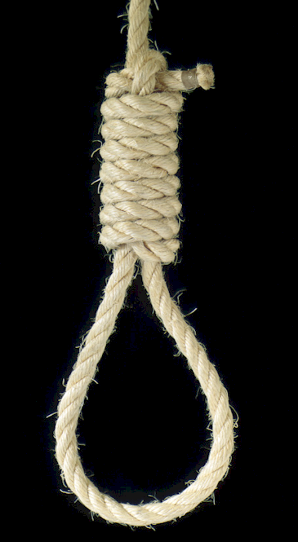
Legislation:
COPYRIGHT
Applied Computing Slideshows
by Mark Kelly
vcedata.com
mark@vcedata.com
Last modified 2024-03-07 @ 13;25;49

Slide 2
©OPYRIGHT ACT 1968
Federal (Commonwealth) act
Recognises that any original work is the property of the person who created it.
Protects all original literary, dramatic, musical and artistic works from unauthorised reproduction.

Slide 3
©OPYRIGHT ACT 1968
Copyright is not registered (as patents and trademarks are)
Copyright is automatically given to the creator of intellectual property (IP) as soon as it is expressed in a tangible form, for example written down, recorded, drawn, spoken.
People can’t claim copyright for simply thinking of something and not recording it.

Slide 4
©OPYRIGHT ACT 1968
Copyright protects the way an idea is expressed.
Ideas themselves cannot be copyrighted – that’s what a patent is for
e.g. Cannot copyright the idea of a love story, but can copyright a specific romance novel.

Slide 5

Since 2000, also protects digital works (software, electronically recorded music, films, books, websites etc)

Slide 6

Copyright Act 1968
The owner of copyright in a work is the only person who has the right to make or authorise reproductions or adaptations of the work.

Slide 7

©
Copyright protection applies whether or not the work has a copyright statement or the © symbol.
But they are recommended to avoid long and expensive court battles to prove ownership of IP.

Slide 8
Copyright holders
have control over how and when material is communicated or published.
can use technological devices to protect material (e.g. encryption, copy protection)
are encouraged to include a statement about their copyright restrictions
usually must give permission before their material can be used or transmitted

Slide 9

Individuals…
Cannot digitise a non-digital work (e.g. scan books, rip DVDs to MKV)
Cannot make or import decoding devices that bypass copyright protection
Cannot tamper with a copyright notice in an electronic document

Slide 10
Individuals…
Cannot share copyrighted material on peer-to-peer networks such as BitTorrent
‘Fair use’ – One can use copyrighted material under some conditions, for example for educational or review purposes. For example, copying 10 per cent or one chapter of a reference book.

Slide 11

Remember
Not getting caught does not make copyright violation legal.

Slide 12
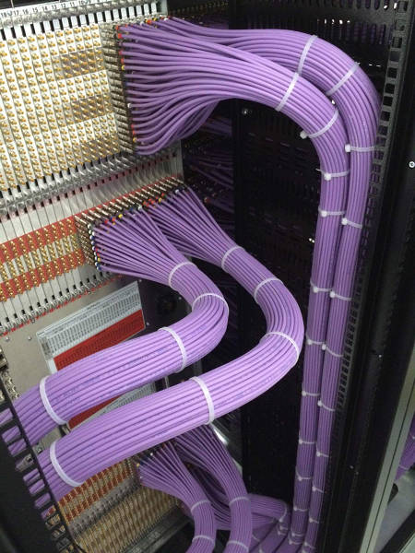
Here’s a nice picture because you’ve been good

Slide 13
Applied Computing Slideshows © >> COPYRIGHT << Mark Kelly vcedata.com mark@vcedata.com
These slideshows may be freely used, modified or distributed by teachers and students anywhere on the planet (but not elsewhere).
They may NOT be sold.
They must NOT be redistributed if you modify them.

