Slide 1

Legislation –
Human Rights &
Spam
Applied Computing Slideshows
by Mark Kelly
vcedata.com
mark@vcedata.com

Slide 2
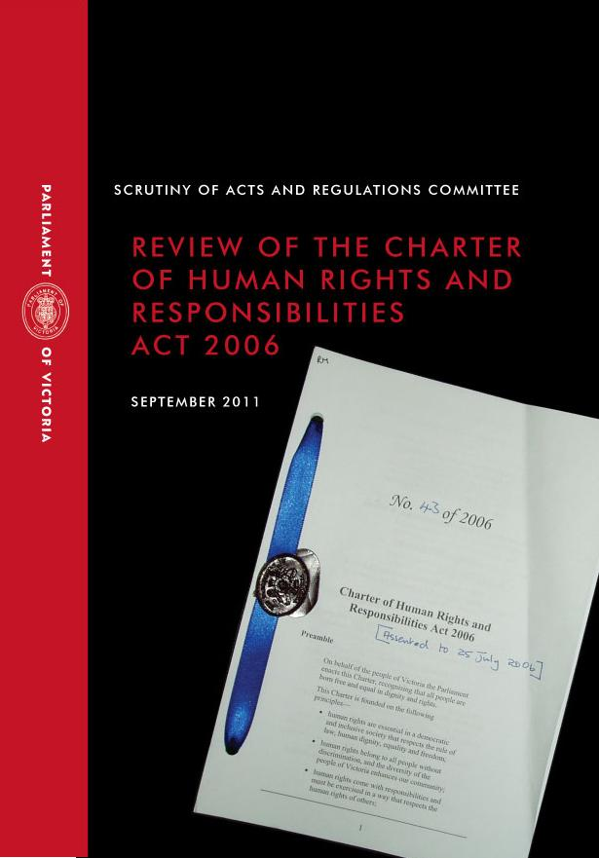
Contents
Charter of Human Rights & Responsibilities Act (Vic) 2006
Spam Act 2003

Slide 3

SECTION 13 - Privacy and reputation
A person has the right-
(a) not to have his or her privacy, family, home or correspondence unlawfully or arbitrarily interfered with; and
(b) not to have his or her reputation unlawfully attacked.

Slide 4

SECTION 14 - Freedom of thought, conscience, religion and belief
(1) Every person has the right to freedom of thought, conscience, religion and belief, including-
(a) the freedom to have or to adopt a religion or belief of his or her choice; and

Slide 5
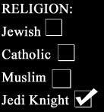
(b) the freedom to demonstrate his or her religion or belief in worship, observance, practice and teaching, either individually or as part of a community, in public or in private.
(2) A person must not be coerced or restrained in a way that limits his or her freedom to have or adopt a religion or belief in worship, observance, practice or teaching.

Slide 6
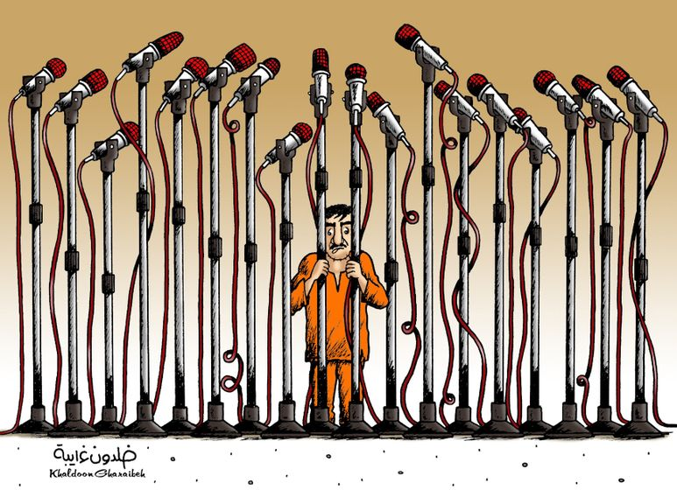
SECTION 15 - Freedom of expression
(1) Every person has the right to hold an opinion without interference.

Slide 7
SECTION 15 - Freedom of expression
(2) Every person has the right to freedom of expression which includes the freedom to seek, receive and impart information and ideas of all kinds, within or outside Victoria and whether orally; in writing; in print; way of art; or in any way.

Slide 8
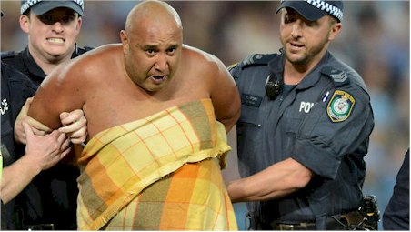

(3) Special duties and responsibilities are attached to the right of freedom of expression and the right may be subject to lawful restrictions -
(a) to respect the rights and reputation of other persons; or
(b) for the protection of national security, public order, public health or public morality.

Slide 9

The Spam Act 2003
Named after a Monty Python sketch where singing Vikings drowned out all attempts to speak in a café.
Got 3.5 minutes to spare?
https://www.youtube.com/watch?v=Gxtsa-OvQLA
Spam email floods email boxes.

Slide 10

Spam Act 2003
A scheme for regulating commercial e­mail and other types of commercial electronic messages.
Unsolicited commercial electronic messages must not be sent.

Slide 11

Spam Act 2003
Commercial electronic messages must include information about the individual or organisation who authorised the sending of the message
Address ­harvesting software must not be supplied, acquired or used.

Slide 12
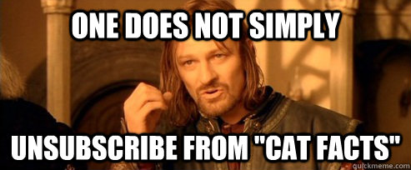
Spam Act 2003
Commercial electronic messages must contain a functional unsubscribe facility.

Slide 13
Spam Act 2003
An electronic address list produced using address­ harvesting software must not be supplied, acquired or used.

Slide 14
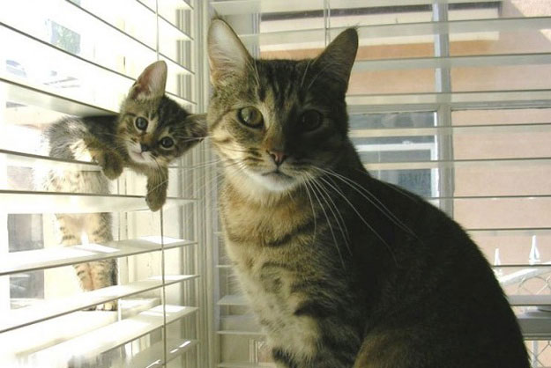
Because you’ve been good you may look at this

Slide 15
Applied Computing Slideshows by Mark Kelly vcedata.com mark@vcedata.com
These slideshows may be freely used, modified or distributed by teachers and students anywhere on the planet (but not elsewhere).
They may NOT be sold.
They must NOT be redistributed if you modify them.

