Slide 1

LAN Design
Applied Computing Slideshows
by Mark Kelly
vcedata.com
mark@vcedata.com

Slide 2
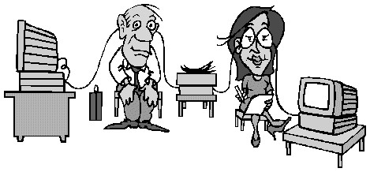
What is a LAN?
Local Area Network
Two or more computers connected so they can exchange data

Slide 3

P2P or Client-Server?
A P2P (Peer-to-Peer) LAN has no file server to control the LAN
Cheap
Easy to set up
Must trust users
Small number of users

Slide 4
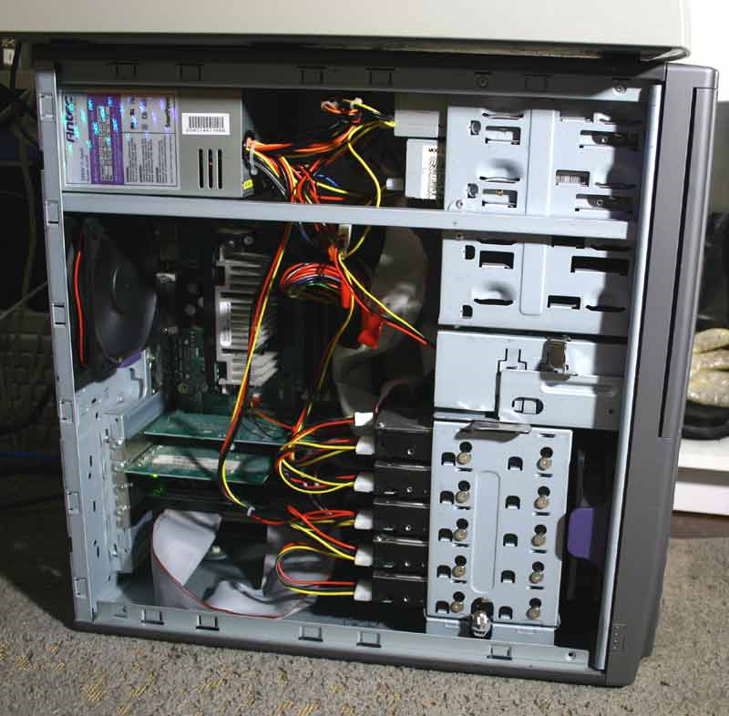
Client-Server
Has a file server at the heart of the LAN
Server runs the NOS
Network Operating System) controls LAN

Slide 5
Client-Server
Manages logins, security, allocates privileges
Runs community services e.g. Virus scan, backup, allocating IP addresses
Controls users (especially untrustworthy ones)
Allows many users to connect
Servers are EXPENSIVE
NOS is difficult to maintain. Expertise required.

Slide 6
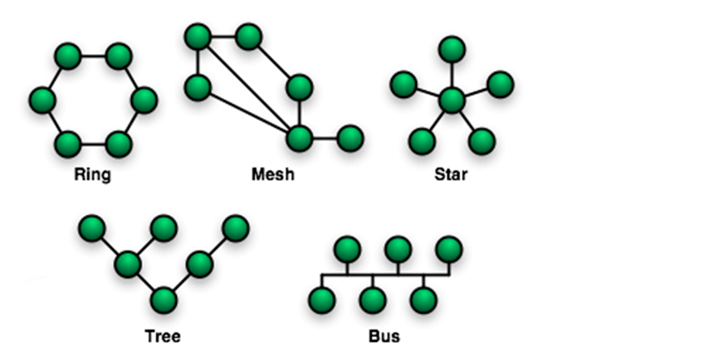
Topology
The logical (idealised) shape of the wiring. You only need to know STAR.

Slide 7
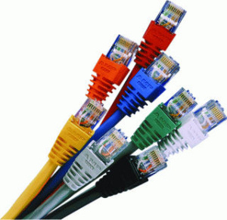
LAN bits
Summary
Cables
Switches
Routers, modems
WAPs
Printers
Internet connections

Slide 8
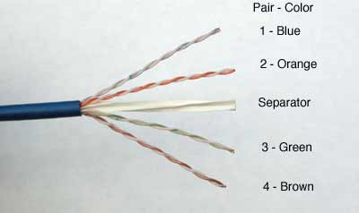
CABLES
UTP
Category 6 (CAT6)
Maximum length:
about 100 metres
Twisted wire core
Electrical signals
RJ45 connectors
Top data bandwidth: 1Gbps (gigabit per sec)
1Gb = 1000 megabits = 1000 million bits

Slide 9
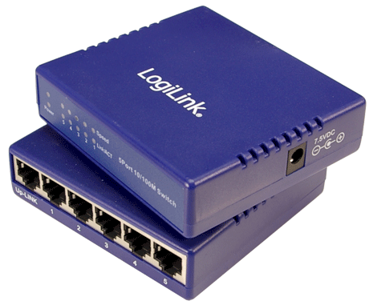
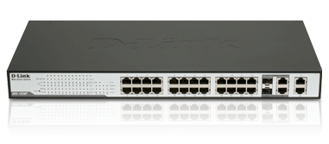
Switch
Short for ‘switching hub’
Lets CAT cables connect up and branch out
6 port switches
24 port switch

Slide 10
Switch
Switches are smart: only send network signals to their intended recipient, unlike dumb hubs which broadcast every packet to every node.
Node = any device on network that sends/receives data packets
Typically has 4, 6, 8, 12, 24 ports
Speeds usually 100Mbps or 1000 Mbps

Slide 11
Hub behaviour
PC1
PC2
PC3
SERVER
Sends
Packet to PC6
HUB
PC4
PC5
PC6

Slide 12
Switch Behaviour
PC1
PC2
PC3
SERVER
Sends packet to PC6
SWITCH
PC4
PC5
PC6

Slide 13
Router
4 roles in networks...
Protect LAN from outside world (firewall)
Guide packets of data from source to destination
Divide LANs into logically separate segments with different privileges/restrictions
Act as a gateway to join dissimilar networks together

Slide 14
IMPORTANT
The box you have on your home network may be called a ‘router’ but it’s usually
A switch (the ports on the back)
A router (invisible circuitry inside the box)
An ADSL modem
A WAP (if it has antennae)
Perhaps a USB print server to share printer amongst computers on the LAN
But...

Slide 15
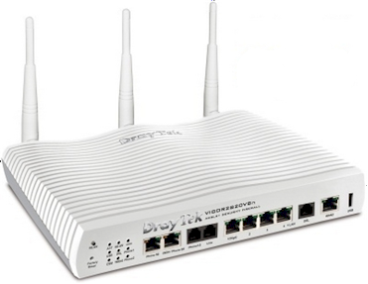
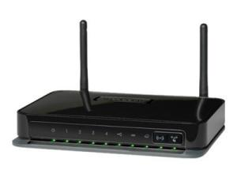
A SWITCH IS NOT A ROUTER!

Slide 16
Wireless Access Point
Can be a separate box, usually high up on the wall with antennae sticking out of it
Can be built into a SOHO (small office/home office) router box.
Connects wireless devices to a normal wired network
802.11 standard
A,b,g,n variants, each with different speeds

Slide 17
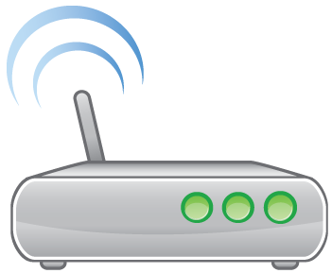
WAP
Must have encryption turned on to protect from bandwidth leechers or hackers
WPA2 encryption currently the best
Don’t use weak WEP encryption
Max theoretical speed 54Mbps
Signal strength reduced by distance, obstacles, interference from other wireless devices

Slide 18
Wireless
Good for providing flexibility to a wired network
Easy to add/detach occasional users (e.g. Boss’ laptop, visitors)
Good for temporary LAN, e.g. consulting at a client’s building for a few days
Good for mobile users (e.g. stocktake in library or warehouse)

Slide 19
Printers
Four main choices to connect a shared printer to a LAN...
Plug it into one of the computers and share it with File and Printer Sharing.
Pro: easy to do; no extra equipment needed
Con: the computer with the printer attached needs to be turned on if anyone is to print

Slide 20
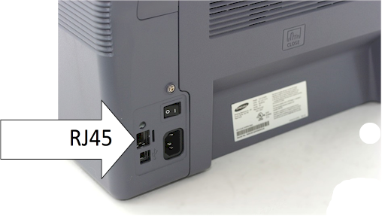
Printers
Get a networked printer
Built-in NIC lets it plug into a switch and be shared easily.
Pro: no particular PC needs to be turned on
Con: extra expense getting a networked printer.

Slide 21
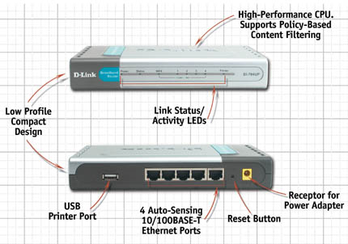
Printers
3. Get a router/switch/modem box with a print server built into it
Pro: cheaper than networked printer; no 1 PC needs to be turned on.
Con: harder to find
Printer port

Slide 22
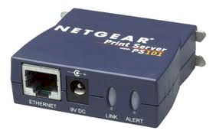
Printers
4. Buy a separate print server box
CAT6 to connect it to the LAN
USB cable to connect to printer

Slide 23
Internet connection
Choose from:
Dialup – slow (e.g. 40Kbps), prone to dropouts, cheap, can’t use phone when internet is in use; can be connected wherever there’s a phone plug.

Slide 24
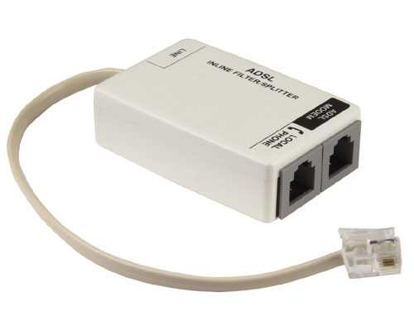
Internet connection
ADSL, ADSL2, ADSL2+ – always connected; can be relatively cheap; can be fast; not available in all places; gets slower the further away is the phone exchange; can be very fast (24Mbps theoretical max)
ADSL splitter allows both a computer and phone to connect to the same line.

Slide 25
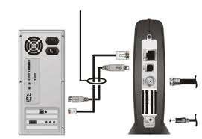
Internet connection
Cable internet – fast (10-20 Mbps); restricted coverage even in cities; bandwidth shared with others in your area

Slide 26
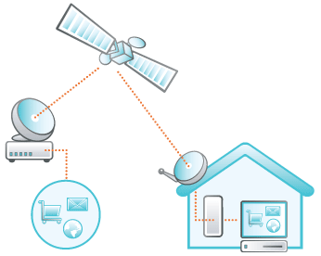
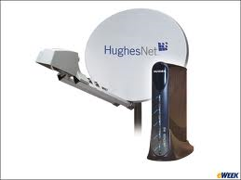
Internet connection
Satellite – used in remote areas; expensive; rather slow (e.g. 256Kbps) ; requires big dish on roof

Slide 27
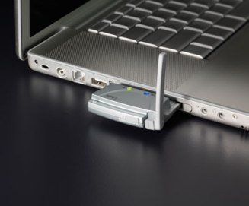
Internet connection
Wireless broadband – good for mobile people; pretty expensive downloads; can be slow; limited coverage; can be black spots with no signal.
Uses same technology as mobile phone internet connection

Slide 28
Internet connection
Dialup and broadband wireless are the only ones that can be used away from the location in which they are installed!
ADSL, satellite and cable modems only work where they were set up.

Slide 29
DHCP
Dynamic Host Configuration Protocol
Allocates IP addresses to computers and other devices needing internet access

Slide 30
Static IP addresses
Static IP addresses do not change – like a phone number
Commonly found with ADSL & cable internet connections
It means that a computer or server can be found at the same location at any time

Slide 31
Dynamic IP addresses
Dynamic IP addresses change every time you connect to the internet.
Typically found with dial-up internet connections.
When you dial the ISP, their DHCP server allocates you an IP address for the duration of your connection.
Like a seat on a train, you’ll probably never get the same address again.

Slide 32
Local IP addresses
At home, school or office, you can’t afford a separate IP address for each device connected to the internet
Instead, use local IP addresses that only exist within your LAN

Slide 33
HOME
ISP
MODEM
The rest of the world finds your home by its public IP address which your ISP gives you.
IP ADDRESS
212.75.1.55

Slide 34
HOME
PC
ISP
MODEM
IP ADDRESS
212.75.1.55

Slide 35
HOME
PC
10.1.1.1
ISP
MODEM
SWITCH
PC
10.1.1.2
But multiple devices need to use the modem’s DHCP service to give local IP addresses
IP ADDRESS
212.75.1.55

Slide 36
HOME
NAS
10.1.1.4
PC
10.1.1.1
ISP
MODEM
SWITCH
PC
10.1.1.2
PC
10.1.1.3
Local devices find each other by their local IP address
IP ADDRESS
212.75.1.55

Slide 37
HOME
NAS
10.1.1.4
PC
10.1.1.1
ISP
MODEM
SWITCH
PC
10.1.1.2
PC
10.1.1.3
Local devices find each other by their local IP address
IP ADDRESS
212.75.1.55

Slide 38
HOME
NAS
10.1.1.4
PC
10.1.1.1
ISP
MODEM
SWITCH
PC
10.1.1.2
PC
10.1.1.3
IP ADDRESS
212.75.1.55

Slide 39
HOME
NAS
10.1.1.4
PC
10.1.1.1
ISP
MODEM
SWITCH
PC
10.1.1.2
PC
10.1.1.3
This PC wants to get a web page
IP ADDRESS
212.75.1.55

Slide 40
HOME
NAS
10.1.1.4
PC
10.1.1.1
ISP
MODEM
SWITCH
PC
10.1.1.2
PC
10.1.1.3
Sends its request to the modem
IP ADDRESS
212.75.1.55

Slide 41
HOME
NAS
10.1.1.4
PC
10.1.1.1
ISP
MODEM
SWITCH
PC
10.1.1.2
PC
10.1.1.3
Modem sends the request to the ISP, identified as 212.75.1.55
IP ADDRESS
212.75.1.55

Slide 42
HOME
NAS
10.1.1.4
PC
10.1.1.1
ISP
MODEM
SWITCH
PC
10.1.1.2
PC
10.1.1.3
Web page comes back from the internet to address 212.75.1.55
IP ADDRESS
212.75.1.55

Slide 43
HOME
NAS
10.1.1.4
PC
10.1.1.1
ISP
MODEM
SWITCH
PC
10.1.1.2
PC
10.1.1.3
Modem passes the page to the computer that requested it via its local IP address
IP ADDRESS
212.75.1.55

Slide 44

Creating Network Diagrams
Network diagrams design the components of a LAN
Software
Visio
Inspiration
Makes adjustments easier than by hand-drawing or using MS Word shapes

Slide 45
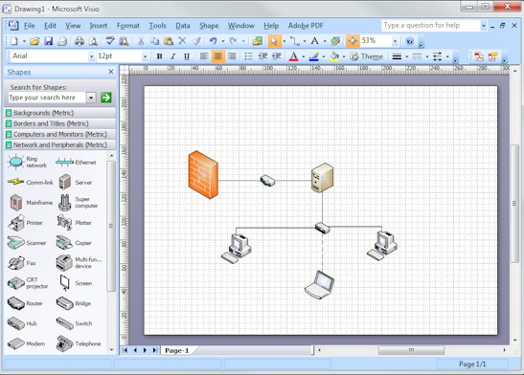
Visio
Drag & drop components.
Click an item and drag to another item to connect them.

Slide 46
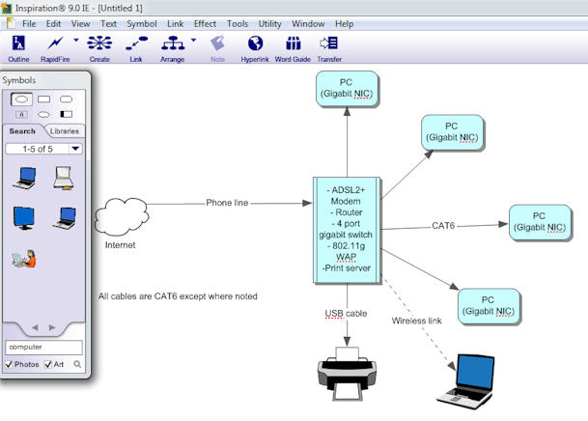
Inspiration
Also has easy connectors. Lots of shapes available.

Slide 47
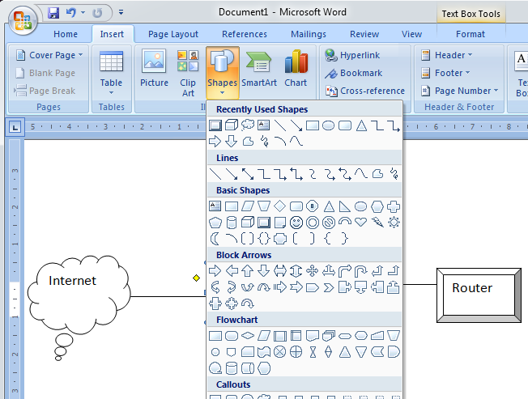
MS Word
A bit clumsier to use.

Slide 48
Network Diagrams
You can summarise rather than labelling repetitively (e.g. “All cables are CAT6 except where noted)
Indicate key information such as speeds (e.g . Gigabit NIC), size (e.g. 4 port switch), features (e.g. 802.11g WAP)
Spell out the components within the router box

Slide 49
Network diagrams
Make it really clear what is connected to what
Make it a good size so it doesn’t become crowded or hard to interpret
When hand-drawing, try using graph paper and Mathomat to keep it neater
There are no strict rules about what shapes represent which network components

Slide 50
Network diagrams
Pay close attention to the case study to work out what network design is appropriate
Especially whether a file server is needed or not
Don’t create a client-server LAN unless you really need to (too expensive and hard to maintain)

Slide 51
Tips
Never recommend hubs. Use switches.
Never use coaxial cable.
Nowadays, never recommend components less than 100Mbps
Prefer gigabit speed components, especially in servers

Slide 52
Thanks!
Applied Computing Slideshows
by Mark Kelly
vcedata.com
mark@vcedata.com
This slideshow may be freely used in schools in Victoria, Australia.
For other uses, (e.g. publication) please contact me.
It may not be sold.
It must not be redistributed if you modify it.

