Slide 1
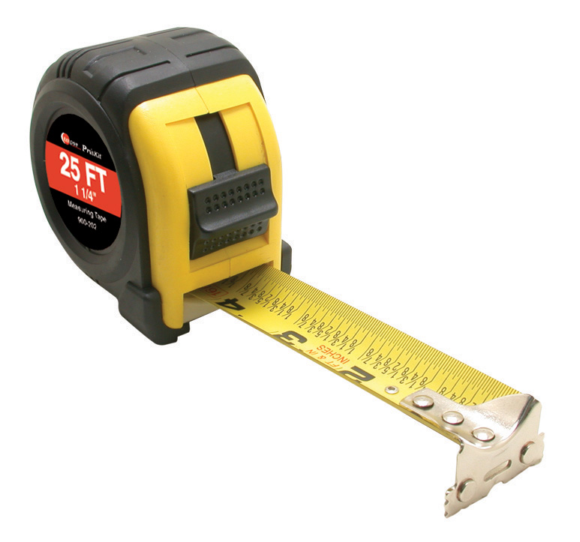
Applied Computing Slideshows by Mark Kelly vcedata.com mark@vcedata.com
A little theory on
Measuring
Network
Reliability

Slide 2
Contents
Techniques for measuring the reliability and maintainability of networks, including
audits
error logs
software tracking tools

Slide 3

‘Reliability’?
How much you can safely rely or depend on the network to do its job.
How much you can trust it to work properly.

Slide 4
‘Maintainability’
To what extent can the network be maintained (kept in working order)?
At some point, most technologies cannot be maintained and must be replaced. E.g.
they can no longer be expanded with new desired functionality (e.g. no new compatible software modules, RAM slots full)
they cannot be repaired any more (e.g. parts are no longer available; noone knows how to fix it)
they are technologically out of date (e.g. no PCI slots)

Slide 5
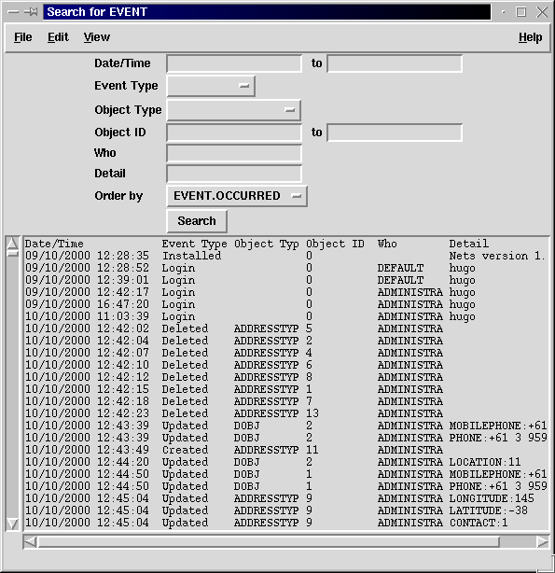
Audits
Audit trails record every action taken by network users.
It records actions taken and the success or failure of the actions.

Slide 6
Audits
One can find if a system is not performing well if many failures are recorded.

Slide 7
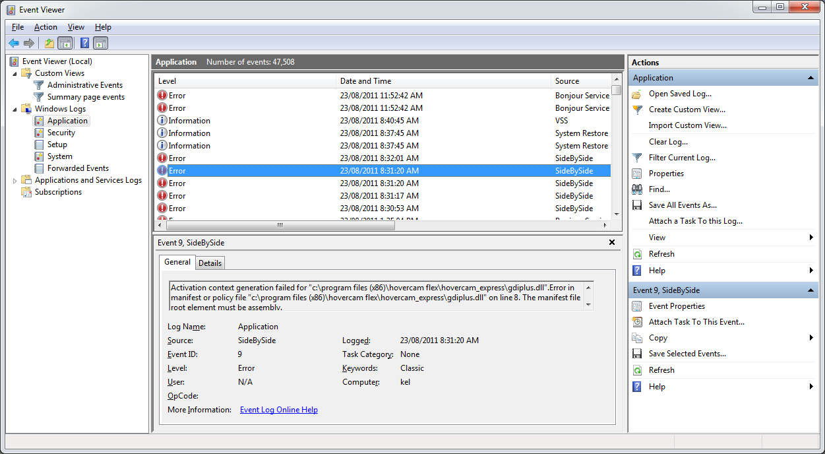
Error logs
Networks and PCs can record errors automatically in logs that can be inspected later to which show components need to be checked out.

Slide 8
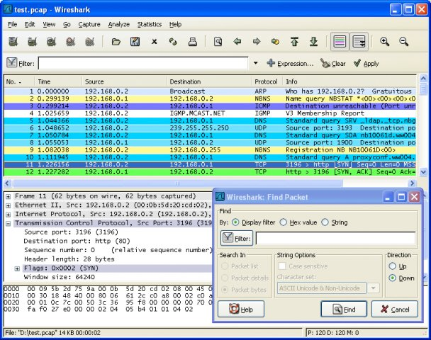
Software Tracking Tools
Wireshark – tracks network activity & problems
IPCONFIG
Ping
Traceroute
Packet sniffers
etc

Slide 9
Applied Computing Slideshows
by Mark Kelly
vcedata.com
mark@vcedata.com
These slideshows may be freely used, modified or distributed by teachers and students anywhere on the planet (but not elsewhere).
They may NOT be sold.
They must NOT be redistributed if you modify them.

