Slide 1

Applied Computing Slideshows by Mark Kelly vcedata.com mark@vcedata.com
Problem Solving Methodology 4
EVALUATION
Last changed
2024-03-15 @ 09;45;25

Slide 2

Contents
What it is – and what it isn’t
When
How
What
Methods
Criteria

Slide 3
Evaluation
Evaluation is not testing!
Evaluation does not try to prove the system works. That was established during testing!
Evaluation establishes how successfully the project performs in achieving organisational goals and objectives.
i.e. is it doing the job it was created for?

Slide 4

Evaluation is not testing!
E.g. an organisation wanted to improve profit.
So, they create a website to appeal to young people.
They test the website. It works 100%. Testing result: site is a complete success.
The development team is delighted.
But...

Slide 5
Evaluation is not testing!
They put the website online. Months later they evaluate it.
Profits have not risen because none of the young visitors have credit cards or Paypal.
Evaluation result: the site is a complete failure because it has not achieved its only criterion for success… profit
But it tested perfectly. So, yay?

Slide 6
When to evaluate?
Not too soon after implementation – users still may be still learning it.
Not too long after implementation – users will have forgotten the old system and be unable to compare them.
e.g. how do your current shoes compare with those you had 3 years ago?
Let users use the new system long enough to be comfortable and skilled (e.g. a month of daily use, six months of weekly use)

Slide 7
How to evaluate
Measure whenever possible – time its speed, count its errors, add up its costs etc. Cold, hard facts are more reliable.
Interview or survey only when opinions are being evaluated – e.g. Is it easy to use?, Do you feel comfortable?, Is it fun? Is the output attractive?
Don’t ask “Do you think the new system is faster/more accurate than the old one?” People are bad at that sort of judgement.

Slide 8
What to evaluate
Evaluate the criteria that were specificed during design.
These criteria should be based on the specifications set out in the logical design.
If the original aim was to make a system faster and more accurate, evaluate its speed and error rate.
e.g. if you get a dog for its companionship, don’t evaluate its fuel economy.

Slide 9
Evaluation methods
For each criterion to evaluate (e.g. speed) there needs to be an appropriate method with which to evaluate it. E.g.
Speed – add up how much output the system produced in 3 months.
Accuracy – count the number of errors recorded in the error log
Fun to use – interview users

Slide 10
Remember
Evaluation criteria are topics to study
Evaluation methods are actions taken to study the topic.
Each criterion has a corresponding method.

Slide 11
Efficiency criteria
Efficiency measures are usually expressed as numbers.
Speed, e.g. output produced in a given time
Amount of labour required to use it (e.g. person-hours)
Total Cost of Ownership of the system
Including initial cost, running costs, repairs, upgrades, consumables, training

Slide 12
Effectiveness criteria
Quality of the product. How well it accomplishes its intended goals.
Accuracy / error rate
Reliability
Attractiveness of output, readability
Ease of use, how enjoyable it is

Slide 13


Effectiveness criteria
Accessibility for people with special needs (e.g. age, disabilities, colour-blind men, shaky hands)
Portability
Security
Compatibility with existing equipment
Expandability, flexibility
Ruggedness
Etc

Slide 14
Evaluation Criteria
There’s a slideshow dedicated to evaluation criteria that you might want to look at.

Slide 15
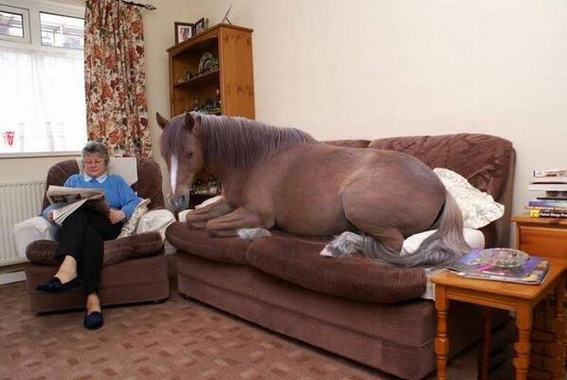
And this is because you’ve been so good

Slide 16
Applied Computing Slideshows
by Mark Kelly
vcedata.com
mark@vcedata.com
These slideshows may be freely used, modified or distributed by teachers and students anywhere on the planet (but not elsewhere).
They may NOT be sold.
They must NOT be redistributed if you modify them.

