Slide 1
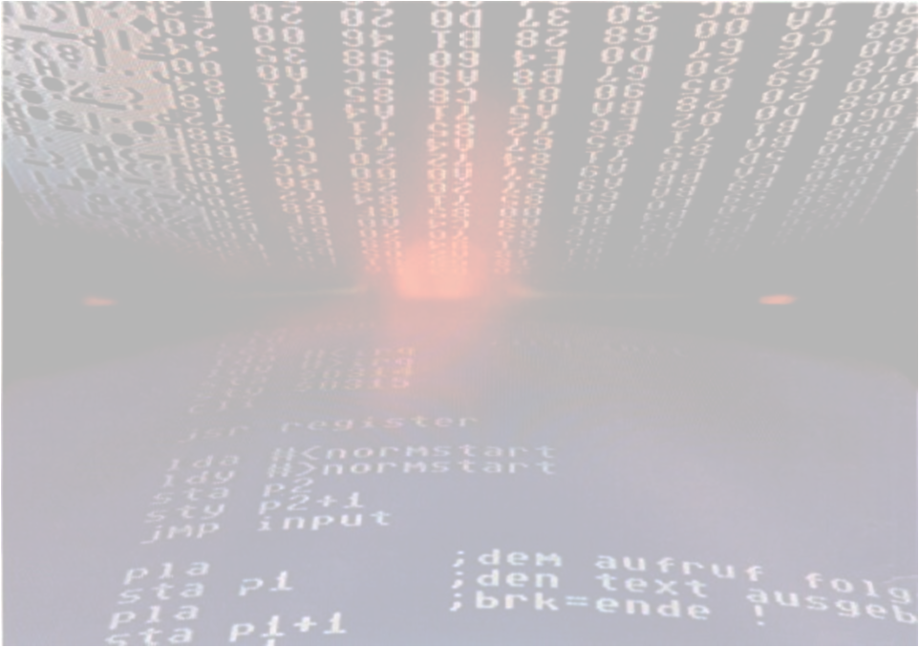
Applied Computing Slideshows by Mark Kelly vcedata.com mark@vcedata.com
Programming Skills

Slide 2
Contents
The basic basics
The programming cycle
Edit source code
Compile & link
Debug
Good and bad practices
Debugging techniques
Some programming terms

Slide 3
The programming cycle
While program not finished
Edit source code
Compile source code into executable code
Debug executable code – find errors
End While

Slide 4
What is a programming language?
A way to control the CPU of a computer to carry out desired operations
Most modern languages consist of
Command statements – e.g MSGBOX, FOR/NEXT
Syntax rules (how to structure & punctuate instructions)
Objects (e.g. textboxes) which have
Methods (open, show)
Properties (e.g. Visible, width, backcolor)
Events which objects can detect and respond to

Slide 5
Languages
There are many computer programming languages (Basic, Java, C, Python, LISP, Cobol etc)
Each has its strengths & weaknesses
Each tends to do better at a particular job
Choose the language for the task in hand
E.g. C for a device driver, Basic for a quick & dirty job.

Slide 6
Object oriented programming
OOP focuses on objects and the events they can detect and respond to
Command buttons carry out instructions when clicked
Listboxes can be scrolled
Objects can be dragged & dropped
Event-driven programming: the system waits for something to happen & then reacts to it.

Slide 7
Basic Basics
Variables – named storage locations in RAM that can hold certain types of data
Variable types - variables can be defined to contain
Numbers (of varying sizes, with or without decimal places)
Text / strings
Dates, times

Slide 8
Numeric variable types
TYPES WITH NO DECIMAL PART
Boolean – stores true or false data, very small
Byte – values of 0-255
Integer – values -32767 to +32767
Long – values up to quadzillions
The higher the possible value stored, the more storage is required.
Aim to use the smallest necessary type.

Slide 9
Numeric variable types
TYPES WITH A DECIMAL PART
Single precision (up to about 7 decimal places)
Double precision (14 decimal places)
Only use these if fractions will need to be stored.
Can store whole numbers (integers) in single/double, but not vice versa!

Slide 10
Variables - example
1. Declare the variable – tell the program that you need storage space
E.g. DIM Age AS INTEGER
DIM Firstname AS STRING

Slide 11
Variables - Example
Initialising variables – giving them a starting value...
Age = 34
Counter = 0
Name = “” (null string – empty)
Some languages let you declare and initialise
e.g. DIM Age as INTEGER = 34

Slide 12
Variables - Example
Using variables
Age = Age + 1
Total = Sub1 + Sub2
Ratio = A / B
H = (Ratio * Distance) / Degrees

Slide 13
Variables - Example
Variable on left of = is assigned the value of the expression on the right of =
Age = Age +1 means
Add 1 to Age, then store the result back in Age.
Shorthand in C, VB … Age += 1
In VCAA pseudocode the left-arrow shows assignment, e.g.
Age ← Age + 1

Slide 14
Arithmetic
Addition +
Subtraction –
Division /
Multiplication *
Exponentiation ^
Also use (parentheses)
Normal order of operations applies

Slide 15
Arithmetic
3 + 4 * 2 / 4
Work left to right
Parentheses first
Multiply or divide next
Add/subtract last
3 + 4 * 2 / 4
3 + 8 / 4
3 + 2

Slide 16
Use parentheses to force order
(3 + 4 * 2) / 4
(3 + 4 * 2) / 4
(3 + 8) / 4
11 / 4

Slide 17
Control structures
Programming components that control the order in which a program executes lines
LOOPS (e.g. FOR/NEXT, DO/LOOP, WHILE/WEND)
IF/AND/OR/ELSEIF/END IF structures
CASE (easy multiple IF tests), e.g.
SELECT CASE age
Case 0 to 2: type = “baby”
Case 3 to 5: type = “toddler”
Case 6 to 12: type = “child”
Case 13 to 19: type= “teen”
Case else: type = “adult”
END SELECT

Slide 18
DATA STUCTURES
Programming components that store data
ARRAYS – 1 dimensional, 2 dimensional, more.
STACKS – temporary, organised data storage
QUEUES – types of stacks used to store incoming data in order until it can be processed (especially when lots of data is arriving at a slow peripheral, like a printer)

Slide 19
Arrays
Group of variables with the same name, but different index numbers
E.g. If you have 1000 people’s incomes and wanted to add them
income1 + income2 + income3 + income4 + income5+ ... + income1000

Slide 20
Arrays
??!! Hopelessly long and difficult and inflexible
What if you didn’t know how many incomes would be there from day to day?
What if you just want to add the first 10, last 100 incomes?

Slide 21
Arrays to the rescue
DIM Incomes(1000)
Means DIMension an array called Incomes with 1000 ‘slots’ (indices)
Refer to array items by name and index
e.g. Incomes(13)

Slide 22
Arrays to the rescue
Most often, a variable is used to address array indices
E.g. Incomes(i) where i contains a value like 13.
‘ convert all names to uppercase
FOR i = 1 to 1000 NAME(i) = UCASE(NAME(i))
NEXT i

Slide 23
Arrays and loops
Arrays really only become powerful with the aid of loops.
Can loop through any number of items in an array with zero effort
For i = 1 to 1000
Total = Total + Incomes(i)
Next

Slide 24
Arrays and loops
Want the last 100 incomes instead? Easy...
For i = 901 to 1000
Total = Total + Incomes(i)
Next

Slide 25
Arrays and loops – built for each other
Want 100,000 incomes instead? Easy...
For i = 1 to 100000
Total = Total + Incomes(i)
Next

Slide 26
Arrays and Loops
Not sure what the starting and ending indices will be needed in future?
Startpoint = Inputbox(“Starting value?”)
Endpoint = Inputbox(“Ending value?”)
For i = Startpoint to Endpoint
Total = total + Incomes(i)
Next

Slide 27
Functions
Predefined calculations defined by the language. Typical ones are
Square root – e.g SQR(num)
Extract characters from the left of a string e.g. LEFT(name,1)
Convert string to uppercase, e.g. UCASE(name)
e.g. Fullname = LEFT(gname,1) & “.” & Surname
Functions can be nested e.g.
Name = ucase(left(gname,1)) & mid(gname,2,999)

Slide 28
Putting it together
DIM sinvalue(180)
For v = 1 to 180
Sinvalue(v) = SIN(v)
Next
Note the indentation of the 3rd line to show it’s controlled by the FOR loop?

Slide 29
Two ways
Use separate tools: source code editor (e.g. Notepad ++), compiler, linker, debugger
Can choose your own favourite tools
More work involved
Use an integrated editor/compiler/debugger (IDE – integrated development environment)
Convenient
If you dislike a component, you have no choice

Slide 30
Some Terms
Source code
Plain human-readable text computer programming code
Cannot be directly run as a program
E.g. ‘For i = 1 to 100’
Executable code
Pronounced “ex ECK you tbl” not “exe CUTE abl”
Source code has been converted into instructions a specific CPU can read and obey
Usually stored as an “EXE” file

Slide 31
More terms
Interpreter
Instead of editing, compiling to executable, source code is converted to executable code every time it is run by the interpreter.
Pro: Is quicker to develop a program because the slow compilation step is omitted in the edit/compile/run loop.
Pro: Run the same source in different interpreters to run the same program on several platforms
Con: Interpreters usually execute more slower than compiled code.

Slide 32
Platform?
Source code is compiled to run on a specific CPU with its specific instruction set (e.g. Intel, AMD, PowerPC)
Cannot run a compiled program on a computer with a different CPU without porting (compiling it again for the other CPU) or emulation.

Slide 33
Emulation
Emulation: software that translates executable code from one CPU’s instruction set into the target platform’s instruction set.

Slide 34
INTERNAL DOCUMENTATION
Comments added to code for programmers to read
Explains what the code is doing
Should be non-trivial
Modules should begin with comments about
the module name
its author(s),
last revision date,
notes on known problems or what needs to be added next.

Slide 35
Debugging
Finding errors in code
Types of errors:
Syntax errors
Logical errors
Runtime errors

Slide 36
Syntax errors
When the source code is not in a format that the compiler or interpreter can understand
For example:
PRONT “Hello” (mistyped keyword)
PRINT ‘Hello’ (punctuation error)
RND(0) instead of RAND(0) or RANDOM (wrong keyword)

Slide 37
Syntax Errors
Very easy for a compiler/interpreter to find and tell you about
Usually easy for you to fix

Slide 38
Logical Errors
The source code’s format and punctuation is correct, but it does not produce the expected answer
Usually a fault of the algorithm
Since no warnings appear, logical errors can be hard to find without extensive testing

Slide 39
Logical errors
E.g. Wanting to increase a number by 10%
Using this: X = X + 10%
Actually adds 0.1 to X.
Needed X = X + (X*10%)

Slide 40
Runtime errors
Syntax is perfect
Logic is correct
Something bad occurs during execution, e.g.
Lost network connectivity
Jammed printer
Running out of memory or disk space
Operating system failure

Slide 41
Analogy
Syntax error: trying to board a bus through the exhaust pipe
Logical error: getting on the wrong bus
Runtime error: the bus breaks down

Slide 42
Debugging Techniques
Use modular programming (more later) to reduce the amount of code you have to wade through to find the error.
Inspect the values of variables line by line until the fault appears
Set breakpoints to pause execution and let you inspect values

Slide 43
Debug
Reduce the amount of active code “remming out” code (converting it to comments) to isolate the faulty code.
Use MSGBOX statements to show program flow (which parts of code are being executed). You might assume a module or branch of an IF statement is executing whereas it’s not even getting that far.
Use DEBUG PRINT to show values during execution

Slide 44
Debugging
Look for patterns. Code often includes similar lines but one might be subtly different which highlights the error.
Use code indenting so missing or misplaced parts of structures, loops etc are highlighted.
Be persistent and logical and detailed.

Slide 45
Logical
Say you have 10,000 lines of data.
One of those lines has an unexpected value that is crashing your program
Search 10,000 lines one by one?
Another strategy?

Slide 46
Better!
Divide data into 2 chunks of 5,000 lines each
Find which one abends (“abnormally ends”) your code.
Take that chunk and divide it in two.
Repeat until the remaining chunk is so small you can manually check lines for the error.
This is an example of a binary search.

Slide 47
How much better?
10 lines = 3 iterations (repetitions) to reach a handful of possible lines
10, 5, 2
100 lines = 5 iterations
100, 50, 25, 12, 6, 3
10,000 lines = 11 iterations
10000, 5000, 2500, 1250, 625, 312, 156, 78, 34, 17, 8, 4
Certainly quicker than 10,000 iterations!

Slide 48
Algorithms
The difference between the 10,000 check method and the 11 check method is based on the logic underlying the procedures.
The logic behind a calculation method is an algorithm.
The algorithm is the secret ingredient that makes one program 100 times better than another.

Slide 49
Algorithms
Compare Google Page Rank algorithm with the inaccurate algorithms used before it
Compare shell sort algorithm with bubble sort
Compare searching with hash codes with a line-by-line search
Compare sorting with an index and sorting by swapping values in an array.

Slide 50
Algorithms
Expressed as pseudocode
Describes the strategy of the calculation without using 100% accurate syntax
Can be converted into the right syntax for any language during coding.

Slide 51
Pseudocode example
Grade_counter ← 1
While grade_counter is <= 10
Input the next grade
Add the grade into the total
Class_average ← total/10
Print class_average.

Slide 52
Variable declarations
Some strongly typed languages force you to declare variables before they’re used
Other languages make it optional (e.g. Visual Basic’s OPTION EXPLICIT)
Better to declare before use
Lets compiler detect mistyped variable names
Also lets the compiler warn you of unused (orphaned) variables.

Slide 53
Variable declarations
Get the variable type as close as you can to its optimal use
E.g. If a value is never going to have a decimal part, don’t make it floating point (real, decimal)

Slide 54
Test time
1. List examples of
a) An object
b) A method
c) A property
d) An event
2. What is a variable?
3. What is another name for string?
4. What is the biggest number a byte can contain?
5. Give an example of data that should be stored as type Boolean.

Slide 55
6. What happens when you
a) Declare a variable
b) Initialise a variable
7. What is the value of X produced by this code?
A=2
B=3
C=4
X = A+B*C

Slide 56
8. What is the answer to 2^3?
9. Rewrite the code in question 7 using standard SD exam pseudocode.
10. What output would the following code produce? (Be careful! Tricky question)
DIM num(10) AS INTEGER
FOR i = 1 to 10
num(i) = i*2+i/10
NEXT i
PRINT num(5)

Slide 57
11. Explain the difference between a subprogram and a function.
12. Give one reason to practise modular programming.
13. What is the role of a compiler.
14. Give a small example of source code.
15. Define:
a. Porting
b. Emulation
c. Platform

Slide 58
16. List the three types of programming errors and give an example of each.
17. What is debugging?
18. Explain the importance of indenting source code.
19. What is an iteration?
20. What is an algorithm?
21. What is an invariant calculation and why is it bad?
22. What is an orphaned variable?

Slide 59
8. What is the answer to 2^3?
9. Rewrite the code in question 7 using standard SD exam pseudocode.
10. What output would the following code produce? (Be careful! Tricky question)
DIM num(10) AS INTEGER
FOR i = 1 to 10
num(i) = i*2+i/10
NEXT i
PRINT num(5)

Slide 60
8. What is the answer to 2^3?
9. Rewrite the code in question 7 using standard SD exam pseudocode.
10. What output would the following code produce? (Be careful! Tricky question)
DIM num(10) AS INTEGER
FOR i = 1 to 10
num(i) = i*2+i/10
NEXT i
PRINT num(5)

Slide 61
Applied Computing Slideshows
by Mark Kelly
vcedata.com
mark@vcedata.com
These slideshows may be freely used, modified or distributed by teachers and students anywhere on the planet (but not elsewhere).
They may NOT be sold.
They must NOT be redistributed if you modify them.

