Slide 1

Applied Computing Slideshows by Mark Kelly vcedata.com mark@vcedata.com
Searching
Techniques

Slide 2
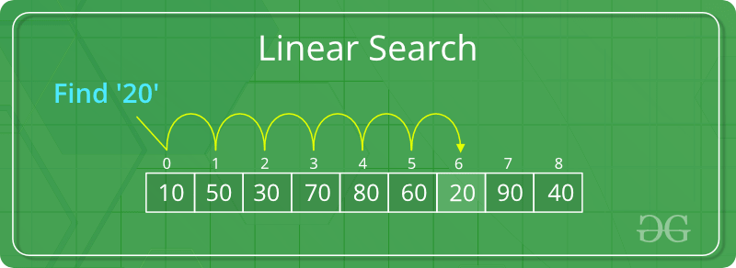
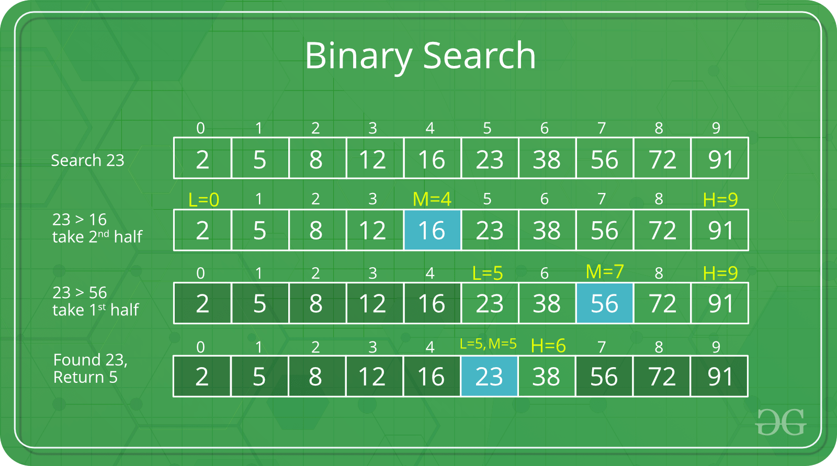
Contents
Linear search
Binary search

Slide 3
When searching is required
You have thousands of clients on file and you need to find one client’s record
In a list of a thousand exam results, you need to find all those who failed and count them.
You need to find the smallest value in a list.
When processing surveys, you develop a list of unique responses. For each response, you need to search the list to see if it already exists.

Slide 4
Linear search
Go to the first item in the list.
Compare the list item with the target value.
If it does not match, move to the next item.
Go to step 2 unless the list is finished.
PROS: the only option you have if the list is unsorted. Easy to code.
CON: slow (up to N comparisons needed to search a list of N items)

Slide 5
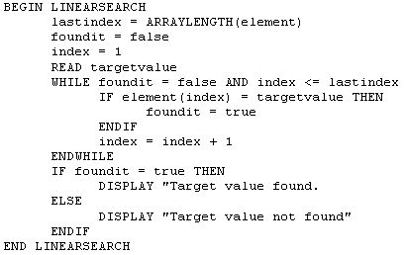
Linear Search Algorithm

Slide 6
Binary Search
Rule #1 = Can only be used if the data is sorted
A simple algorithm:
find which half of the data the value should be in.
Ignore the other half of the data.
repeat until data is found, or is known not to exist.

Slide 7
Binary Search
Algorithm:
Divide the data set in half
Is the value being sought less than or greater than the half-way value?
Throw away the wrong half.
Repeat
In only a few comparisons the value will be either found or proved not to be in the data set

Slide 8
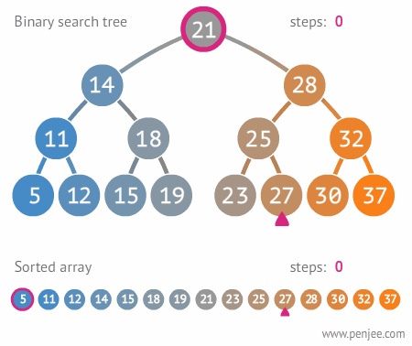
Pros/Cons of Binary Search
+ Far faster than linear search – rarely need more than 5 comparisons
- Data must be sorted, which takes processing time and computing effort

Slide 9
Binary Search Pseudocode
Found ← false
Start ← 1
End ← data array size
While not found
Halfway ← (start + end) /2
Halfwayvalue ← value of item at index halfway
If ValueBeingSearched = Halfwayvalue then
exit (value was found)
Else
if valuebeingsearched < halfwayvalue
end ← halfway ’ ignore top half of data set
else
start ← halfway ’ ignore bottom half of data set
end if
if start >= end then display “Data not found”
End if
End while

Slide 10
A Practical Binary Search Demo
Pick a word – any word
Pick up a dictionary
Open the pages to about their middle
Is the word before or after the open page?
Ignore the half of the dictionary that doesn’t contain the word.
Repeat from step 3 until you find the word’s page, or find the word is not in there.
End.

Slide 11
For example
1000 page book. We’re looking for page 296
Start = 1, End = 1000
Success in 6 comparisons.
Linear search would have taken 296 comparisons
PASS | HALF WAY | Test | New Start | New Half | New End
1 | 500 | 296 < 500 | 1 | 250 | 500
2 | 250 | 296 > 250 | 250 | 375 | 500
3 | 375 | 296 < 275 | 250 | 312 | 375
4 | 312 | 296 < 312 | 250 | 281 | 312
5 | 281 | 296 > 281 | 281 | 296 | 312
6 | 296 | 296 = 296 | End!

Slide 12
Which to choose?
If linear search was always worse than binary, it would no longer exist.
The fact the it still exists means it has a purpose.
It’s much easier to program = saves time.
Data does not have to be kept sorted = Saves processing.
A good, easy choice if there will never be a lot of data to search. (Warning – over time, data often grows far bigger than originally expected!)
If searching time is not an issue, linear is fine.

Slide 13

Exam Tips
Do not confuse searching (linear, binary) with sorting (selection, quick) - it happens far too often. Read questions really carefully looking for this.
If asked which search to use in a scenario, consider :
If the scenario says the data are sorted, choose binary. Otherwise, only linear can work.
If the question stresses that there is a lot of data or that speed is essential, go for binary.

Slide 14
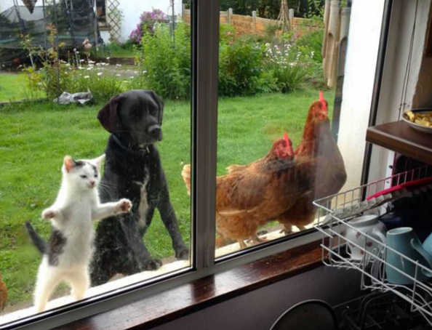
Question: Should you use a binary or linear search to find the dog in this picture?

Slide 15
Answer: Neither. Call “Here boy!”

Slide 16
Applied Computing Slideshows by Mark Kelly vcedata.com mark@vcedata.com
These slideshows may be freely used, modified or distributed by teachers and students anywhere on the planet (but not elsewhere).
They may NOT be sold.
They must NOT be redistributed if you modify them.

