Slide 1

Applied Computing Slideshows by Mark Kelly vcedata.com mark@vcedata.com
Testing Network Security

Slide 2
Remember
Criteria = what is being measured
Techniques = how to measure them
Bonus reminder
1 criterion
2 or more criteria

Slide 3
Criteria for testing network security
Cost of establishing & maintaining security
The amount of effort needed to enforce security
How long it takes to follow security procedures
How quickly security measures kick in when a threat is detected

Slide 4

Criteria for testing network security
How reliable the security measures are – can you trust them to work?
How accurate the security is – especially
false positives (alerts that are wrong)
false negatives (real threats that are not detected)

Slide 5
Criteria for testing network security
How many types of threats the system can detect and cope with
How resistant the security is to interference or penetration
How up-to-date the security is – can it cope with new threats?

Slide 6
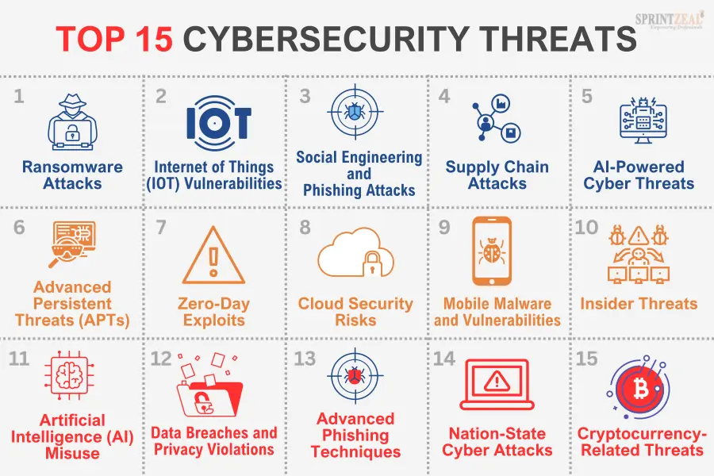

Slide 7

Techniques for testing security
Simulate known threats and measure system response in terms of speed, accuracy and effectiveness of its reaction
Hire an expert outsider (e.g. a network testing organisation or a reputable “grey hat”) to test the security with a thorough penetration test (“pen test”), and report its weaknesses

Slide 8

Testing Techniques
Attempt to ‘socially engineer’ staff to see if anyone divulges sensitive network information (e.g. passwords)
Send staff members an unexpected email with a (harmless) executable attachment and record how many run it. (The exe file could record its running in a log on the network)

Slide 9
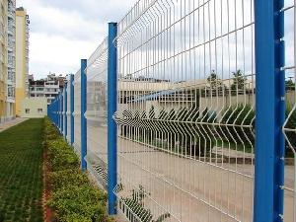
Testing Techniques
Test the physical security of the system, including doors, windows, fences, swipe cards etc.

Slide 10
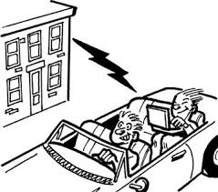
Wardriving
Try getting access to a wireless access point from outside the organisation’s grounds.

Slide 11
Applied Computing Slideshows
by Mark Kelly
vcedata.com
mark@vcedata.com
These slideshows may be freely used, modified or distributed by teachers and students anywhere on the planet (but not elsewhere).
They may NOT be sold.
They must NOT be redistributed if you modify them.

