Slide 1

Applied Computing Slideshows by Mark Kelly vcedata.com mark@vcedata.com v1.1 – 2022-02-18 V2 - 2024-09-04
User Acceptance Testing

Slide 2
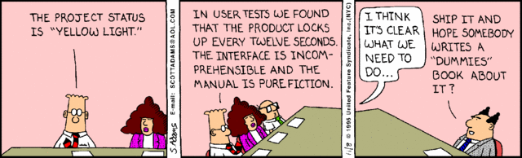
User Acceptance Testing (UAT)
Formal testing of whether the intended end-user of a system or product is happy with the way it carries out its functional and non-functional requirements.
i.e. do average users think it works right?

Slide 3

UAT happens
When Informal (alpha)testing by developers is complete
i.e. the programmers have tested and (hopefully) fixed all the bugs.
The client (the one who is paying for the solution) is happy that the solution satisfies all functional and non-functional requirements.
But is the solution suitable for real users?

Slide 4
UAT
Typical end-users are used for UAT
not managers
not programmers
not clients who paid for the solution
Only actual real-life users can tell if a product has problems that an expert or non-user would never notice

Slide 5
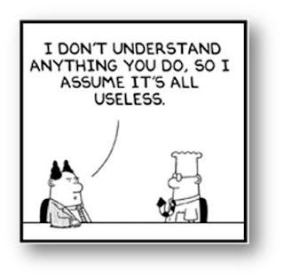
UAT
e.g., a supermarket manager would not know the pain of using an awkward checkout register 8 hours a day
an IT expert would assume that certain dumb acts could never be committed - but an average user might be so ‘dumb’ – especially with no training or documentation
Real checkout operators would know what usually goes wrong and can point out those failings

Slide 6


What is the purpose of UAT?
To demonstrate that the system is fit for real use by real people in the business.
Is different to system testing which proves that the system behaves as promised in the original design.
A product could satisfy the design but still be a never-ending pain for its users.
Developer
Manager
Solution purchaser
Daily user

Slide 7
What UAT sounds like
Developer: The product should respond briskly. Proof: I click here, and we get instant response.
User: OK.
Developer: The product should be easy to read. See the font size and colours we used? OK? Proof!
User: They’re fine.
Developer: Help needs to be contextual. See, I open this and press F1 – relevant help appears. Voila!
User: Yep. OK. But that help makes no sense. If I click here I’d expect it to expand, but it doesn’t. I have to go up to a menu and that’s a pain, and why does it takes two clicks to…

Slide 8
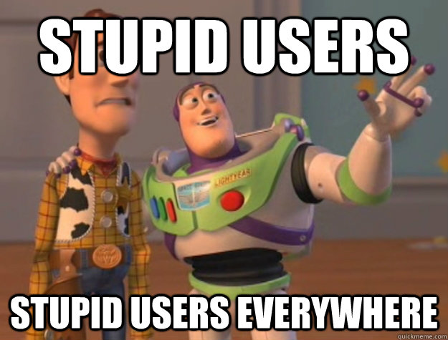
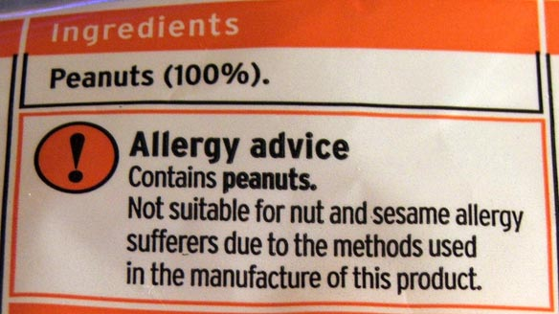
After successful UAT
The product is known to be suitable for use by real-world average users.
Even if they’re not the brightest people – good products often have to cater for them.

Slide 9
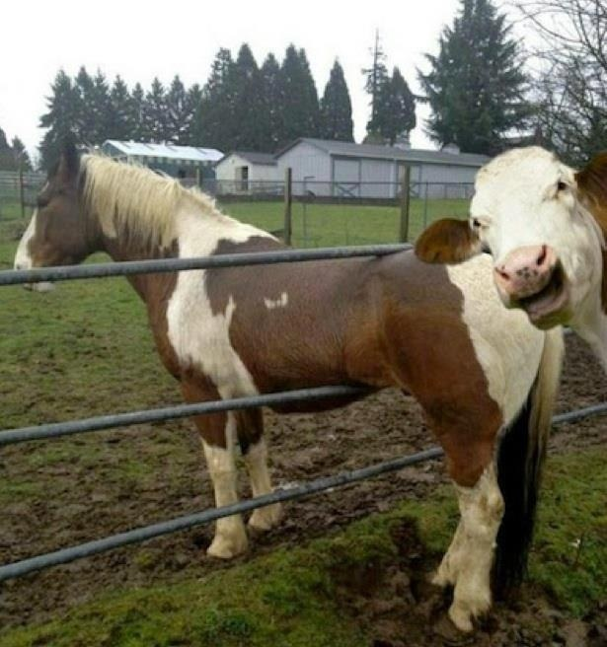
Because you’ve been good

Slide 10
Applied Computing Slideshows by Mark Kelly vcedata.com mark@vcedata.com
These slideshows may be freely used, modified or distributed by teachers and students anywhere on the planet (but not elsewhere).
They may NOT be sold.
They must NOT be redistributed if you modify them.

