Slide 1


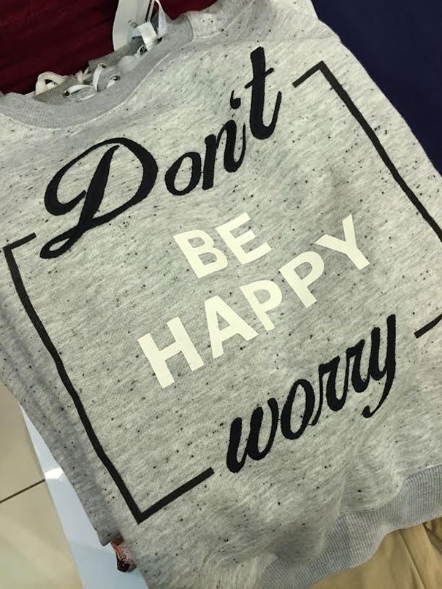
Affordance
(not “affordability”)
v2 – 2024-08-26 @ 12;20;14
v1 – 2022-02-09 @ 10:45

Slide 2
Affordance
Has nothing to do with cost or affordability!
(The 2016 study design got the two confused)
Affordance = the quality or property of an object that
defines its possible uses or
makes clear how it can or should be used
e.g. a 3 dimensional button image on a webpage is crying out to be clicked...

Slide 3
Affordance
Users perceive actions to be possible based on the design of an interface
Good design = users easily when actions are possible and productive... and when to wait.

Slide 4
Affordance

Slide 5
Affordance
A large, very visible, impossible-to-ignore, in your face clue to what a user should do may be called an explicit affordance (not examinable).
These often are seen after updating an operating system – constant popups saying things like
This is new. Have you noticed this? Click here >>>”

Slide 6
Affordance
Sensory affordance (not examinable)
Beeps, vibration when email arrives
Colour / size / formatting changes to show changes in an object’s state (e.g. an icon of a document that has been edited might turn from green to red to show it needs to be saved; a shopping cart icon may become bold when any item is in it)

Slide 7
Anti-Affordance ?
(No such term – I just made it up.)
Consider interface design where a desired or possible human action is impossible to discover intuitively?
e.g. to see the definition of a word, users must hold down the CTRL key and click a word.
How could the average user ever have discovered this without memorising the user manual?
That is not affordance!

Slide 8
Anti-Affordance ?
(No such term – I just made it up.)
We get used to poor affordance with experience
pressing CTRL+V to paste text
right-clicking on an item to get a menu
pressing CTRL+ALT+DEL to raise a task manager
These are not intuitive and offer no affordance.

Slide 9
Anti-Affordance ?
(No such term – I just made it up.)
When affordance goes wrong...
false affordance* – when an action looks like it will do a task, but it does something else.
hidden affordance* – when a function is available, but is not easily detectable by the user
* not examinable, but nice to know

Slide 10
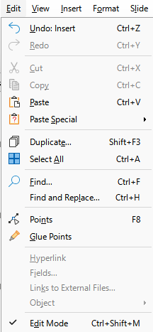
Affordance
Negative affordance (not examinable)
Stopping users doing dumb or impossible things
Greying out impossible options
No relevant item is active, so these options are greyed out to mark their unavailability

Slide 11
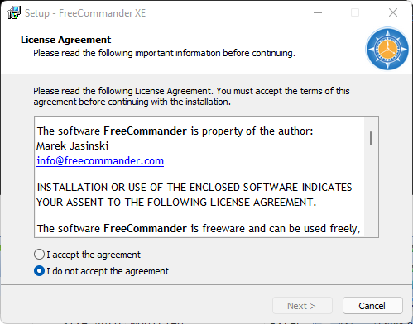
Affordance
Negative affordance (not examinable)
Preventing progress until desired conditions are met
Can’t proceed until agreement is accepted

Slide 12
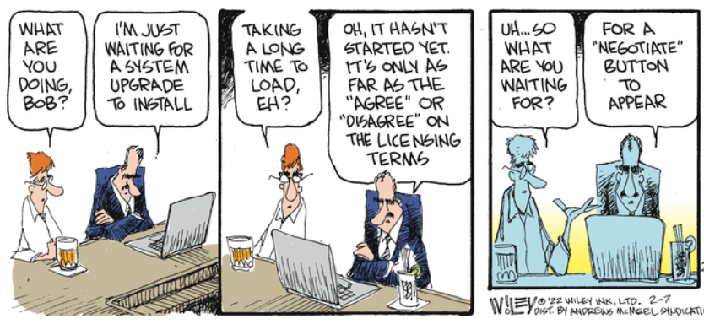
Affordance

Slide 13
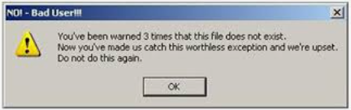
How to create or improve affordance
Test the UX (user experience)
Watch real target users use your solution.
Don’t use developers to test affordance because they know how things should work and will not make rookie mistakes.
What mistakes do users make? Why? Ask them.

Slide 14
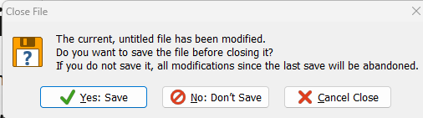
How to create or improve affordance
Do they fail to notice intended functionality? Offer pop-up tips or better documentation.
Do they become frustrated? Ask why. Get feedback.
Record their typing, clicks etc to analyse their performance. Warning – there will be privacy issues even if you tell users they are being monitored!
Improve the user documentation when affordance can’t easily be improved. e.g. provide video tutorials.
Ask for confirmation before doing anything destructive - e.g. not saving data before closing an app.

Slide 15
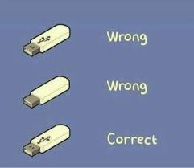
Getting affordance wrong
The inventor of USB (Ajay Bhatt) has long regretted his failure to make it clear which way up to insert a USB device.
To do it right was beyond the budget of his team.
https://mashable.com/article/usb-inventor-explains-difficulty

Slide 16
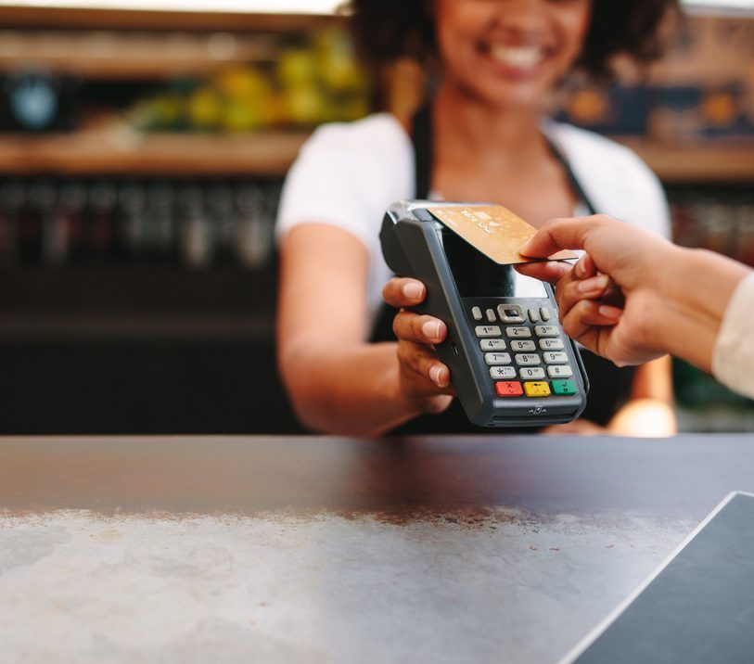
Getting affordance wrong
Do you tap your card on the
back edge,
the glass face, between your knees?
It seems every EFTPOS card reader is different.

Slide 17
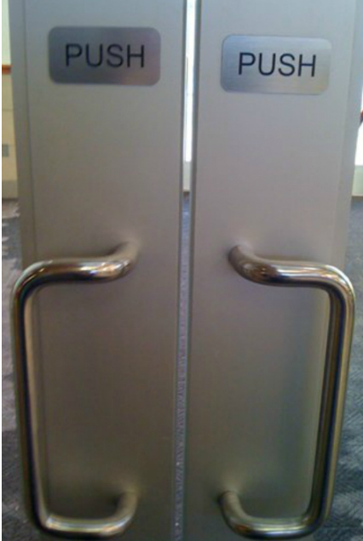
Getting affordance wrong
PUSH doors usually have flat panels that you... push.
PULL doors have handles that you pull.
Except for these...

Slide 18
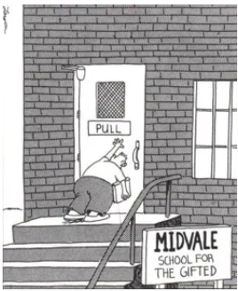
Sometimes you can’t do it right
Dog bless Gary Larson

Slide 19
Getting affordance wrong
Contradictory documentation

Slide 20
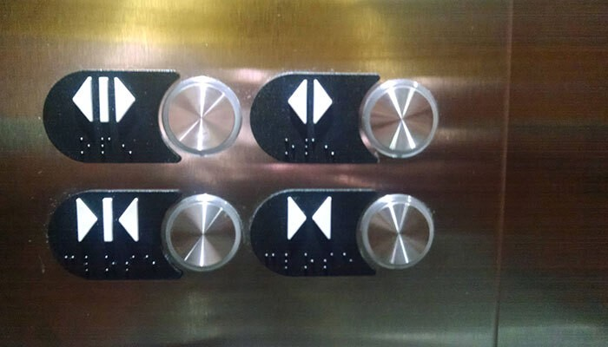
Getting affordance wrong
Developers said, “Well, it made perfect sense to us”

Slide 21
Other examples of bad affordance?
Go on a hunt for examples of bad affordance.
The winner gets 10 points.
Submit them to mark@vcedata.com

Slide 23
These slideshows may be freely used, modified or distributed by teachers and students anywhere.
They may not be sold
You must not change or remove their authorship information or copyright notices.
You must not redistribute them if you modify them.
This is not a VCAA publication and does not speak for VCAA.
Portions (e.g. exam questions, study design extracts, glossary terms) may be copyright Victorian Curriculum and Assessment Authority and are used with permission for educational purposes.

