Slide 1


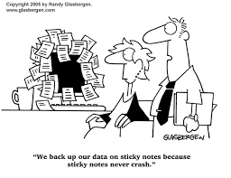
Data Backups
Extracted and enhanced from the Security-Data slideshow
v1.1 2023-09-07

Slide 2
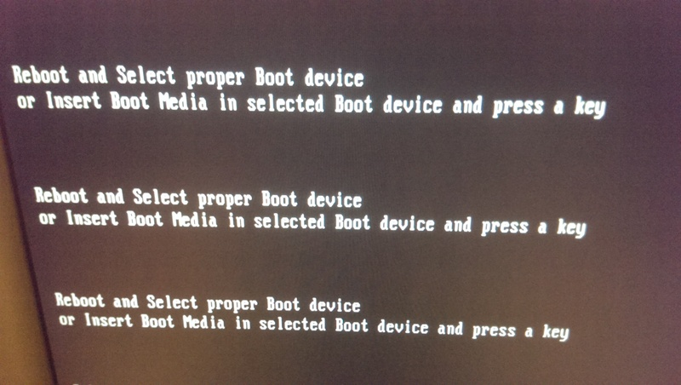
Why back up? One day you press the power switch and you see this

Slide 3
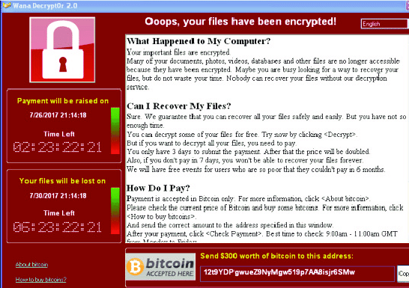
Or you see this cheerful message

Slide 4
The VCEDATA Golden Rule
No matter how much you value your data, it will suddenly be 1000 times more valuable after it has been permanently lost.

Slide 5

You calmly consider your situation:
You have no system backup.
You have lost a year of irreplaceable work.
Losing that work will get you fired.
You will also probably get sued by your clients for breach of contract.
You scream, like a little girl.

Slide 6
Or... not
Major data loss can be
catastrophic
unrecoverable, even by experts
prevented, some of the time
overcome, most of the time if you have backups

Slide 7
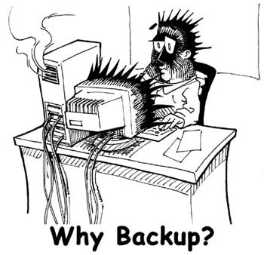
Backup Basics
Backup = copying data so it can be restored if the original is lost or damaged
Good backups are
regular
stored offsite
tested and documented

Slide 8
Regular backups
Backups are too vital to be done monthly or “Yeah, tomorrow maybe for sure”
Ask yourself, “Exactly how much of my data am I willing to lose forever?”
who owes you money, and whom do you owe? See you in court.
your tax records? The ATO will be at your door at tax time.
lists of items in stock, unfulfilled and past orders, suppliers, customers, staff?
details of your insurance policies, bank accounts
family photos

Slide 9
Regular backups
Data should be backed up whenever it is
created or
changed
At a minimum: daily.
But even losing one day’s data could be a nightmare for a business.
Preferably: continuously.

Slide 10
Regular backups
Backing up data “When I get around to it” is a recipe for disaster.

Slide 11
Regular backups
Backups can be done manually or automatically.
Manual backups
may be prone to user error or forgetfulness
give conscious control of the process

Slide 12
Regular backups
Backups can be done manually or automatically.
Automatic backups
don’t need human time or effort
will be done properly (if set up properly)
can be scheduled to occur during quiet times (e.g. at night when new data is not being created and active files are not locked)

Slide 13
Storing backups offsite
Rule #1
NEVER store backups on the same device that stores the original data
If the device fails, is stolen, gets damaged – you will lose your original data and your only backups together.

Slide 14
Storing backups offsite
If your only backups are stored in the manager’s desk drawer, they can be
destroyed by fire, storm etc
stolen
lost
At least take them home with you.

Slide 15
Storing backups offsite
Cloud storage
is safely offsite
should be reliable

Slide 16
Storing backups offsite
Cloud storage
cost, storage limits, speed of uploads/downloads may be an issue
can you trust your cloud provider with valuable data? What if they sell it, go out of business, expose it to hackers?

Slide 17
Testing Backups
After setting up any backup procedure, check that it actually works
is all the data actually backed up?
can it be restored on demand?
if compressed, can the data be decompressed accurately?

Slide 18
Testing Backups
If using backup software or online service
is it up-to-date?
have bugs been patched?
have security holes been found and patched?
can the current version still read its old data files created by older versions?
can you still get good support from the manufacturer?

Slide 19
Testing Backups
Create fake test data for testing. Do not experiment with real data!
Create some data
Delete it
Restore it.
Verify that it is complete and accurate.

Slide 20
Testing Backups – True Story
Scene – a large secondary college in Melbourne.
Data – college financial records
Backup – performed daily by college bursar.

Slide 21
Testing Backups – True Story
Stored – offsite - the bursar took the backup disks home each night.
One day – new accounting software was to be installed, and a new backup schedule was needed.
System manager – examined existing backup settings

Slide 22
Testing Backups – True Story
Discovered – for the past nine or so years, the diligent daily backups had been saving data from the wrong network directory.
No data had ever been backed up.
Luckily, no data disaster had occurred.

Slide 23
Documenting Backup Procedures
Staff come and go, roles change.
New staff taking over data backups need to know precisely how the procedure is done, to avoid errors or damaging data.
A documented explanation of the backup procedures ensures it’s done properly.

Slide 24
Backup tips
Data files in active use (currently being edited) may be locked and cannot be backed up
Backups are often best scheduled to be done at night
files will be closed
the file-intensive backup process will not slow down the network during business

Slide 25
Backup tips
Do not allow workers to save data to their local computer
PCs fail,
users do dumb things and delete data
data stored on a single PC cannot be accessed by other workers

Slide 26
Backup tips
Do not allow workers to save data to their local computer
Set up and enforce an organisational rule: All data must be saved to the LAN (local area network)

Slide 27
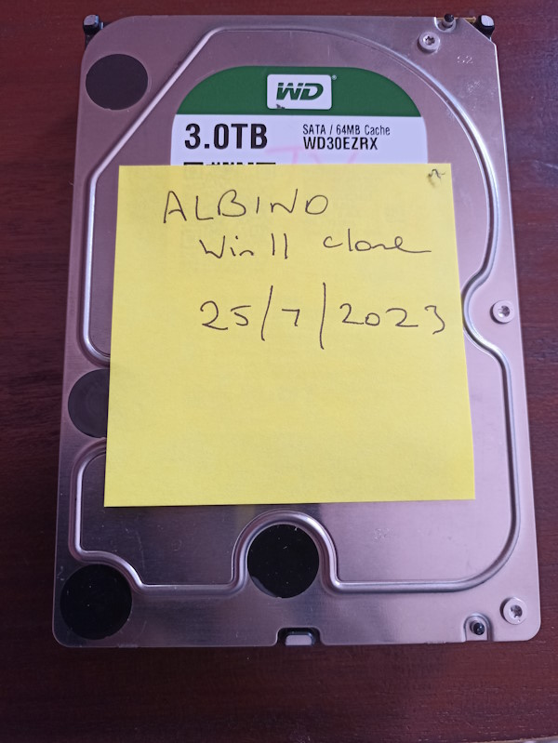
Backup tips
If backing up to physical media (e.g. SSD, USB key), label the backup’s date, time and contents
Just do it. You can thank me later.

Slide 28
Backup tips
Multilayer backups (for the paranoid)
PC’s HDD/SSD (manual save)
NAS (manually or using folder sync)
Cloud (automatic, using folder sync)
Monthly copy to spare HDD (manually)

Slide 29
Backup types
Full
Partial
incremental
differential
careless

Slide 30
Full backup
Full backup = all data is copied, regardless of its age, importance, last-save-date
This is the foundation of a complete system restore
PRO – allows the restoration of a completely trashed system. Gets you back to how you were.
CON – lots of storage needed, takes time

Slide 31
Partial backups
Incremental
Saves files that are NEW or CHANGED since the last FULL backup

Slide 32
Partial backups
Differential
Similar to incremental, but all files created since the last FULL backup will always be copied again – even if they have already been saved during a previous incremental backup.
Like incremental with a little more added insurance.

Slide 33
Careless backups
Files are copied whenever you happen to remember it.
Not all files are backed up, because you didn’t care.
You can’t find them when disaster strikes.
You find a backup, but it’s too old to be useful, or can’t be read by your newfangled technology. But these floppy disks worked just fine in 1983!
You swear you will never let this happen again if some helpful God points you to a good, recent backup. But Gods don’t work like that. Your opinion about the efficacy of IT Gods may vary.

Slide 34
Typical Backup Scheme
Weekly full backups
Daily incremental backups
To restore data,
reload the latest full backup and then
add on all the incremental daily backups made since then.

Slide 35
Continuous Data Protection (CDP)
New and changed files are automatically and immediately saved
Different historical versions of a file can be restored
e.g. the spreadsheet you work on and save every day can be restored to its pristine version from last Thursday when you totally wrecked it.
Can save to NAS, cloud, local network, removeable disk, remote computer, network of another branch of your organisation

Slide 36
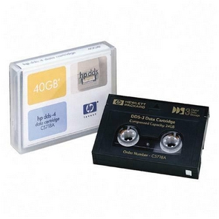
Backup Media
“Media” = what the data is saved to
Tape = large capacity, slow, wears out, expensive. Still common in some businesses.
Removable hard disk = fast, large capacity, cheap.
CD/DVD = now obsolete.
LAN – file servers are robust, reliable, high-capacity, fast, centralised, accessible remotely.
NAS – Network Attached Storage. Adorable.

Slide 37
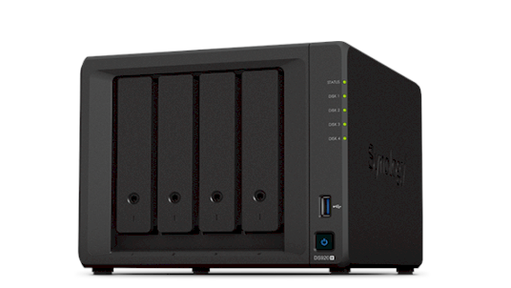
Backup Media
NAS = network attached storage
Attached to LAN – accessible to all users
Can be high capacity (e.g. 32 TB = 32,000 GB)
Excellent data protection: can use RAID* (usually RAID5) to protect against disk failure.
Fast
*Redundant array of independent disks

Slide 38
Backup Media
Selection criteria:
Read/write speed
Storage Capacity
Lifetime of recorded data
Robustness (e.g. against scratching, magnetic fields, disk rot)

Slide 39
Backing Up vs Archiving
Archiving = copying obsolete data to secondary storage (e.g. a loose hard disk) and deleting the original data.
Backing up = copying data, keeping the original.

Slide 40
Other backup issues
Never have just one copy of a data file
If software offers automatic saving of backups – turn it on.
Any time to are about to make a significant change to a vital file, save it with a new name, e.g. mypasswords-v3.doc! That lets you recover old versions.

Slide 41
Other backup issues
Use document version numbering – so you can roll-back to earlier versions when past stupidities go wrong
- 1st save = budget2020-v1.xls
- 2nd save = budget2020-v2.xls
- 3rd save = budget2020-v3a-before new sheet.xls
- 4th save = budget2020-v3b-after new sheet.xls
etc
It may be a bit of a pain, but one day you will shower me with champagne for this tip.

Slide 42
These slideshows may be freely used, modified or distributed by teachers and students anywhere.
They may not be sold
You must not change or remove their authorship information or copyright notices.
You must not redistribute them if you modify them.
This is not a VCAA publication and does not speak for VCAA.
Portions (e.g. exam questions, study design extracts, glossary terms) may be copyright Victorian Curriculum and Assessment Authority and are used with permission for educational purposes.
If you liked this slideshow, please name your next hamster after me.

