Slide 1
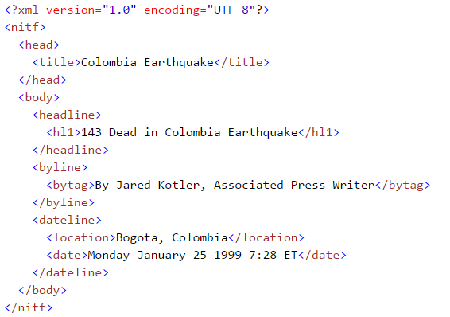

Applied Computing Slideshows by Mark Kelly vcedata.com mark@vcedata.com
XML data files
v1.1 - 2022-02-18
This message is brought to you by the XML Marketing Board

Slide 2
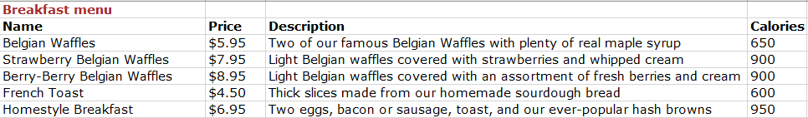
The problem
You are writing a program that processes large quantities of stored data.
Data like this…

Slide 3

The problem
You want to be able to write this data so that many other programs – not just your own software - can read it and interpret it.
A CSV (comma-separated values) file is too limiting - it cannot store field names, nor can you easily add extra fields later.
A Microsoft Access database, but not all programs can read Access .mdb data files.

Slide 4

What you need is
a data file format that …
uses only plain-text,
is information-rich,
has a table/field structure that explains itself,
is universally-readable – any half-way competent program can import it

Slide 5
XML Introduction
XML = extensible markup language
Uses metatags to give data structure and meaning
CSV (comma separated value) data files only contain raw data. XML also contains field names and data structure.
Plain text: easy to edit and read by humans and software.
Similar to HTML – plain text + tags
Stores and transports data between all sorts of software

Slide 6
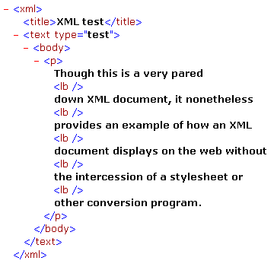
XML Introduction
XML stores and transports data between all sorts of software...
Microsoft Office file formats = docx, pptx
What does the “x” stand for?
Saved in XML format!

Slide 7
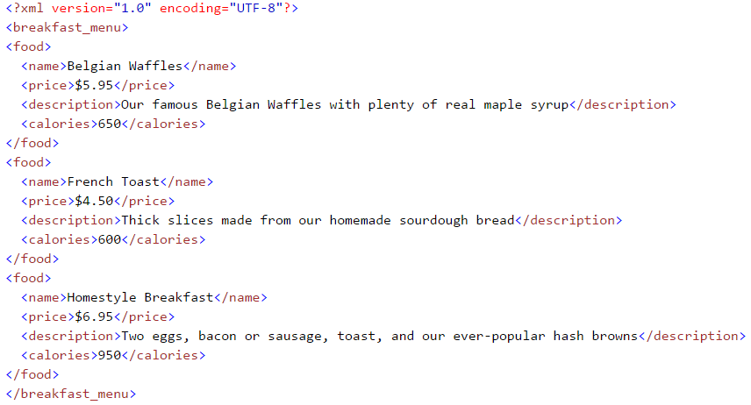
What XML looks like

Slide 8
What XML looks like
Explains its own format

Slide 9
What XML looks like
Notice the structure?
Closing tag

Slide 10
What XML looks like
Hierarchical

Slide 11
What XML looks like
Opening tag
Closing tag

Slide 12
What XML looks like
Opening + closing tags with content = an element

Slide 13
XML
Unlike HTML tags, which use pre-defined standards, XML tags are created by the author of the data.
“Price” could have been called “Cost” – it’s up to the XML creator
XML is extensible
new data fields can be later added, and existing software could still read and understand it.
Its format is universal and open-source.
No competing or incompatible file formats that can go out of date.

Slide 14
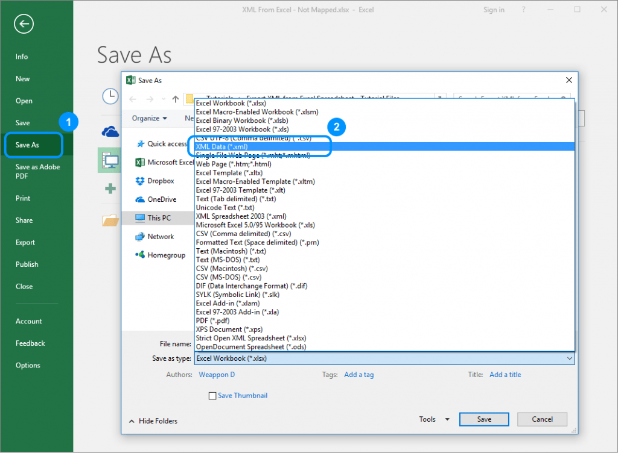
XML
XML data contains no information about how the data should be presented. The same XML data can be displayed in many different ways.
Large data stores (e.g. weather bureau) often export data in XML format so it can be read by nearly any software.

Slide 15
XML EXPORT
E.g. a newsfeed may be exported like this:

Slide 16
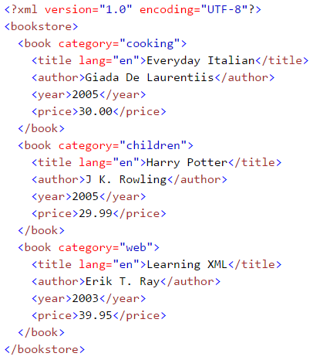
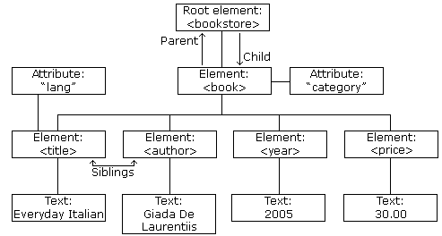
XML Trees
XML documents can have hierarchical tree-like structure

Slide 17
XML Components
The optional declaration (or prologue or ‘prolog’) announces the XML version (1.0) and character encoding scheme (UTF-8)
The root element must exist
An attribute (‘lang’) can provide further information about the element (‘title’)
Every element must have a closing tag
XML tags are case-sensitive: “year” is a different tag to “Year”

Slide 18
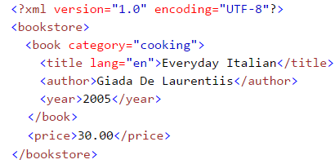
XML Components
XML elements must be properly nested.
A child element must be closed before its parent is closed.
This is illegal…
PRICE tag is a child of BOOK tag, and should appear within its parent

Slide 19
XML Internal Documentation
Insert comments in XML use the same syntax as in HTML like this
<!-- This is a comment -->

Slide 20
XML Internal Documentation
<?xml version="1.0" encoding="utf-8"?>
<!-- This Xml file has comments including html or xml tags -->
<!-- Each restaurant is created using the following highlights difference
<Restaurant>
<title>This is the page where the top restaurant appears on the top</title>
<Resname>This is the name of the Restaurant who have undertaken</Resname>
<Serving>This is provided for food serving for the customers</Serving>
<Hall>The area could be alloted for party function</Hall>
<rating>This is the user review rating</rating>
</Restaurant>
-->
<Restaurant>
<Nonveg>
<Resname>Dhaba Special</Resname>
<Location>ECR- II</Location>
<Serving>Buffet 100</Serving>
<Hall>Birthday</Hall>
<rating> A </rating>
</Nonveg>
...
Start of comment
End of comment

Slide 21
XML Element Names
Are invented by the data’s author
are case-sensitive
must start with a letter or _under_score
cannot contain spaces
XML element names should preferably:
be short but meaningful
not contain hyphens, colons or full stops
use CamelCase if they use multiple words
See the Naming Conventions slideshow for more info

Slide 22
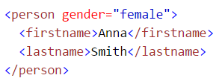
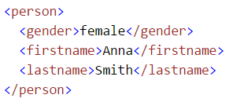
XML Elements vs Attributes
In example 1, gender is an attribute.
In example 2, gender is an element.
They both provide exactly the same data.
You can use attributes or elements.
(Attribute data must be in single or double quotes.)
Example 1
Example 2

Slide 23
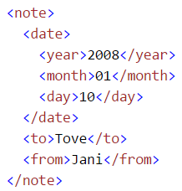
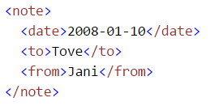
XML Field Structure
In example 1, date is stored as a single value
In example 2, date is broken into its components.
They both provide the same data.
But accessing year, month and day will be far easier using example 2’s field schema
Example 1
Example 2

Slide 24
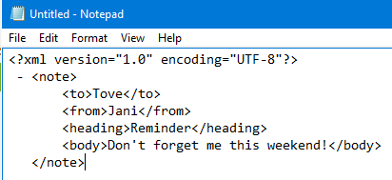
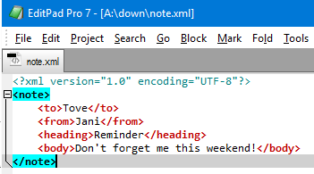
Displaying XML
Raw XML files can be loaded by lots of programs, but what do the programs show?
A very dumb text editor…
A clever text editor…

Slide 25
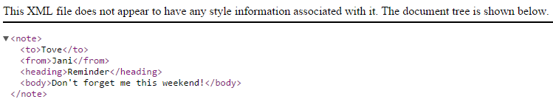
Displaying XML
Raw XML files can be loaded by lots of programs, but what do the programs show?
A Chrome browser

Slide 26
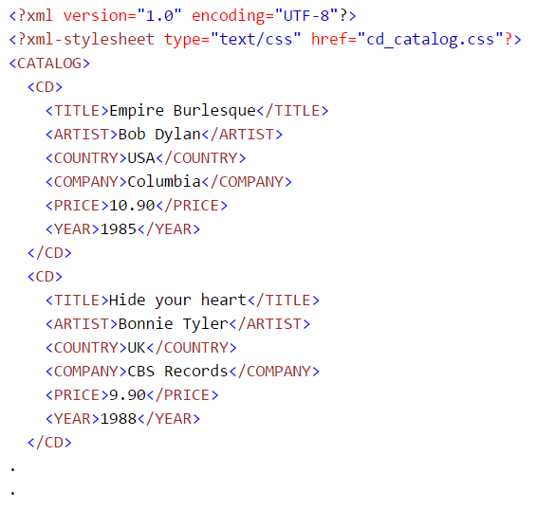
Why so ugly?
Why do raw XML files get displayed so horribly?
XML files only contain raw data.
They don’t contain any formatting information (as HTML does)
So you could attach a stylesheet like a CSS file to provide formatting data to an XML file

Slide 27
Reading XML in your program
Most languages have pre-built XML support to read and interpret (‘parse’) and write XML files.
Support may include XML object classes and libraries.

Slide 28
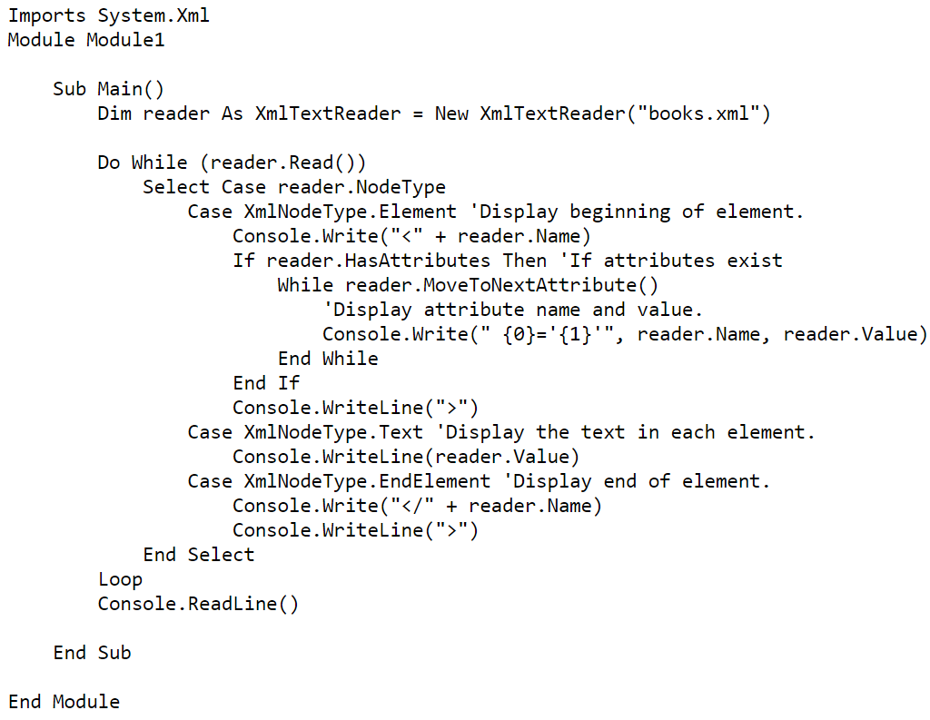
Sample Visual Basic code to write XML

Slide 29
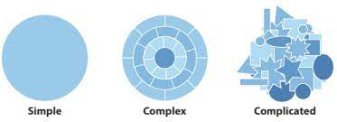
In short
Handling XML is more complex than working with simple CSV data files – but it’s not too complicated considering...
the power and opportunities XML open up. XML - Well worth the effort.
This message is brought to you by the XML Marketing Board

Slide 30
Applied Computing Slideshows by Mark Kelly vcedata.com mark@vcedata.com
These slideshows may be freely used, modified or distributed by teachers and students anywhere
but
they may NOT be sold.
they must NOT be redistributed if you modify them.
This is not a VCAA publication and does not speak for VCAA.
Portions (e.g. exam questions, study design extracts, glossary terms) may be copyright Victorian Curriculum and Assessment Authority and are used with permission for educational purposes.

Slide 31
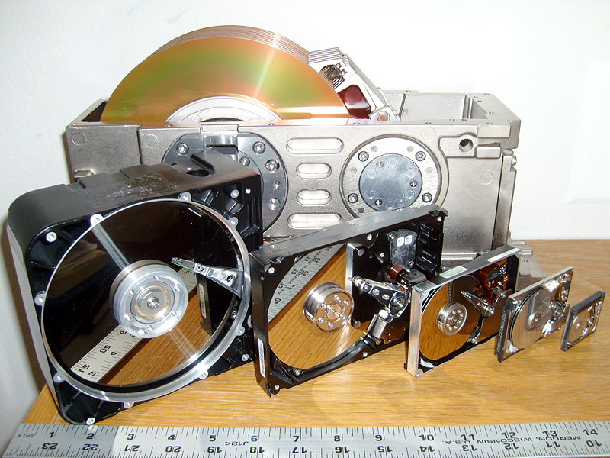
THANKS!
Because you’ve been so good, here’s a picture you can look at
while your teacher works out what to do next
The history of hard disks

