Slide 1
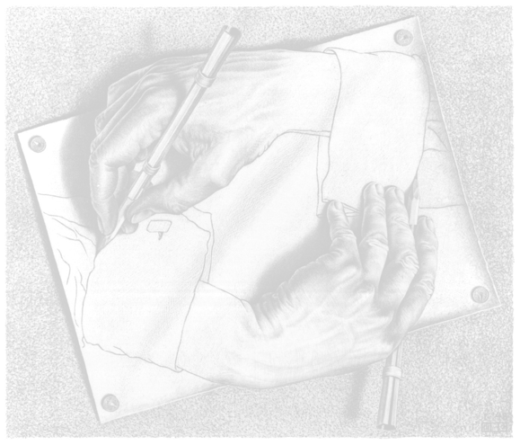
Applied Computing Slideshows by Mark Kelly vcedata.com mark@vcedata.com
Primary & Secondary
Data Integrity
v1.0, 2022-02-09

Slide 2
Why valuable?
Orgs cannot conduct business without storing data that has integrity, e.g. for
Financial transactions
Customer information
Supplier information
Previous actions taken
Tax information

Slide 3
Without reliable data
Could not contact clients or suppliers
Could not keep track of expenses
Could not manage debts, incomes
Could not satisfy tax laws
Would not know what stock they had
Could not manage employees’ time, jobs or wages

Slide 4
And
Could not plan ahead or remember the past – memory is far from perfect!
Could not manage projects
Could not generate continuous income
Would suffer organisational death
Trustworthy data and information are the basis of sound business.

Slide 5
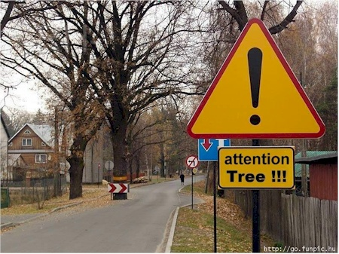
Value of data and information
Data and information are valuable if they are (bold items are examinable 2020+ others are not)
Accurate
Authentic
Correct
Reasonable
Relevant
Timely
verifiable, complete,
unbiased, up-to-date
Valuable information…

Slide 6
Accurate
Authentic
Correct
Reasonable
Relevant
Timely
Unbiased
Reliable
With integrity (i.e. all the points above, combined)
Also: verifiable, complete

Slide 7


But first... Data? Information?
Data
Raw, unprocessed, discrete (separate), unordered facts and figures
Information
Data that has been processed to yield knowledge that can be understood and used by humans

Slide 8
Objective? Subjective?
Objective data – fact-based, unemotional, gained by measurement
Subjective data – opinion-based. Gained by interview, survey etc.
Objective data - where possible - is preferred.
Subjective data useful for criteria that can’t be measured (e.g. enjoyment, fear, worry, comfort)

Slide 9
Primary? Secondary?
Primary data – collected by the user of the data. Not collected or pre-processed by other people.
Secondary data – collected by other people. It may be accurate, complete and unbiased, but it might not be.

Slide 10
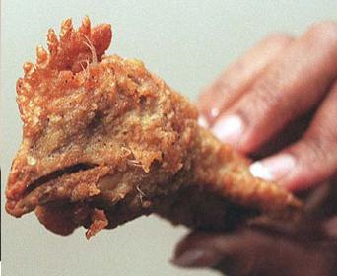
Gathering/Producing data
Primary data is more reliable because its user knows exactly how it was gathered and handled.
It's like cooking something yourself. You know what went into it and what was done to it.
Primary data tends to be expensive and slow to collect.

Slide 11

Primary Data sources
Personal observation
Automated sensors
Interviews, surveys, questionnaires
Diaries

Slide 12
Secondary Data sources
Internet (e.g. Google, Wikipedia, corporate websites, blogs, HowStuffWorks)
Textbooks, encyclopaedias
Journals, magazines, newspapers, TV
Government reports and publications
Consultants, experts, loud-mouthed fools
Special interest groups (e.g. churches, Greenpeace, Free Tibet, Right To Life)
Beware of bias.

Slide 13
Secondary Data Sources
Some sources are more trustworthy than others.
.edu domains should be reliable
.gov may or may not be – e.g. Australia vs China
Reliable sources more like to have a rigorous editing procedure to ensure good quality-control

Slide 14
Dubious sources
Organisations or people with a vested interest in the issue
i.e. they stand to gain or lose from the issue
E.g. Will a car maker say their new vehicle sucks?
Information may be valuable if taken with a grain of salt, e.g. a church’s information on abortion.

Slide 15
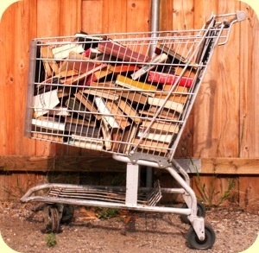
Why use secondary data?
There's a lot more secondary data than primary data.
Gathering the data yourself may be impossible
It’s a whole lot cheaper, faster and easier to acquire.

Slide 16
Questioning secondary data
Who collected it?
What processing did they do to it?
Did they stand to benefit from misrepresenting, distorting or adjusting it?
How old is it?
Is it relevant to your needs?
data from another country may not apply to you
Does it leave out important information?

Slide 17
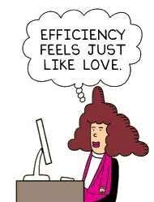
Efficient Handling

Slide 18
Handling?
Storage & retrieval
Communication
Processing (See the processing-efficiency slideshow)

Slide 19
Storage & retrieval
Use devices with fast read/write times for data/info that is accessed frequently
Hard disk
Solid state storage
Network
Cloud
Not tape, or slow memory keys

Slide 20
Storage
Use a device with plenty of free space.
Nearly-full devices are slow to write to because they’re busy finding an empty sector to save to.

Slide 21
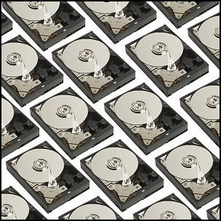
Backup!
Much faster to restore lost data from a backup than it is to re-enter it!
Backup regularly (daily), store backups offsite
Backup procedures should be documented and tested. (Why?)

Slide 22
Efficient Storage - RAID
RAID (Redundant Array of Independent Disks)
RAID 5 – uses multiple disks as a single unit
Files are striped (split up) across multiple physical disks
File segments are redundantly saved
If a disk fails, redundant copies of file segments from remaining disks can rebuilt the lost disk’s contents

Slide 23
RAID
Can retrieve multiple file segments at the same time from different disks
E.g. a file in 15 segments saved to a single disk takes 15 consecutive write operations.
E.g. striped across 3 disks, the file can be retrieved in only 5 consecutive disk operations
Each of the 3 disks retrieves 5 segments
3 times faster!

Slide 24
Storage Efficiency
Use logical, consistent folder and file naming
Files can be found more quickly
Less chance of losing files

Slide 25
Version Control
Also use file version control to make it clear which document version is newer than or different to another
Allows rolling back to a previous version in case the latest version is found to be a disaster

Slide 26
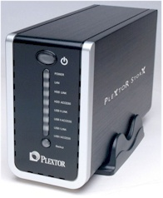
Centralised storage
Don’t save team files to your local PC’s hard disk (except as backup)
Save shared team files centrally so team can get to them from anywhere, at any time
Create a shared network folder
NAS (network attached storage) on a small office/home office LAN
And/or save to a secure website

Slide 27

Communication
Over a LAN
Limited to local area
Instant
Massive file capacity
Secure

Slide 28
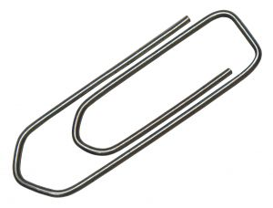
Email attachments, mailing lists
Attachment size may be limited
Can be sent anywhere in the world
Can be very quick to arrive (can be slow too!)
Slow to download large attachments

Slide 29

Email attachments, mailing lists
May ‘bounce’ and not be delivered if destination mailbox is full
May be blocked/deleted by spam filter
Good for ‘pushing’ information to people
C.f. “pulling” where people download at will
Return receipts reassure sender that delivery was successful

Slide 30
HTTP
Click a link to download a file from a website
Not too good for really large files or large numbers of files
Can ‘drop out’ mid-way, forcing a restart (browsers tend not to have ‘download resume’ facilities)
Don’t need any software more than a web browser

Slide 31
FTP
File Transfer Protocol
Designed for file transfer
Secure – login can be required
Like a file manager with drag-and-drop
Supports resumption of interrupted downloads
Good for exchanging large or many files
Requires FTP client software

Slide 32

Yousendit.com, megaupload.com etc
Allows transfer of very large files
Basic access is free
Secure – can require a login

Slide 33
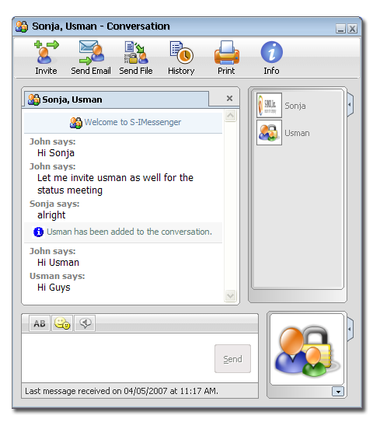
Instant Messaging file transfers
Can exchange files between individuals during live chat
Quick, spontaneous

Slide 34

Communication Overview
Needs to be secure
Login to storage site
Encrypt documents in transit
VPN (Virtual Private Network) is a secure, private, encrypted internet connection
Needs to be fast
Needs to be able to cope with very large files
May be expensive for fast, fat bandwidth

Slide 35
Applied Computing Slideshows
by Mark Kelly
vcedata.com
mark@vcedata.com
These slideshows may be freely used, modified or distributed by teachers and students anywhere on the planet (but not elsewhere).
They may NOT be sold.
They must NOT be redistributed if you modify them.

