Slide 1
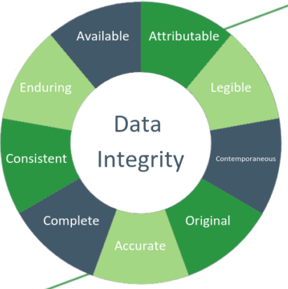
Applied Computing Slideshows by Mark Kelly vcedata.com mark@vcedata.com
Data Integrity
v1.0, 2022-02-09
Under
Reconstruction
2022-02-28 @ 13:26

Slide 2

Data integrity
If data has integrity, it is accurate, internally consistent, and free from corruption.
This means the data (and the information derived from the data) are reliable and trustworthy.
The old IT maxim GIGO (“Garbage In, Garbage Out”) means that unreliable data leads to unreliable information.
And unreliable information is worse than useless – it can be dangerous if it’s believed.
<number>/20

Slide 3
Data integrity
Data has integrity if it is...
(bold items in red are examinable 2020+)
Accurate
Authentic
Correct
Reasonable
Relevant
Timely
Other (unexaminable criteria) also exist, e.g. being:
- Verifiable
- Complete,
- Unbiased
- consistent
- enduring
- attributable
- legible
- original
- available
- legally compliant
3/20

Slide 4
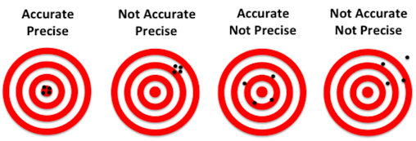
Accurate
Exactly or closely representing the true state of reality.
Not being incorrect.
Note – being precise is different to being accurate.
Precision refers to the amount of detail that is in the information, and how consistent the data are.
3/20

Slide 5
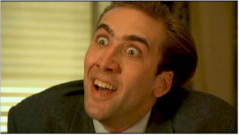
Accurate
So it is accurate to say that Nicolas Cage is a bad actor.
It is precise to say that he has been a bad actor in 121 movies.
3/20

Slide 6

Authentic
Authentic data comes from the source it claims. It is not deliberately or accidentally attributed to an incorrect source.
It is not invented and passed off as being genuine. (see Deep Fake)
Inauthentic data are often generated to deceive or persuade people into believing a desired “fact” or interpretation of facts.
Authentic data may have been modified since its collection (e.g. to cleanse it) but it has not been corrupted by malicious modifications (e.g. selective deletions or “enhancements”) to alter its original meaning.
3/20

Slide 7
Correct
Correct data does not contain errors.
The difference between accuracy and correctness makes for a good philosophical discussion.
My take:
Accuracy refers to how exactly data reflects the truth on a scale. Data may be very accurate, more accurate, mostly accurate etc.
Correctness is more of a true/false condition: data is either correct or it is not based on some accepted rule of what is right and wrong.
So, there are various degrees of accuracy, but only 2 possible states of correctness.
3/20

Slide 8
Reasonable
Reasonable data fit within acceptable, commonsense parameters (limits) or they satisfy specified criteria.
What is “reasonable” depends on circumstances and context.
Reasonableness checks may be done during data validation to exclude certain data from subsequent processing.
3/20

Slide 9

Reasonable
e.g. It may prove to be correct that Jim Smith of grade 3 is twenty-five years old, but it’s not reasonable.
e.g. in a list of baby gifts, a teddy bear is reasonable; a carving knife is not.
3/20

Slide 10
Relevant
Relevant data has a close connection to the issue being studied.
It offers meaningful and appropriate assistance to understanding a subject, and helps its users make accurate decisions.
Data may be irrelevant if it
Relates to a different topic, e.g.
Mum, why can’t I go to Paul’s party?
Because you know Paul’s mother hates me.
Pertains to a time, place or conditions that don’t match the case in question:
No you can’t have a mobile phone. Your grandfather never had one and he turned out very well.
We should be allowed to have guns. They can have them in America.
3/20

Slide 11
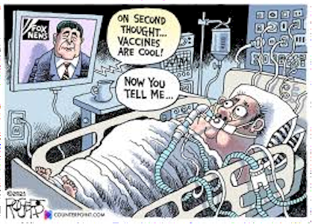
Timely
Means “available when needed” or “coming at the right time”.
If data is only available after it was needed, it would be untimely if it had become useless or irrelevant.
3/20

Slide 12
Some other (unexaminable but nice to know) criteria for data integrity
Verifiable – the data can be compared with an original source to verify its accuracy
Complete – parts have not been deleted or ignored to present a misleading interpretation (see Cherrypicking)
Unbiased – data fairly represents both sides of a controversial issue
Consistent – the same data means the same thing in different places (e.g. “Excellent” always means “Over 80%”; all phone numbers use the same format; all sizes measured in the same units)
Enduring – will not degrade or become unusable over time (e.g. stored on media that decays, or can’t be read like VHS video tapes)
Attributable – the source of the data can be identified
Legible – is readable
Available – can be accessed, and is not locked up or lost
Legally compliant – satisfies local current laws of privacy, copyright, decency etc
Originality – no one has it, except you.
3/20

Slide 13
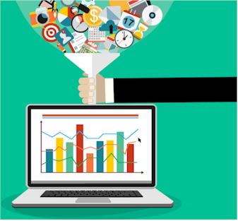
How to preserve data integrity
NEW DATA BEING ADDED
must be validated
remove duplicates
Back it up
3/20

Slide 14
How to preserve data integrity
DATA - IN USE
use access control to prevent improper access or misuse
maintain an audit trail to track usage
remove data that has become irrelevant or outdated
remove or reexamine data that came from sources that are now dubious (e.g. convicted stars, disgraced politicians)
3/20

Slide 15
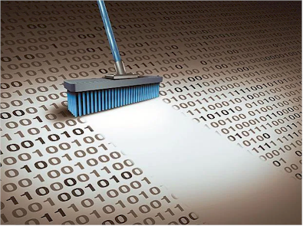
How to preserve data integrity
DATA - AFTER USE
should be archived (just in case it’s needed later for other reasons)
original data must be securely deleted (wiped, not just put into recycle bin)
paper copies should be shredded, not binned
discarded disks should be reformatted or destroyed
https://www.youtube.com/watch?v=sQYPCPB1g3o
3/20

Slide 16
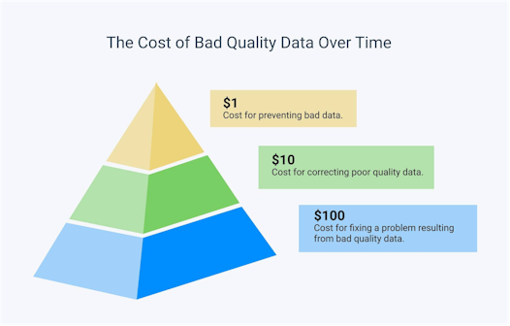
Consequences of losing data integrity
All information derived from the data comes under suspicion. What can be trusted? What cannot?
Decisions based on the data become unreliable.
Planning becomes unsure or dangerous.
3/20

Slide 17
Consequences of losing data integrity
Projects based on dodgy data may fail.
The information and organisation that created it lose trust, credibility, respect, and persuasiveness.
Product recalls.
Lawsuits for breach of contract.
3/20

Slide 18
Consequences of losing data integrity
Money and time spent on generating information is wasted.
Loss of new sales.
Loss of existing contracts that relied on the dodgy data.
Billing errors – customer complaints – cost of compensation.
Legal problems from tax office, consumer affairs commission.
3/20

Slide 19
Consequences of losing data integrity
Misjudged financial forecasts.
Inaccurate ordering of stock and supplies.
Poor inventory management.
Inaccurate product shipments.
Damage to reputation.
Public shame, ridicule and embarrassment.
3/20

Slide 20
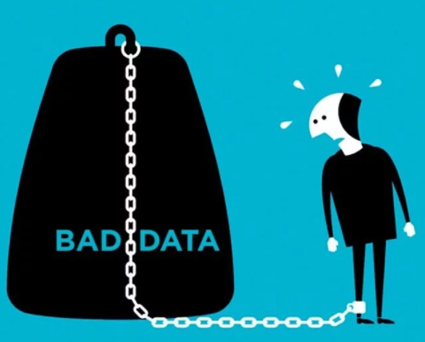
Applied Computing Slideshows
by Mark Kelly
vcedata.com
mark@vcedata.com
These slideshows may be freely used, modified or distributed by teachers and students anywhere on the planet (but not elsewhere).
They may NOT be sold.
They must NOT be redistributed if you modify them.

