Slide 1
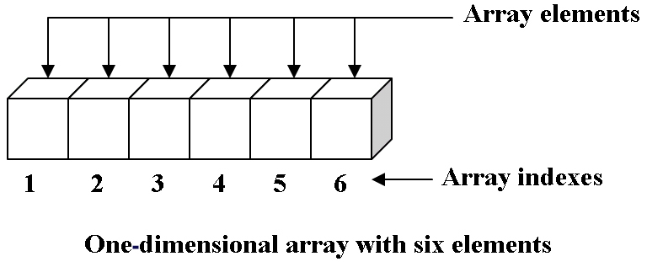
Applied Computing Slideshows by Mark Kelly vcedata.com mark@vcedata.com
Arrays

Slide 2

Data Storage Structures
Variables
Arrays – 1 and 2 dimensional
VB objects – textbox, listbox etc

Slide 3
Variables
Variable = its value can be changed
compare with a constant – a value that is defined once and cannot be changed
e.g. PI = 3.14159
1 variable contains one piece of data of a specific data type e.g. number, date, text
Is accessed by its individual name
Not good when you need to group large quantities of related data - cannot be used to work on a group of variables in one operation.

Slide 4
Variables
You’d need code like this:
total_cost = fuel_expense + rent_costs + food_costs + insurance + repair_costs
A lot of typing!
Hard to manage 1000 or a million costs…

Slide 5
Arrays
A storage structure with many storage locations addressable by index number
E.g. COSTS(12)
Defines an array called COSTS with 12 ‘slots’
COST(1), COST(2), COST(3)… COST(12)

Slide 6

Zero-based Arrays
Some (many?) real programming languages might start numbering at zero
COST(0), COST(1), COST(2)… COST(11)
VCAA exams have tended to start numbering arrays at element zero.

Slide 7
Declaring Arrays
In BASIC, arrays are declared (created) using the DIM (short for DIMENSION) statement
Includes the name of the array,
and its size, and
sometimes its data type e.g.
DIM COST(12) AS SINGLE

Slide 8
Array data types
Can create arrays of any allowable data type
DIM ClassSize as INTEGER = 28
DIM BIRTHDATES(ClassSize) as DATE
DIM GNAMES(ClassSize) as STRING
DIM FEES(ClassSize) as SINGLE

Slide 9
Using arrays
total_cost ← COST[1] + COST[2] + COST[3] + COST[4]
Not much better than using individual variables…
But teamed with loops, the power of arrays is unleashed!
Because the name of the storage structure (COST) remains the same, only the index needs to be specified…

Slide 10
Add up costs with a loop
Counter ← 1 total ← 0 LOOP
TOTAL ← TOTAL + COST[counter]
Counter ← Counter + 1 WHILE counter <= 12
You could work with 12 or a million items with the same number of lines of code!

Slide 11

OK. Take a moment to celebrate learning
… that puppies are warm

Slide 12


OK. Take a moment to celebrate learning
… and that arrays are powerful

Slide 13
Counter ← 1 total ← 0 LOOP TOTAL ← TOTAL + COST[counter]
Counter ← Counter + 1 WHILE counter <= 12
Initialise counter value

Slide 14
Counter ← 1 total ← 0 LOOP TOTAL ← TOTAL + COST[counter]
Counter ← Counter + 1 WHILE counter <= 12
Initialise total value

Slide 15
Counter ← 1 total ← 0 LOOP TOTAL ← TOTAL + COST[counter]
Counter ← Counter + 1 WHILE counter <= 12
START THE LOOP

Slide 16
Counter ← 1 total ← 0 LOOP TOTAL ← TOTAL + COST[counter]
Counter ← Counter + 1
WHILE counter <= 12
Replace value of TOTAL with the value of total plus COST array’s slot 1.
Equal to
TOTAL ← TOTAL + COST[1]

Slide 17
Counter ← 1 total ← 0 LOOP TOTAL ← TOTAL + COST[counter]
Counter ← Counter + 1
WHILE counter <= 12
Increment counter – now = 2

Slide 18
Counter ← 1 total ← 0 LOOP TOTAL ← TOTAL + COST[counter]
Counter ← Counter + 1
WHILE counter <= 12
Counter = 2 so it is less than or equal to 12, so it loops back to the LOOP statement

Slide 19
Counter ← 1 total ← 0 LOOP TOTAL ← TOTAL + COST[counter]
Counter ← Counter + 1
WHILE counter <= 12
Second time around

Slide 20
Counter ← 1 total ← 0 LOOP TOTAL ← TOTAL + COST[counter]
Counter ← Counter + 1
WHILE counter <= 12
Replace value of TOTAL with the value of total plus COST array’s slot 2.
Equal to
TOTAL ← TOTAL + COST[2]

Slide 21
Counter ← 1 total ← 0 LOOP TOTAL ← TOTAL + COST[counter]
Counter ← Counter + 1
WHILE counter <= 12
Increment counter again, now = 3

Slide 22
Counter ← 1 total ← 0 LOOP TOTAL ← TOTAL + COST[counter]
Counter ← Counter + 1
WHILE counter <= 12
Counter = 3 still less than 12 so do it all again… until counter>12

Slide 23
And so on…
Time passes, the counter is incremented to 12

Slide 24
Counter ← 1 total ← 0 LOOP TOTAL ← TOTAL + COST[counter]
Counter ← Counter + 1
WHILE counter <= 12
Counter = 12, so it’s still within the looping range

Slide 25
It loops one more time and finally counter gets incremented to 13.

Slide 26
Counter ← 1 total ← 0 LOOP TOTAL ← TOTAL + COST[counter]
Counter ← Counter + 1
WHILE counter <= 12
Counter = 13 so it fails the WHILE test and drops down to the following line of code.

Slide 27
Or, more elegantly (in VB)
DIM counter AS INTEGER = 0
Total = 0
FOR counter = 1 TO 12
Total = Total + COST(counter)
NEXT

Slide 28
Array dimensions
The COST array above is an example of a one dimensional array.
Arrays, however, can have two, three or more dimensions.

Slide 29
For example
Consider the need to store 3 values for each of 12 months (e.g. rent, phone costs, transport).
You need 36 storage locations. If you created 36 discrete (separate) variables, there would be a lot of typing, and you would have very little power to manipulate the data.
However, create a two dimensional array like this... COSTS[12,3]

Slide 30
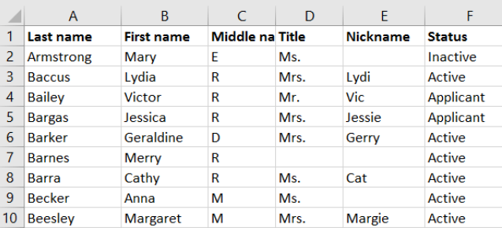
Think of it like a table with 12 rows (or columns) and 3 columns (or rows). Cells in the array are addressed Spreadsheet style by referring to the row/column num.
e.g. address C6 contains data “D”

Slide 31
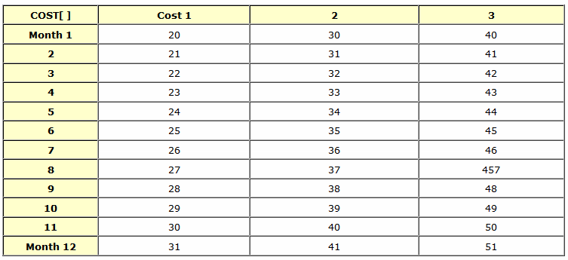
Or like this

Slide 32
More dimensions, more loops!
Now you can add the grand total using 2 nested loops - one inside the other. Here I'll use BASIC's FOR..NEXT loop.
FOR monthnum = 1 to 12 FOR costnum = 1 to 3 total = total + COST[monthnum, costnum] NEXT costnum NEXT monthnum

Slide 33
The FOR statements each have a loop counter (monthnum and costnum). Each counter starts at the starting value (1) and goes up top the ending value (12 for the month loop and 3 for the cost loop).

Slide 34
So the pair of loops begins. Monthnum is initialised to 1. The very next statement is another FOR so costnum is initialised to 1. The totalcost calculation is carried out, and it plugs in the current values of monthnum and costnum so you get
totalcost = totalcost + COST[1, 1] In other words, totalcost = totalcost + 20.

Slide 35
The "NEXT monthnum state" terminates the inner loop. It checks to see if the counter has reached its ending value. If not, it loops back to the matching FOR statement, increments the value of the counter (so costnum now is 2) and repeats, giving...
totalcost = totalcost + COST[1, 2] In other words, totalcost = totalcost + 30.

Slide 36
After the third loop of the costnum loop, its counter hits its max value and it drops down to the NEXT statement of the monthnum loop and that loop now terminates, checks whether it has finished, and loops back to start all over again, this time with monthnum = 2.
So you can see that for each month that ticks by, three costs are processed.

Slide 37
Eventually, after all 3 costs are added for all 12 months, the monthnum loop finishes and the program continues.
If you're still with me, good. We're ready for three dimensional arrays.

Slide 38
Imagine, as before, there are 3 costs over 12 months, but now there are a hundred years...
That's 3600 values to process. Not easy with discrete variables.
But with loops and an array, it's a doddle.
Create the array:
DIM COST[100,12,3]

Slide 39
For each of the 100 years, there are 12 months. For each month there are 3 costs.
Then the turbo kicks in...

Slide 40
FOR year = 1 to 100 FOR month = 1 to 12 FOR cost = 1 to 3 totalcost += COST[year, month, cost] NEXT cost NEXT month NEXT year

Slide 41
Look at the nested loops like a car's odometer counting kilometers.
The innermost dial is spinning the fastest. Every time it hits '9', the next dial ticks over 1. When that dial passes '9', the next dial ticks over 1. That can continue for as many dials (loops) as you care to create (or your brain can handle).

Slide 42
Want an example of a 4 dimensional array?
Think of the example above, but now the same data must be stored for 16 different departments in the organisation.

Slide 43
Five dimensional array?
Same as above, but now there are branches of the organisation in 33 countries, each with 16 departments, each with 100 years, each with 12 months, each with 3 costs.
Now we're up to 2,059,200 values - all controlled with a handful of lines like this...

Slide 44
FOR country = 1 to 33 FOR dept = 1 to 16 FOR year = 1 to 100 FOR month = 1 to 12 FOR cost = 1 to 3 totalcost += COST[country, dept, year, month, cost] NEXT cost NEXT month NEXT year NEXT dept NEXT country

Slide 45
Relax. The study design only mandates the knowledge of two-dimensional arrays.
Not only can you manage sheer amounts of data, you can customise your processing. We'll revert to an earlier scenario to make life easier.

Slide 46
Let's say we just wanted the total for year 56. Easy.
year = 56
FOR month = 1 to 12 FOR cost = 1 to 3 totalcost += COST[year, month, cost] NEXT cost
NEXT month

Slide 47
Or we could loop through in a different direction to find the totals for cost 2 over years 33 to 77...
FOR year = 33 to 77 FOR month = 1 to 12 totalcost += COST[year, month, 2] NEXT month NEXT year

Slide 48
(Notice how I used the constant 2 in this case. It's usually not wise, since it's so inflexible: after all, 2 will always be 2. Using a variable lets you change the cost num easily.
When the true power of arrays and loops finally shines upon you, it's a bit like discovering girls... the possiblities are nearly endless.

Slide 49
Practice
A challenge: how would you represent the following data constructs?
- a list of 13 people's incomes?
- a chess board?
- a deck of playing cards?
- rainfall figures from 5 locations in each of 6 states over the past 80 years?

Slide 50

Because you’ve been good…

Slide 51
Applied Computing Slideshows by Mark Kelly vcedata.com mark@vcedata.com
These slideshows may be freely used, modified or distributed by teachers and students anywhere on the planet (but not elsewhere).
They may NOT be sold.
They must NOT be redistributed if you modify them.

