Slide 1
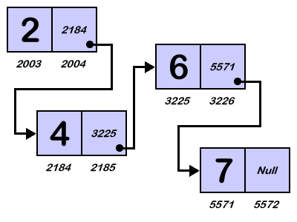
Applied Computing Slideshows by Mark Kelly vcedata.com mark@vcedata.com
Linked Lists

Slide 2
Contents
Note: linked lists are not mandated knowledge, but they’ve well worth knowing
Why?
How?

Slide 3
Why linked lists?
When storing incoming data in a sorted or organised manner, moving items to accommodate new data is very slow.

Slide 4
For example
Data
45
78
94
103
New data arrives and has to be added: 56

Slide 5
For example
Data
45
78
94
103

Slide 6
For example
Data
45
78
94
103

Slide 7
For example
Data
45
78
94
103

Slide 8
For example
Data
45
78
94
103

Slide 9
For example
Data
45
56
78
94
103
Moving data in memory is slow and processor-intensive – and it’s FAR slower when moved on disk

Slide 10
A better way?
Each data item also has a link to the next data item’s location
New data is stored at the next available location
To change the relative position of data items, you only need to change the links, not physically move data in RAM or on disk.

Slide 11
For example
Position | Fwd Link | Data
1 | 2 | 45
2 | 3 | 78
3 | 4 | 94
4 | 0 | 103
The position is just the location where the data is stored.
The forward link points to the next item in sequence.
The FwdLink of the last item is zero to indicate no more items are available.

Slide 12
New Data Arrives: 56 !
Position | Fwd Link | Data
1 | 2 | 45
2 | 3 | 78
3 | 4 | 94
4 | 0 | 103
5 |  | 56
The new data is dumped in the next available location (position 5)

Slide 13
Now to update links…
Position | Fwd Link | Data
1 | 5 | 45
2 | 3 | 78
3 | 4 | 94
4 | 0 | 103
5 |  | 56
The item after “45” is now “56” so change the FwdLink of item 1 to point to the location of “56”

Slide 14
Now to update links…
Position | Fwd Link | Data
1 | 5 | 45
2 | 3 | 78
3 | 4 | 94
4 | 0 | 103
5 | 2 | 56
The item following “56” is “78”

Slide 15
Now to update links…
Position | Fwd Link | Data
1 | 5 | 45
2 | 3 | 78
3 | 4 | 94
4 | 0 | 103
5 | 2 | 56
So instead of heavy-duty data moving, we only had to change 2 numbers!

Slide 16
The price you pay…
Extra storage needed for the links
Processing overhead to maintain links
Storage needed for pointers to:
The location of the first item
The location of the next free slot

Slide 17
Doubly-linked lists
A limitation of the linked list before is that you can only travel forward through data items.
You can’t easily find a previous data item
This can be fixed with a doubly-linked list

Slide 18
Doubly-linked list
Each data item has a link to the next item and another link to the previous item

Slide 19
For example
Position | Fwd Link | BackLink | Data
1 | 2 | 0 | 45
2 | 3 | 1 | 78
3 | 4 | 2 | 94
4 | 0 | 3 | 103
Now you can move backwards by from item n by going to item referred to in Backlink(n)

Slide 20
Circular linked lists
Instead of using 0 to indicate the end of a chain of links…
Set the FORWARD link of the LAST item to the FIRST item in the chain
Set the BACKWARD link of the FIRST item to the LAST item in the chain
So you can ‘roll around’ from the end of the list back to the start!

Slide 21
A real-world example
When I taught English, I often taught the novel To Kill A Mockingbird
When discussing recurring themes (e.g. prejudice), I’d often have to find examples to prejudice throughout the book (e.g. pages 67,96, 126)

Slide 22
How it works
On the inside front cover I recorded the start of the chain (page 67)
On p.67 I’d have a note to go to p.96
On p.96 I’d have a note to go Backward to 67 and forward to 126
On p.126 there’d be a note to go back to 96

Slide 23
Doubly-Linked Lists
So in this doubly-linked list, I could travel in either direction by following the links

Slide 24
Linked lists ran your file system!
Unless you use NTFS file system, your files on disk are managed by a FAT – file allocation table.
Still needed for devices like USB sticks formatted as ‘FAT32’
Since parts of files are sprinkled all over a disk, there needs to be a way to find all the pieces
Avoids moving a million files to make room for a new file.
The FAT is a linked list

Slide 25
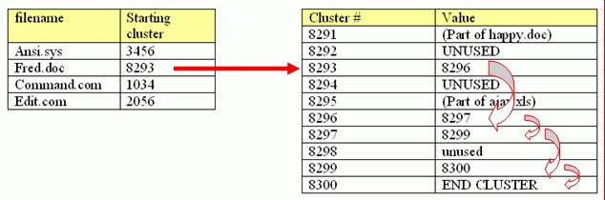
Follow the links to find the next piece of the file!
FAT
DISK CLUSTERS

Slide 26
Exercise
Write a program to let a user enter a word.
Use a linked list so you can print out the stored words in alphabetical order.
Bonus – print the list of words in reverse alphabetical order.

Slide 27
For serious SD U4O1 practice!
Find a text file containing a non-trivial amount of text (e.g. a public-domain book from gutenberg.net.au
Write a program to read the entire text and store each unique word in a linked list.
Save the list and links to a text file so the data can be read back later by your program.
Also count how often each word appears in the text, and print the frequencies of the 10 most-repeated words. Good luck!

Slide 28
Applied Computing Slideshows by Mark Kelly vcedata.com mark@vcedata.com
These slideshows may be freely used, modified or distributed by teachers and students anywhere on the planet (but not elsewhere).
They may NOT be sold.
They must NOT be redistributed if you modify them.

