Slide 1
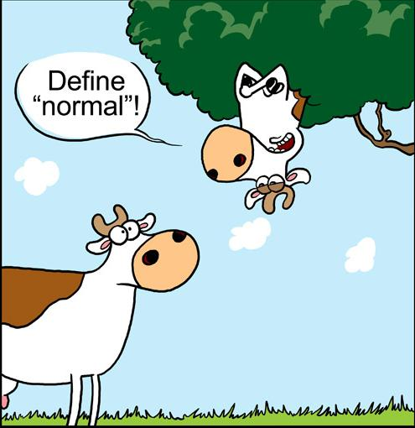
VCE IT Theory Slideshows
by Mark Kelly
vcedata.com
mark@vcedata.com

Slide 2
Identifying different normal forms
1st normal form (1NF), 2nd normal form (2NF) and 3rd normal form (3NF) are the stages of normalising a database.
1NF is the most basic and inefficient
3NF is the most sophisticated and efficient
You may need to be able to tell them apart

Slide 3
1NF

Slide 4
Not 1NF
Only one piece of data in a field, not a list
THIS IS BAD:
ProductCode | Name | Price
P203 | Slushy | Small: $2.50 Medium: $3.40 Large: $4.10
P205 | Pie | Meat: $2.50 Chicken: $2.60
P304 | Softdrink | Coke: $1.30 Fanta: $1.15

Slide 5
Better – 1NF
ProductCode | Name | Price
P203 | Slushy | Small: $2.50 Medium: $3.40 Large: $4.10
P205 | Pie | Meat: $2.50 Chicken: $2.60
P304 | Softdrink | Coke: $1.30 Fanta: $1.15
ProductCode | Name | Price
P203a | Slushy small | $2.50
P203b | Slushy medium | $3.40
P203c | Slushy large | $4.10
P205a | Pie – meat | $2.50
P205b | Pie - chicken | $2.60
P304a | Softdrink - Coke | $.130
P304 | Softdrink - Fanta | $1.15

Slide 6
1NF requires…
Each cell in a table must contain only one piece of information, not a list
There must be no duplicate rows (records)
Don’t have repeating fields (e.g. multiple fields containing the same type of data)

Slide 7
This is also not 1NF
SubID | Name | Task 1 | Task 2 | Task 3 | Task 4 | Task 5
ENG | English | Essay | Poem | Grammar | Text
MAT | Maths | Adding | Matrices | Stats | Graphs | CAS
SCI | Science | Chem | Physics | Biol
The repeating fields containing subjects’ tasks wastes space and limits the number of tasks that can be entered.

Slide 8
Better…. 1NF
SUBJECTS
SubID | Name
ENG | English
MAT | Maths
SCI | Science
TASKS
SubID | Task
ENG | Essay
ENG | Poem
ENG | Grammar
MAT | Maths
MAT | Adding
MAT | Matrices
SCI | Chem
SCI | Physics
Now you can have as many or as few tasks as you like for each subject.

Slide 9
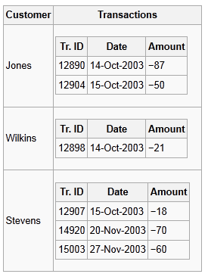
Another example of lists in a field
The problem is that a transaction can’t be accessed without unpacking the embedded list.
This unpacking is either slow and computationally difficult, or just impossible.

Slide 10
2NF

Slide 11
First, a definition
Many tables contain more than one key field
E.g. a table of shop sales could contain
  customerID (key field, links to the customer table)
  productID (key field, links to the products table)
  sale date (non-key field)
The key for each sales record is both the customerID and the productID.
Together, they are called the table’s KEY.
Both are needed to identify a single sale.

Slide 12
The 2NF rule
A non-key field (e.g. saledate) must be dependent on the entire key (e.g. customerID and productID)
i.e. the saledate must apply to the sale with that customer AND that product
It can’t be dependent on just one part of the key and not the other

Slide 13
How to identify a 2NF fail
Where a non-key field in a table is related to one key field, but not the entire key.
It usually looks like the field should be stored in one of the related tables…

Slide 14
Not 2NF
SALES TABLE
CustomerID | ProductID | SaleDate | ItemColour
C103 | P304 | 10/2/2012 | Blue
C495 | P201 | 12/3/2012 | Green
C495 | P211 | 12/3/2012 | Red
C103 | P213 | 13/4/2012 | Black
CustomerID and ProductID are key fields, and both are necessary to describe a sale.

Slide 15
Not 2NF
SALES TABLE
CustomerID | ProductID | SaleDate | ItemColour
C103 | P304 | 10/2/2012 | Blue
C495 | P201 | 12/3/2012 | Green
C495 | P211 | 12/3/2012 | Red
C103 | P211 | 13/4/2012 | Black
The sale date is not a key field, but it is completely dependent on both of the key fields: it is relevant to both the customer and product in that sale.
So that’s fine.

Slide 16
Not 2NF
SALES TABLE
CustomerID | ProductID | SaleDate | ItemColour
C103 | P304 | 10/2/2012 | Blue
C495 | P201 | 12/3/2012 | Green
C495 | P211 | 12/3/2012 | Red
C103 | P212 | 13/4/2012 | Black
SALES TABLE
CustomerID | ProductID | SaleDate | ItemColour
C103 | P304 | 10/2/2012 | Blue
C495 | P201 | 12/3/2012 | Green
C495 | P211 | 12/3/2012 | Red
C103 | P211 | 10/2/2012 | Black
The ItemColour is also not a key field, and it is dependent on the ProductID, but it has nothing to do with the customer. It should instead live in the product table with the product it describes.

Slide 17
Another failed 2NF example
Here’s a table containing a history of courses that have been offered.
The entire key that uniquely identifies each record is CourseID and Semester.
Course ID is a key field.
CourseID | Semester | Course Name
IT101 | 2009-1 | Programming
IT101 | 2009-2 | Programming
IT102 | 2009-1 | Databases
IT102 | 2010-1 | Databases
IT103 | 2009-2 | Web Design

Slide 18
CourseID | Semester | Course Name
IT101 | 2009-1 | Programming
IT101 | 2009-2 | Programming
IT102 | 2009-1 | Databases
IT102 | 2010-1 | Databases
IT103 | 2009-2 | Web Design
This is not in 2NF, because the last column does not rely upon the entire key (courseID & semester), but only a part of it (courseID).
So we have duplicate information - several rows telling us that IT101 is programming, and IT102 is Databases.

Slide 19

Solution – 2NF
Solution: put the course name into another table, where CourseID is the ENTIRE key. No redundancy!
CourseID | Course Name
IT101 | Programming
IT102 | Databases
IT103 | Web Design
CourseID | Semester
IT101 | 2009-1
IT101 | 2009-2
IT102 | 2009-1
IT102 | 2010-1
IT103 | 2009-2

Slide 20
3NF

Slide 21
The 3NF rule
To be 3NF, every field in a table must be related to the primary key and not to another field.
An example...

Slide 22
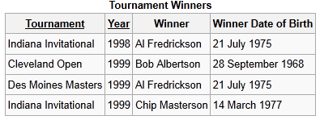
Failed 3NF
Why is this a problem?

Slide 23
Failed 3NF
It looks a bit like a 2NF fail because the birthdate belongs in another table. (Which is true!)
The difference is that the birthdate does not relate to the key at all!
Instead, it refers to the winner field!

Slide 24
Failed 3NF
The data of birth data does not relate to the tournament/year key.

Slide 25
Failed 3NF
The data of birth data does not relate to the tournament/year key.

Slide 26
Failed 3NF
It relates to the Winner field instead, and belongs in the Winner table

Slide 27
Failed 3NF
If there is no winner table, it needs to be created

Slide 28
So
2NF fails because a field does not relate to the entire key (e.g. both the subjectID AND semester)
3NF fails because a field does not relate to the key at all (e.g. relating to the winner field instead of the tournament/year key combination)
But 2NF and 3NF fails are solved the same way – by putting the troublesome data into a related table.

Slide 29
Note
To achieve each level of normalisation, you must first achieve each level below it.
You can’t have 2NF without 1NF.
You can’t have 3NF without 2NF.

Slide 30
Codd’s Law
A non-key field must provide a fact about the key, the whole key, and nothing but the key, so help me Codd.

Slide 31
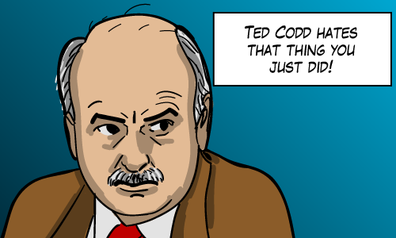
Codd’s Law
A non-key field must provide a fact about
NF1 - the key
NF2 - the whole key
NF3 - and nothing but the key
so help me Codd.

Slide 32
Applied Computing Slideshows
by Mark Kelly
vcedata.com
mark@vcedata.com
These slideshows may be freely used, modified or distributed by teachers and students anywhere on the planet (but not elsewhere).
They may NOT be sold.
They must NOT be redistributed if you modify them.

