Slide 1

Applied Computing Slideshows by Mark Kelly vcedata.com mark@vcedata.com
A
Beginner’s
Guide
To
Databases

Slide 2
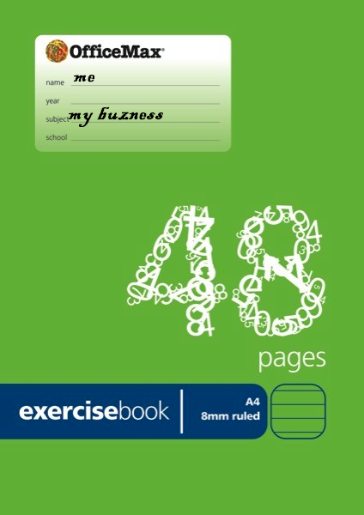
A database is born
You run a small bookshop
You store data about your business
You pull out the exercise book you use to store the data in

Slide 3
You see this…
My buisness stuff
Book | Sold to | Date | Cost Me | Sold for | Profit | Publisher | Format | Address | Author
Biggles Goes too Far | John Smith | 3 March | 4.50 | 7.20 |  |  | hardback | 6 Rat St, Bentleigh, 3193 | Capt Biggles
The Famous Six |  |  | 4.70 |  |  | Penguin | PB |  | Enid Blight
The Famous Three | John Smith | 5 May | 6.20 | 7.40 | 1.20 |  |  | 4 Fish St, Chelt 3192 | Enid Bligh
Billy Gets into Trouble & Billy Says Sorry | Jane Goodall | 7 Jul 2011 | 6.50 + 4.10 = $10.60 | $15 | $4.40 | Puffin | HB | 19A Africa St, Melb 3000
You see toubles…

Slide 4
You see this…
My buisness stuff
Book | Sold to | Date | Cost Me | Sold for | Profit | Publisher | Format | Address | Author
Biggles Goes too Far | John Smith | 3 March | 4.50 | 7.20 |  |  | hardback | 6 Rat St, Bentleigh, 3193 | Capt Biggles
The Famous Six |  |  | 4.70 |  |  | Penguin | PB |  | Enid Blight
The Famous Three | John Smith | 5 May | 6.20 | 7.40 | 1.20 |  |  | 4 Fish St, Chelt 3192 | Enid Bligh
Billy Gets into Trouble & Billy Says Sorry | Jane Goodall | 7 Jul 2011 | 6.50 + 4.10 = $10.60 | $15 | $4.40 | Puffin | HB | 19A Africa St, Melb 3000
Data missing (year)

Slide 5
You see this…
My buisness stuff
Book | Sold to | Date | Cost Me | Sold for | Profit | Publisher | Format | Address | Author
Biggles Goes too Far | John Smith | 3 March | 4.50 | 7.20 |  |  | hardback | 6 Rat St, Bentleigh, 3193 | Capt Biggles
The Famous Six |  |  | 4.70 |  |  | Penguin | PB |  | Enid Blight
The Famous Three | John Smith | 5 May | 6.20 | 7.40 | 1.20 |  |  | 4 Fish St, Chelt 3192 | Enid Bligh
Billy Gets into Trouble & Billy Says Sorry | Jane Goodall | 7 Jul 2011 | 6.50 + 4.10 = $10.60 | $15 | $4.40 | Puffin | HB | 19A Africa St, Melb 3000
Two books in one cell means you can’t pull out the data on each book separately

Slide 6
You see this…
My buisness stuff
Book | Sold to | Date | Cost Me | Sold for | Profit | Publisher | Format | Address | Author
Biggles Goes too Far | John Smith | 3 March | 4.50 | 7.20 |  |  | hardback | 6 Rat St, Bentleigh, 3193 | Capt Biggles
The Famous Six |  |  | 4.70 |  |  | Penguin | PB |  | Enid Blight
The Famous Three | John Smith | 5 May | 6.20 | 7.40 | 1.20 |  |  | 4 Fish St, Chelt 3192 | Enid Bligh
Billy Gets into Trouble & Billy Says Sorry | Jane Goodall | 7 Jul 2011 | 6.50 + 4.10 = $10.60 | $15 | $4.40 | Puffin | HB | 19A Africa St, Melb 3000
Typing errors

Slide 7
You see this…
My buisness stuff
Book | Sold to | Date | Cost Me | Sold for | Profit | Publisher | Format | Address | Author
Biggles Goes too Far | John Smith | 3 March | 4.50 | 7.20 |  |  | hardback | 6 Rat St, Bentleigh, 3193 | Capt Biggles
The Famous Six |  |  | 4.70 |  |  | Penguin | PB |  | Enid Blight
The Famous Three | John Smith | 5 May | 6.20 | 7.40 | 1.20 |  |  | 4 Fish St, Chelt 3192 | Enid Bligh
Billy Gets into Trouble & Billy Says Sorry | Jane Goodall | 7 Jul 2011 | 6.50 + 4.10 = $10.60 | $15 | $4.40 | Puffin | HB | 19A Africa St, Melb 3000
Two customers with the same name will get mixed up
Two customers with the same name will get mixed up

Slide 8
You see this…
My buisness stuff
Book | Sold to | Date | Cost Me | Sold for | Profit | Publisher | Format | Address | Author
Biggles Goes too Far | John Smith | 3 March | 4.50 | 7.20 |  |  | hardback | 6 Rat St, Bentleigh, 3193 | Capt Biggles
The Famous Six |  |  | 4.70 |  |  | Penguin | PB |  | Enid Blight
The Famous Three | John Smith | 5 May | 6.20 | 7.40 | 1.20 |  |  | 4 Fish St, Chelt 3192 | Enid Bligh
Billy Gets into Trouble & Billy Says Sorry | Jane Goodall | 7 Jul 2011 | 6.50 + 4.10 = $10.60 | $15 | $4.40 | Puffin | HB | 19A Africa St, Melb 3000
One in Rat St

Slide 9
You see this…
My buisness stuff
Book | Sold to | Date | Cost Me | Sold for | Profit | Publisher | Format | Address | Author
Biggles Goes too Far | John Smith | 3 March | 4.50 | 7.20 |  |  | hardback | 6 Rat St, Bentleigh, 3193 | Capt Biggles
The Famous Six |  |  | 4.70 |  |  | Penguin | PB |  | Enid Blight
The Famous Three | John Smith | 5 May | 6.20 | 7.40 | 1.20 |  |  | 4 Fish St, Chelt 3192 | Enid Bligh
Billy Gets into Trouble & Billy Says Sorry | Jane Goodall | 7 Jul 2011 | 6.50 + 4.10 = $10.60 | $15 | $4.40 | Puffin | HB | 19A Africa St, Melb 3000
One in Fish St

Slide 10
You see this…
My buisness stuff
Book | Sold to | Date | Cost Me | Sold for | Profit | Publisher | Format | Address | Author
Biggles Goes too Far | John Smith | 3 March | 4.50 | 7.20 |  |  | hardback | 6 Rat St, Bentleigh, 3193 | Capt Biggles
The Famous Six |  |  | 4.70 |  |  | Penguin | PB |  | Enid Blight
The Famous Three | John Smith | 5 May | 6.20 | 7.40 | 1.20 |  |  | 4 Fish St, Chelt 3192 | Enid Bligh
Billy Gets into Trouble & Billy Says Sorry | Jane Goodall | 7 Jul 2011 | 6.50 + 4.10 = $10.60 | $15 | $4.40 | Puffin | HB | 19A Africa St, Melb 3000
Or is it the same John Smith who has changed his address?

Slide 11
You see this…
My buisness stuff
Book | Sold to | Date | Cost Me | Sold for | Profit | Publisher | Format | Address | Author
Biggles Goes too Far | John Smith | 3 March | 4.50 | 7.20 |  |  | hardback | 6 Rat St, Bentleigh, 3193 | Capt Biggles
The Famous Six |  |  | 4.70 |  |  | Penguin | PB |  | Enid Blight
The Famous Three | John Smith | 5 May | 6.20 | 7.40 | 1.20 |  |  | 4 Fish St, Chelt 3192 | Enid Bligh
Billy Gets into Trouble & Billy Says Sorry | Jane Goodall | 7 Jul 2011 | 6.50 + 4.10 = $10.60 | $15 | $4.40 | Puffin | HB | 19A Africa St, Melb 3000
Profit calculated by hand, slowly and often inaccurately

Slide 12
You see this…
My buisness stuff
Book | Sold to | Date | Cost Me | Sold for | Profit | Publisher | Format | Address | Author
Biggles Goes too Far | John Smith | 3 March | 4.50 | 7.20 |  |  | hardback | 6 Rat St, Bentleigh, 3193 | Capt Biggles
The Famous Six |  |  | 4.70 |  |  | Penguin | PB |  | Enid Blight
The Famous Three | John Smith | 5 May | 6.20 | 7.40 | 1.20 |  |  | 4 Fish St, Chelt 3192 | Enid Bligh
Billy Gets into Trouble & Billy Says Sorry | Jane Goodall | 7 Jul 2011 | 6.50 + 4.10 = $10.60 | $15 | $4.40 | Puffin | HB | 19A Africa St, Melb 3000
You can’t find nearby customers by their postcode to do a mailout because the postcode’s buried in the address

Slide 13
You see this…
My buisness stuff
Book | Sold to | Date | Cost Me | Sold for | Profit | Publisher | Format | Address | Author
Biggles Goes too Far | John Smith | 3 March | 4.50 | 7.20 |  |  | hardback | 6 Rat St, Bentleigh, 3193 | Capt Biggles
The Famous Six |  |  | 4.70 |  |  | Penguin | PB |  | Enid Blight
The Famous Three | John Smith | 5 May | 6.20 | 7.40 | 1.20 |  |  | 4 Fish St, Chelt 3192 | Enid Bligh
Billy Gets into Trouble & Billy Says Sorry | Jane Goodall | 7 Jul 2011 | 6.50 + 4.10 = $10.60 | $15 | $4.40 | Puffin | HB | 19A Africa St, Melb 3000
You can’t produce a list of books by a single author

Slide 14
You see this…
My buisness stuff
Book | Sold to | Date | Cost Me | Sold for | Profit | Publisher | Format | Address | Author
Biggles Goes too Far | John Smith | 3 March | 4.50 | 7.20 |  |  | hardback | 6 Rat St, Bentleigh, 3193 | Capt Biggles
The Famous Six |  |  | 4.70 |  |  | Penguin | PB |  | Enid Blight
The Famous Three | John Smith | 5 May | 6.20 | 7.40 | 1.20 |  |  | 4 Fish St, Chelt 3192 | Enid Bligh
Billy Gets into Trouble & Billy Says Sorry | Jane Goodall | 7 Jul 2011 | 6.50 + 4.10 = $10.60 | $15 | $4.40 | Puffin | HB | 19A Africa St, Melb 3000
Unsold books still in stock, and sold books are mixed up in the same list

Slide 15
You see this…
My buisness stuff
Book | Sold to | Date | Cost Me | Sold for | Profit | Publisher | Format | Address | Author
Biggles Goes too Far | John Smith | 3 March | 4.50 | 7.20 |  |  | hardback | 6 Rat St, Bentleigh, 3193 | Capt Biggles
The Famous Six |  |  | 4.70 |  |  | Penguin | PB |  | Enid Blight
The Famous Three | John Smith | 5 May | 6.20 | 7.40 | 1.20 |  |  | 4 Fish St, Chelt 3192 | Enid Bligh
Billy Gets into Trouble & Billy Says Sorry | Jane Goodall | 7 Jul 2011 | 6.50 + 4.10 = $10.60 | $15 | $4.40 | Puffin | HB | 19A Africa St, Melb 3000
You wanted to put the publisher’s address and phone in, but it got so repetitive you just left it out

Slide 16
You see this…
My buisness stuff
Book | Sold to | Date | Cost Me | Sold for | Profit | Publisher | Format | Address | Author
Biggles Goes too Far | John Smith | 3 March | 4.50 | 7.20 |  |  | hardback | 6 Rat St, Bentleigh, 3193 | Capt Biggles
The Famous Six |  |  | 4.70 |  |  | Penguin | PB |  | Enid Blight
The Famous Three | John Smith | 5 May | 6.20 | 7.40 | 1.20 |  |  | 4 Fish St, Chelt 3192 | Enid Bligh
Billy Gets into Trouble & Billy Says Sorry | Jane Goodall | 7 Jul 2011 | 6.50 + 4.10 = $10.60 | $15 | $4.40 | Puffin | HB | 19A Africa St, Melb 3000
You can’t SORT books by name, cost, date sold

Slide 17
You see this…
My buisness stuff
Book | Sold to | Date | Cost Me | Sold for | Profit | Publisher | Format | Address | Author
Biggles Goes too Far | John Smith | 3 March | 4.50 | 7.20 |  |  | hardback | 6 Rat St, Bentleigh, 3193 | Capt Biggles
The Famous Six |  |  | 4.70 |  |  | Penguin | PB |  | Enid Blight
The Famous Three | John Smith | 5 May | 6.20 | 7.40 | 1.20 |  |  | 4 Fish St, Chelt 3192 | Enid Bligh
Billy Gets into Trouble & Billy Says Sorry | Jane Goodall | 7 Jul 2011 | 6.50 + 4.10 = $10.60 | $15 | $4.40 | Puffin | HB | 19A Africa St, Melb 3000
You can’t show just the unsold or sold books

Slide 18
You see this…
My buisness stuff
Book | Sold to | Date | Cost Me | Sold for | Profit | Publisher | Format | Address | Author
Biggles Goes too Far | John Smith | 3 March | 4.50 | 7.20 |  |  | hardback | 6 Rat St, Bentleigh, 3193 | Capt Biggles
The Famous Six |  |  | 4.70 |  |  | Penguin | PB |  | Enid Blight
The Famous Three | John Smith | 5 May | 6.20 | 7.40 | 1.20 |  |  | 4 Fish St, Chelt 3192 | Enid Bligh
Billy Gets into Trouble & Billy Says Sorry | Jane Goodall | 7 Jul 2011 | 6.50 + 4.10 = $10.60 | $15 | $4.40 | Puffin | HB | 19A Africa St, Melb 3000
You can’t print anything for your records

Slide 19
There has to be a better way

Slide 20
The Better Way
Start by dividing the data up into neat, self-contained tables, each one containing one type of data…
Book information
Sales information
Customer information

Slide 21
Now, each table focuses on information about one subject only – book information, customer information or sales information
books
Book | Sold to | Cost Me | Publisher | Format | Author
Biggles Goes too Far | John Smith | 4.50 | Penguin | hardback | Capt Biggles
The Famous Six |  | 4.70 | Penguin | PB | Enid Blight
The Famous Three | John Smith | 6.20 | York |  | Enid Bligh
Billy Gets into Trouble & Billy Says Sorry | Jane Goodall | 6.50 + 4.10 = $10.60 | Puffin | HB
customers
Customer | Address
John Smith | 6 Rat St, Bentleigh, 3193
John Smith | 4 Fish St, Chelt 3192
Jane Goodall | 19A Africa St, Melb 3000
sales
Book | Sold to | Date | Cost Me | Sold for | Profit
Biggles Goes too Far | John Smith | 3 March | 4.50 | 7.20
The Famous Three | John Smith | 5 May | 6.20 | 7.40 | 1.20
Billy Gets into Trouble & Billy Says Sorry | Jane Goodall | 7 Jul 2011 | 6.50 + 4.10 = $10.60 | $15 | $4.40

Slide 22
Now, each table focuses on information about one subject only – book information, customer information or sales information
books
Book | Sold to | Cost Me | Publisher | Format | Author
Biggles Goes too Far | John Smith | 4.50 | Penguin | hardback | Capt Biggles
The Famous Six |  | 4.70 | Penguin | PB | Enid Blight
The Famous Three | John Smith | 6.20 | York |  | Enid Bligh
Billy Gets into Trouble & Billy Says Sorry | Jane Goodall | 6.50 + 4.10 = $10.60 | Puffin | HB
So now, if you want to find information about books,
you get it from the book table.
All info about sales is in the sales table. etc
The info is not copied anywhere else,
so it reduces data duplication
and database size!
customers
Customer | Address
John Smith | 6 Rat St, Bentleigh, 3193
John Smith | 4 Fish St, Chelt 3192
Jane Goodall | 19A Africa St, Melb 3000
sales
Book | Sold to | Date | Cost Me | Sold for | Profit
Biggles Goes too Far | John Smith | 3 March | 4.50 | 7.20
The Famous Three | John Smith | 5 May | 6.20 | 7.40 | 1.20
Billy Gets into Trouble & Billy Says Sorry | Jane Goodall | 7 Jul 2011 | 6.50 + 4.10 = $10.60 | $15 | $4.40

Slide 23
Next problem to fix: there’s more than one piece of data in a cell. That’s bad because we can’t separate one datum from the other!
Before…
sales
BookID | Book | Sold to | Date | Cost Me | Sold for | Profit
S0001 | Biggles Goes too Far | John Smith | 3 March | 4.50 | 7.20
S0002 | The Famous Three | John Smith | 5 May | 6.20 | 7.40 | 1.20
S0003 | Billy Gets into Trouble & Billy Says Sorry | Jane Goodall | 7 Jul 2011 | 6.50 + 4.10 = $10.60 | $15 | $4.40

Slide 24
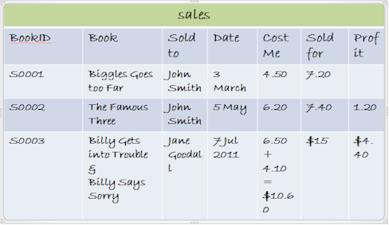
After…
sales
BookID | Book | Sold to | Date | Cost Me | Sold for | Profit
S0001 | Biggles Goes too Far | John Smith | 3 March | 4.50 | 7.20
S0002 | The Famous Three | John Smith | 5 May | 6.20 | 7.40 | 1.20
S0003 | Billy Gets into Trouble | Jane Goodall | 7 Jul 2011 | 6.50 | 10.00 | 3.50
S0004 | Billy Says Sorry | Jane Goodall | 7 Jul 2011 | 4.10 | 5.00 | .90

Slide 25
And in the Books table
books
Book | Cost Me | Publisher | Format | Author
Biggles Goes too Far | 4.50 | Penguin | hardback | Capt Biggles
The Famous Six | 4.70 | Penguin | PB | Enid Blight
The Famous Three | 6.20 | York |  | Enid Bligh
Billy Gets into Trouble | 6.50 | Puffin | HB
Billy Says Sorry | 4.10 | Puffin | HB

Slide 26
Next problem – which John Smith is which? Names are not unique, so we invent an ID for each different customer, and this ID will be unique!
customers
Customer ID | Customer name | Address
C0001 | John Smith | 6 Rat St, Bentleigh, 3193
C0002 | John Smith | 4 Fish St, Chelt 3192
C0003 | Jane Goodall | 19A Africa St, Melb 3000

Slide 27
IDs
These ID fields are really important
They uniquely identify every record (e.g. each customer, each book, each sale) in a table
Think of your student ID, bank account number, username for a website: they must never be used more than once.
They are so important they are called KEY FIELDS.

Slide 28
Key fields
Are so useful that when we create a table of data, we automatically create a key field for the table
It becomes habit…

Slide 29
Now, each table focuses on information about one subject only – book information, customer information or sales information
books
BookID | Book | Cost Me | Publisher | Format | Author
B0001 | Biggles Goes too Far | 4.50 | Penguin | hardback | Capt Biggles
B0002 | The Famous Six | 4.70 | Penguin | PB | Enid Blight
B0003 | The Famous Three | 6.20 | York |  | Enid Bligh
B0004 | Billy Gets into Trouble | 6.50 | Puffin | HB
B0005 | Billy Says Sorry | 4.10 | Puffin | HB
sales
SaleID | Book | Sold to | Date | Cost Me | Sold for | Profit
V0001 | Biggles Goes too Far | John Smith | 3 March | 4.50 | 7.20
V0002 | The Famous Three | John Smith | 5 May | 6.20 | 7.40 | 1.20
V0003 | Billy Gets into Trouble & Billy Says Sorry | Jane Goodall | 7 Jul 2011 | 6.50 + 4.10 = $10.60 | $15 | $4.40
customers
Customer ID | Customer name | Address
C0001 | John Smith | 6 Rat St, Bentleigh, 3193
C0002 | John Smith | 4 Fish St, Chelt 3192
C0003 | Jane Goodall | 19A Africa St, Melb 3000

Slide 30
Now, each table focuses on information about one subject only – book information, customer information or sales information
books
BookID | Book | Cost Me | Publisher | Format | Author
B0001 | Biggles Goes too Far | 4.50 | Penguin | hardback | Capt Biggles
B0002 | The Famous Six | 4.70 | Penguin | PB | Enid Blight
B0003 | The Famous Three | 6.20 | York |  | Enid Bligh
B0004 | Billy Gets into Trouble | 6.50 | Puffin | HB
B0005 | Billy Says Sorry | 4.10 | Puffin | HB
sales
SaleID | Book | Sold to | Date | Cost Me | Sold for | Profit
S0001 | Biggles Goes too Far | John Smith | 3 March | 4.50 | 7.20
S0002 | The Famous Three | John Smith | 5 May | 6.20 | 7.40 | 1.20
S0003 | Billy Gets into Trouble & Billy Says Sorry | Jane Goodall | 7 Jul 2011 | 6.50 + 4.10 = $10.60 | $15 | $4.40
customers
Customer ID | Customer name | Address
C0001 | John Smith | 6 Rat St, Bentleigh, 3193
C0002 | John Smith | 4 Fish St, Chelt 3192
C0003 | Jane Goodall | 19A Africa St, Melb 3000

Slide 31
But now… we have the book name appearing in the book table and the sales table. We should get rid of this duplication.
books
BookID | Book | Cost Me | Publisher | Format | Author
B0001 | Biggles Goes too Far | 4.50 | Penguin | hardback | Capt Biggles
B0002 | The Famous Six | 4.70 | Penguin | PB | Enid Blight
B0003 | The Famous Three | 6.20 | York |  | Enid Bligh
B0004 | Billy Gets into Trouble | 6.50 | Puffin | HB
B0005 | Billy Says Sorry | 4.10 | Puffin | HB
sales
SaleID | Book | Sold to | Date | Cost Me | Sold for | Profit
S0001 | Biggles Goes too Far | John Smith | 3 March | 4.50 | 7.20
S0002 | The Famous Three | John Smith | 5 May | 6.20 | 7.40 | 1.20
S0003 | Billy Gets into Trouble | Jane Goodall | 7 Jul 2011 | 6.50 | 10.00 | 3.50
S0004 | Billy Says Sorry | Jane Goodall | 7 Jul 2011 | 4.10 | 5.00 | .90

Slide 32
We keep the book name where it belongs – in the book table.
In the other tables we refer to a book by its ID.
books
BookID | Book | Cost Me | Publisher | Format | Author
B0001 | Biggles Goes too Far | 4.50 | Penguin | hardback | Capt Biggles
B0002 | The Famous Six | 4.70 | Penguin | PB | Enid Blight
B0003 | The Famous Three | 6.20 | York |  | Enid Bligh
B0004 | Billy Gets into Trouble | 6.50 | Puffin | HB
B0005 | Billy Says Sorry | 4.10 | Puffin | HB
sales
SaleID | BookID | Sold to | Date | Cost Me | Sold for | Profit
S0001 | B0001 | John Smith | 3 March | 4.50 | 7.20
S0002 | B0002 | John Smith | 5 May | 6.20 | 7.40 | 1.20
S0003 | B0003 | Jane Goodall | 7 Jul 2011 | 6.50 | 10.00 | 3.50
S0004 | B0005 | Jane Goodall | 7 Jul 2011 | 4.10 | 5.00 | .90

Slide 33
But – what does “B0001” refer to? We know we should look up “B0001” in the book table to find its name, cost, format etc
books
BookID | Book | Cost Me | Publisher | Format | Author
B0001 | Biggles Goes too Far | 4.50 | Penguin | hardback | Capt Biggles
B0002 | The Famous Six | 4.70 | Penguin | PB | Enid Blight
B0003 | The Famous Three | 6.20 | York |  | Enid Bligh
B0004 | Billy Gets into Trouble | 6.50 | Puffin | HB
B0005 | Billy Says Sorry | 4.10 | Puffin | HB
sales
SaleID | BookID | Sold to | Date | Cost Me | Sold for | Profit
S0001 | B0001 | John Smith | 3 March | 4.50 | 7.20
S0002 | B0002 | John Smith | 5 May | 6.20 | 7.40 | 1.20
S0003 | B0003 | Jane Goodall | 7 Jul 2011 | 6.50 | 10.00 | 3.50
S0004 | B0005 | Jane Goodall | 7 Jul 2011 | 4.10 | 5.00 | .90

Slide 34
Then when we find the matching book, we can then read across to get whatever info we want, e.g. name, author.
books
BookID | Book | Cost Me | Publisher | Format | Author
B0001 | Biggles Goes too Far | 4.50 | Penguin | hardback | Capt Biggles
B0002 | The Famous Six | 4.70 | Penguin | PB | Enid Blight
B0003 | The Famous Three | 6.20 | York |  | Enid Bligh
B0004 | Billy Gets into Trouble | 6.50 | Puffin | HB
B0005 | Billy Says Sorry | 4.10 | Puffin | HB
sales
SaleID | BookID | Sold to | Date | Cost Me | Sold for | Profit
S0001 | B0001 | John Smith | 3 March | 4.50 | 7.20
S0002 | B0002 | John Smith | 5 May | 6.20 | 7.40 | 1.20
S0003 | B0003 | Jane Goodall | 7 Jul 2011 | 6.50 | 10.00 | 3.50
S0004 | B0005 | Jane Goodall | 7 Jul 2011 | 4.10 | 5.00 | .90

Slide 35
Related Tables
This idea of creating relationships between tables using a key field to find matching items in the tables is the basis of…
Relational databases!
The key field in the table that is fetching data is called a primary key field.
The field in the table from which data is being fetched is called the foreign key field.

Slide 36
Primary and foreign keys
books
BookID | Book | Cost Me | Publisher | Format | Author
B0001 | Biggles Goes too Far | 4.50 | Penguin | hardback | Capt Biggles
B0002 | The Famous Six | 4.70 | Penguin | PB | Enid Blight
B0003 | The Famous Three | 6.20 | York |  | Enid Bligh
B0004 | Billy Gets into Trouble | 6.50 | Puffin | HB
B0005 | Billy Says Sorry | 4.10 | Puffin | HB
sales
SaleID | BookID | Sold to | Date | Cost Me | Sold for | Profit
S0001 | B0001 | John Smith | 3 March | 4.50 | 7.20
S0002 | B0002 | John Smith | 5 May | 6.20 | 7.40 | 1.20
S0003 | B0003 | Jane Goodall | 7 Jul 2011 | 6.50 | 10.00 | 3.50
S0004 | B0005 | Jane Goodall | 7 Jul 2011 | 4.10 | 5.00 | .90
BookID is the primary key. B0001 is the value to find in the other table

Slide 37
Primary and foreign keys
BookID is the foreign key in because the sales table is searching for info in the books table
books
BookID | Book | Cost Me | Publisher | Format | Author
B0001 | Biggles Goes too Far | 4.50 | Penguin | hardback | Capt Biggles
B0002 | The Famous Six | 4.70 | Penguin | PB | Enid Blight
B0003 | The Famous Three | 6.20 | York |  | Enid Bligh
B0004 | Billy Gets into Trouble | 6.50 | Puffin | HB
B0005 | Billy Says Sorry | 4.10 | Puffin | HB
sales
SaleID | BookID | Sold to | Date | Cost Me | Sold for | Profit
S0001 | B0001 | John Smith | 3 March | 4.50 | 7.20
S0002 | B0002 | John Smith | 5 May | 6.20 | 7.40 | 1.20
S0003 | B0003 | Jane Goodall | 7 Jul 2011 | 6.50 | 10.00 | 3.50
S0004 | B0005 | Jane Goodall | 7 Jul 2011 | 4.10 | 5.00 | .90

Slide 38
Let’s keep going
Let’s tidy up the references to customers
sales
SaleID | BookID | Sold to | Date | Cost Me | Sold for | Profit
S0001 | B0001 | C0001 | 3 March | 4.50 | 7.20
S0002 | B0002 | C0002 | 5 May | 6.20 | 7.40 | 1.20
S0003 | B0003 | C0003 | 7 Jul 2011 | 6.50 | 10.00 | 3.50
S0004 | B0005 | C0003 | 7 Jul 2011 | 4.10 | 5.00 | .90
customers
Customer ID | Customer name | Address
C0001 | John Smith | 6 Rat St, Bentleigh, 3193
C0002 | John Smith | 4 Fish St, Chelt 3192
C0003 | Jane Goodall | 19A Africa St, Melb 3000
We now have another relationship: between a customer ID in the customer table and a customer ID used in another table.

Slide 39
Mapping the relationships
We often use a data structure diagram to show the relationships between tables…
BOOKS
*BookID
SALES
*SaleID
Book ID
Customer ID
CUSTOMERS
*CustomerID
This tells us that a CustomerID in the sales table refers to the person with that customer ID in the Customers Table.
Also, a BookID in the sales table refers to the book with the matching BookID in the Books Table.

Slide 40
More database repairs
Again, there is more than one piece of vital data in a single cell… in the address.
We could not , for example, sort or search records for a particular suburb because it’s buried in with street addresses and postcode data.
Let’s fix that…
customers
Customer ID | Customer name | Address
C0001 | John Smith | 6 Rat St, Bentleigh, 3193
C0002 | John Smith | 4 Fish St, Chelt 3192
C0003 | Jane Goodall | 19A Africa St, Melb 3000

Slide 41
That’s better
customers
Customer ID | Customer name | Street | Suburb | Postcode
C0001 | John Smith | 6 Rat St | Bentleigh | 3193
C0002 | John Smith | 4 Fish St | Chelt | 3192
C0003 | Jane Goodall | 19A Africa St | Melb | 3000

Slide 42
And let’s be consistent…
With formats and suburbs, data is not consistent. Inconsistency might mean you could search for “Hardback” but books entered as “HB” would not be found!
customers
Customer ID | Customer name | Street | Suburb | Postcode
C0001 | John Smith | 6 Rat St | Bentleigh | 3193
C0002 | John Smith | 4 Fish St | Cheltenham | 3192
C0003 | Jane Goodall | 19A Africa St | Melbourne | 3000
books
BookID | Book | Cost Me | Publisher | Format | Author
B0001 | Biggles Goes too Far | 4.50 | Penguin | HB | Capt Biggles
B0002 | The Famous Six | 4.70 | Penguin | PB | Enid Blight
B0003 | The Famous Three | 6.20 | York |  | Enid Bligh
B0004 | Billy Gets into Trouble | 6.50 | Puffin | HB
B0005 | Billy Says Sorry | 4.10 | Puffin | HB

Slide 43
Normalisation
The process of removing duplicate fields
Setting up key fields
Relating tables

Slide 44
Database Capabilities
Storing data – fields, records, tables
Searching data - queries
Calculating data – like Excel formulas
Presenting data – reports

Slide 45
Storing data
Database – e.g. Bookshop Database
Tables – customers, stock, sales, etc
Records – e.g. title + ISBN + format + genre + cost
Fields – e.g. title
Fields must be defined before data can be entered
Field name, type, validation rules

Slide 46
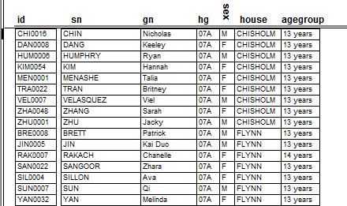
One record

Slide 47
One Field

Slide 48
Field types
Maximum storage efficiency
Can interpret contents of field e.g. date
Types:
Number
Text
Date/time
Container (in Filemaker)
Calculation e.g. Age = (DateNow – DOB) / 365.25

Slide 49
Be careful planning field types
Get data types right at the beginning. Errors can be costly later.
Phone numbers are stored as TEXT
Store dates as DATE so the data can be used
Beware: a field like ‘lap time’ is stored as NUMBER (of seconds) , not as a TIME of day!
Dates, numbers stored as TEXT cannot (easily) be used as real dates or numbers

Slide 50
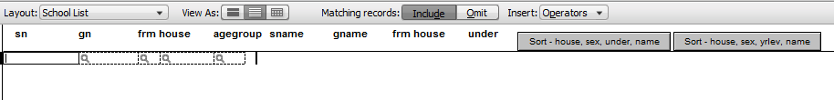
Queries, finds
Can search massive quantities of data for specific records
E.g.
age > 24
Name starts with “A” and town not Albury
Find mode – enter what you want to find in the field you want to find it in…

Slide 51
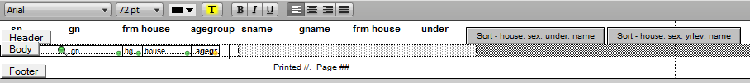
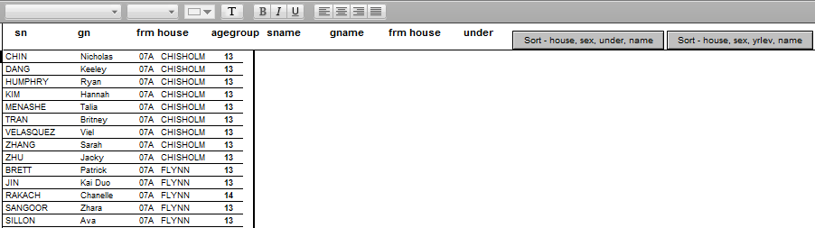
Output
Define a report (Access) or layout (Filemaker) to show data. Combine fields and fixed text…
Layout mode – designing the output
Browse mode – viewing/printing the output

Slide 52
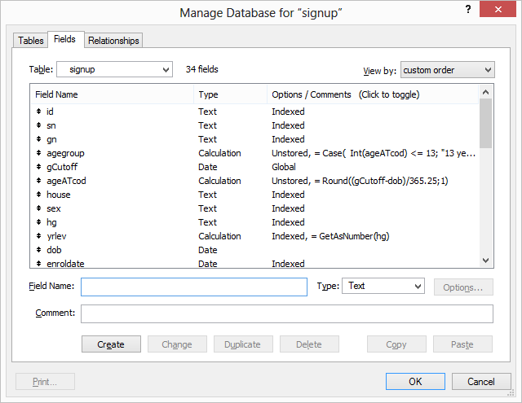
In summary
Plan your tables, fields, relationships
Define tables, fields, relationships

Slide 53
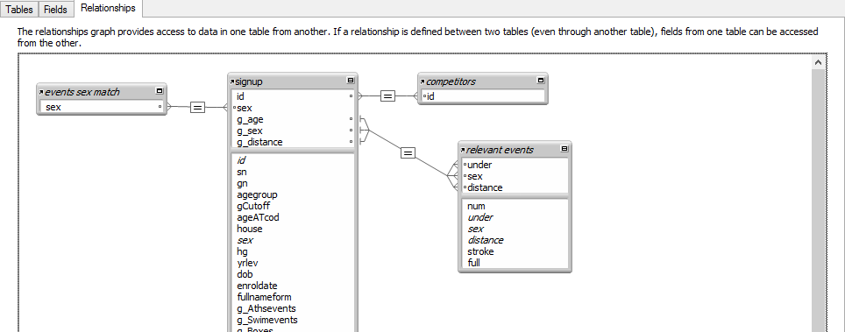
Define Relationships
Using drag and drop

Slide 54
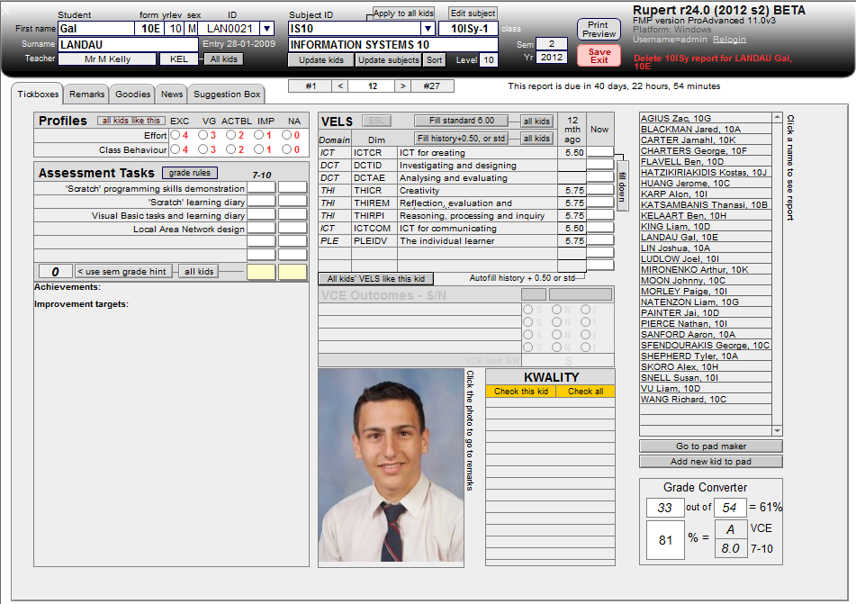
Enter data
Using a custom input layout (‘form’ in Access)

Slide 55
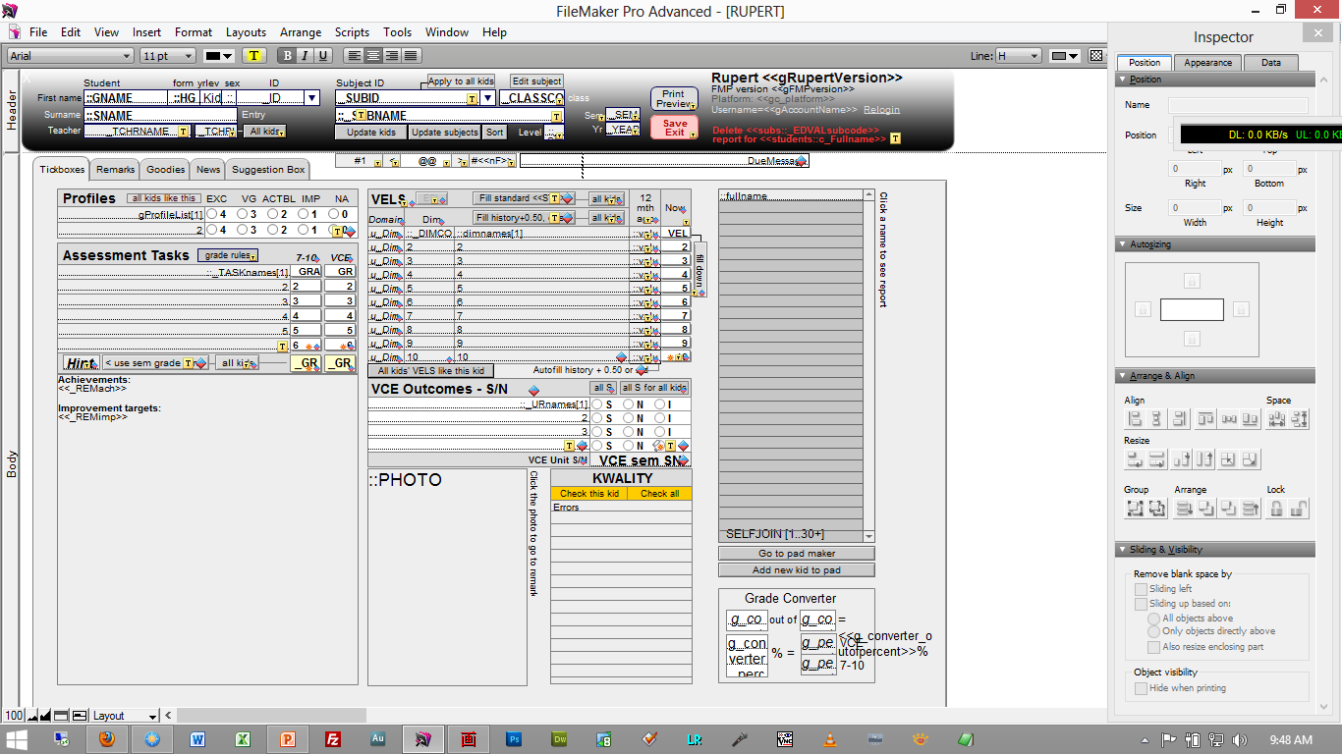
The input layout shown in layout (design) mode

Slide 56
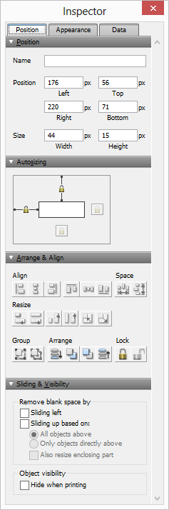
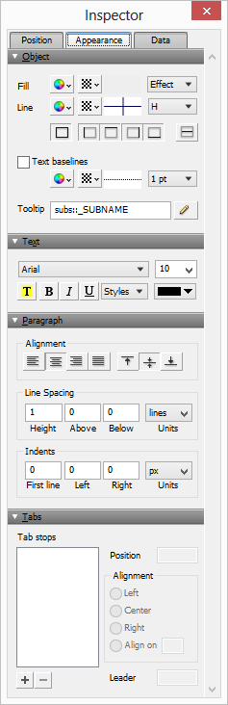
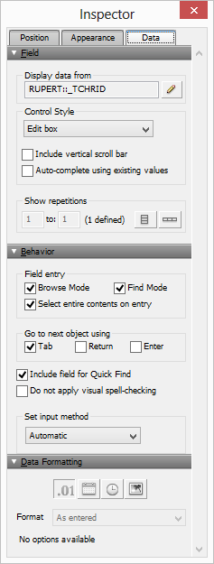
Object Properties Similar to VB properties

Slide 57
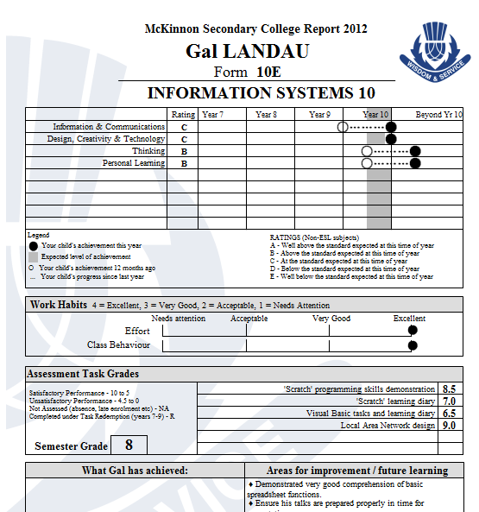
Output
Usually, a different layout is specially designed for printing
Input layout (above) and print layout (right)
Note the use of buttons, list boxes, etc for data entry

Slide 58
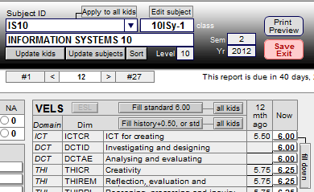
Automation
Write scripts to automate tasks for unskilled users.
Attach scripts to buttons
Like writing code for a button in VB

Slide 59
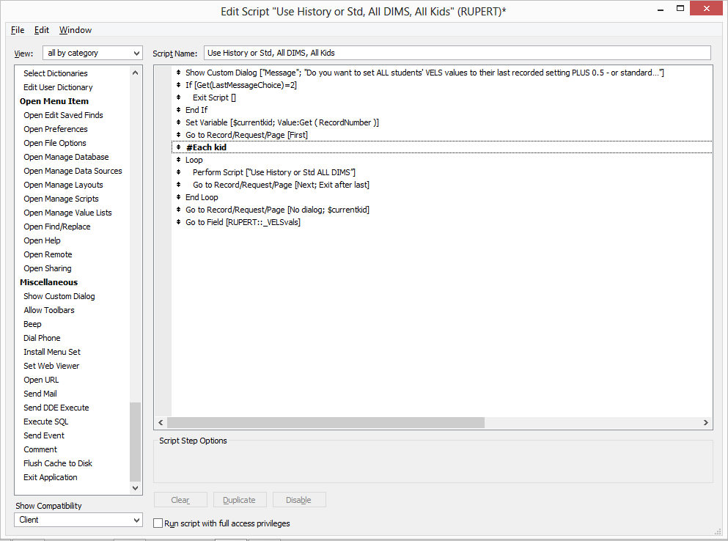
The Script Editor

Slide 60
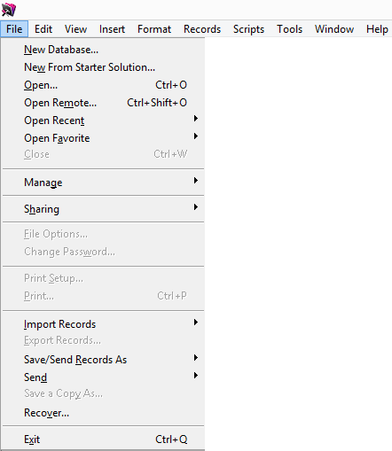
And in the end
There is no need to save data
Data saves automatically for security
No ‘Save’ menu item

Slide 61
Applied Computing Slideshows by Mark Kelly vcedata.com mark@vcedata.com
These slideshows may be freely used, modified or distributed by teachers and students anywhere on the planet (but not elsewhere).
They may NOT be sold.
They must NOT be redistributed if you modify them.

