Slide 1
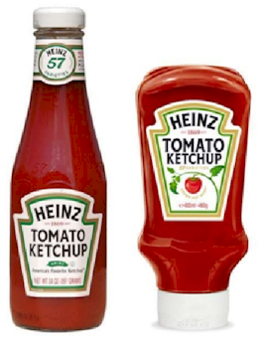

Applied Computing Slideshows by Mark Kelly vcedata.com mark@vcedata.com
Solution Design Factors
Version 1.1 - 2022-02-08

Slide 2
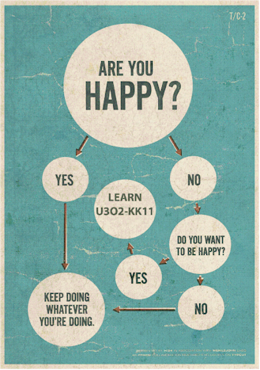
Contents
Factors influencing the design of solutions, including
usability,
cost
affordance*,
security,
interoperability and
marketability
*Not “affordability” as it was in the 2016 study design

Slide 3
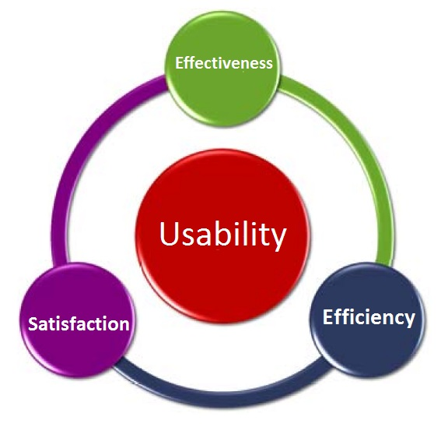
Useability
(‘Usability’ in America and our study design - sigh)
Useability – The degree to which an object, device, software application, etc. is easy to use to achieve objectives.

Slide 4

Useability may include
how long it takes to learn to use;
how satisfying it is to use;
the amount of thought, effort or activity is required to use;
its robustness and reliability;
the quality of its results;
its operating speed;

Slide 5

Useability may include
its storage and processing capacity;
its error tolerance;
its ability to be adapted to suit users’ needs or preferences, e.g.
changing keyboard shortcuts,
offering a choice of using menus, buttons or keyboard shortcuts to perform the same function;
Its ‘user experience’ (UX)

Slide 6

Useability may include
its predictability and consistency;
the readability of its interface and output;
its accessibility for users with disabilities or special needs;
its ability to meet reasonable users’ needs

Slide 7
Affordance See the separate dedicated slideshow

Slide 8

Security

Slide 9
Security
Can be more or less important depending on the nature of the solution.
Is vital for solutions that are online, money-managing, or responsible for storing sensitive data.
Achieving good security is difficult and expensive – needs effort and skill to identify and counteract possible threats.

Slide 10
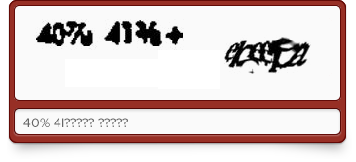
Security
The need for security must always be balanced against useability: a very secure solution that is unpleasant or annoying to use is not going to be very successful.
For example, CAPTCHA codes may protect online data providers, but some of them are extremely frustrating to solve.

Slide 11

Interoperability
The ability to cooperate and communicate with other systems.
Hardly any software today works in isolation.
Most apps share data with external websites, databases, online services, hardware such as printers or network devices.

Slide 12
Interoperability
All of these communications require strict observance of protocols.
Maintaining compatibility is a key concern when designing.
For example
designing a filenaming scheme that uses no spaces so a Linux web server will handle the file names appropriately;
using correct USB, HDMI or Ethernet cables to connect devices.

Slide 13

Marketability
Marketability - designing a solution that can be successfully sold.
This requires market research to discover what customers want, and good design to satisfy those requirements in a way that attracts customers yet still generates a profit.

Slide 14

Marketability
Solutions may be marketed on various criteria such as price, feature set, trendiness, novelty, simplicity, capacity, power, innovation, performance, ease of use, compatibility with standards - and many others.
As an exercise, ask yourself what made you choose to buy your current phone out of the hundreds of items on the market.

Slide 15
VCE IT THEORY SLIDESHOWS Applied Computing Slideshows by Mark Kelly vcedata.com mark@vcedata.com
These slideshows may be freely used, modified or distributed by teachers and students anywhere
but
they may NOT be sold.
they must NOT be redistributed if you modify them.
This is not a VCAA publication and does not speak for VCAA.
Portions (e.g. exam questions, study design extracts, glossary terms) may be copyright Victorian Curriculum and Assessment Authority and are used with permission for educational purposes. Thanks, guys!

Slide 16
THANKS!
Because you’ve been so good, here’s a picture you can look at
while your teacher works out what to do next

