Slide 1

Applied Computing Slideshows by Mark Kelly vcedata.com mark@vcedata.com
Generating design ideas

Slide 2
Contents
What is a design idea?
Ways to generate design ideas.
These are just suggestions.
There are many other possible techniques.

Slide 3
What is a design idea?
A very rough, undetailed, basic strategy for solving a problem.
May be a sketch or a brief description
“We could use a database, spreadsheet, custom-written software, online utility…”
Will not contain details such as a data dictionary.

Slide 4
What is a design idea?
Will not be a fully-formed or workable idea.
Stands as a candidate idea amongst other candidates.
Ideas are judged using criteria, such as development speed and cost, ease of development, functionality.
The successful design idea is then developed into a complete and detailed design.

Slide 5

Techniques for generating design ideas
brainstorming - creating spontaneous, rough concepts without fear of rejection or ridicule
One idea may spark further ideas.
Rules:
Any idea is welcome.
No idea should be judged or rejected.

Slide 6
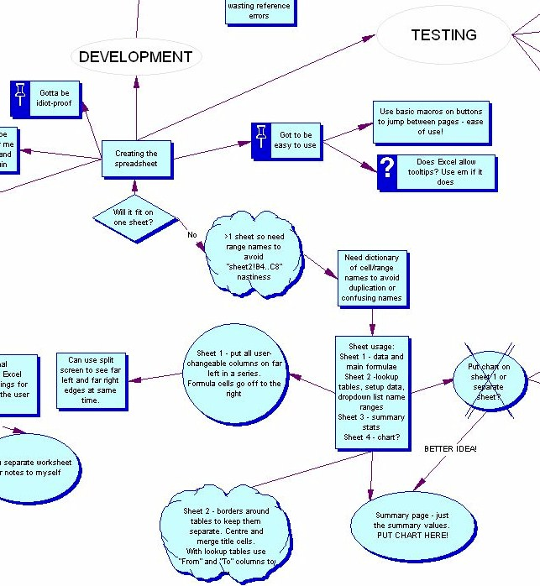
Mind map

Slide 7
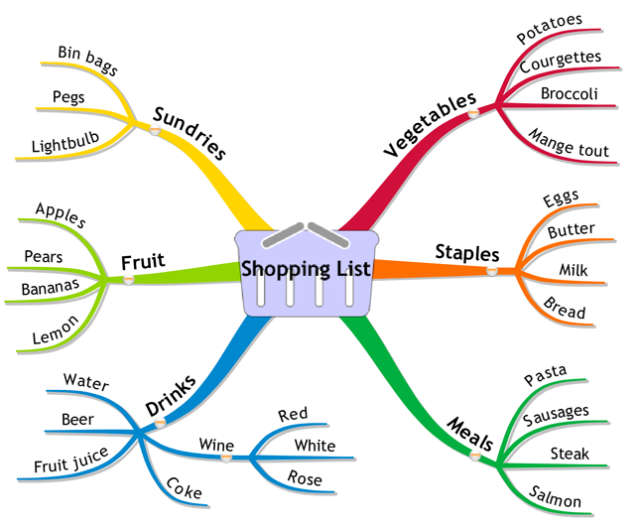
Techniques for generating design ideas
mind maps - free-form documents joining ideas together graphically (e.g. with Inspiration software or butcher's paper and textas)

Slide 8
Techniques for generating design ideas
various diagrams like PMI (Plus/Minus/Interesting), POOCH, Venn diagrams, that break down or reorganise big problems into component parts in unexpected ways that provoke new ways of thinking.

Slide 9
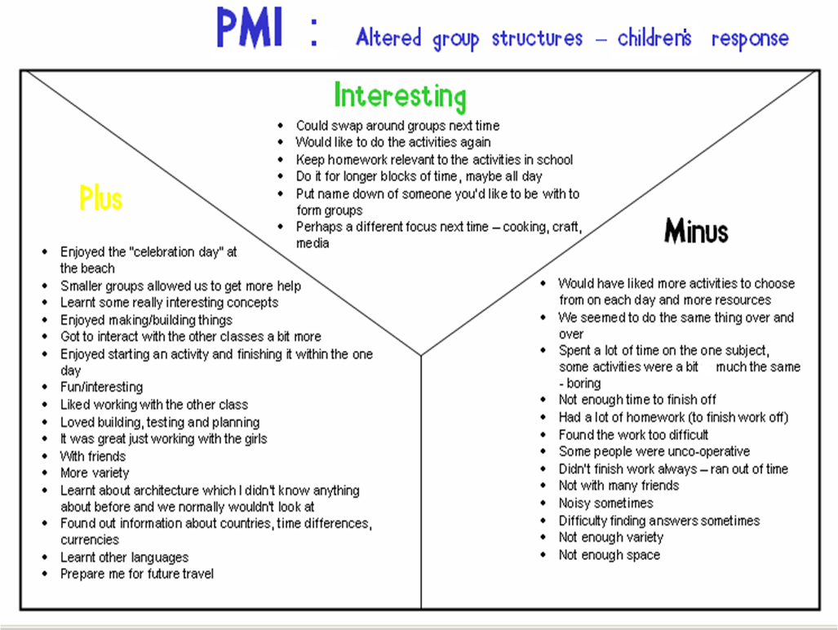

Slide 10
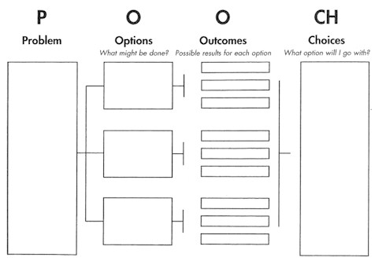
POOCH

Slide 11
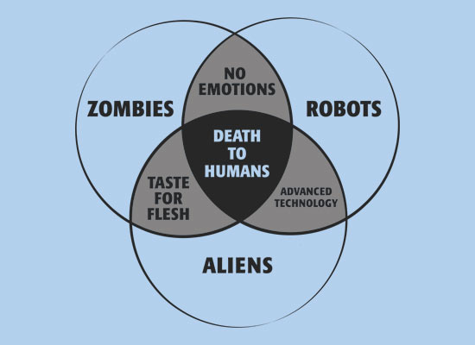
Venn diagram

Slide 12
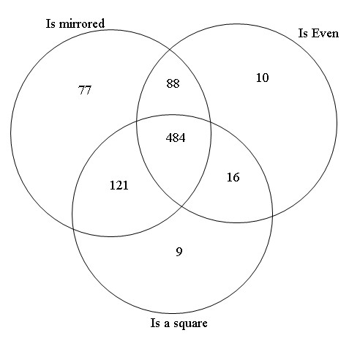
Venn diagram

Slide 13
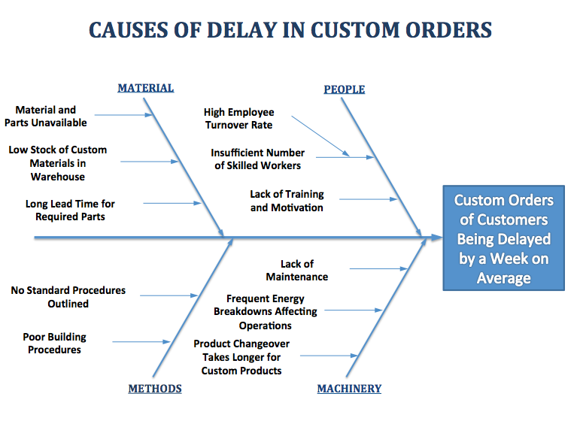
Fishbone diagram

Slide 14
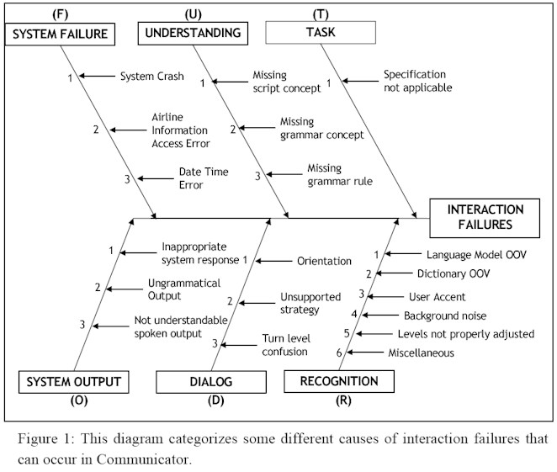
AKA Cause and Effect or Ishikawa diagram

Slide 15
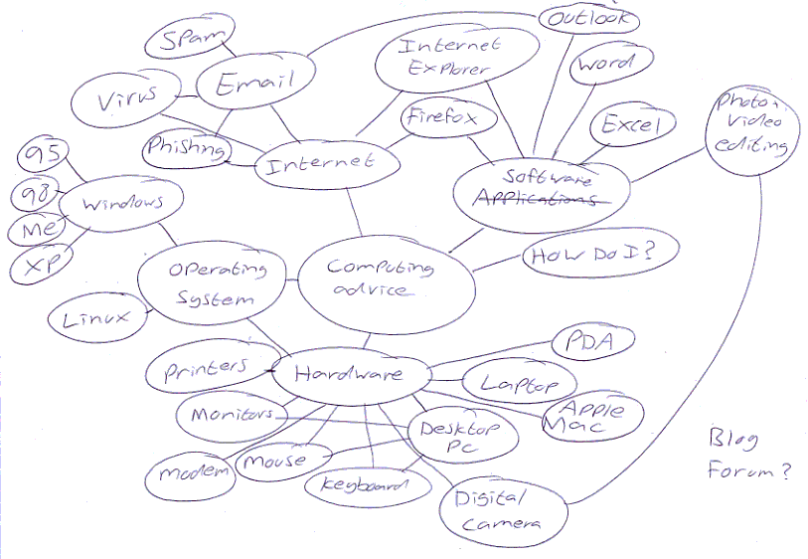
Spidermap

Slide 16
Spidermap

Slide 17
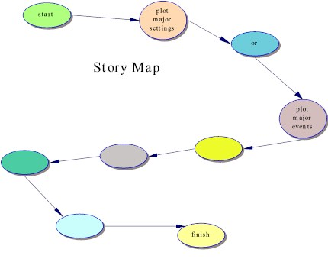
Story Map
(The source site for this image is now dead.)

Slide 18
Story Map
(The source site for this image is now dead.)

Slide 19
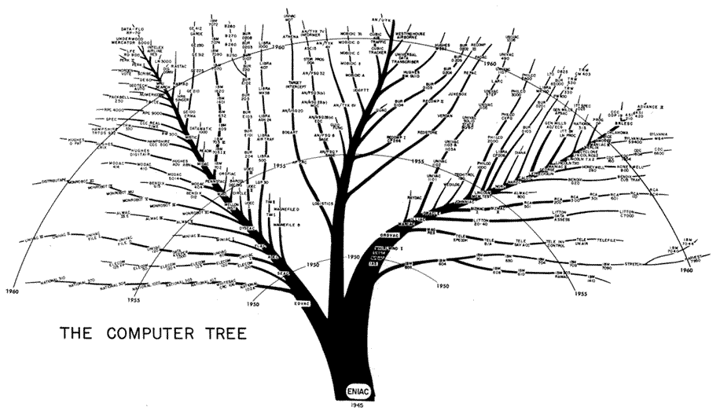
Tree diagram – to organise parts and subparts

Slide 20
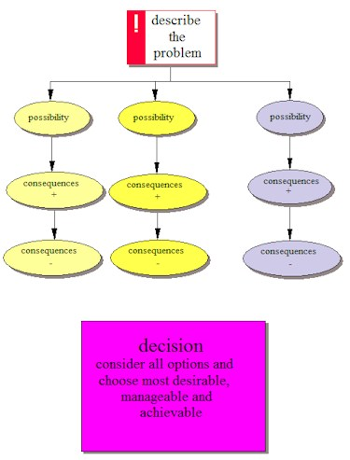
Possibilities – Consequences - Decision

Slide 21
Techniques for generating design ideas
forums (physical meeting or electronic) - where many people can present or respond to ideas.
Invite people with many different backgrounds, talents and past experience

Slide 22
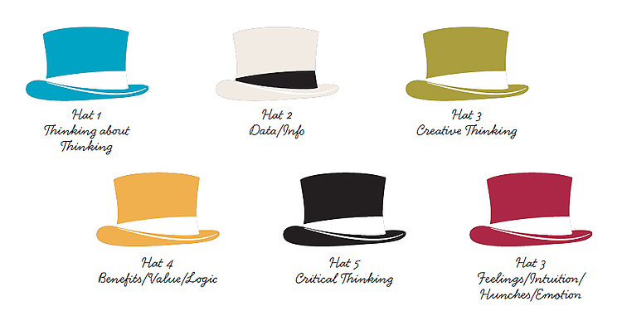
Techniques for generating design ideas
De bono’s six hats of thinking – force yourself to consider the problem and possible solutions in very different ways.

Slide 23
Techniques for generating design ideas
external consultants – outsiders view problems without traditional, local thinking patterns or prejudices.
They can bring in fresh knowledge and experience that the local team may lack.
More likely to have a global view of the problem and not confined by a single department's view and vested interests.

Slide 24
Techniques for generating design ideas
Consultants are not not confined by fear of the local boss: not scared of losing their job like local workers may be.

Slide 25
Techniques for generating design ideas
Market research – ask stakeholders, customers etc what they value, think and want.

Slide 26
Techniques for generating design ideas
SCAMPER
S – Substitute
C – Combine
A – Adapt
M – Modify
P – Put to another use
E – Eliminate
R – Reverse

Slide 27
Techniques for generating design ideas
SCAMPER
S – Substitute
For sleeping on ships, substitute hammocks for beds.
Use a database instead of a spreadsheet.

Slide 28
Techniques for generating design ideas
SCAMPER
C – Combine
Instead of designers planning a solution and end-users testing it, combine both groups in the design phase.

Slide 29
Techniques for generating design ideas
SCAMPER
A – Adapt
Use a component for a different and unexpected purpose.
Use Powerpoint to create a graphic image.
Use your shoe to hammer something flat.

Slide 30
Techniques for generating design ideas
SCAMPER
M – Modify
Alter an existing product to suit a new need.
Add an extra chute to a lawnmower to create a mulcher.
Change an existing JPG compression algorithm to compress videos.

Slide 31
Techniques for generating design ideas
SCAMPER
P – Put to another use
Use cable TV lines to provide cable internet access.

Slide 32
Techniques for generating design ideas
SCAMPER
E – Eliminate
Remove the relational aspects from a RDBMS to create spreadsheet software.
Eliminate WYSIWYG from a word processor to create a text editor.
Strip out the advanced features from an big, expensive product (e.g. Photoshop) to create a cheaper, attractive alternative (e.g. Photoshop Elements)

Slide 33
Techniques for generating design ideas
SCAMPER
R – Reverse
What if we tried the exact opposite of what we’re trying (unsuccessfully) to achieve?
Stop making CPUs more dense and complex – create RISC chips that are simpler, cheaper, smaller.
Let’s aim for simplicity of design rather than complexity. E.g. Google homepage and page rank algorithm.

Slide 34
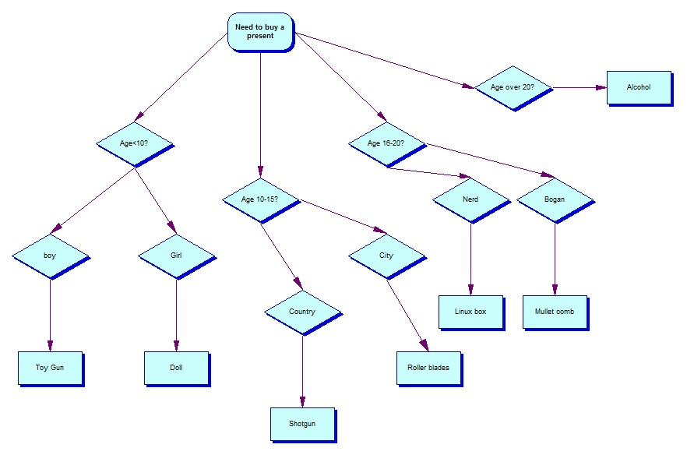
Decision Tree
Helps to crystalise options and decisions.

Slide 35
Applied Computing Slideshows by Mark Kelly vcedata.com mark@vcedata.com
These slideshows may be freely used, modified or distributed by teachers and students anywhere
but
they may NOT be sold.
they must NOT be redistributed if you modify them.
This is not a VCAA publication and does not speak for VCAA.
Portions (e.g. exam questions, study design extracts, glossary terms) may be copyright Victorian Curriculum and Assessment Authority and are used with permission for educational purposes.

Slide 36
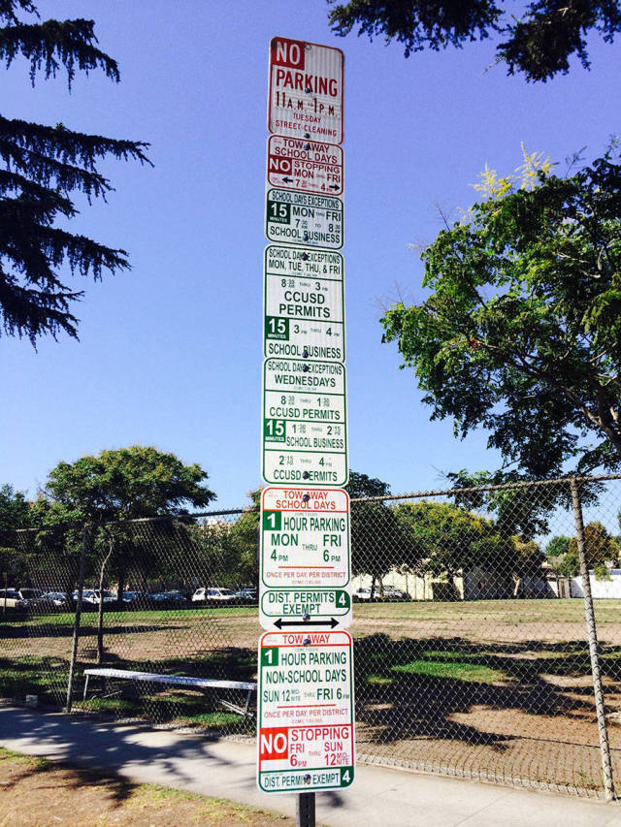
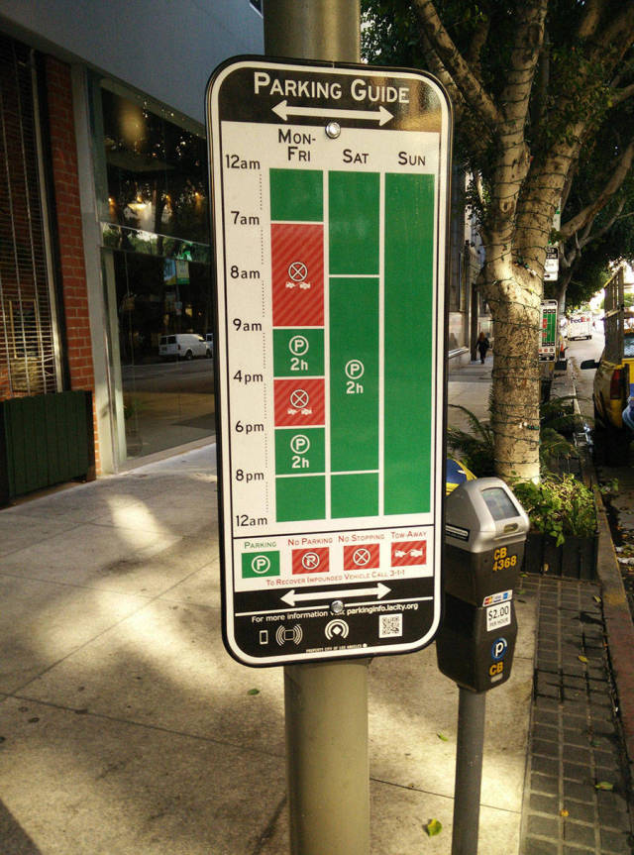
THANKS!
Because you’ve been so good, here’s a picture you can look at
while your teacher works out what to do next

