Slide 1
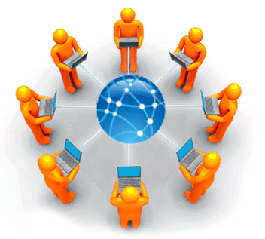
Applied Computing Slideshows
by Mark Kelly
vcedata.com
mark@vcedata.com
Intranet, Internet, VPN

Slide 2
Internet
Worldwide network of WANs
Uses TCP/IP protocol
World Wide Web – only part of the internet – uses HTTP to send/receive web pages.
Each device needs a unique IP address (e.g. 209.33.1.102)

Slide 3
Other services using the internet
Usenet - a network of discussion groups
File sharing networks – torrent sites, Kazaa, Limewire etc
Email
FTP
Closed networks like Facebook, Twitter
Blogs
RSS feeds

Slide 4
Domains
Human readable URLs with domain names (e.g. microsoft.com) are not computer friendly
Domain names are converted to an IP address to find the destination server.
DNS (Domain Name System) does the conversion
DNS = massive ‘phonebook’ with all domain names and matching IP addresses

Slide 5
Web server
Computer that stores web pages making up a site.
Visitors use web browsers to make requests for web pages using HTTP.
Web server uses HTTP to return requested page to visitor.

Slide 6
Intranet
Local, private version of the internet
Uses the Internet Protocol to securely share information within an organisation’s Local Area Network.
May involve local websites, email, collaboration tools, databases that are not available to those who are not within the LAN.

Slide 7
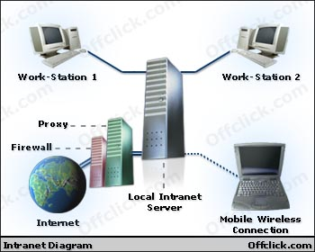
Intranet
Can be as simple as webpages stored on a shared network drive.
Uses page references to files on the file server rather than on a webserver.
Simple to access with only a web browser.

Slide 8
Intranet
Intranet is protected by a network gateway and firewall to keep outsiders out.
Intranet can be made safe by using privatem, local IP addresses (e.g. 192.168.1.xx or 10.1.1.x) which cannot be used by outsiders to refer to computers within the LAN.

Slide 9
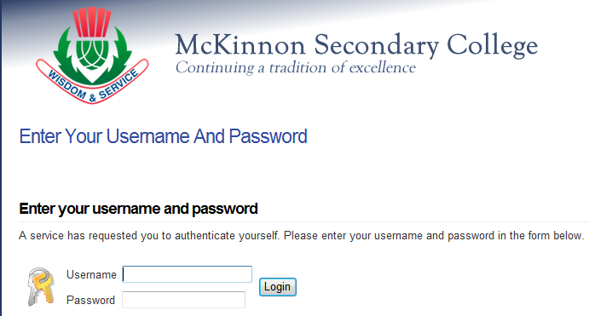
Intranet
In some cases the intranet has a public face on the internet, but a password-protected login is needed to gain access.

Slide 10

Intranet uses
Collaboration – tools (e.g. Google docs, and shared documents)
Communication (email, VoIP, messaging)
Resource sharing
Training

Slide 11
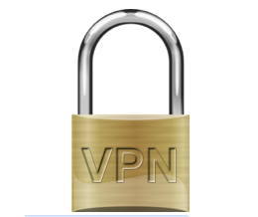
VPN
Virtual Private Network
Used to provide access to a LAN or intranet to off-site people.
A secure, private link using normal internet infrastructure.
A VPN box creates the encrypted tunnel between the box and a same-keyed box elsewhere on the internet.

Slide 12
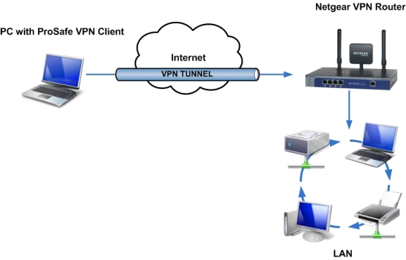
VPN
http://kbserver.netgear.com/media/images/answer_1128/clienttobox.jpg

Slide 13
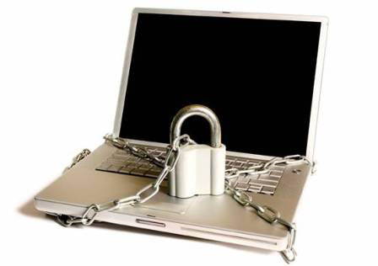
Corporate VPNs
Corporate VPN box can support hundreds of simultaneous encrypted remote access connections.
VPN can also be done with software (e.g. in MS Server) but is slower and less robust
A 200-user VPN box can cost $7,000

Slide 14
Applied Computing Slideshows
by Mark Kelly
vcedata.com
mark@vcedata.com
These slideshows may be freely used, modified or distributed by teachers and students anywhere on the planet (but not elsewhere).
They may NOT be sold.
They must NOT be redistributed if you modify them.

